Slide 1
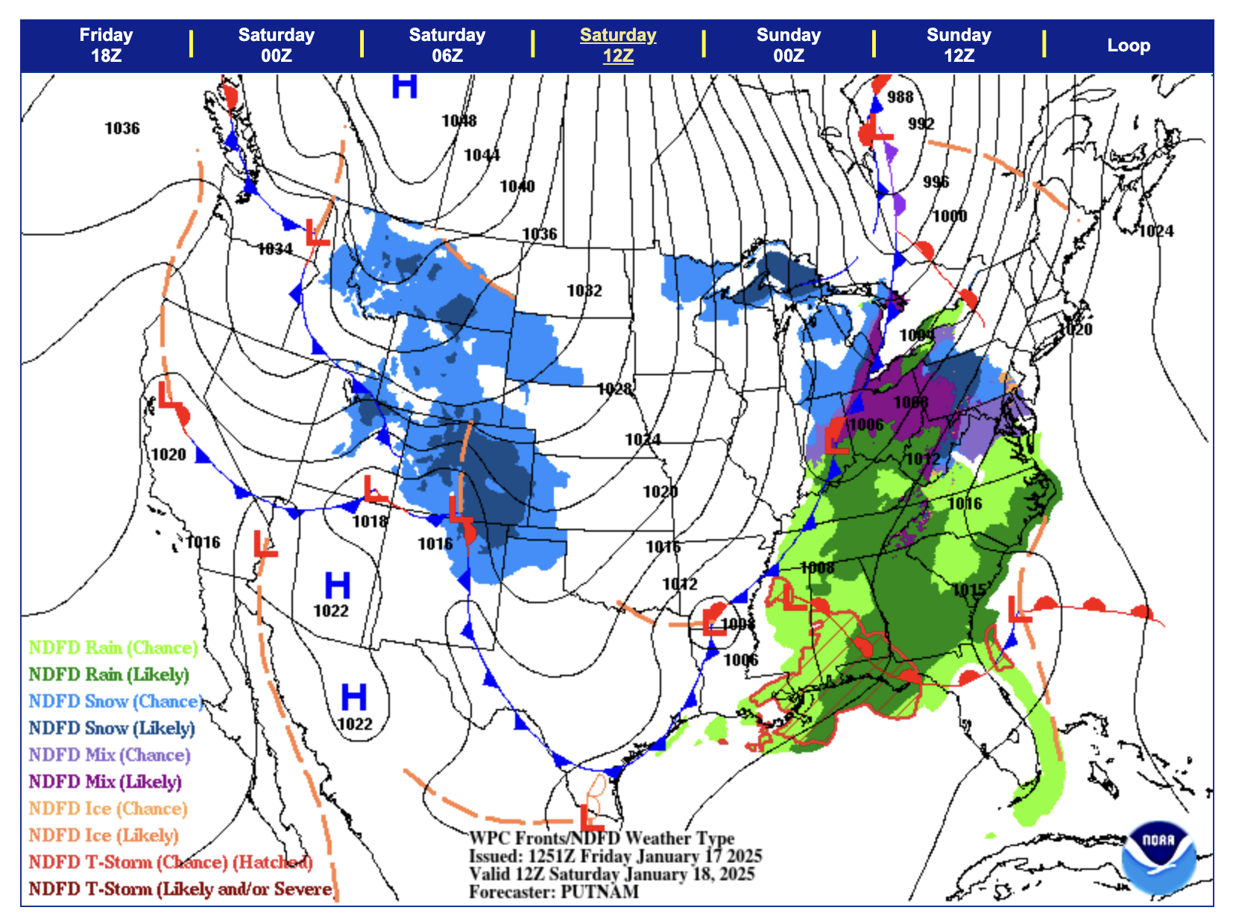
Wind direction at A?
2. Wind direction at B?
Wind direction at C?
Where is the wind
strongest? (A-D)?
What kind of front
is this and where is the
cold air?
cold, to the northeast
warm, to the northeast
stationary, to the southwest
occluded, to the southwest
D
C
B
A
5

Slide 2
Wind direction at A?
S or SSE
2. Wind direction at B?
N
Wind direction at C?
N
Where is the wind
strongest? (A-D)?
D
What kind of front
is this and where is the
cold air?
cold, to the northeast
warm, to the northeast
stationary, to the southwest
occluded, to the southwest
D
C
B
A
5

