Slide 1
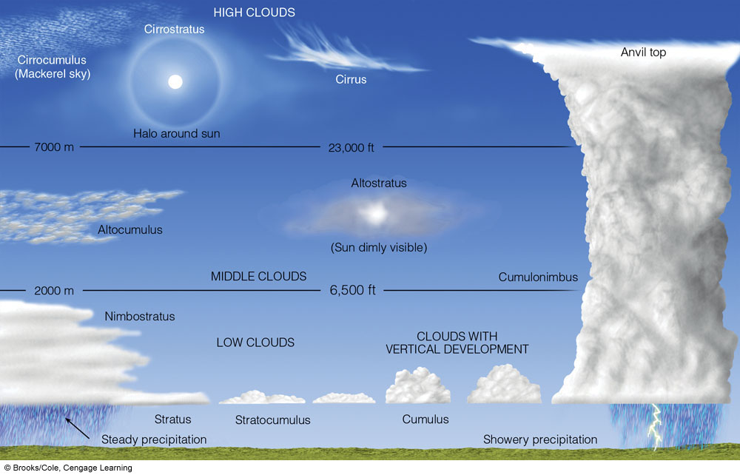
Basic Cloud Types
Notes:
FIGURE 5.24 A generalized illustration of basic cloud types based on height above the surface and vertical development.

Slide 2
Question #1

Slide 3
Question #2

Slide 4
Question #3

