Slide 1
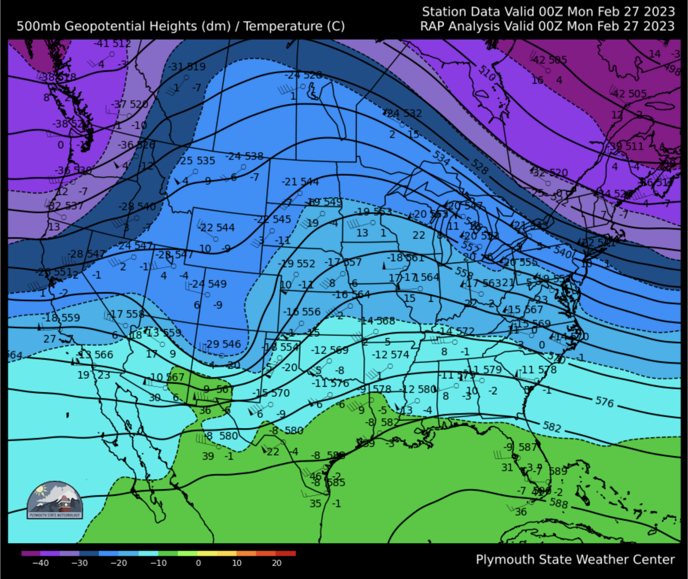
What is the wind
direction at A?
A
A

Slide 2
What is the wind
direction at A?
Southwest
A
A

Slide 3
2. Where are the weakest
winds found?
A
B
C
D

Slide 4
2. Where are the weakest
winds found?
C
A
B
C
D

Slide 5
3. What is represented by
the ”576” contour?
The pressure at 500 mb.
The 500 mb temperature.
The elevation of the
500 mb surface.
The 500 mb dew point
temperature.

Slide 6
3. What is represented by
the ”576” contour?
The elevation of the
500 mb surface is
5,760 m above Earth’s
surface.

Slide 7
Where would you expect
to find a surface low
pressure system?
A
B
D
C
D
A
C
B

Slide 8
Where would you expect
to find a surface low
pressure system?
C. Surface cyclones tend
to be found downstream
of upper air troughs and
upstream of ridges.
A
Trough axis
B
D
L
D
A
C
B
Ridge axis

Slide 9
