Slide 1
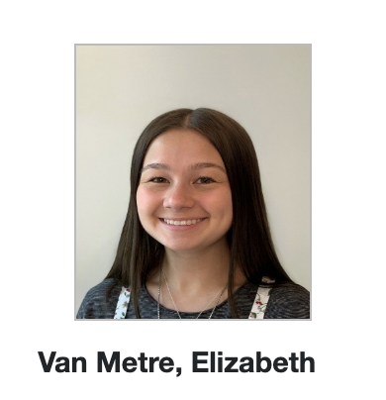
4th Place
3rd Place
12.7 pts/forecast
12.6 pts/forecast

Slide 2
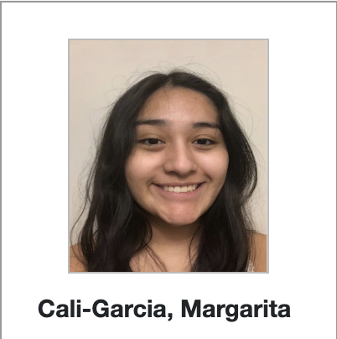
2nd Place
11.9 pts/forecast

Slide 3
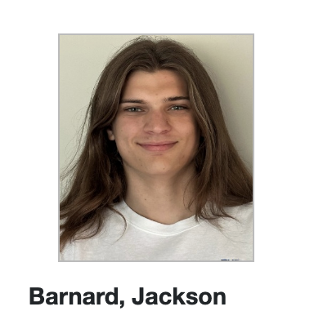
1st Place
11.8 pts/forecast

Slide 4
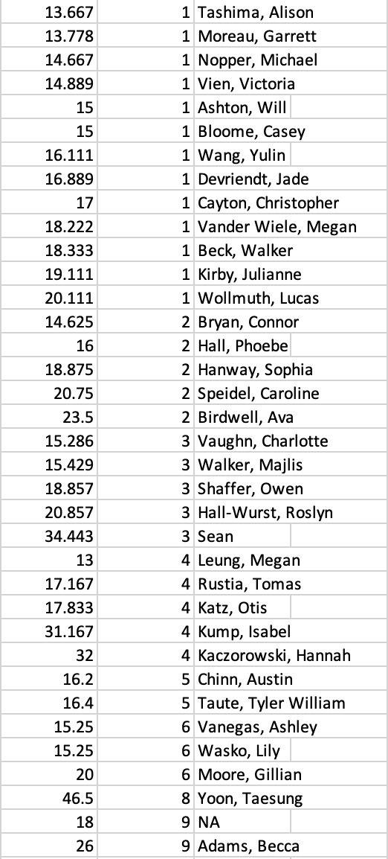
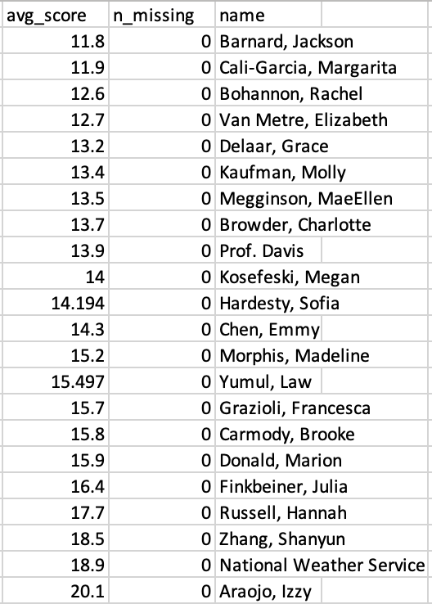
FINAL RESULTS
8 students bested Prof. Davis
18 student performed better than
the National Weather Service

Slide 5
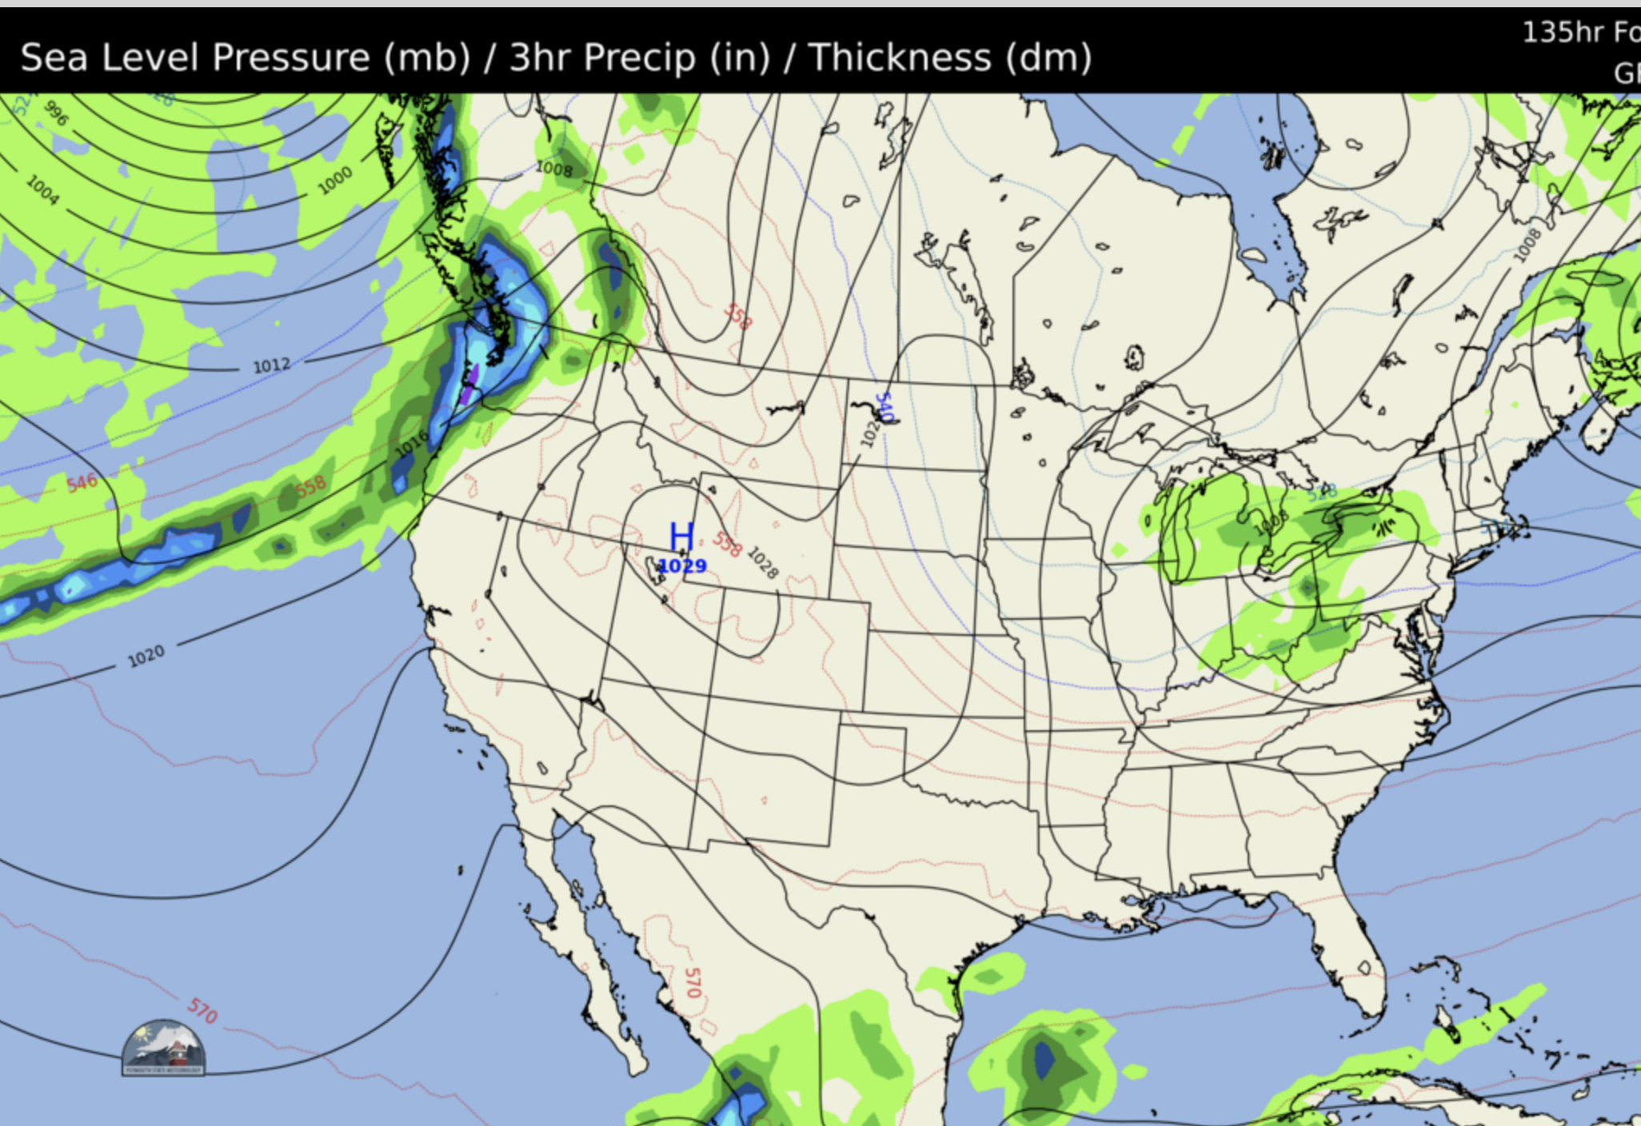
L

Slide 6
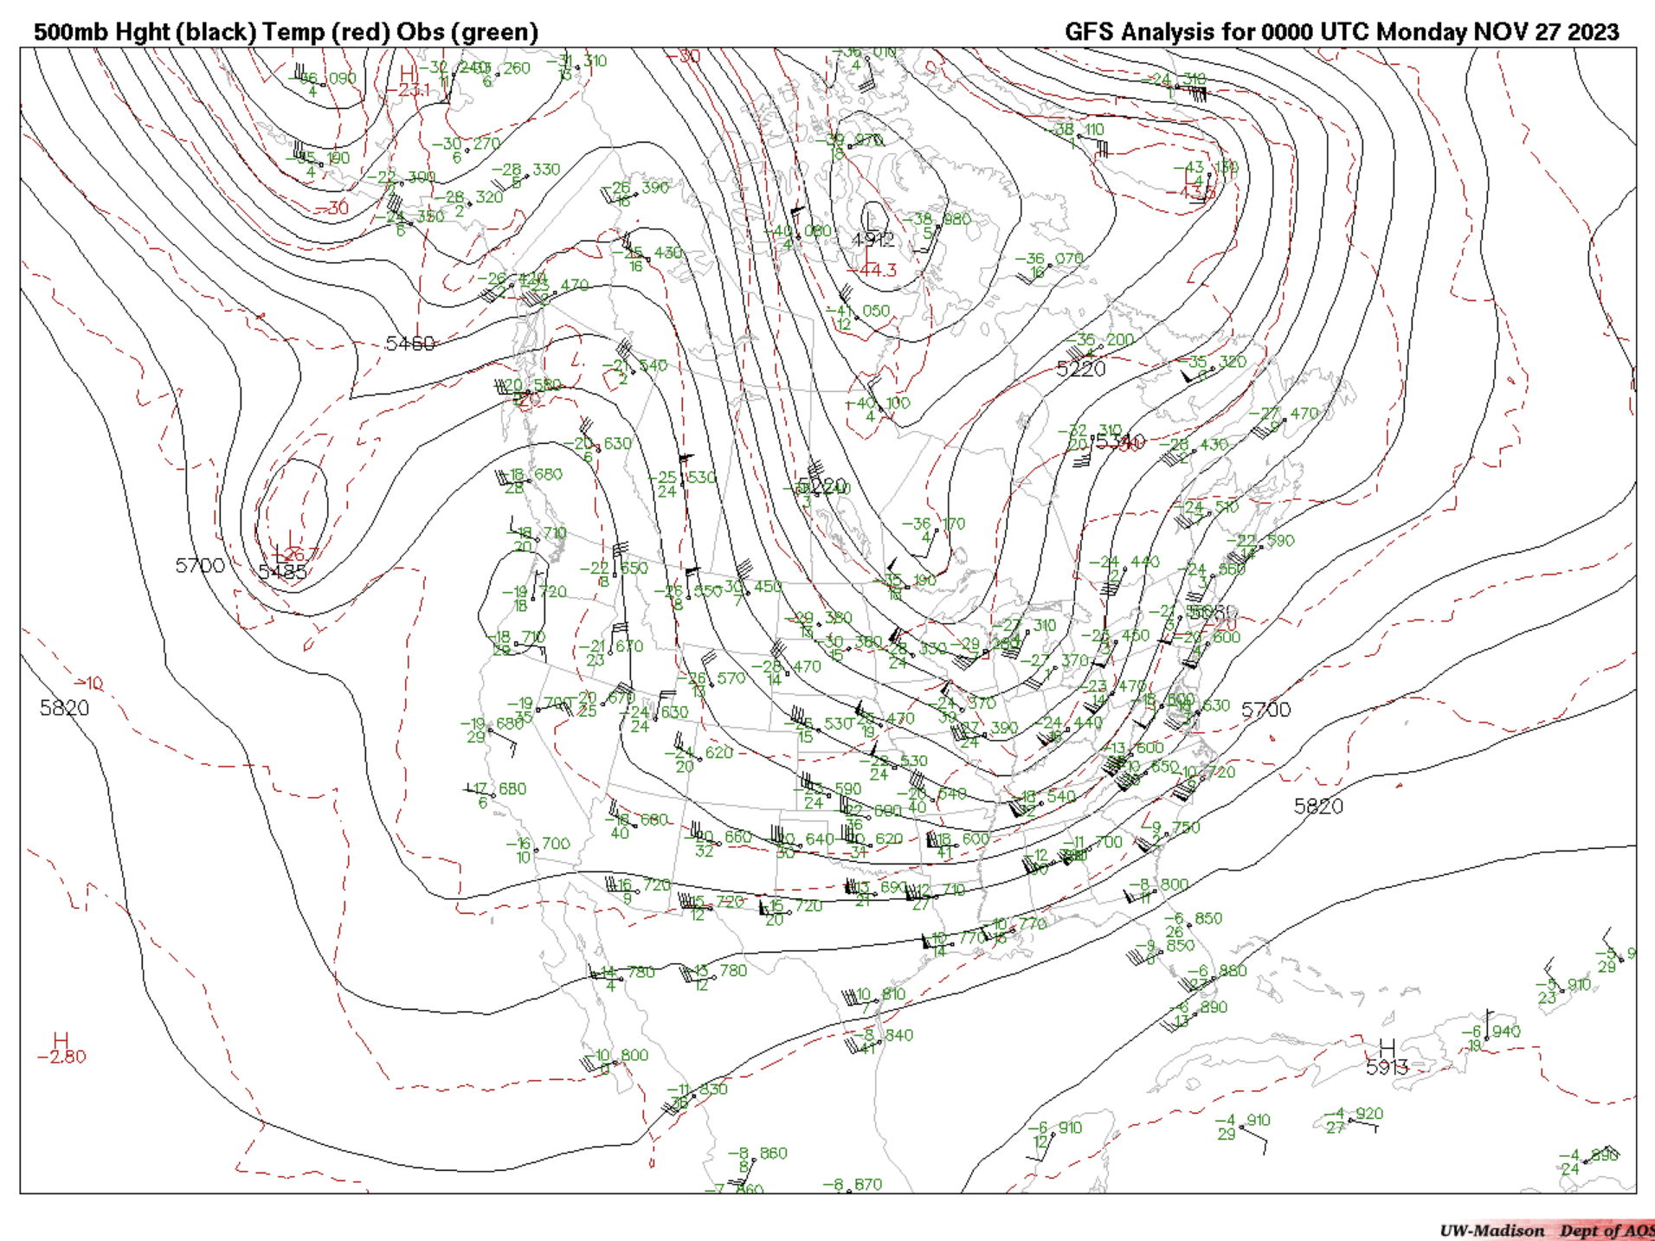

Slide 7
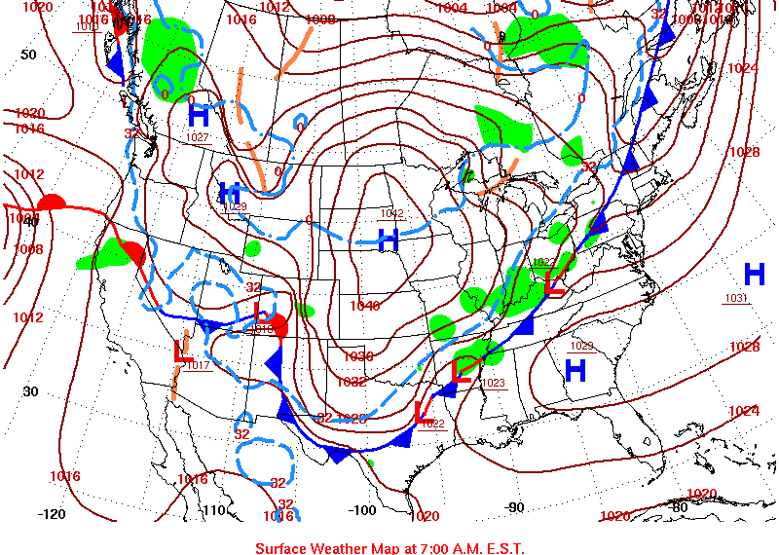
B
C
A

Slide 8
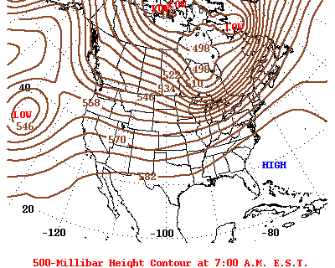
A
B

Slide 9
250 mb
250 mb
500 mb
500 mb
1000 mb
1000 mb
A
B

