Slide 1
EVSC 3300
ATMOSPHERIC
FLUID
DYNAMICS

Slide 2
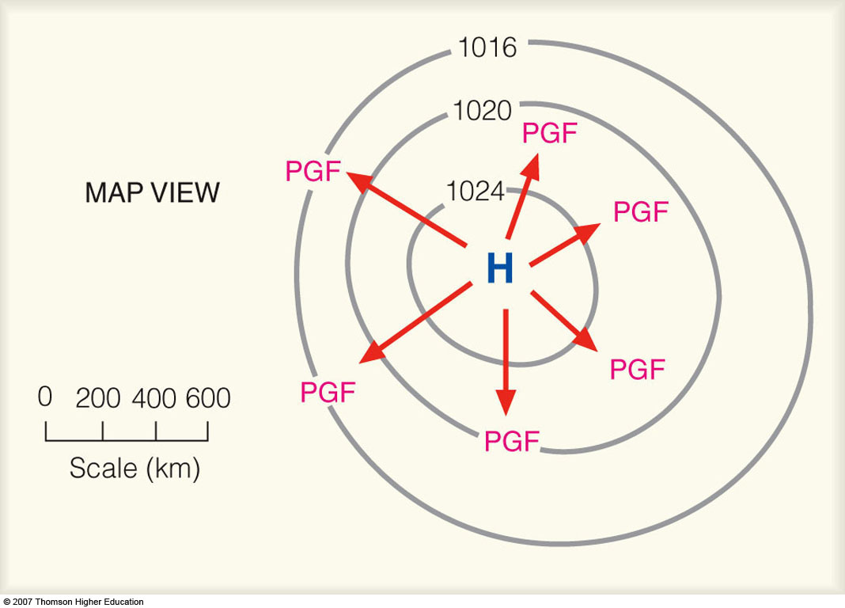
Pressure Gradient Force (PGF)
Notes:
Figure 8.18
The closer the spacing of the isobars, the greater the pressure gradient. The greater the pressure gradient, the stronger the pressure gradient force (PGF). The stronger the PGF, the greater the wind speed. The red arrows represent the relative magnitude of the force, which is always directed from higher toward lower pressure.

Slide 3
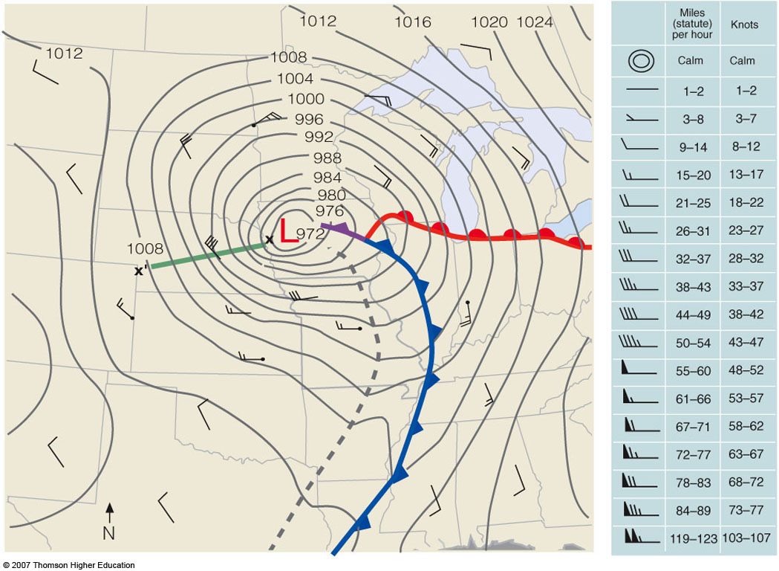
PGF
Notes:
Figure 8.19
Surface weather map for 6 A.M. (CST), Tuesday, November 10, 1998. Dark gray lines are isobars with units in millibars. The interval between isobars is 4 mb. A deep low with a central pressure of 972 mb (28.70 in.) is moving over northwestern Iowa. The distance along the green line X-X’ is 500 km. The difference in pressure between X and X’ is 32 mb, producing a pressure gradient of 32 mb/500 km. The tightly packed isobars along the green line are associated with strong northwesterly winds of 40 knots, with gusts even higher. Wind directions are given by lines that parallel the wind. Wind speeds are indicated by barbs and flags. (A wind indicated by the symbol [not available] would be a wind from the northwest at 10 knots. See blue insert.) The solid blue line is a cold front, the solid red line a warm front, and the solid purple line an occluded front. The heavy dashed line is a trough.

Slide 4
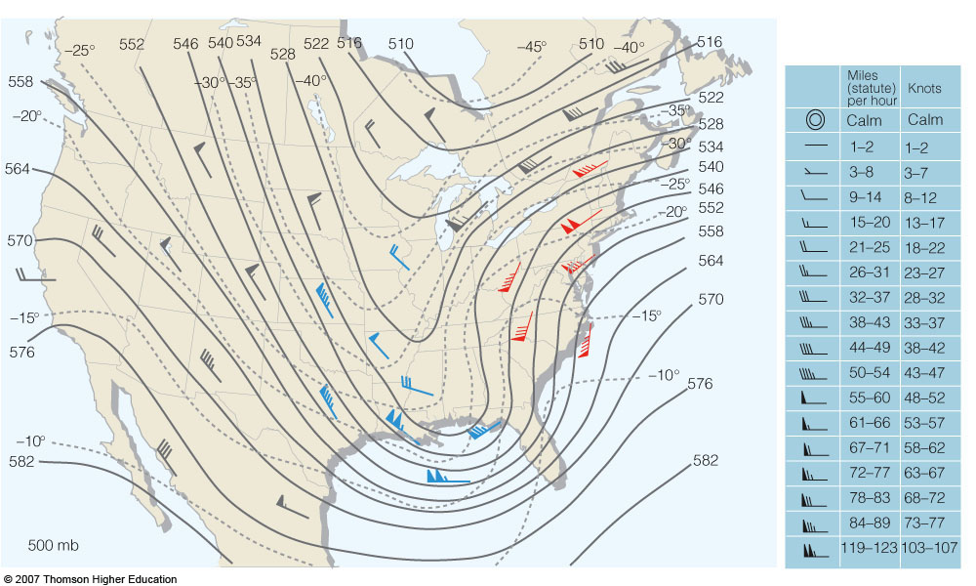
Gradients on a 500 mb Map
height gradient force
(N: 169–178; A: 209–210)
Notes:
Figure 12.17
The 500-mb chart for 7 A.M. (EST) March 13, 1993. Solid lines are contours where 564 equals 5640 meters. Dashed lines are isotherms in °C. Wind entries in red show warm advection. Those in blue show cold advection. Those in gray indicate no appreciable temperature advection is occurring.

Slide 5
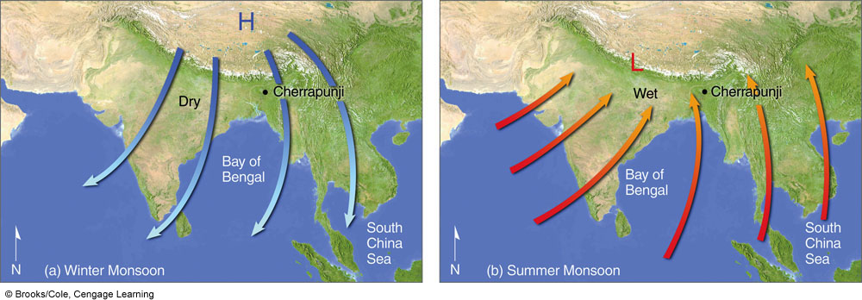
Monsoon Circulation
Winter
Summer
“mausim” (Arabic): season
Notes:
FIGURE 9.30 Changing annual wind-flow patterns associated with the winter and summer Asian monsoon.

Slide 6
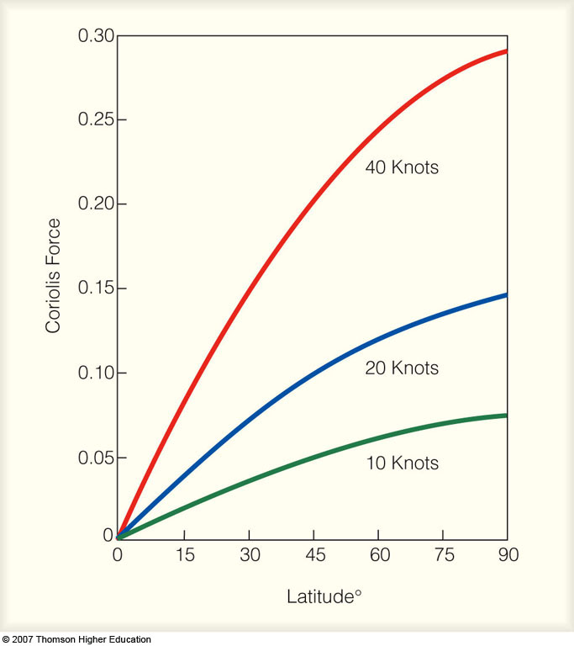
Coriolis Force
Notes:
Figure 8.21
The relative variation of the Coriolis force at different latitudes with different wind speeds.

Slide 7
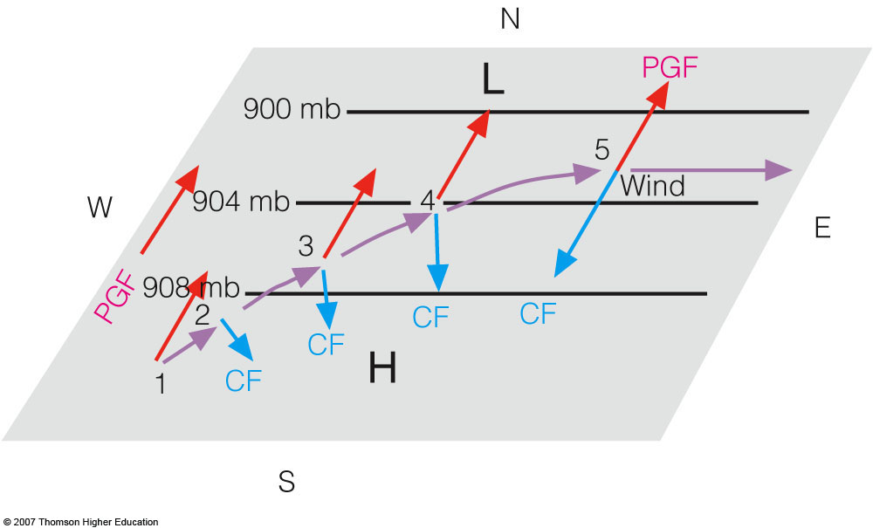
GEOSTROPHIC FLOW
Geostrophic
Wind
Notes:
Figure 8.23
Above the level of friction, air initially at rest will accelerate until it flows parallel to the isobars at a steady speed with the pressure gradient force (PGF) balanced by the Coriolis force (CF). Wind blowing under these conditions is called geostrophic.

Slide 8
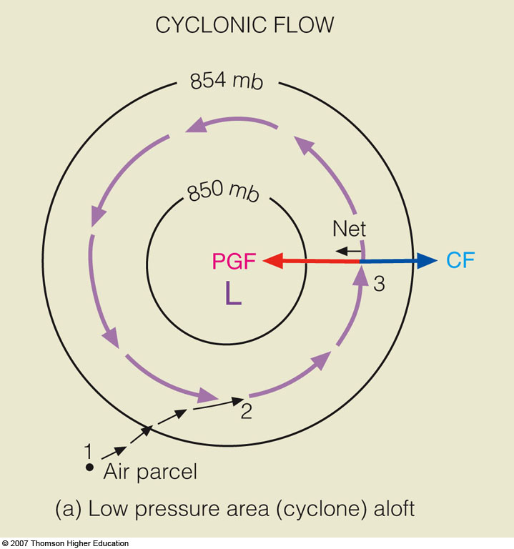
Gradient
wind
Net=centripetal
Notes:
Figure 8.26
Winds and related forces around areas of low and high pressure above the friction level in the Northern Hemisphere. Notice that the pressure gradient force (PGF) is in red, while the Coriolis force (CF) is in blue.

Slide 9
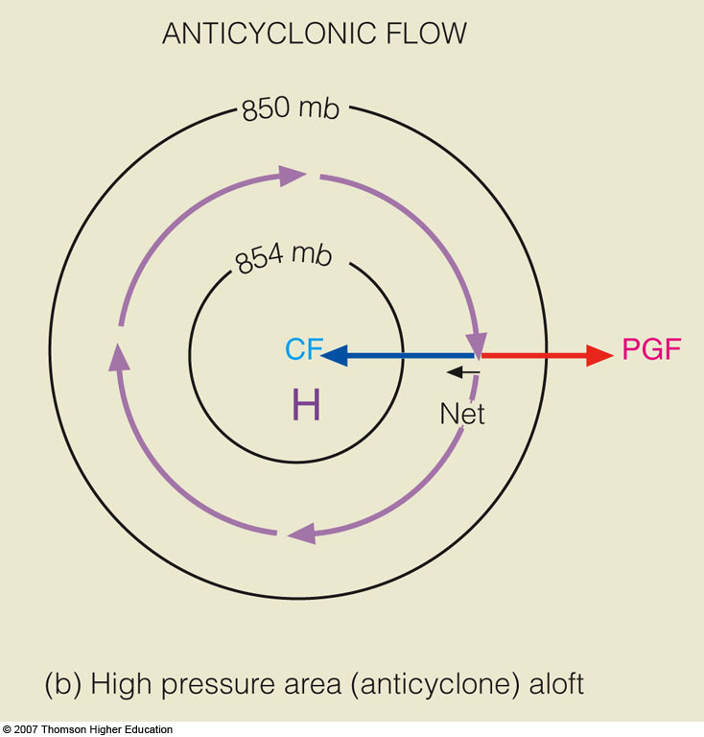
Gradient
wind
Net=centripetal
Notes:
Figure 8.26
Winds and related forces around areas of low and high pressure above the friction level in the Northern Hemisphere. Notice that the pressure gradient force (PGF) is in red, while the Coriolis force (CF) is in blue.

Slide 10
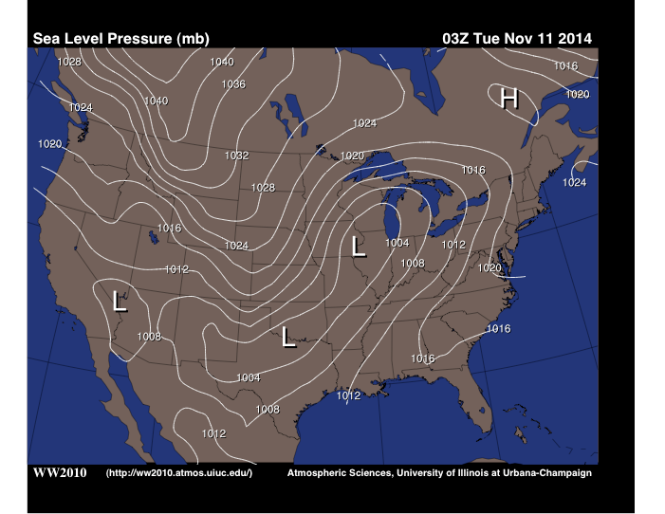
GEOSTROPHIC FLOW
COR
PGF
V_{gs}
V_{gs}
PGF
COR

Slide 11
GRADIENT FLOW
V_{gr}
COR
CENTRIFUGAL
PGF
(N: 195–199; A: 215–220)

Slide 12
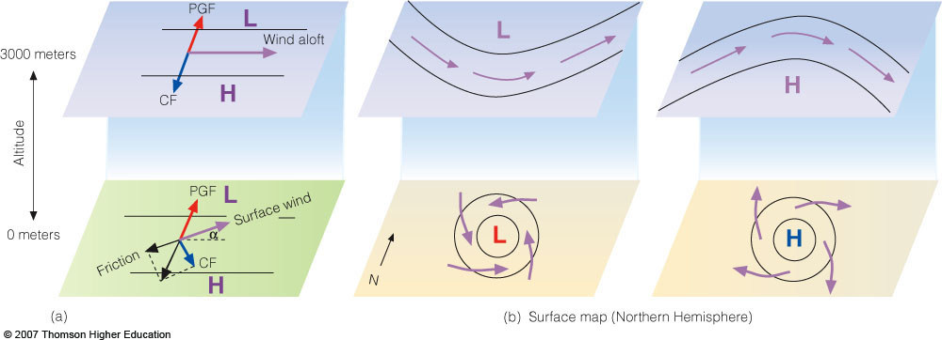
Northern Hemisphere
Wind Aloft (Above Boundary Layer)
Surface Wind
Notes:
Figure 8.29
The effect of surface friction is to slow down the wind so that, near the ground, the wind crosses the isobars and blows toward lower pressure (a). This phenomenon at the surface (b) produces an inflow of air around a low and an outflow around a high. Aloft, the winds blow parallel to the lines.

Slide 13
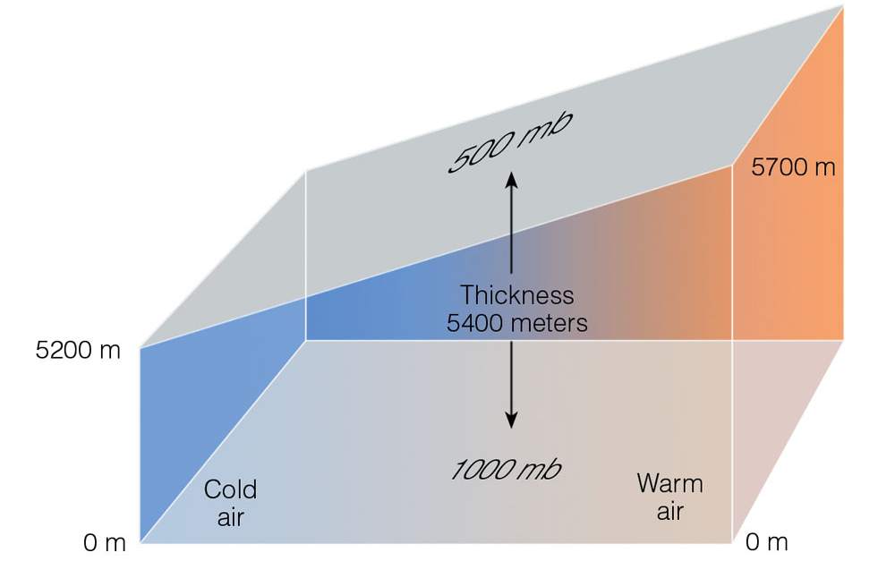
1000–500 mb Thickness

Slide 14
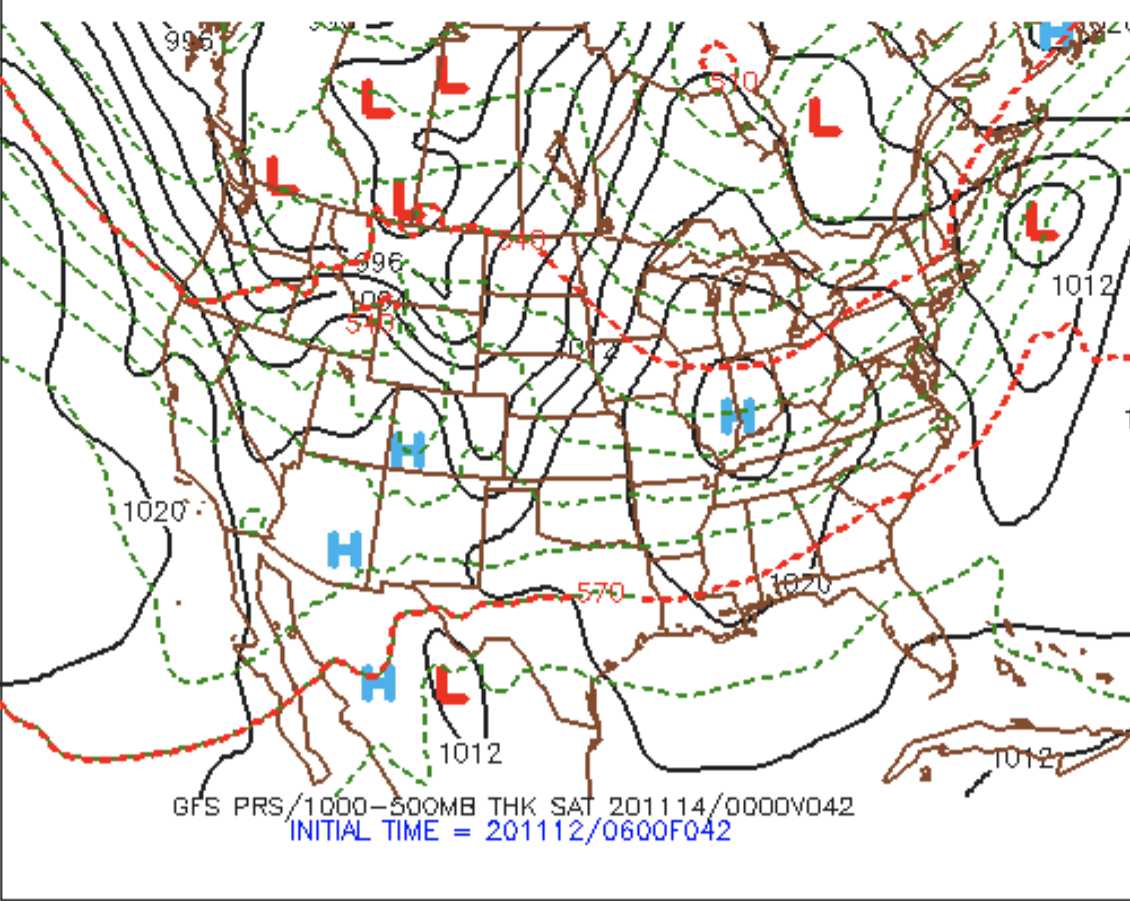
Warm Advection
No (weak) Advection
Cold Advection

Slide 15
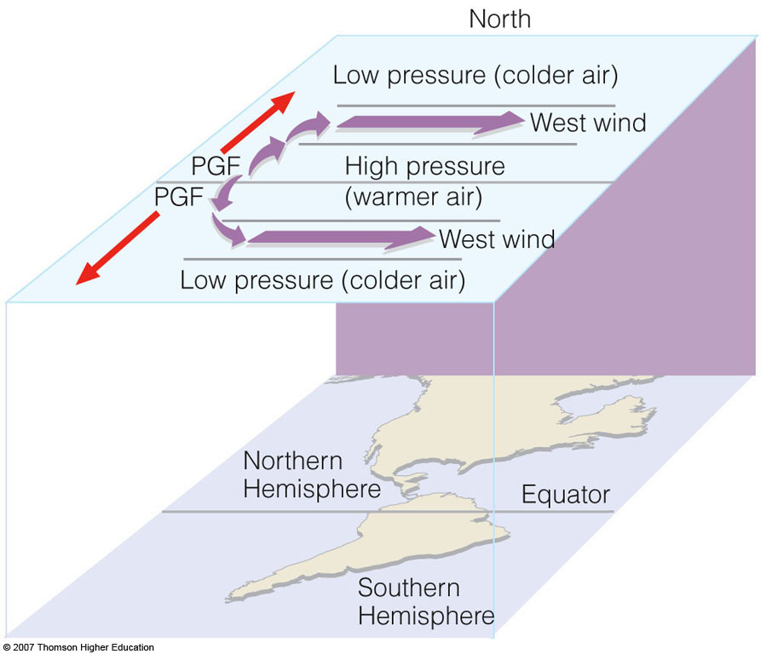
heights
heights
heights
Notes:
Figure 6
Upper-level chart that extends over the Northern and Southern Hemispheres. Solid gray lines on the chart are isobars.

Slide 16
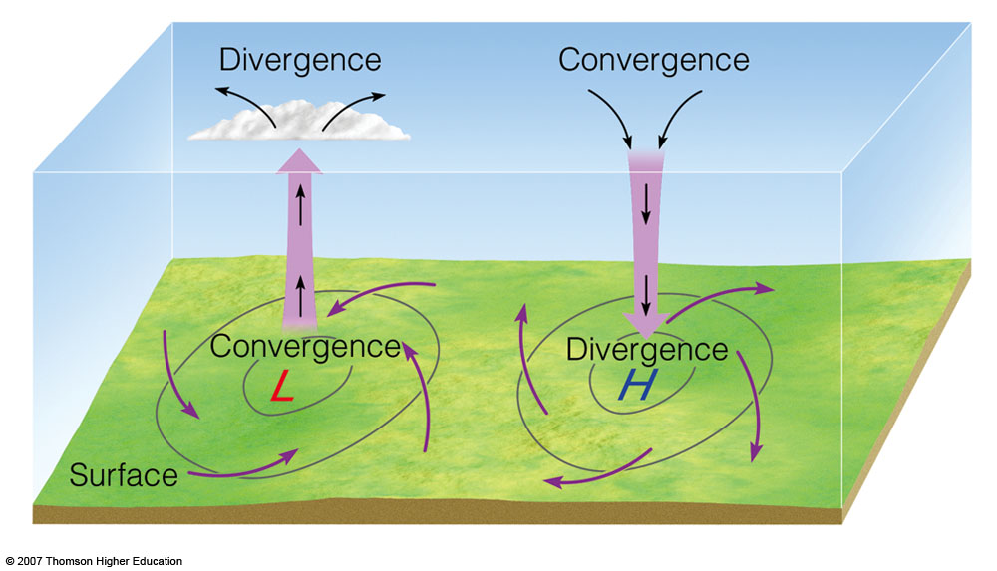
Convergence & Divergence
Mass convergence/divergence aloft produces surface anticyclones/cyclones.

Slide 17
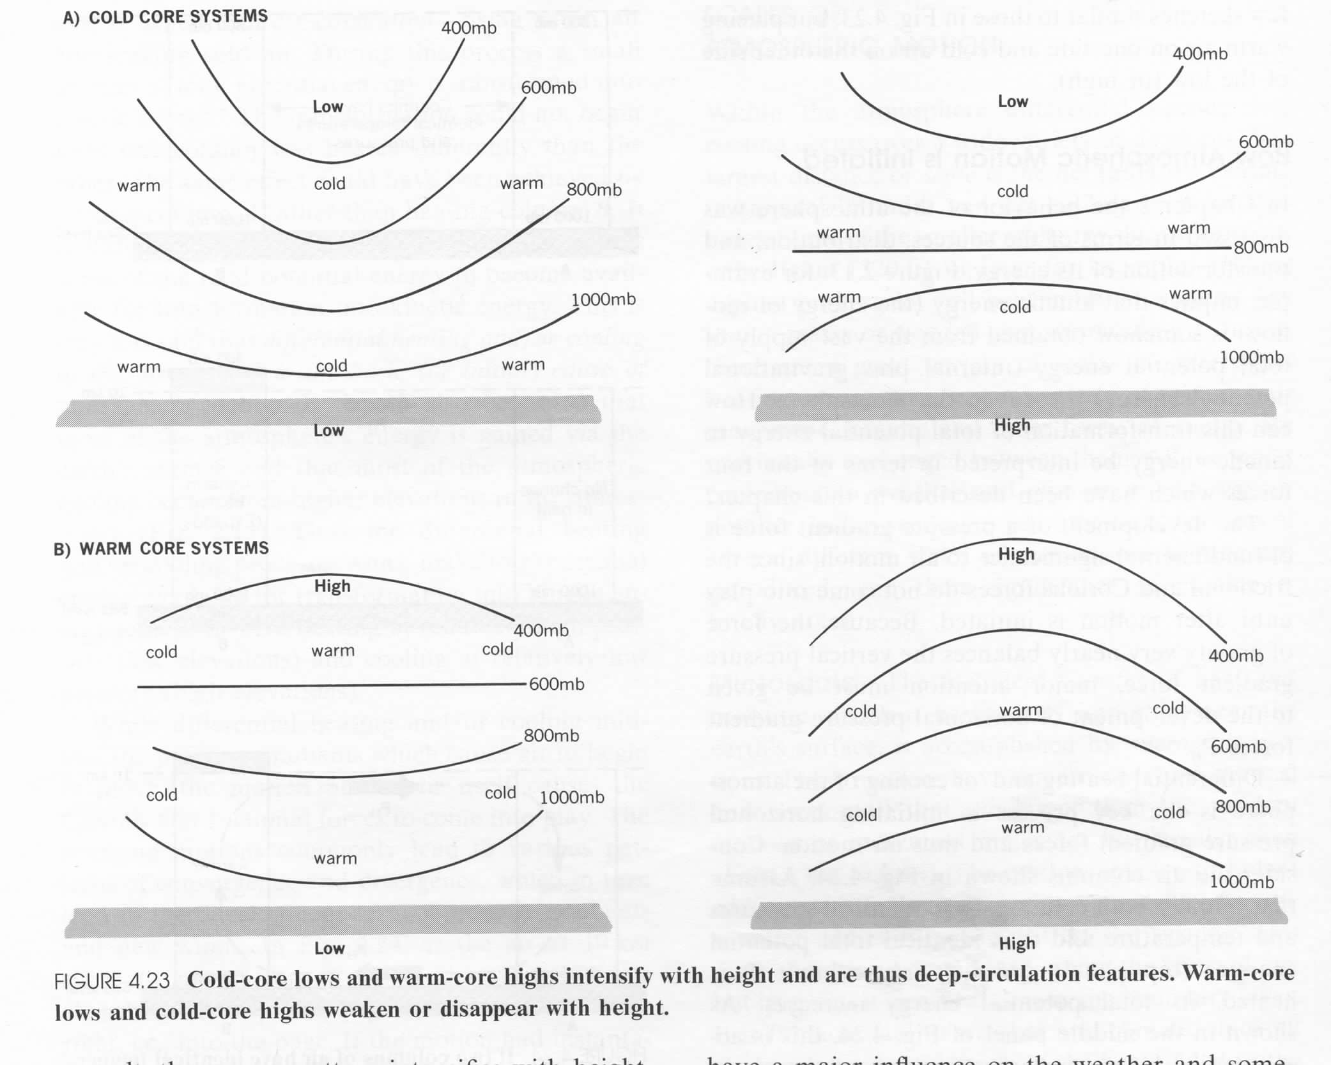
Cold- vs. Warm-core Systems
dz

Slide 18
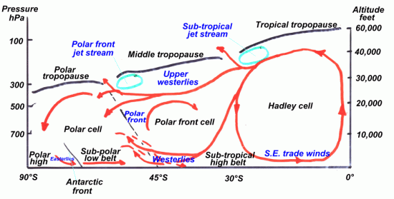
More Accurate Characterization of General Circulation*
(*This is Southern Hemisphere but Northern Hemisphere circulation is similar)

Slide 19
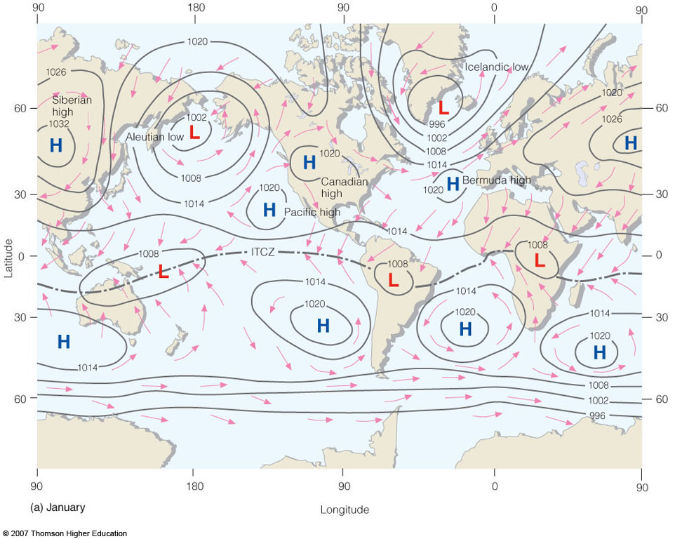
January Average Surface Pressure
Notes:
Figure 10.3
Average sea-level pressure distribution and surface wind-flow patterns for January (a) and for July (b). The heavy dashed line represents the position of the ITCZ.

Slide 20
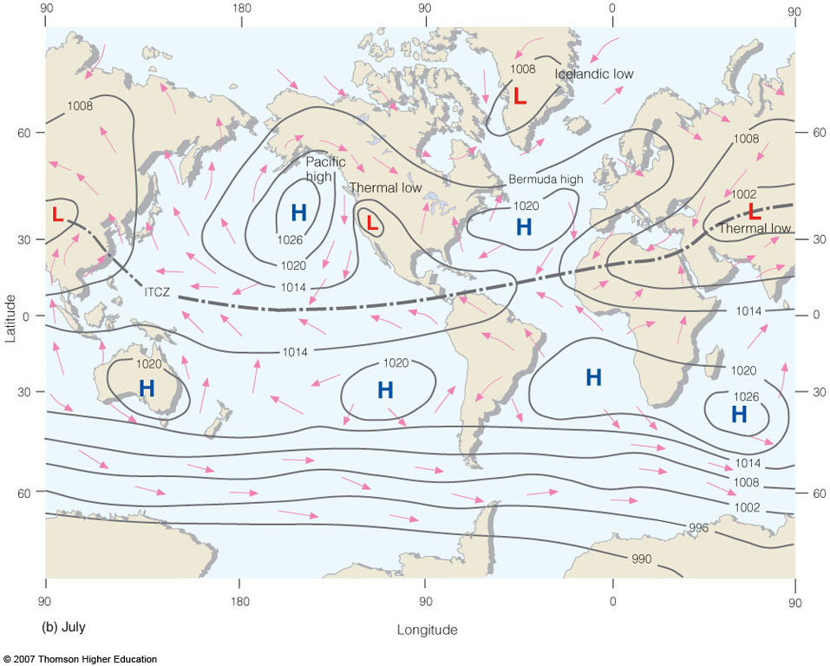
July Average Surface Pressure
Notes:
Figure 10.3
Average sea-level pressure distribution and surface wind-flow patterns for January (a) and for July (b). The heavy dashed line represents the position of the ITCZ.

Slide 21
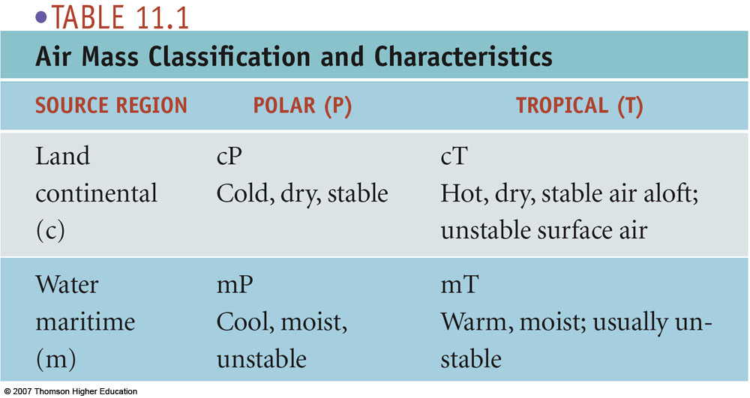
Bergeron Air Mass Classification

Slide 22
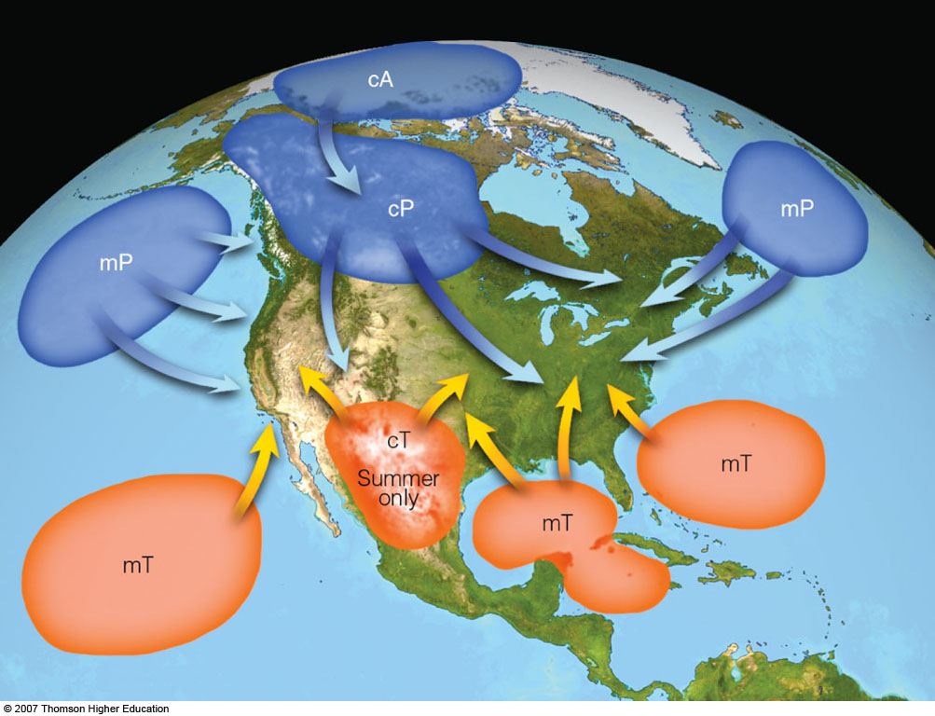
North American Air Masses
Notes:
Figure 11.2
Air mass source regions and their paths.

Slide 23
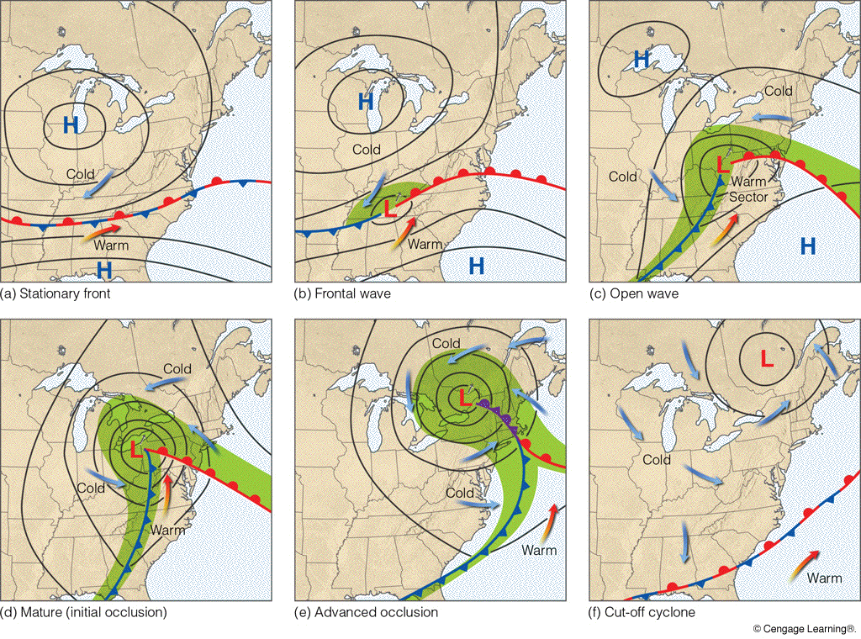
Norwegian Cyclone Model
Notes:
Figure 12.1
The idealized life cycle of a midlatitude cyclone (a through f) in the Northern Hemisphere based on the polar front theory. As the life cycle progresses, the system moves eastward in a dynamic fashion. The small arrow next to each L shows the direction of storm movement.

Slide 24
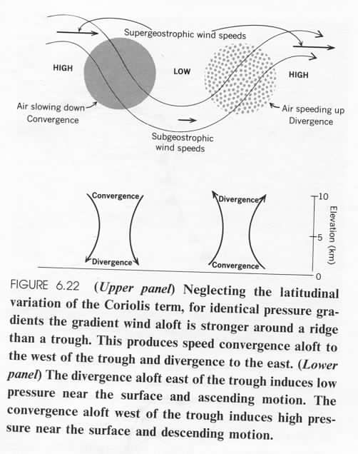
Cyclogenesis
and
Anticyclogenesis

Slide 25
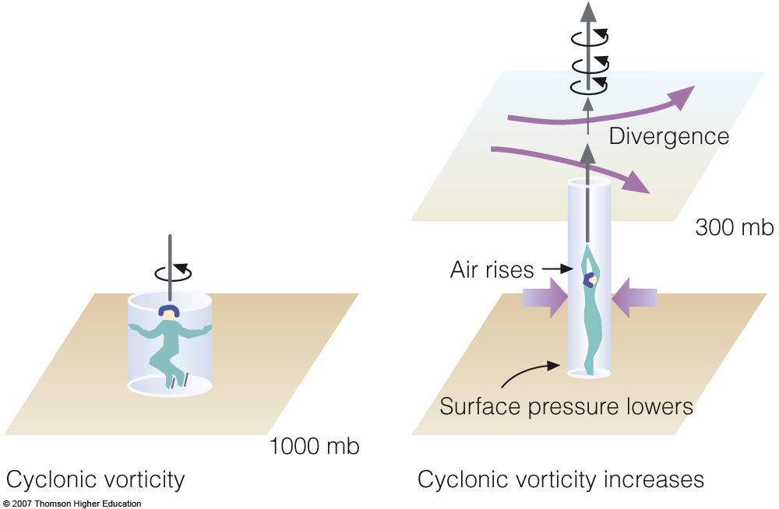
Convergence/Divergence, Vorticity, and Vertical Motion
Divergence aloft
Surface convergence
Increasing positive vorticity
Rising air (vertical stretching)
Spin-up
Notes:
Figure 12.19
When upper-level divergence moves over an area of weak cyclonic circulation, the cyclonic circulation increases (that is, it becomes more positive), and air is forced upward.

Slide 26
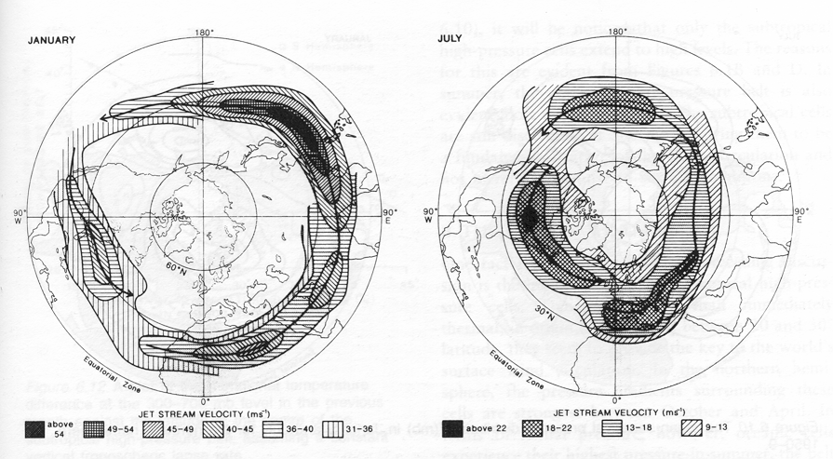
JET STREAM CORE
Note: key differs between maps
(A: 320–345)

Slide 27
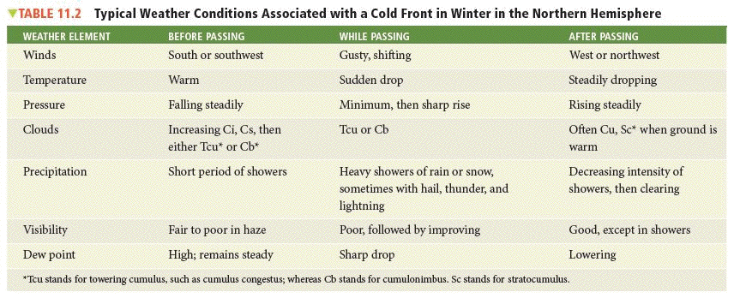
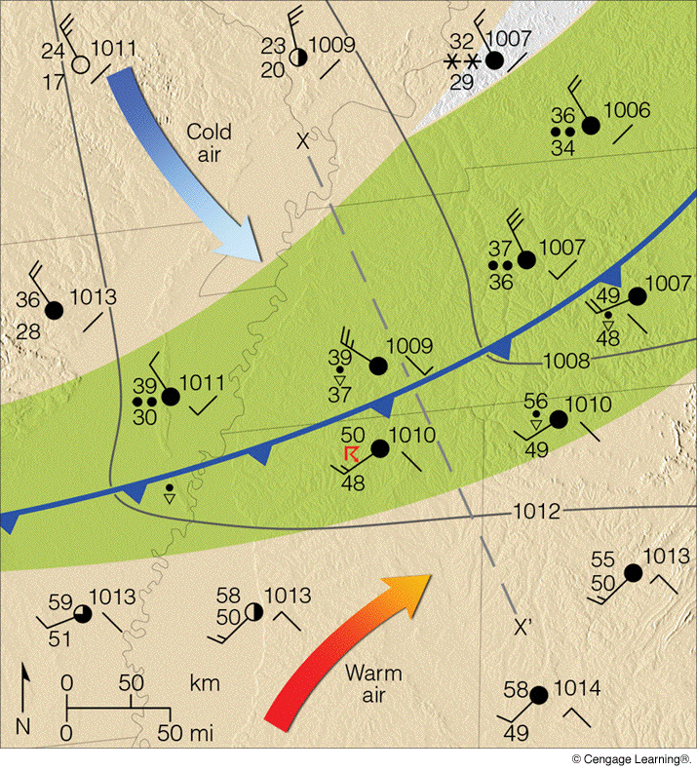
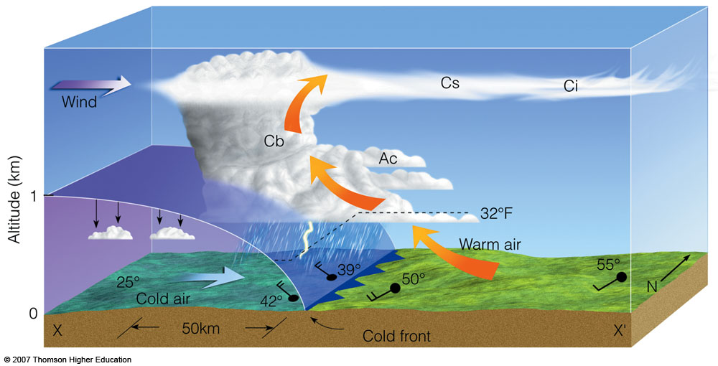

Slide 28
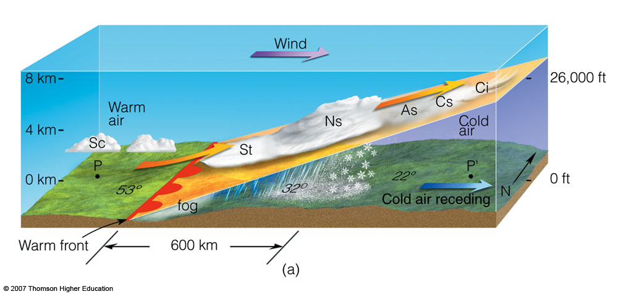
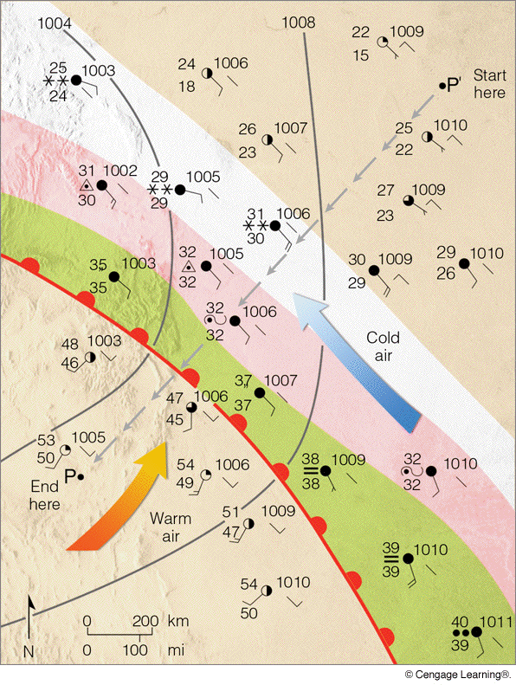
Warm Front (vertical cross-section)
Notes:
Figure 11.19
Vertical view of clouds, precipitation, and winds across the warm front in Fig. 11.18 along the line P–P’.

Slide 29
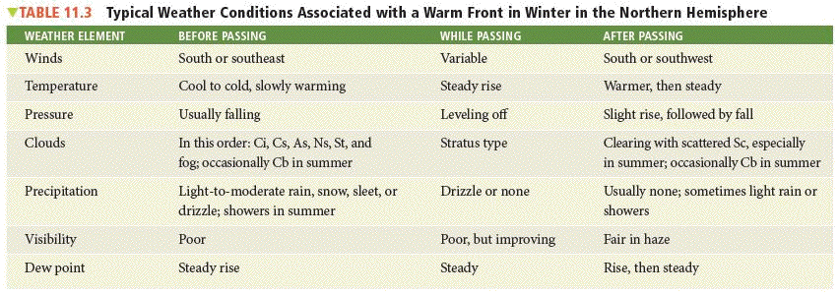

Slide 30
