Slide 1
EVSC 3300
ATMOSPHERIC
FLUID
DYNAMICS

Slide 3
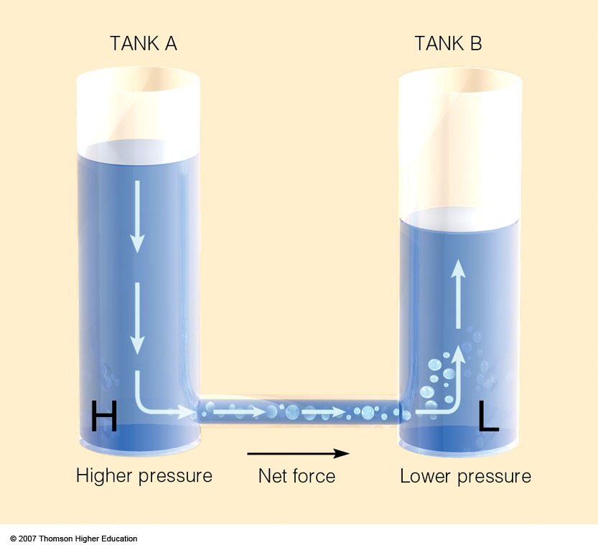
Notes:
Figure 8.16
The higher water level creates higher fluid pressure at the bottom of tank A and a net force directed toward the lower fluid pressure at the bottom of tank B. This net force causes water to move from higher pressure toward lower pressure.

Slide 4
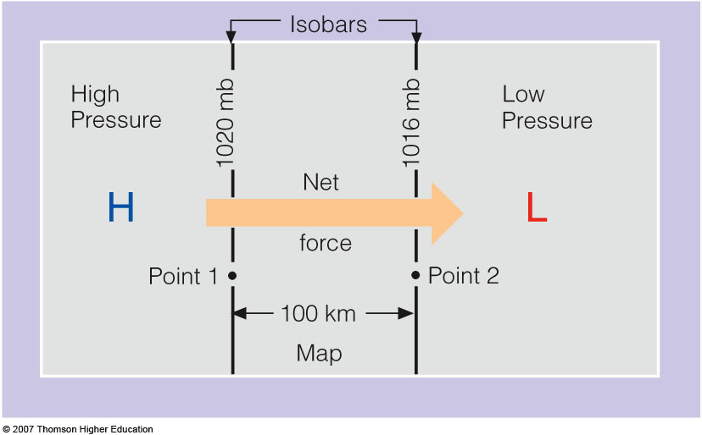
Pressure Gradient Force (PGF)
Notes:
Figure 8.17
The pressure gradient between point 1 and point 2 is 4 mb per 100 km. The net force directed from higher toward lower pressure is the pressure gradient force.

Slide 5
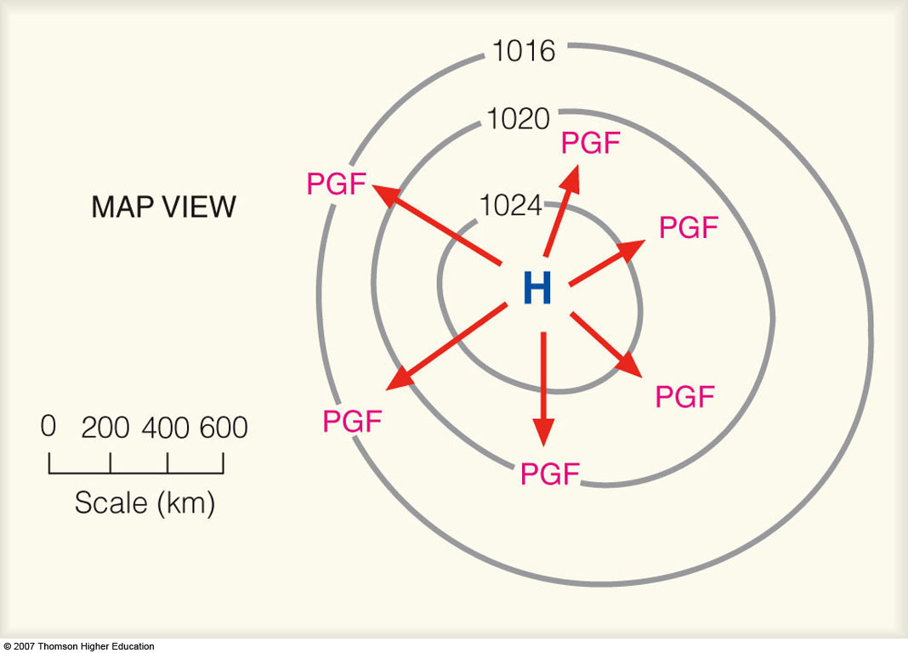

Pressure Gradient Force (PGF)
Notes:
Figure 8.18
The closer the spacing of the isobars, the greater the pressure gradient. The greater the pressure gradient, the stronger the pressure gradient force (PGF). The stronger the PGF, the greater the wind speed. The red arrows represent the relative magnitude of the force, which is always directed from higher toward lower pressure.

Slide 6
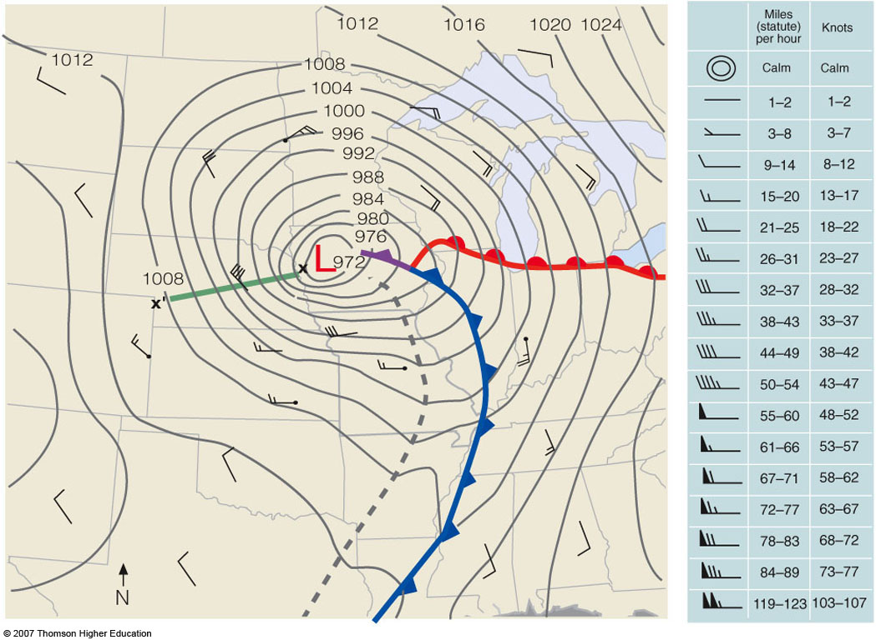
PGF
Notes:
Figure 8.19
Surface weather map for 6 A.M. (CST), Tuesday, November 10, 1998. Dark gray lines are isobars with units in millibars. The interval between isobars is 4 mb. A deep low with a central pressure of 972 mb (28.70 in.) is moving over northwestern Iowa. The distance along the green line X-X’ is 500 km. The difference in pressure between X and X’ is 32 mb, producing a pressure gradient of 32 mb/500 km. The tightly packed isobars along the green line are associated with strong northwesterly winds of 40 knots, with gusts even higher. Wind directions are given by lines that parallel the wind. Wind speeds are indicated by barbs and flags. (A wind indicated by the symbol [not available] would be a wind from the northwest at 10 knots. See blue insert.) The solid blue line is a cold front, the solid red line a warm front, and the solid purple line an occluded front. The heavy dashed line is a trough.

Slide 7
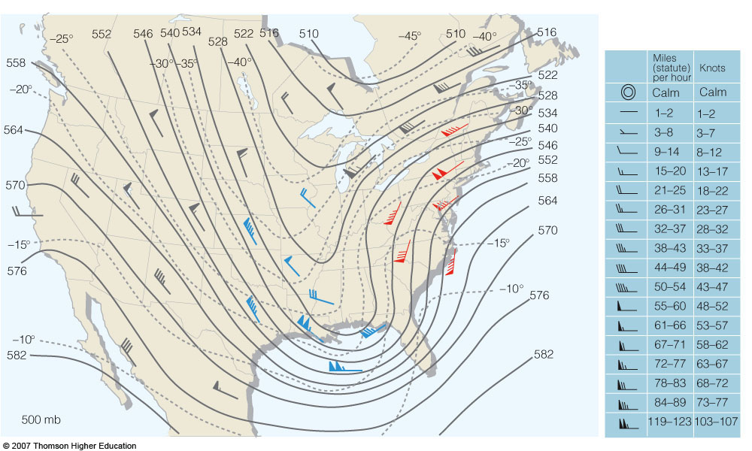
Gradients on a 500 mb Map
height gradient force
(N: 169–178; A: 209–210)
Notes:
Figure 12.17
The 500-mb chart for 7 A.M. (EST) March 13, 1993. Solid lines are contours where 564 equals 5640 meters. Dashed lines are isotherms in °C. Wind entries in red show warm advection. Those in blue show cold advection. Those in gray indicate no appreciable temperature advection is occurring.

Slide 8
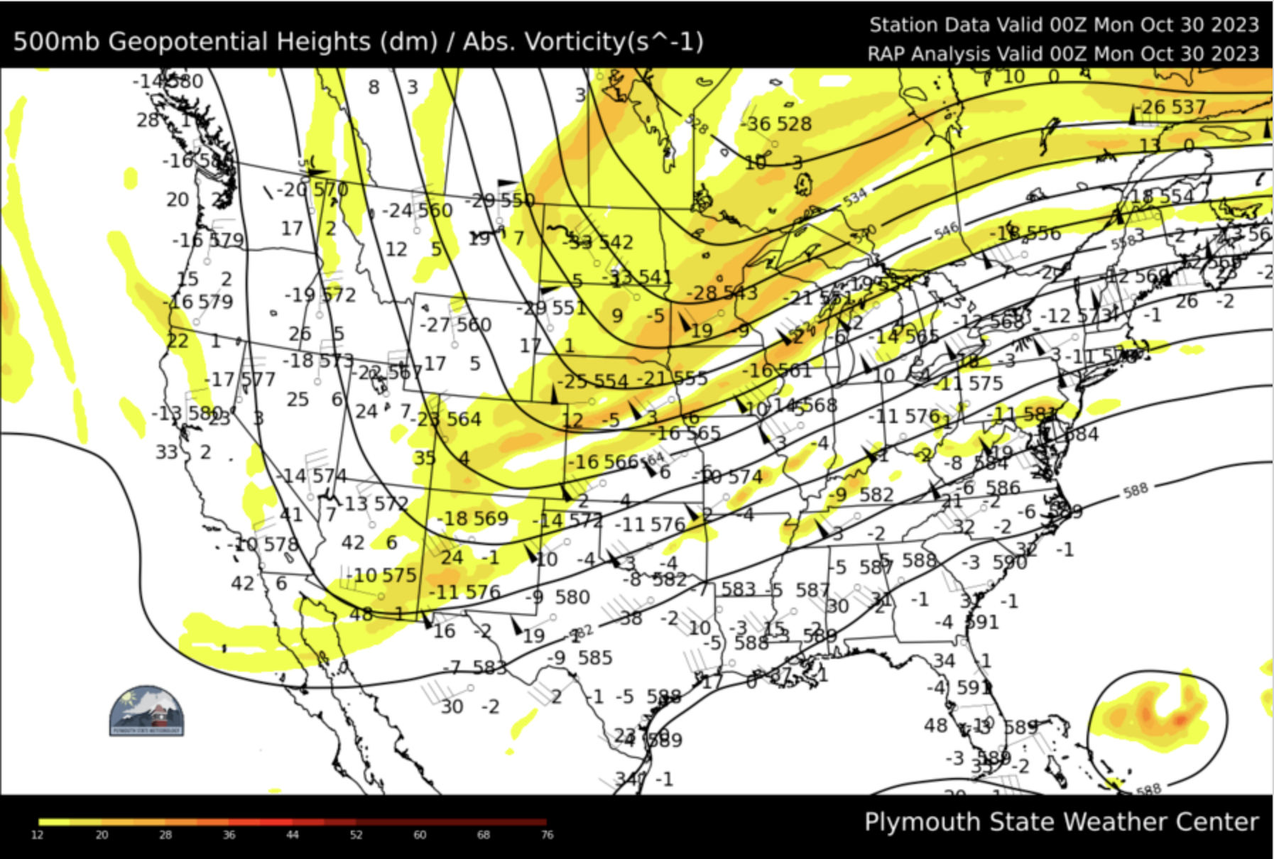

Slide 9
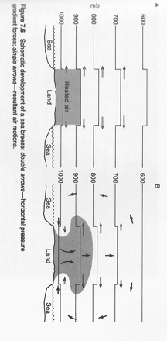
Thermally-induced Circulation
Neiburger, fig. 7.6

Slide 10
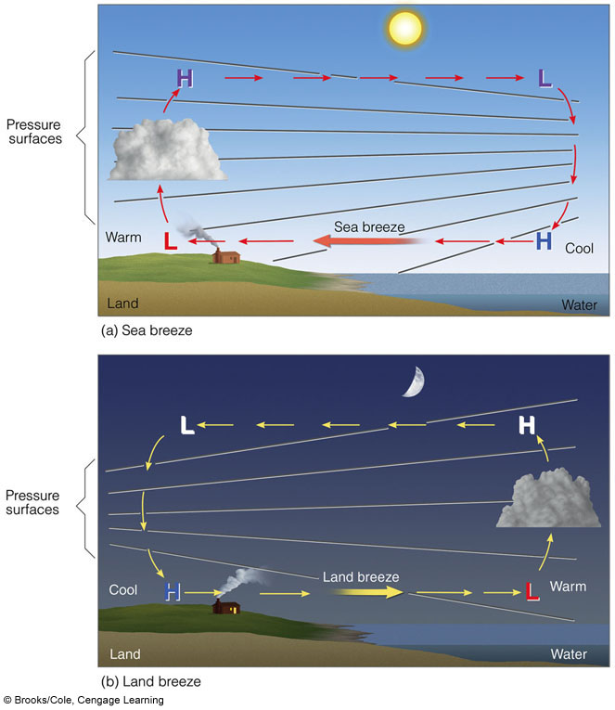
SEA
BREEZE
LAND
BREEZE
Notes:
FIGURE 9.24 Development of a sea
breeze and a land breeze. (a) At the surface, a sea
breeze blows from the water onto the land,
whereas (b) the land breeze blows from the land
out over the water. Notice that the pressure at
the surface changes more rapidly with the sea
breeze. This situation indicates a stronger
pressure gradient force and higher winds with a
sea breeze.

Slide 11
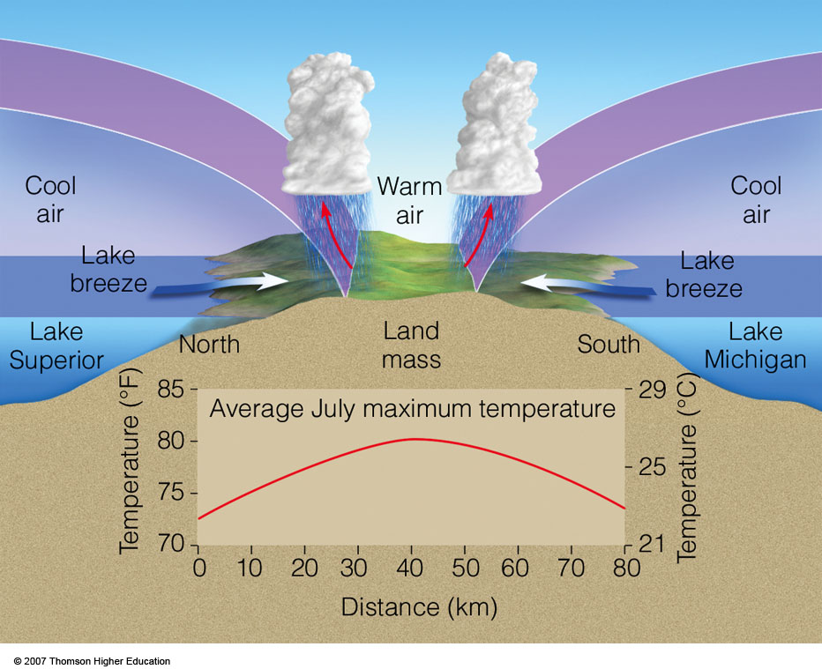
Notes:
Figure 9.24
The convergence of two lake breezes and their influence on the maximum temperature during July in upper Michigan.

Slide 12
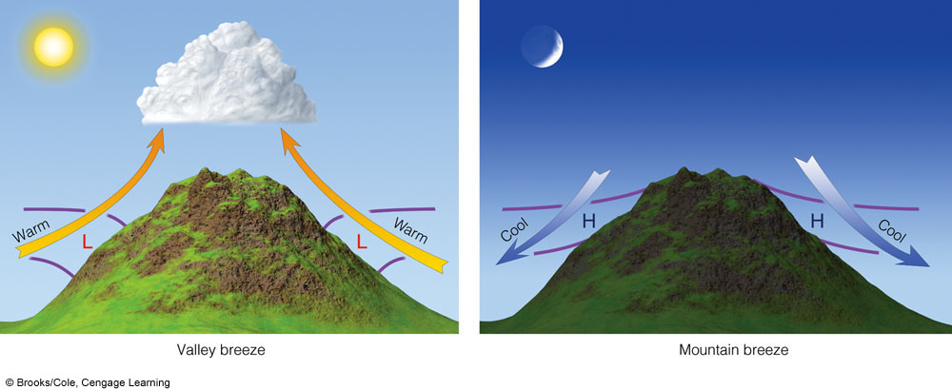
VALLEY BREEZE
MOUNTAIN BREEZE
Notes:
FIGURE 9.34 Valley breezes blow uphill during the day; mountain breezes blow downhill at night. (The L’s and H’s represent pressure,
whereas the purple lines represent surfaces of constant pressure.)

Slide 13
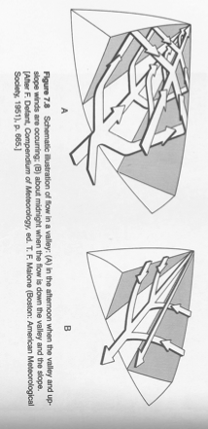
Diurnal Terrain Flows
Afternoon
Midnight
figure 7.8
anabatic flow
katabatic flow

Slide 14

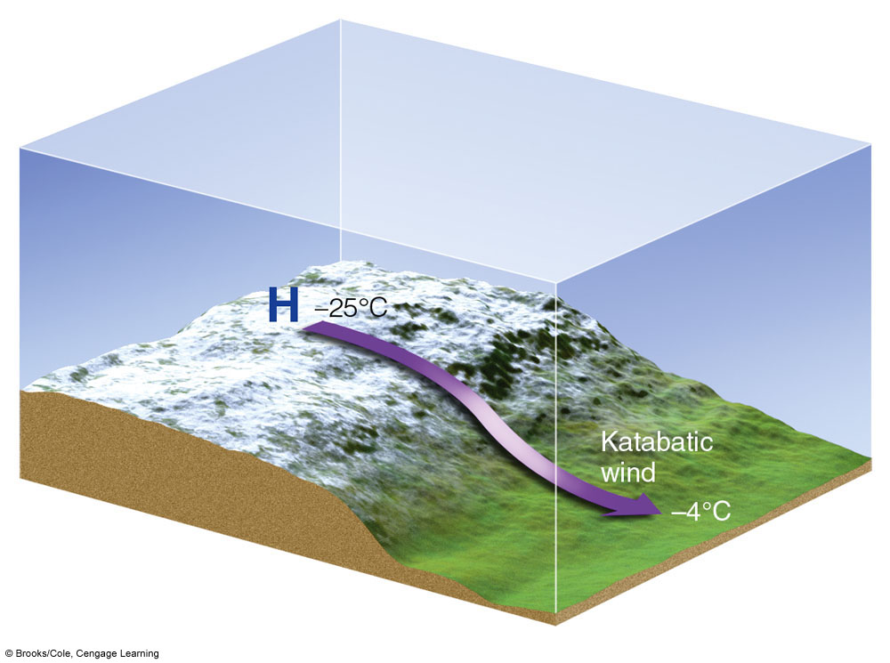
Katabatic Wind
Downslope flow driven by cooling of air along surface
Notes:
FIGURE 9.36 Strong katabatic winds can form where cold winds
rush downhill from an elevated plateau covered with snow.

Slide 15
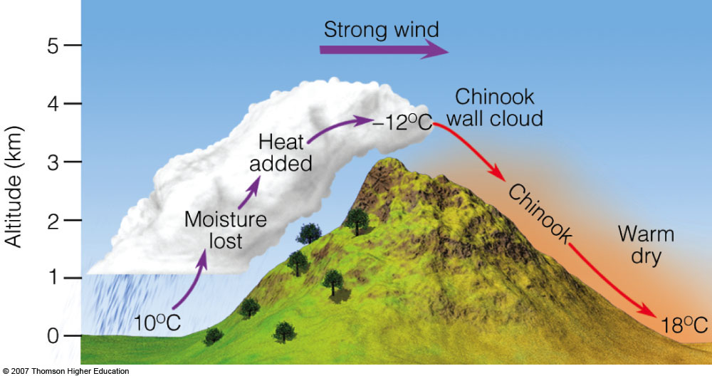
Chinook
Notes:
Figure 9.33
Conditions that may enhance a chinook.

Slide 16
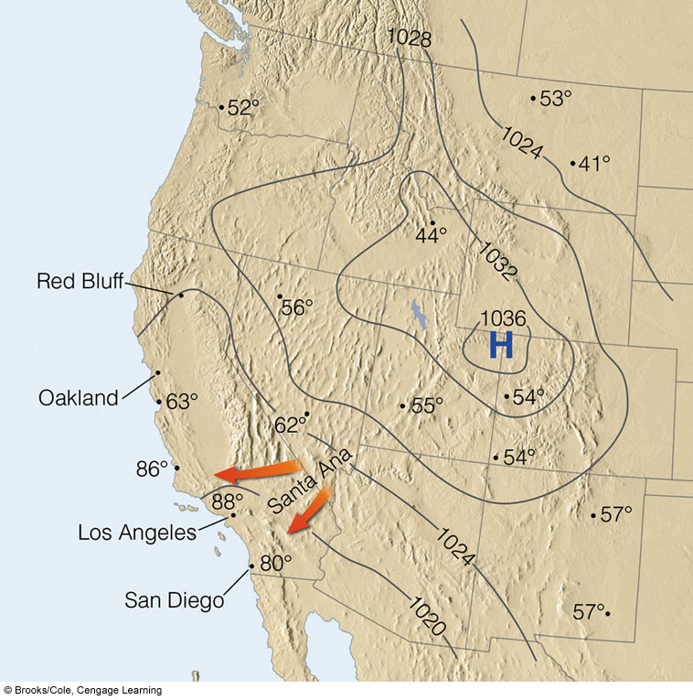
Santa Ana Wind
Notes:
FIGURE 9.39 Surface weather map showing Santa Ana conditions
in January. Maximum temperatures for this particular day are
given in ºF. Observe that the downslope winds blowing into southern
California raised temperatures into the upper 80s, while elsewhere temperature
readings were much lower.

Slide 17
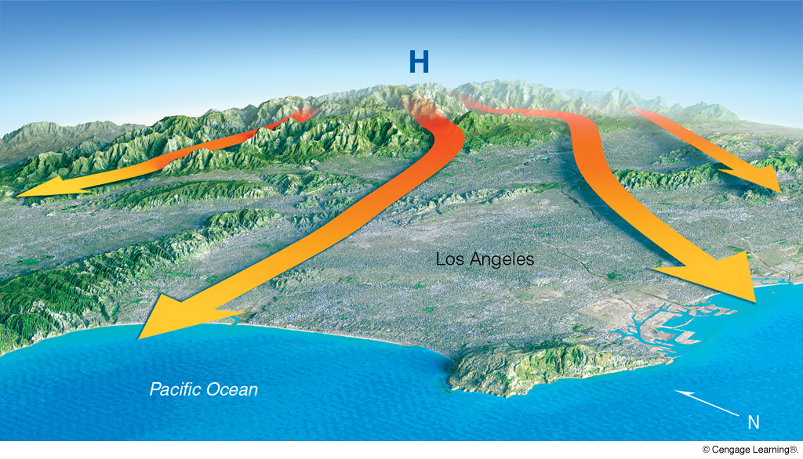
Santa Ana Wind

Slide 18
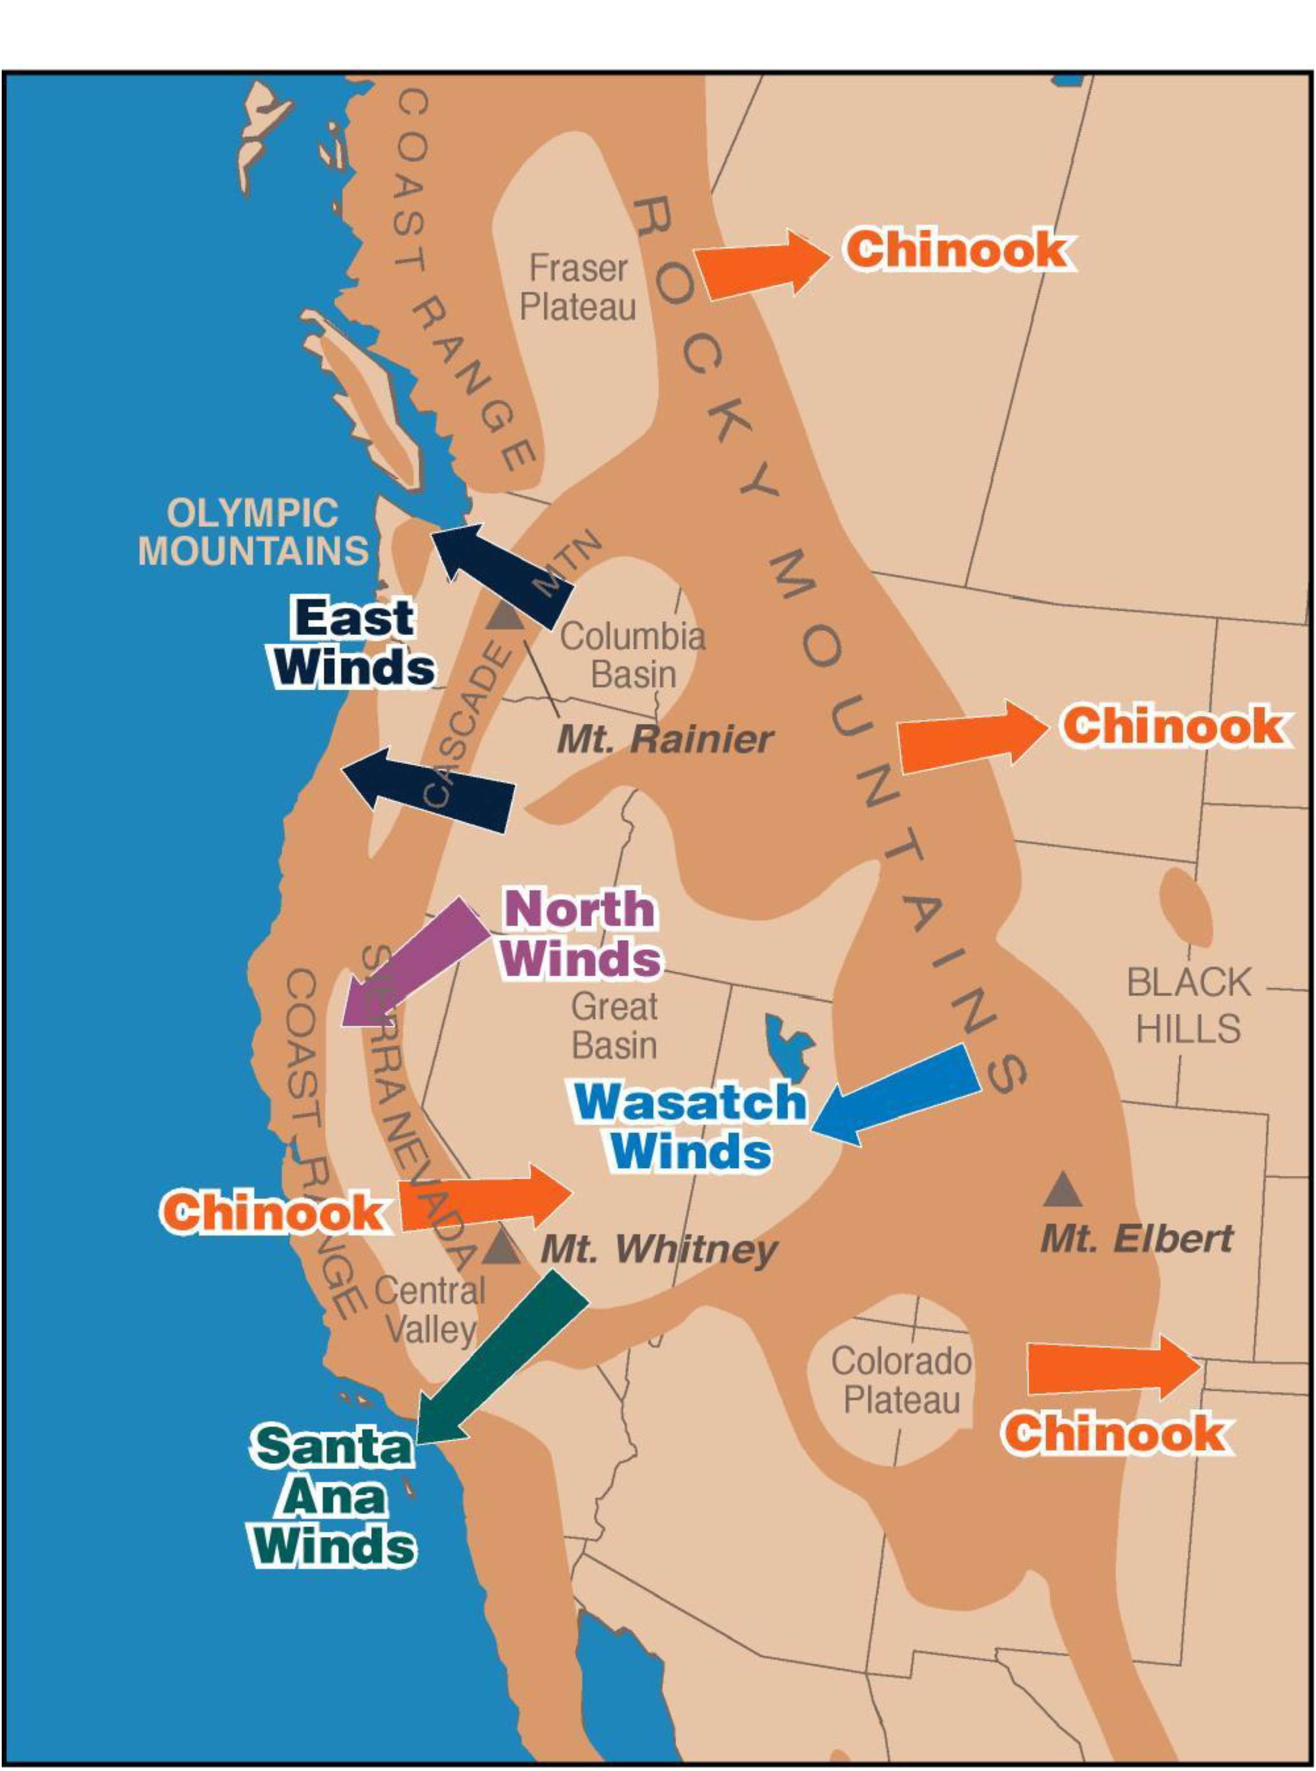
Foehn Winds of the Intermountain West
Chinook winds usually occur on the east side of N. American mountain ranges since winds aloft are usually westerly. But they can occur on the west sides when upper-level winds are from the east (Ex: Santa Ana and Wasatch winds).
Santa Ana winds—late Fall and Winter, cause horrendous wildfires.
Wasatch or canyon winds are of two types. Some come through gaps in the Wasatch ridgeline, affecting primarily the canyon exits. Others (less common) affect a more or less contiguous zone along the foothills. These are probably produced by strong mountain waves.

Slide 19
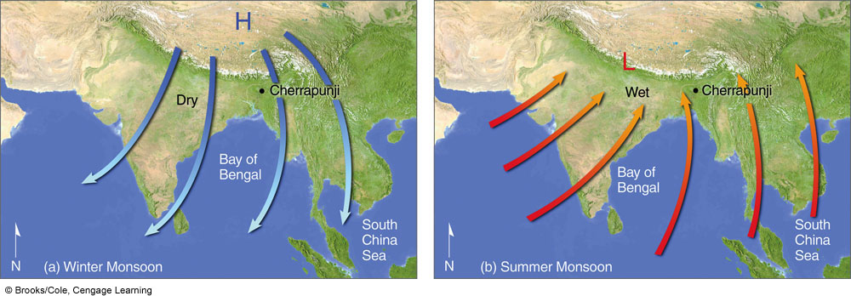

Monsoon Circulation
Winter
Summer
“mausim” (Arabic): season
Notes:
FIGURE 9.30 Changing annual wind-flow patterns associated with the winter and summer Asian monsoon.

Slide 20
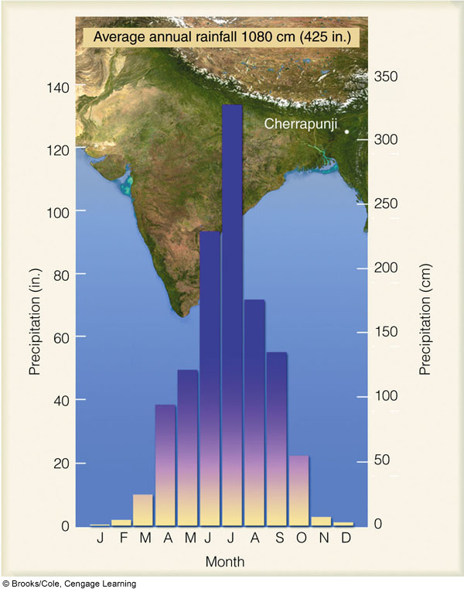
Cherrapunji,
India Monthly
Rainfall
Notes:
FIGURE 9.31 Average annual precipitation for Cherrapunji,
India. Note the abundant rainfall during the summer monsoon (April
through October) with the lack of rainfall during the winter monsoon
(November through March).

Slide 21
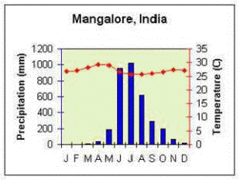
Mangalore, India
Monthly Temperature & Precipitation
dry hot wet dry

Slide 22
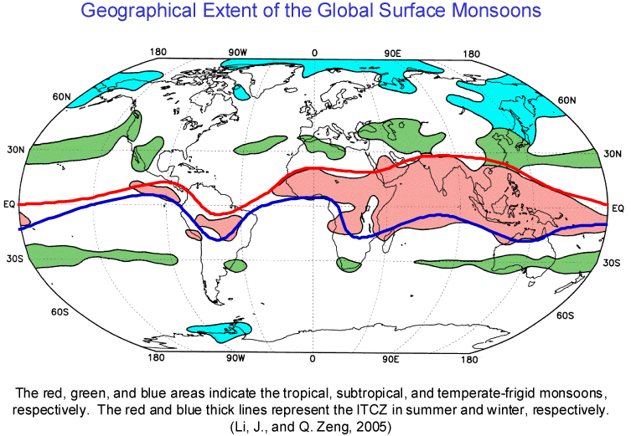
Global Monsoon Regions
Red area indicates the standard tropical monsoon regions.
(N: 178–185; A: 237–251)

Slide 23
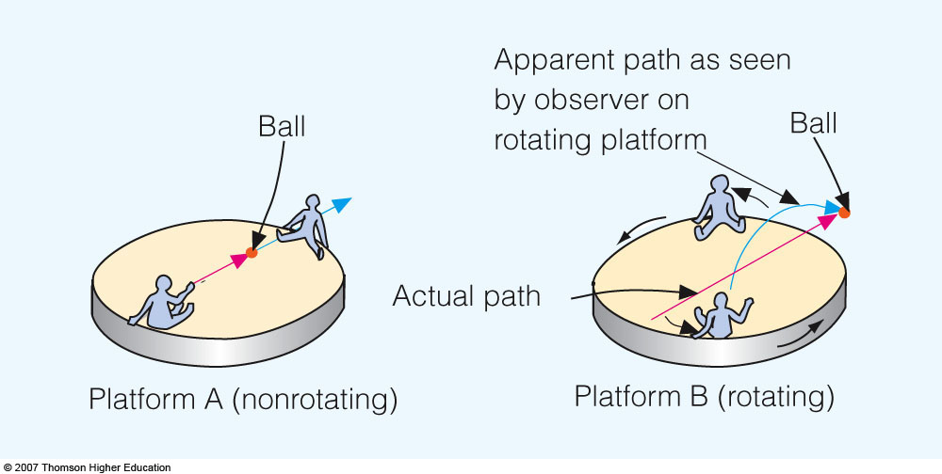
Coriolis Force
Notes:
Figure 8.20
On nonrotating platform A, the thrown ball moves in a straight line. On platform B, which rotates counterclockwise, the ball continues to move in a straight line. However, platform B is rotating while the ball is in flight; thus, to anyone on platform B, the ball appears to deflect to the right of its intended path.

Slide 24
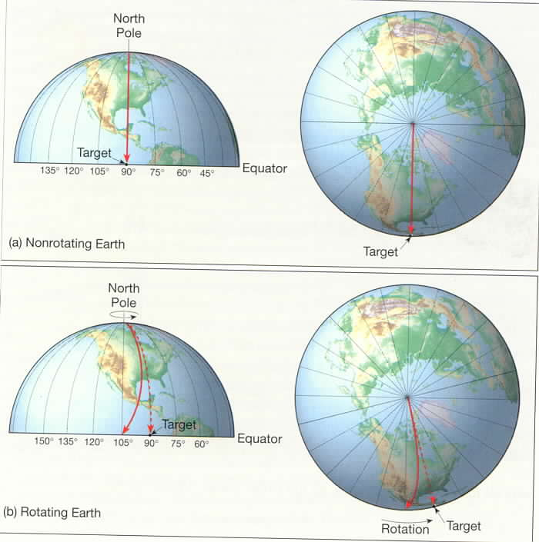
Equatorward-moving Air Parcel
Non-
Rotating
Rotating

Slide 25
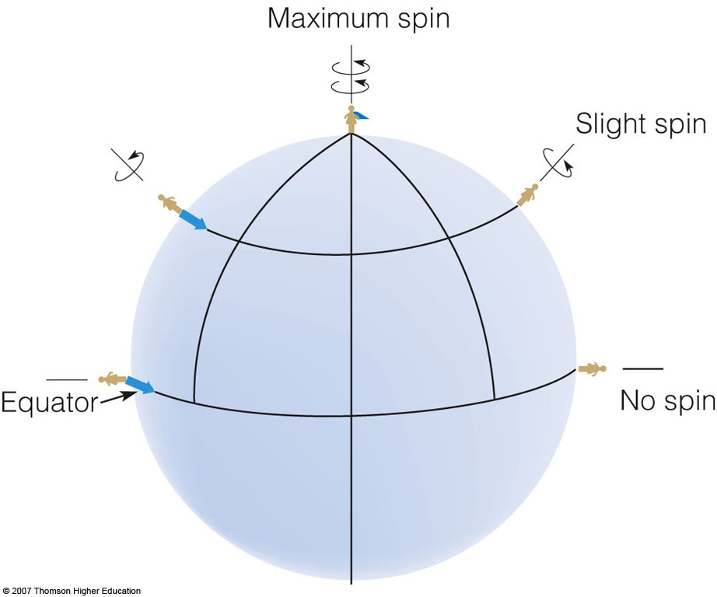

Slide 26
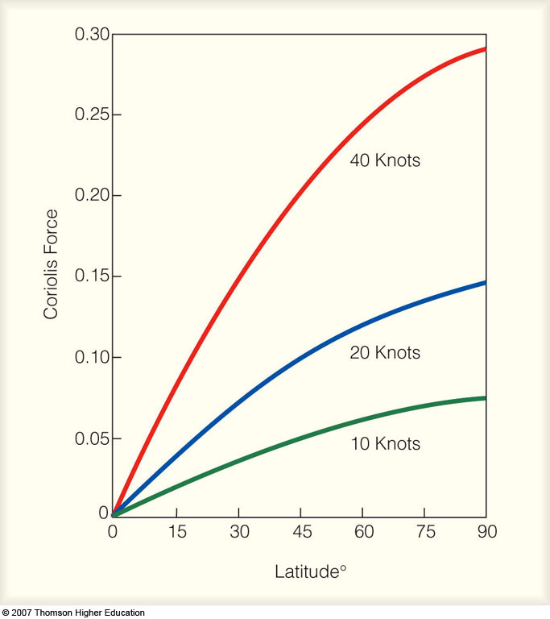

Coriolis Force
Notes:
Figure 8.21
The relative variation of the Coriolis force at different latitudes with different wind speeds.

Slide 27
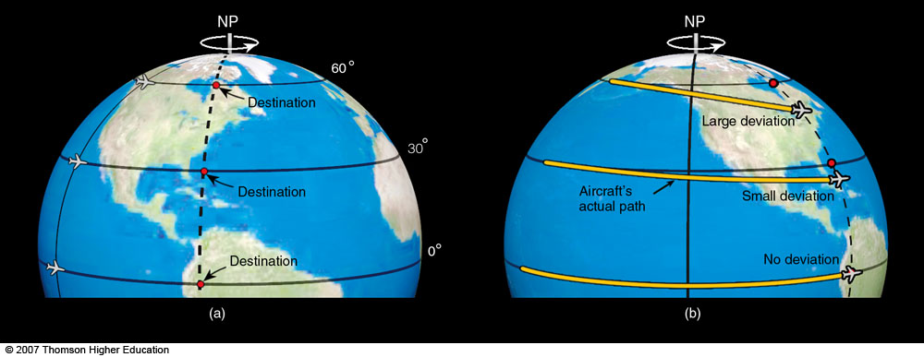
Eastward-moving Air Parcel
Notes:
Figure 8.22
Except at the equator, a free-moving object heading either east or west (or any other direction) will appear from the earth to deviate from its path as the earth rotates beneath it. The deviation (Coriolis force) is greatest at the poles and decreases to zero at the equator.

Slide 28
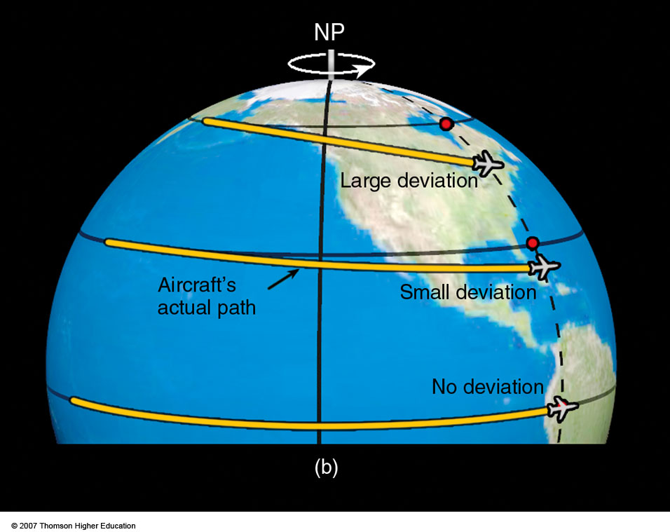
Eastward-moving Air Parcel
Notes:
Figure 8.22
Except at the equator, a free-moving object heading either east or west (or any other direction) will appear from the earth to deviate from its path as the earth rotates beneath it. The deviation (Coriolis force) is greatest at the poles and decreases to zero at the equator.

Slide 29
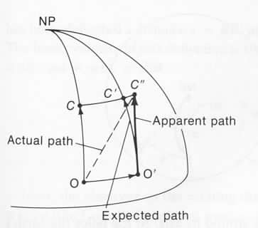
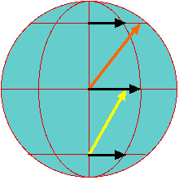
Northward-moving Air Parcel
(N: 186–192;
A: 211–214)
Northward-moving parcel
from equator maintains its
initial equatorial momentum
For another explanation: http://stratus.ssec.wisc.edu/courses/gg101/coriolis/coriolis.html

Slide 30
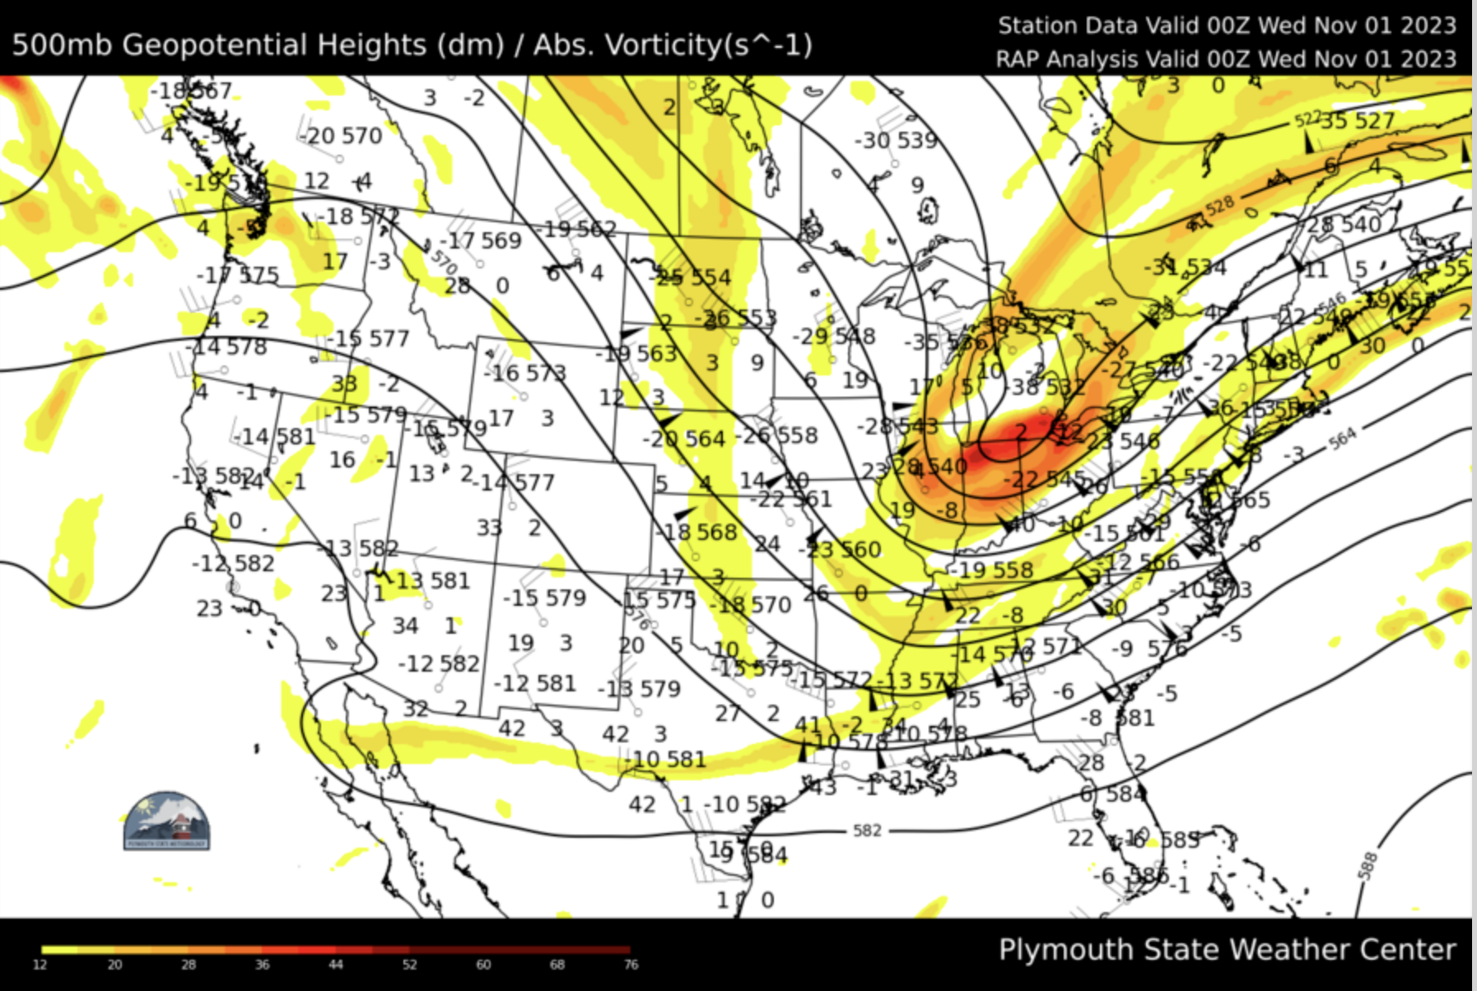

Slide 31
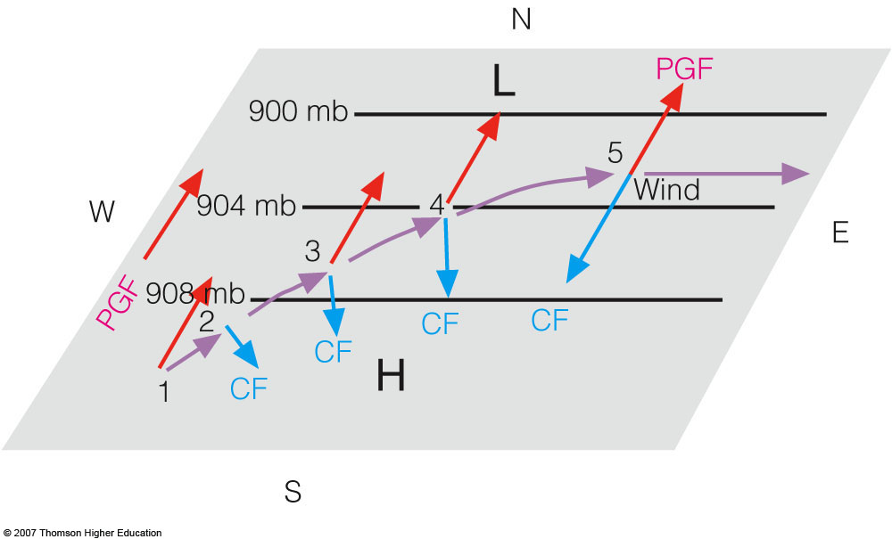

GEOSTROPHIC FLOW
Geostrophic
Wind
Notes:
Figure 8.23
Above the level of friction, air initially at rest will accelerate until it flows parallel to the isobars at a steady speed with the pressure gradient force (PGF) balanced by the Coriolis force (CF). Wind blowing under these conditions is called geostrophic.

Slide 32
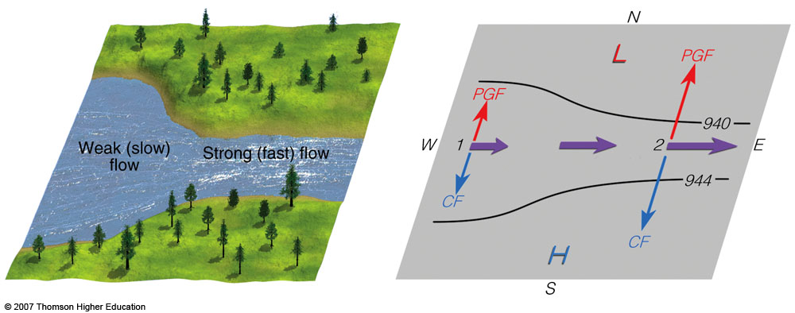
GEOSTROPHIC FLOW
Notes:
Figure 8.24
The isobars and contours on an upper-level chart are like the banks along a flowing stream. When they are widely spaced, the flow is weak; when they are narrowly spaced, the flow is stronger. The increase in winds on the chart results in a stronger Coriolis force (CF), which balances a larger pressure gradient force (PGF).

Slide 33
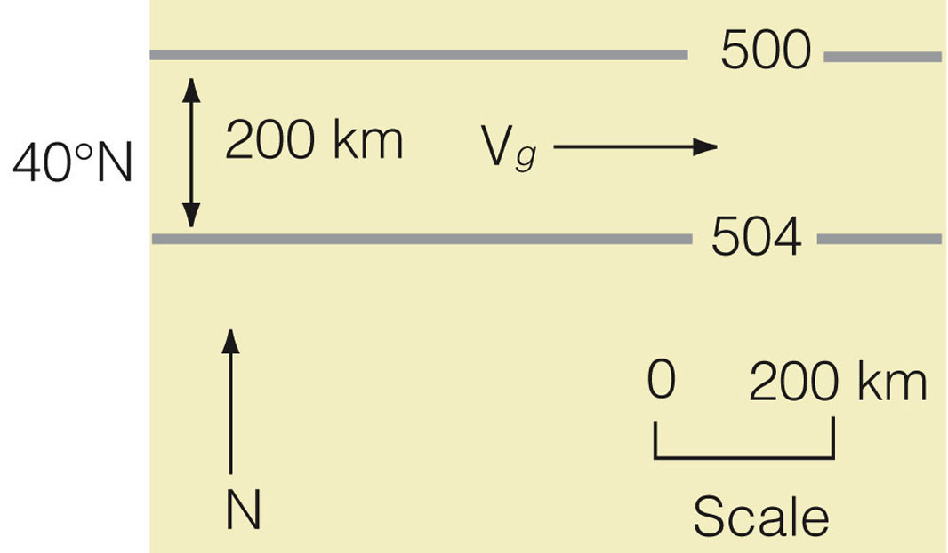
GEOSTROPHIC WIND
PGF
COR
(N: 193–195; A: 214–215)
Notes:
Figure 4
A portion of an upper-air chart for part of the Northern Hemisphere at an altitude of 5600 meters above sea level. The lines on the chart are isobars where 500 equals 500 millibars. The air temperature is 25°C and the air density is 0.70 kg/m³.

Slide 34
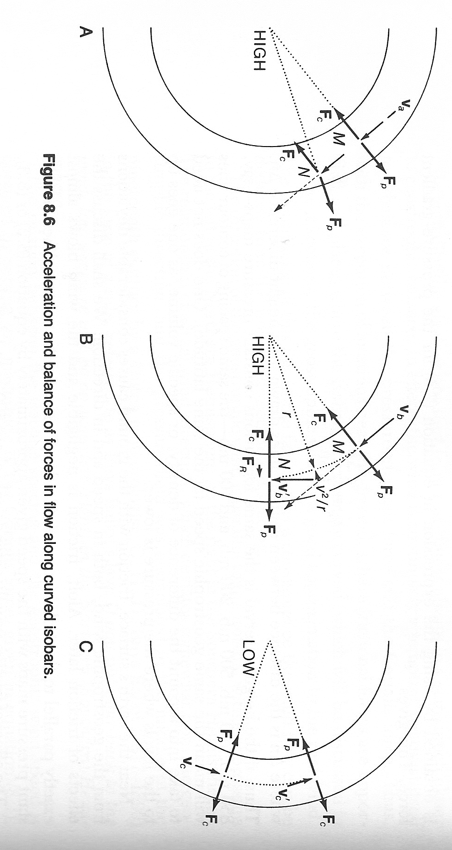
Gradient Wind
@M: geostrophic
balance; PGF = COR
PGF
PGF
COR
@N: ageostrophic
same PGF magnitude
but COR not opposite
Note net forward force
@N; i.e., acceleration
COR

Slide 35
Gradient Wind
@ M: Assume COR>PGF
such that air moves parallel
to the curved isobars; i.e.,
speed is higher than Vgs
PGF
COR
Parcel moves at constant
speed but direction changes,
i.e, acceleration
COR
PGF
CENT
centripetal acceleration = v²/r
Wind speed is
“supergeostrophic”

Slide 36
Gradient Wind
For cyclonic flow,
PGF > COR
COR
Wind is “subgeostrophic”
PGF
PGF
COR

Slide 37
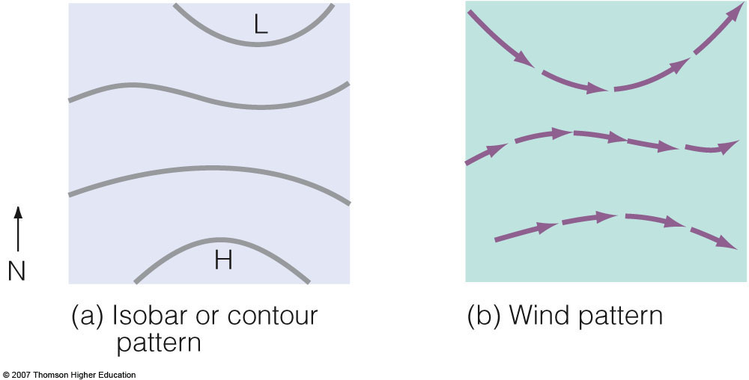
Gradient Wind
Notes:
Figure 8.25
By observing the orientation and spacing of the isobars (or contours) in diagram (a), the geostrophic wind direction and speed can be determined for diagram (b).

Slide 38
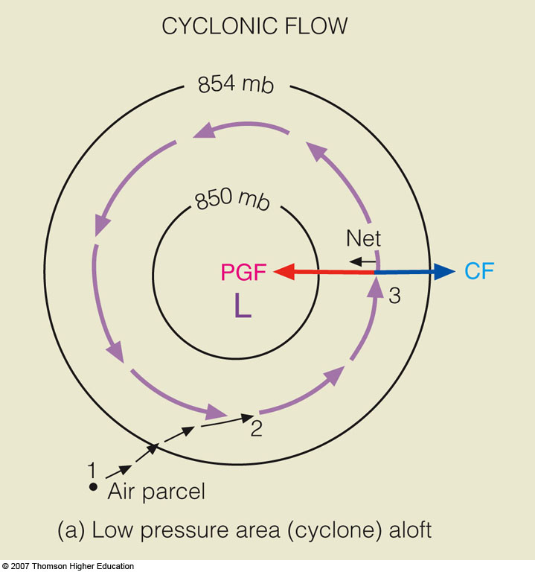

Gradient
wind
Net=centripetal
Notes:
Figure 8.26
Winds and related forces around areas of low and high pressure above the friction level in the Northern Hemisphere. Notice that the pressure gradient force (PGF) is in red, while the Coriolis force (CF) is in blue.

Slide 39
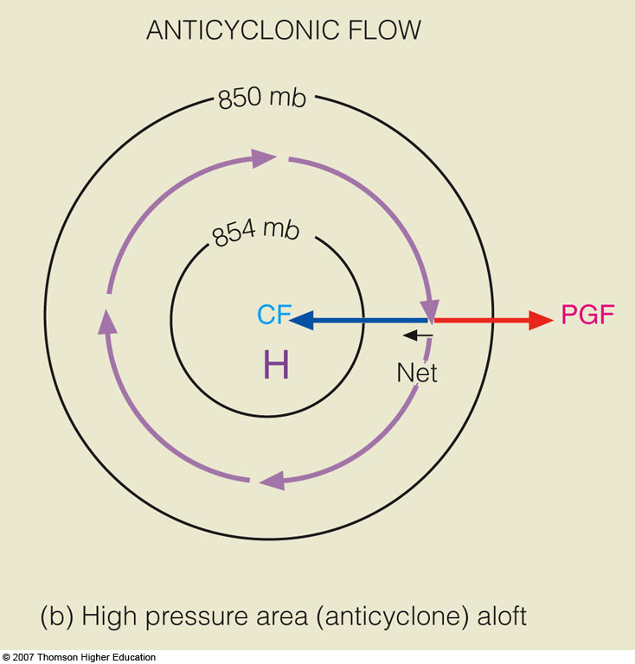
Gradient
wind
Net=centripetal
Notes:
Figure 8.26
Winds and related forces around areas of low and high pressure above the friction level in the Northern Hemisphere. Notice that the pressure gradient force (PGF) is in red, while the Coriolis force (CF) is in blue.

Slide 40
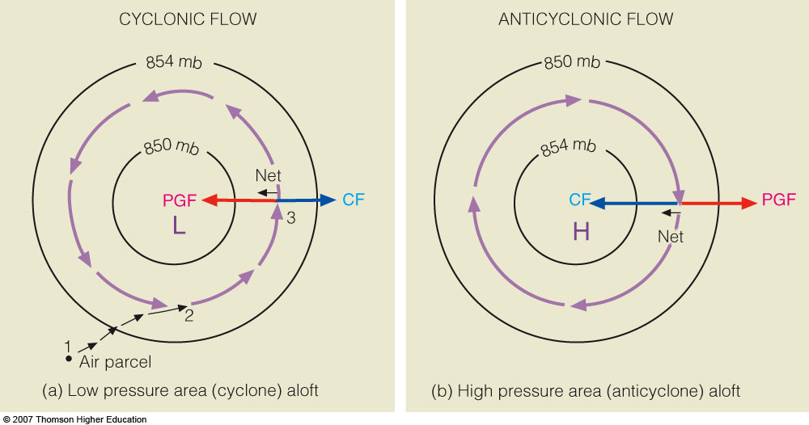
Gradient Wind
Notes:
Figure 8.26
Winds and related forces around areas of low and high pressure above the friction level in the Northern Hemisphere. Notice that the pressure gradient force (PGF) is in red, while the Coriolis force (CF) is in blue.

Slide 41
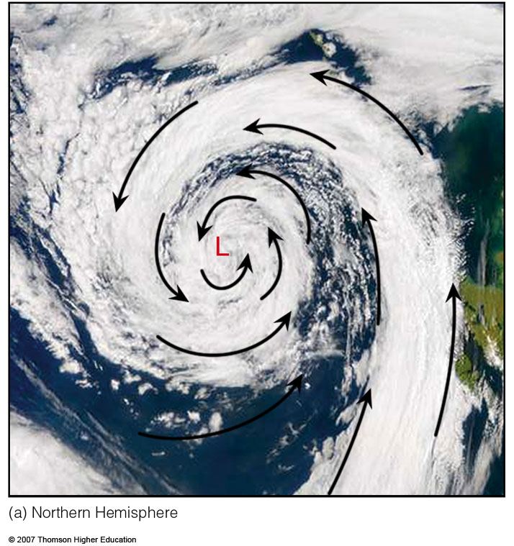
Notes:
Figure 8.27
Clouds and related wind-flow patterns (black arrows) around low-pressure areas.
(a) In the Northern Hemisphere, winds blow counterclockwise around an area of low pressure.

Slide 42
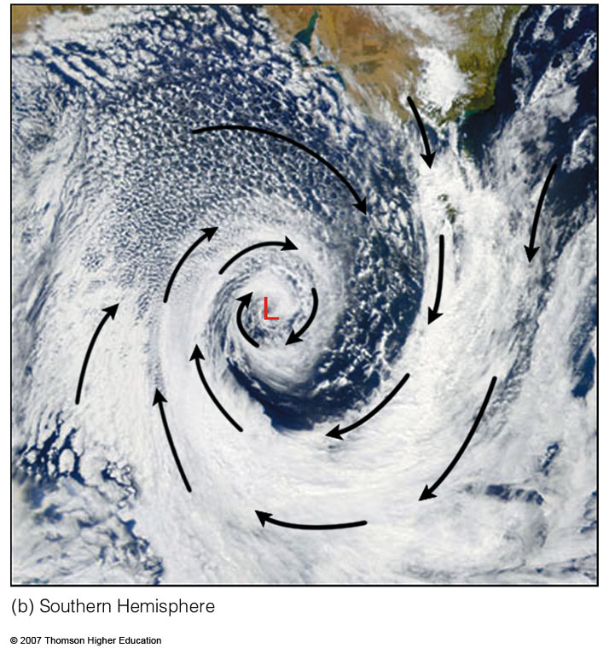
Notes:
Figure 8.27
Clouds and related wind-flow patterns (black arrows) around low-pressure areas.
(b) In the Southern Hemisphere, winds blow clockwise around an area of low pressure.

Slide 43
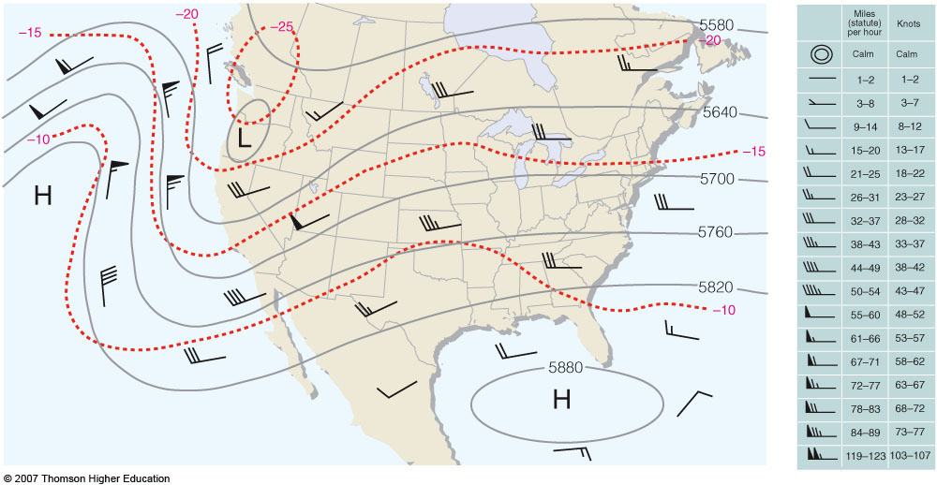
500 mb
Notes:
Figure 8.28
An upper-level 500-mb map showing wind direction, as indicated by lines that parallel the wind. Wind speeds are indicated by barbs and flags. (See the blue insert.) Solid gray lines are contours in meters above sea level. Dashed red lines are isotherms in °C.

Slide 44
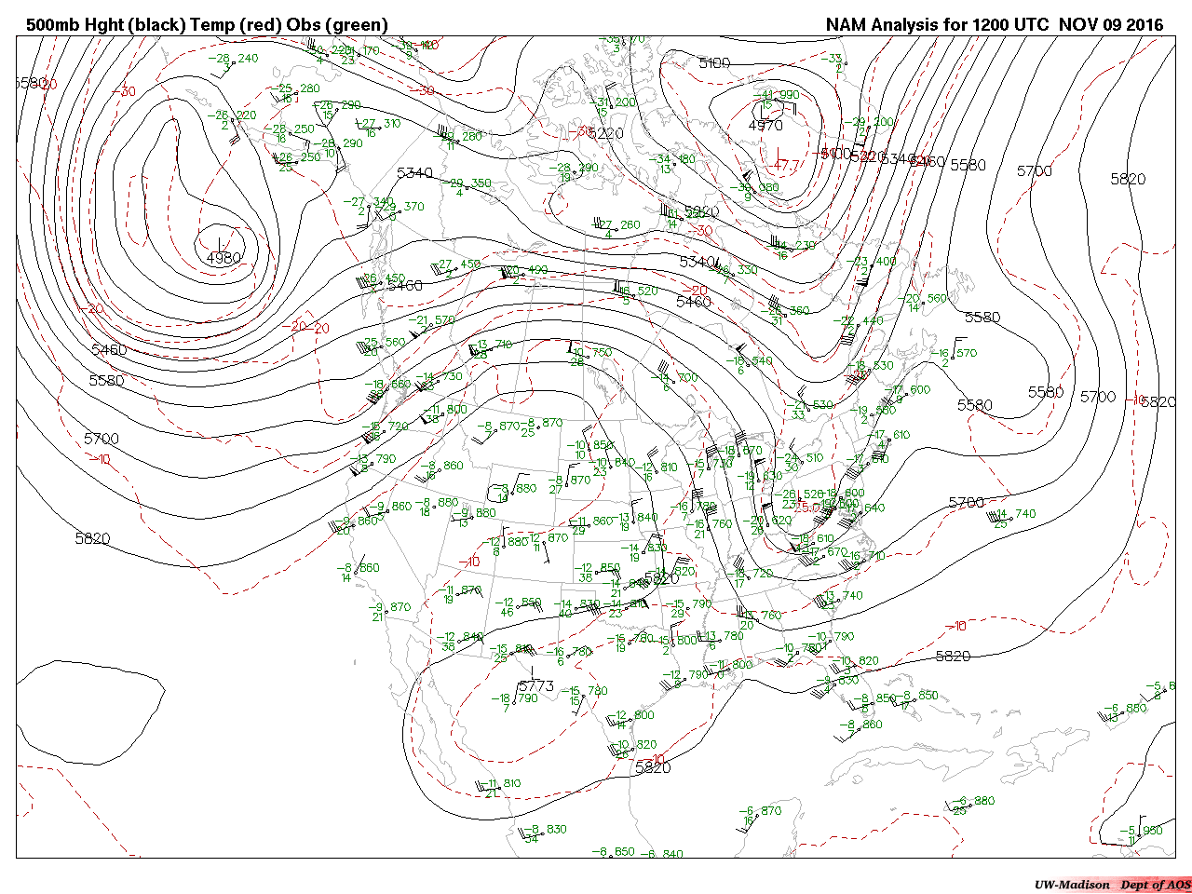
500 mb

Slide 45
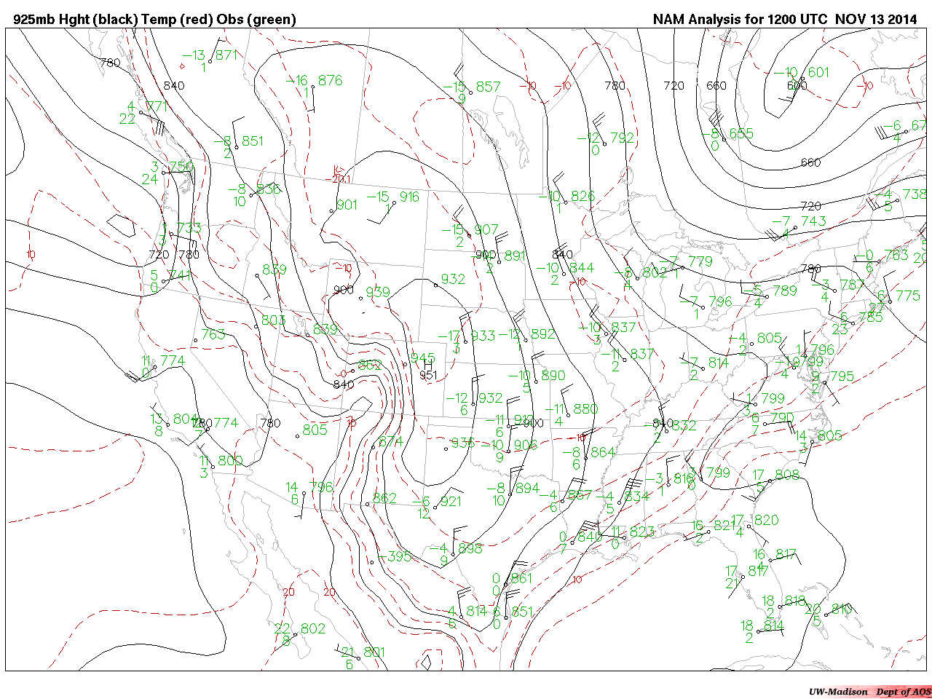
925 mb

Slide 46
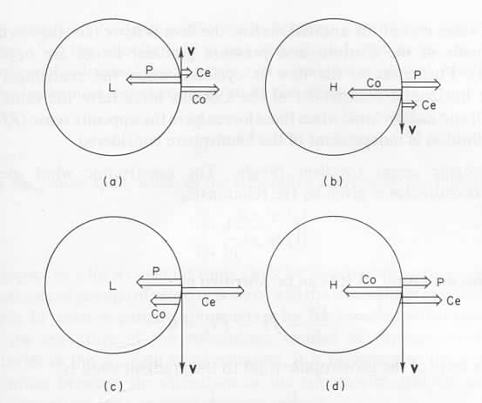
Gradient Wind
centrifugal
pressure
gradient
Coriolis
Regular Low
Regular High
Antibaric Low
Anomalous High

Slide 47
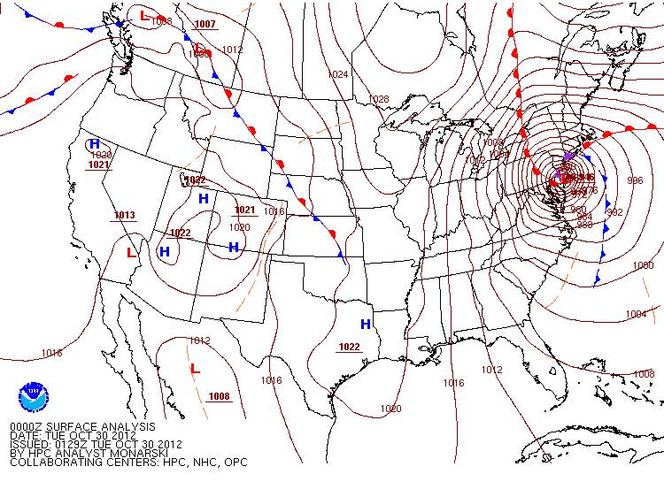
“Anticyclonic Limit”

Slide 48
“Anticyclonic Limit”
Regular High
V²/R
fV
if PGF increases, V will increase
as V increases, centrifugal increases more than Coriolis
only way for centrifugal not to overwhelm Coriolis is a large R
Therefore, anticyclones have weak winds!

Slide 49
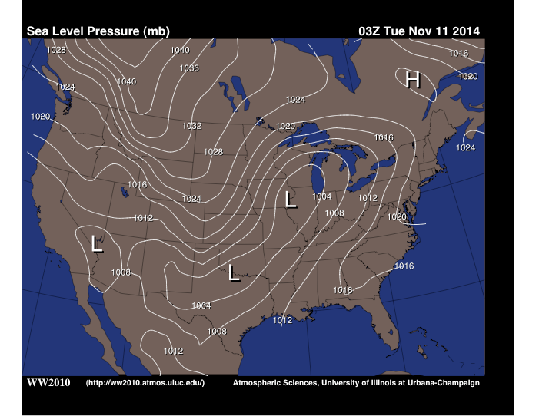

GEOSTROPHIC FLOW
COR
PGF
V_{gs}
V_{gs}
PGF
COR

Slide 50
GRADIENT FLOW
V_{gr}
COR
CENTRIFUGAL
PGF
(N: 195–199; A: 215–220)

Slide 51
Earth
Vorticity
Notes:
Figure 12.20
Due to the rotation of the earth, the rate of spin of observers about their vertical axes increases from zero at the equator to a maximum at the poles.

Slide 52
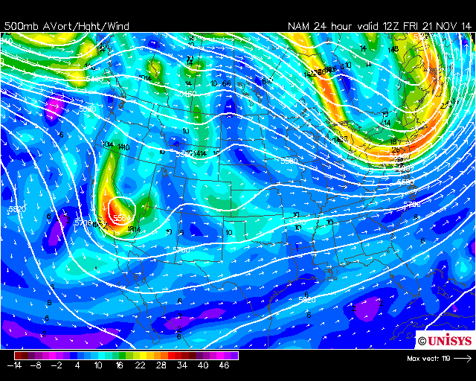
500 mb
absolute
vorticity

Slide 53
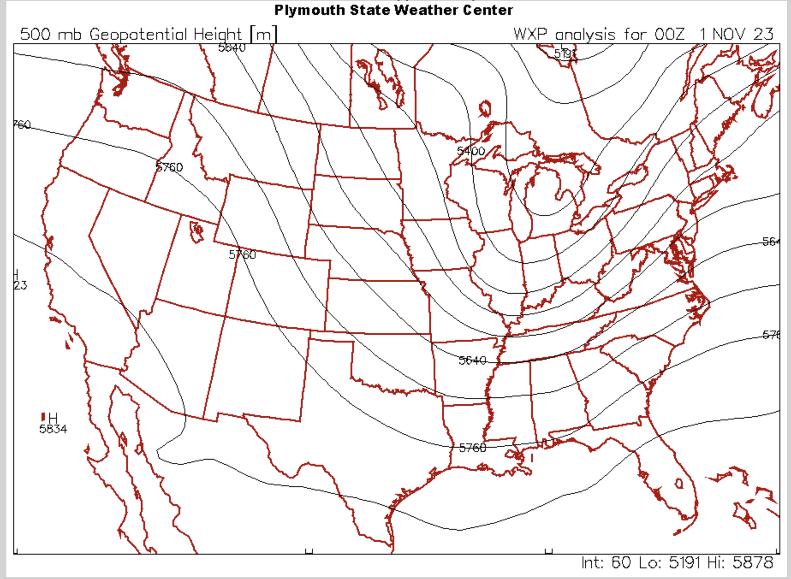
A
E
D
B
C

Slide 54
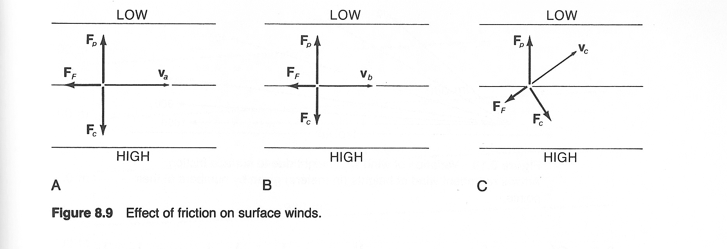
Surface Wind with Friction
PGF
PGF
PGF
Friction
Friction
COR
COR
Friction
COR
If wind is
geostrophic
and friction is
introduced...
Subsequent balance
will be cross-isobaric
flow toward low
pressure.
...speed will
slow, as
will Coriolis.

Slide 55
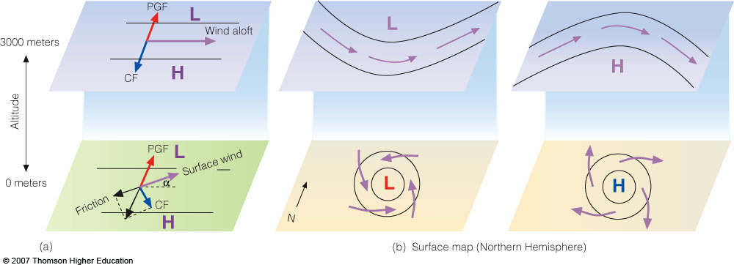

Northern Hemisphere
Wind Aloft (Above Boundary Layer)
Surface Wind
Notes:
Figure 8.29
The effect of surface friction is to slow down the wind so that, near the ground, the wind crosses the isobars and blows toward lower pressure (a). This phenomenon at the surface (b) produces an inflow of air around a low and an outflow around a high. Aloft, the winds blow parallel to the lines.

Slide 56
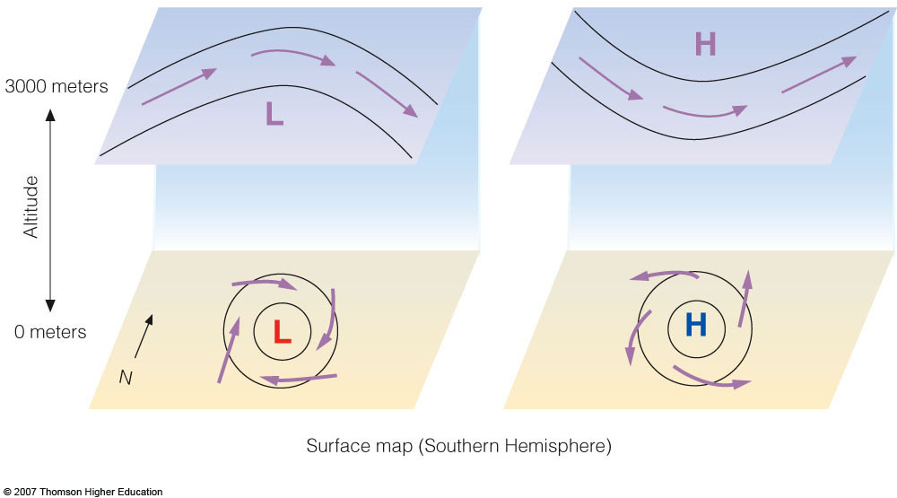
Southern Hemisphere
Wind Aloft (Above Boundary Layer)
Surface Wind
Notes:
Figure 8.30
Winds around areas of low and high pressure in the Southern Hemisphere. Notice that at the surface winds blow clockwise and inward around the low (L); counterclockwise and outward around the high (H).

Slide 57

Notes:
Figure 8.31
Surface weather map showing isobars and winds on a day in December in South America.

Slide 58

Effect of Friction on Boundary Layer Wind: Ekman Spiral
increasing friction
geostrophic
As friction increases, wind slows and becomes more cross-isobaric.
(N: 199–204; A: 218–219, 337–342)

Slide 59


1000–500 mb Thickness

Slide 60


Slide 61

Thickness (dashed lines, in dm)
540 dm
546 dm
Sea-level pressure (solid black lines, in mb)

Slide 62

Warm Advection
No (weak) Advection
Cold Advection

Slide 63

mod. cold
mod. warm
weak cold
none
Solid cyan = sea-level pressure; dashed yellow = 1000–500 mb thickness

Slide 64

A
B

Slide 65

heights
heights
heights
Notes:
Figure 6
Upper-level chart that extends over the Northern and Southern Hemispheres. Solid gray lines on the chart are isobars.

Slide 66

250 mb Chart

Slide 67

Northern
Hemisphere
250 mb Chart
Jet stream
black lines =
250 mb heights
colors =
wind speed

Slide 68

Northern
Hemisphere
500 mb Chart
High heights
Warm air
High heights
Warm air
colors =
500 mb heights
Circumpolar Vortex
Circumpolar Votex
Circumpolar Vortex
Low heights
Cold air
High heights
Warm air
High heights
Warm air

Slide 69

Convergence & Divergence
Both of these surface systems would dissipate.

Slide 70


Convergence & Divergence
Mass convergence/divergence aloft produces surface anticyclones/cyclones.

Slide 71


Cold- vs. Warm-core Systems
dz

Slide 72
Cold- vs. Warm-core Systems
Warm-core lows (hurricanes)
and cold-core highs (polar
anticyclones) are shallow systems—
they weaken with height. They are
vertically stacked.
Warm-core highs (subtropical anticyclones) and cold-core lows (polar and mid-latitude
storms) are deep systems—they strengthen with height. They must be vertically
tilted to survive.

Slide 73

Hurricane: A Warm-core Low
Vertically stacked:
divergence aloft is above surface convergence.
Notes:
FIGURE 15.9 The top diagram shows an intensifying
tropical cyclone. As latent heat is released
inside the clouds, the warming of the air aloft creates
an area of high pressure, which induces air to
move outward, away from the high. The warming of
the air lowers the air density, which in turn lowers
the surface air pressure. As surface winds rush in
toward the surface low, they extract sensible heat,
latent heat, and moisture from the warm ocean. As
the warm, moist air flows in toward the center of the
storm, it is swept upward into the clouds of the eyewall.
As warming continues, surface pressure lowers
even more, the storm intensifi es, and the winds blow
even faster. This situation increases the transfer of
heat and moisture from the ocean surface. The middle
diagram illustrates how the air pressure drops
rapidly as you approach the eye of the storm. The
lower diagram shows how surface winds normally
reach maximum strength in the region of the
eyewall.

Slide 74


MEAN 700 MB
H
L
L
L
H
L
L
L
H
H
H
H
H
H
H
H
January
L = surface systems; L = aloft
July
(A: 326–328)

Slide 75

Latitude Zones
Notes:
Figure 10.1
Diagram (b) shows the names that apply to the different regions of the world and their approximate latitudes.

Slide 76

Non-rotating
homogeneous
sphere
Notes:
Figure 10.1
Diagram (a) shows the general circulation of air on a nonrotating earth uniformly covered with water and with the sun directly above the equator. (Vertical air motions are highly exaggerated in the vertical.)

Slide 77

Angular Momentum
angular momentum =
M x V x R
M = mass from center
of rotation
V = velocity
R = radius from axis
of rotation
In atmosphere, angular momentum is conserved,
so MxVxR = constant.

Slide 78

Angular Momentum
As equatorial air moves
poleward, to conserve
ang. mtm., speed must
increase. This produces
a subtropical jet stream.
At higher latitudes,
speeds cannot be
sustained, so Hadley
Cells are confined to
the tropics and
subtropics.

Slide 79

Weak
Rotating,
homogeneous
sphere
Notes:
Figure 10.2
The idealized wind and surface-pressure distribution over a uniformly water-covered rotating earth.

Slide 80


More Accurate Characterization of General Circulation*
(*This is Southern Hemisphere but Northern Hemisphere circulation is similar)

Slide 81

Zonal
Precipitation

Slide 82

January Average Surface Pressure
Notes:
Figure 10.3
Average sea-level pressure distribution and surface wind-flow patterns for January (a) and for July (b). The heavy dashed line represents the position of the ITCZ.

Slide 83

July Average Surface Pressure
Notes:
Figure 10.3
Average sea-level pressure distribution and surface wind-flow patterns for January (a) and for July (b). The heavy dashed line represents the position of the ITCZ.

Slide 84

“General Circulation” Features on a Weather Map
Notes:
Figure 10.4
A winter weather map depicting the main features of the general circulation over North America. Notice that the Canadian high, polar front, and subpolar lows have all moved southward into the United States, and that the prevailing westerlies exist south of the polar front. The arrows on the map illustrate wind direction.

Slide 85

Dishpan Experiments
Notes:
Figure 2
(a) A “dishpan” with a hot “equator” and a cold “pole” rotating at a speed corresponding to that of the earth (b) produces troughs, ridges, and eddies, which appear (when viewed from above) very similar to the patterns we see on an upper-level chart.

Slide 86

Rossby Waves form along temperature gradient
Notes:
Figure 3
The circulation of the air aloft is in the form of waves—troughs and ridges—that encircle the globe.

Slide 87

Rossby
Waves
Notes:
Figure 12.8
A 500-mb map of the Northern Hemisphere from a polar perspective shows five longwaves encircling the globe. Note that the wavelength of wave number 3 is as great as the width of the United States. Solid lines are contours. Dashed lines show the position of longwave troughs.

Slide 88

H
H
H
H
Ocean Currents
Notes:
FIGURE 10.14 Average position and extent of the major surface ocean currents. Cold currents are shown
in blue; warm currents are shown in red.

Slide 89

Average
sea-surface
temp. (°C)
(SST)
SST
variation
from latitude
average

Slide 90


barotropic
baroclinic
barotropic
(N: 208–239; A: 262–291)

Slide 91

Ai
Air Masses and Fronts on a Surface Map
Notes:
Figure 11.12
A weather map showing surface-pressure systems, air masses, fronts, and isobars (in millibars) as solid gray lines. Large arrows in color show air flow. (Green-shaded area represents precipitation.)

Slide 92


Bergeron Air Mass Classification

Slide 93

North American Air Masses
Notes:
Figure 11.2
Air mass source regions and their paths.

Slide 94

Vertical Structure of Source Region Air Masses

Slide 95

Lake Effect Snow
Notes:
Figure 1
The formation of lake-effect snows. Cold, dry air crossing the lake gains moisture and warmth from the water. The more buoyant air now rises, forming clouds that deposit large quantities of snow on the lake’s leeward shores.

Slide 96

Lake Effect Snow Regions
Notes:
Figure 2
Areas shaded purple show regions that experience heavy lake-effect snows.

Slide 97

Air Mass
Modification
(N: 240–248;
A: 292–304)
Notes:
Figure 11.4
Typical vertical temperature profile over land for a summer and a winter cP air mass.

Slide 98


Slide 99
air mass
Warm air mass

Slide 100
Fronts
Notes:
Figure 11.12
A weather map showing surface-pressure systems, air masses, fronts, and isobars (in millibars) as solid gray lines. Large arrows in color show air flow. (Green-shaded area represents precipitation.)

Slide 101


Vertical Temperature Structure of a Frontal Zone
warm
cold
Fronts are stable in the vertical dimension. The cold, denser air is below the warm, less dense air.

Slide 102

Norwegian Cyclone Model
Notes:
Figure 12.1
The idealized life cycle of a midlatitude cyclone (a through f) in the Northern Hemisphere based on the polar front theory. As the life cycle progresses, the system moves eastward in a dynamic fashion. The small arrow next to each L shows the direction of storm movement.

Slide 103

Norwegian Cyclone Model

Slide 104

Vertical Structure of
Lows and Highs
Notes:
Figure 12.24
A region of high absolute vorticity—a vorticity maximum—on its downwind (eastern) side has diverging air aloft, converging surface air, and ascending air motions. On its upwind (western) side, there is converging air aloft, diverging surface air, and descending air motions.

Slide 105

Norwegian Cyclone Model Evolution over Time (3D)
Deepening
trough
Cut-off
low
Cold advection
Warm advection
Open wave
cyclone
Closed wave
(occlusion)
Notes:
Figure 12.10
An idealized view of the formation of a mid-latitude cyclone during baroclinic instability. (a) A longwave trough at 500 mb lies parallel to and directly above the surface stationary front. (b) A shortwave (not shown) disturbs the flow aloft, initiating temperature advection. The upper trough intensifies and provides the necessary vertical motions (as shown by vertical arrows) for the development of the surface cyclone. (c) The surface storm occludes, and without upper level divergence to compensate for surface converging air, the storm system dissipates.

Slide 106
Cyclogenesis (and Anticyclogenesis)

Slide 107

Cyclogenesis
and
Anticyclogenesis

Slide 108

Rossby Waves
Notes:
Figure 12.9
(a) Upper-air chart showing a longwave with three shortwaves (heavy dashed lines) embedded in the flow. (b) Twenty-four hours later the shortwaves have moved rapidly around the longwave. Notice that the shortwaves labeled 1 and 3 tend to deepen the longwave trough, while shortwave 2 has weakened as it moves into a ridge. Notice also that as the longwave deepens in diagram (b), its length actually shortens. Dashed lines are isotherms in °C. Solid lines are contours. Blue arrows indicate cold advection and red arrows warm advection.

Slide 109

Curvature Vorticity
Notes:
Figure 12.21
In a region where the contour lines curve, air moving through a ridge spins clockwise and gains anticyclonic relative vorticity. In the trough, the air spins counterclockwise and gains cyclonic relative vorticity.

Slide 110

Absolute Vorticity (Relative + Earth)
Northern Hemisphere
Notes:
Figure 12.23
As an air parcel moves through the wave pattern from position 1 to position 3, its absolute vorticity increases with time. In this region (shaded purple), we normally experience an area of upper-level converging air. As an air parcel moves from position 3 to position 5, its absolute vorticity decreases with time. In this region (shaded green), we normally experience an area of upper-level diverging air.

Slide 111


Convergence/Divergence, Vorticity, and Vertical Motion
Divergence aloft
Surface convergence
Increasing positive vorticity
Rising air (vertical stretching)
Spin-up
Notes:
Figure 12.19
When upper-level divergence moves over an area of weak cyclonic circulation, the cyclonic circulation increases (that is, it becomes more positive), and air is forced upward.

Slide 112

500 mb Heights & Absolute Vorticity
T
T
R

Slide 113

500 mb Heights &
Absolute Vorticity
L
L
H
Surface Pressure &
1000–500 mb Thickness

Slide 114

Cyclone Family
Notes:
Figure 12.2
A series of wave cyclones (a “family” of cyclones) forming along the polar front.

Slide 115

Notes:
Figure 12.3
Visible satellite image of the north Pacific with two mid-latitude cyclones in different stages of development during February, 2000.

Slide 116

Jet Stream
Westerly
Jet Stream
Barotropic
Barotropic

Slide 117

Jet Stream Structure

Slide 118


MEAN 300 MB
January
July

Slide 119

Average January 500 mb Map
Notes:
Figure 10.8
Average 500-mb chart for the month of January (a) and for July (b). Solid lines are contour lines in meters above sea level. Dashed lines are isotherms in °C. Arrowheads illustrate wind direction.

Slide 120

Average July 500 mb Map
Notes:
Figure 10.8
Average 500-mb chart for the month of January (a) and for July (b). Solid lines are contour lines in meters above sea level. Dashed lines are isotherms in °C. Arrowheads illustrate wind direction.

Slide 121

Jet Streams and the General Circulation
Notes:
Figure 10.9
Average position of the polar jet stream and the subtropical jet stream, with respect to a model of the general circulation in winter. Both jet streams are flowing from west to east.

Slide 122

Northern
Hemisphere
Jet Streams
Notes:
Figure 10.10
A jet stream is a swiftly flowing current of air that moves in a wavy west-to-east direction. The figure shows the position of the polar jet stream and subtropical jet stream in winter. Although jet streams are shown as one continuous river of air, in reality they are discontinuous, with their position varying from one day to the next.

Slide 123


JET STREAM CORE
Note: key differs between maps
(A: 320–345)

Slide 124
Cold Fronts
Notes:
Figure 11.12
A weather map showing surface-pressure systems, air masses, fronts, and isobars (in millibars) as solid gray lines. Large arrows in color show air flow. (Green-shaded area represents precipitation.)

Slide 125

Cold Front
(map view)
Notes:
Figure 11.13
A closer look at the surface weather associated with the cold front situated in the southeastern United States in Fig. 11.12. (Gray lines are isobars. Dark green-shaded area represents rain; white-shaded area represents snow.)

Slide 126

Notes:
Figure 11.14
A Doppler radar image showing precipitation patterns along a cold front similar to the cold front in Fig. 11.13. Green represents light-to-moderate precipitation; yellow represents heavier precipitation; and red the most likely areas for thunderstorms.

Slide 127

Cold Front (vertical cross-section)
Notes:
Figure 11.15
A vertical view of the weather across the cold front in Fig. 11.13 along the line X–X’.

Slide 128

“Back Door” Cold Front
Notes:
Figure 11.17
A “back door” cold front moving into New England during the spring. Notice that, behind the front, the weather is cold and damp with drizzle, while to the south, ahead of the front, the weather is partly cloudy and warm.

Slide 129



Slide 130

Warm Front (map view)
Notes:
Figure 11.18
Surface weather associated with a typical warm front. (Green-shaded area represents rain, pink-shaded area represents freezing rain and sleet; white-shaded area represents snow.)

Slide 131

Warm Front (vertical cross-section)
Notes:
Figure 11.19
Vertical view of clouds, precipitation, and winds across the warm front in Fig. 11.18 along the line P–P’.

Slide 132

Warm Front (vertical cross-section)
Notes:
Figure 11.19
Vertical view of clouds, precipitation, and winds across the warm front in Fig. 11.18 along the line P–P’.

Slide 133


Slide 134

Dryline
cT
mT
Notes:
Figure 4
A dryline moves across Texas and Oklahoma during the late afternoon in May.

Slide 135

Occluded Front Formation (vertical cross-section)
Prior to occlusion
Notes:
Figure 11.20
The formation of a cold-occluded front. The faster-moving cold front (a) catches up to the slower-moving warm front (b) and forces it to rise off the ground (c). (Green-shaded area represents precipitation.)

Slide 136

Occluded Front Formation (vertical cross-section)
Initial occlusion
Notes:
Figure 11.20
The formation of a cold-occluded front. The faster-moving cold front (a) catches up to the slower-moving warm front (b) and forces it to rise off the ground (c). (Green-shaded area represents precipitation.)

Slide 137

Occluded Front Formation (vertical cross-section)
Established occlusion
Notes:
Figure 11.20
The formation of a cold-occluded front. The faster-moving cold front (a) catches up to the slower-moving warm front (b) and forces it to rise off the ground (c). (Green-shaded area represents precipitation.)

Slide 138

Occluded Front
“cold occlusion”
Notes:
Figure 11.20
The formation of a cold-occluded front. The faster-moving cold front (a) catches up to the slower-moving warm front (b) and forces it to rise off the ground (c). (Green-shaded area represents precipitation.)

Slide 139



Occluded Front
“warm occlusion”
Notes:
Figure 11.21
The formation of a warm-type occluded front. The faster-moving cold front in (a) overtakes the slower-moving warm front in (b). The lighter air behind the cold front rises up and over the denser air ahead of the warm front. Diagram (c) shows a surface map of the situation.

Slide 140


Slide 141

Clouds
and
Fronts
(N: 249–273;
A: 305–323)
Notes:
Figure 11.22
A visible satellite image showing a mid-latitude cyclonic storm with its weather fronts over the Atlantic Ocean during March, 2005. Superimposed on the photo is the position of the surface cold front, warm front, and occluded front. Precipitation symbols indicate where precipitation is reaching the surface.

