Slide 1
THERMODYNAMICS
AND
MOISTURE

Slide 2
Atmospheric State Variables
Pressure (p)
Volume (V)
Mass (m)
Density (ρ)
Temperature (T)
Humidity (various)

Slide 3
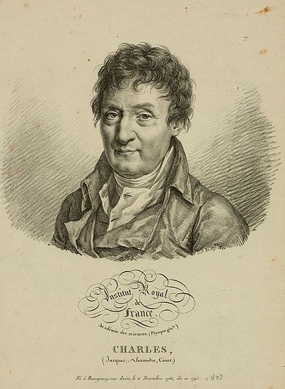
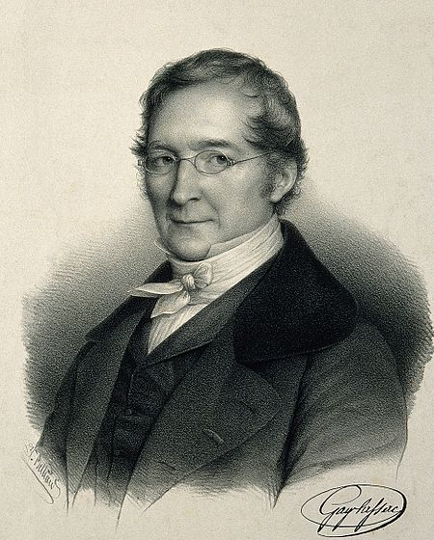
CHARLES’ LAW
Jacques Charles
1746–1823
Joseph Louis Gay-Lussac
1778–1850
Relates air temperature to volume (at constant pressure)

Slide 4
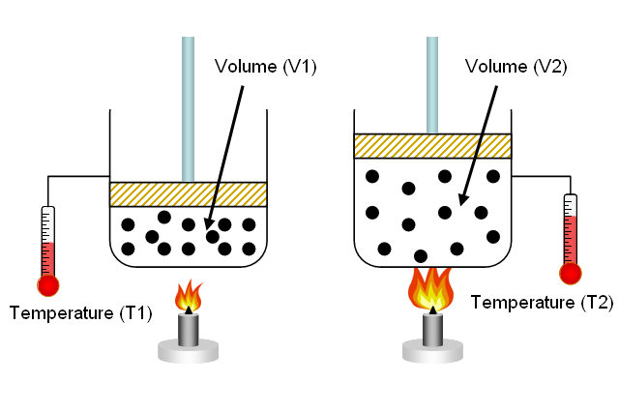
CHARLES’ LAW
Warm air occupies a greater volume (warm air expands)

Slide 5
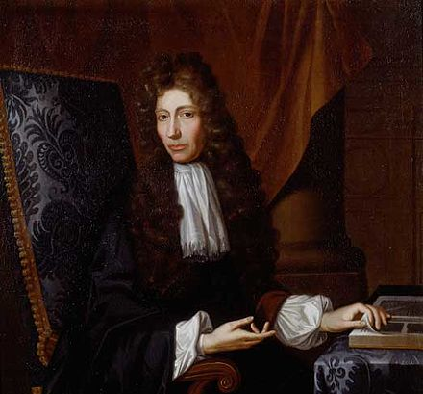
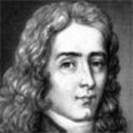
BOYLES’ LAW
Robert Boyle
1627–1691
Edme Mariotte
1620–1684
Relates pressure to volume (at constant temperature)

Slide 6
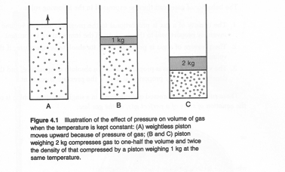
BOYLES’ LAW
α is ‘specific volume’ (inverse of density)
Temperature is constant

Slide 7
IDEAL GAS LAW (EQUATION OF STATE)
R is called the specific gas constant. Its value depends on the molecular weight of the gas, so it varies from gas to gas.

Slide 8
Gas Constant for Dry Air
M_{d} = 28.97 g⋅mol⁻¹

Slide 9
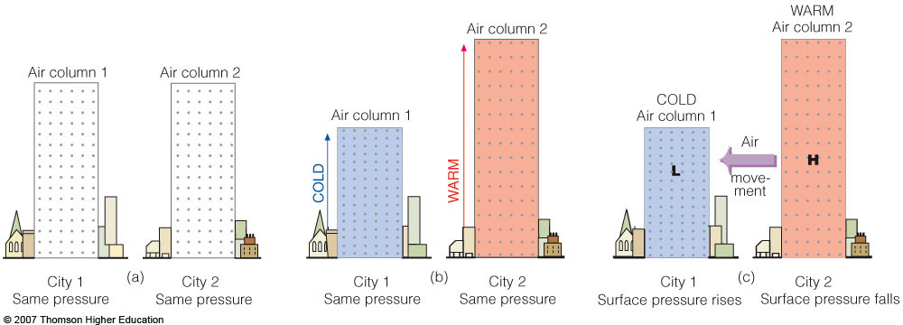
IDEAL GAS LAW (EQUATION OF STATE)
Temperature
gradients can
generate pressure
gradients and wind
Cold air is
denser than
warm air
Notes:
Figure 8.2
It takes a shorter column of cold air to exert the same pressure as a taller column of warm air. Because of this fact, aloft, cold air is associated with low pressure and warm air with high pressure. The pressure differences aloft create a force that causes the air to move from a region of higher pressure toward a region of lower pressure. The removal of air from column 2 causes its surface pressure to drop, whereas the addition of air into column 1 causes its surface pressure to rise. (The difference in height between the two columns is greatly exaggerated.)

Slide 10
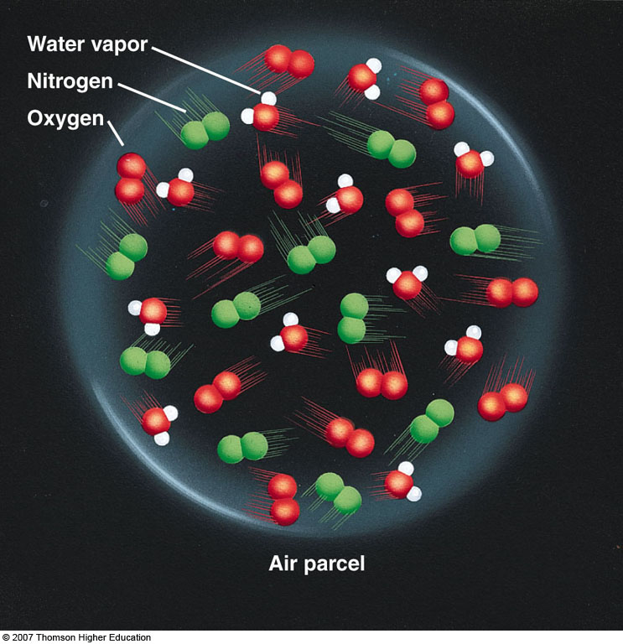
AIR PARCEL
Hypothetical
No mixing of external
air with air inside of
parcel
Large-scale atmosphere
often behaves as a
collection of parcels
Notes:
Figure 4.6
The water vapor content (humidity) inside this air parcel can be expressed in a number of ways.

Slide 11
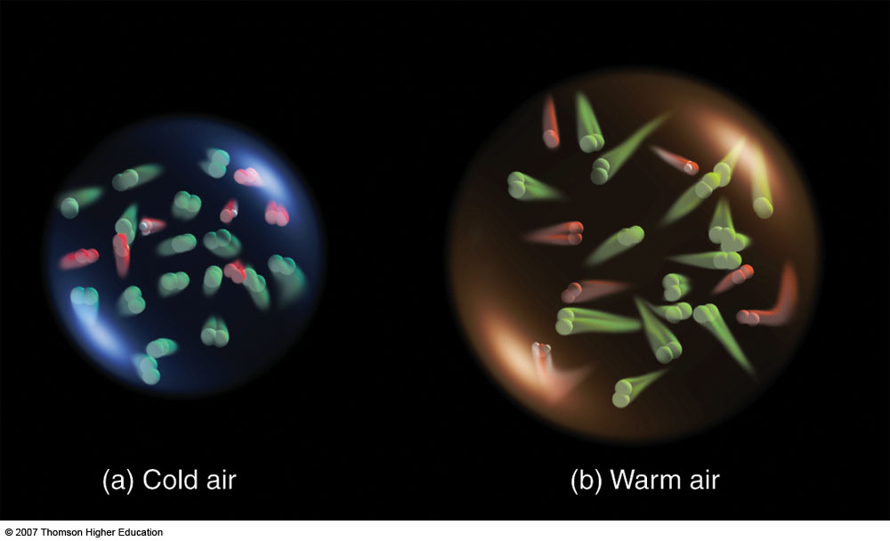
Cold air is denser than warm air at constant pressure.
Notes:
Figure 2.1
Air temperature is a measure of the average speed of the molecules. In the cold volume of air the molecules move more slowly and crowd closer together. In the warm volume, they move faster and farther apart.

Slide 12
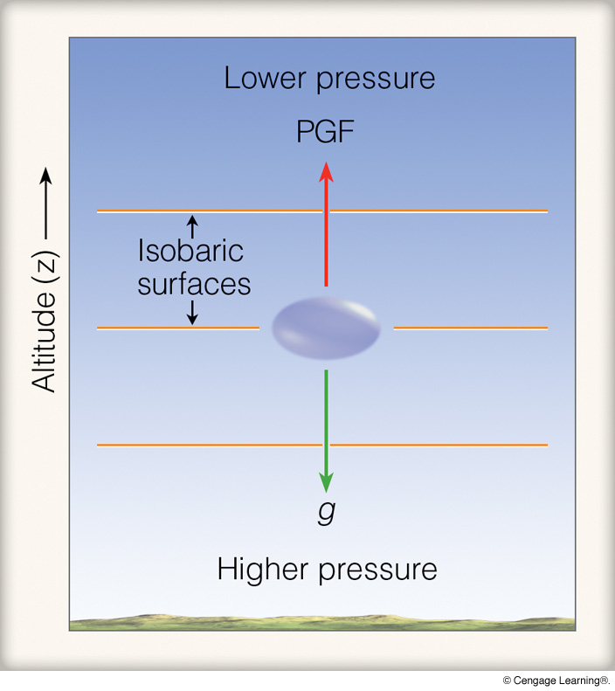
HYDROSTATIC BALANCE
so

Slide 13
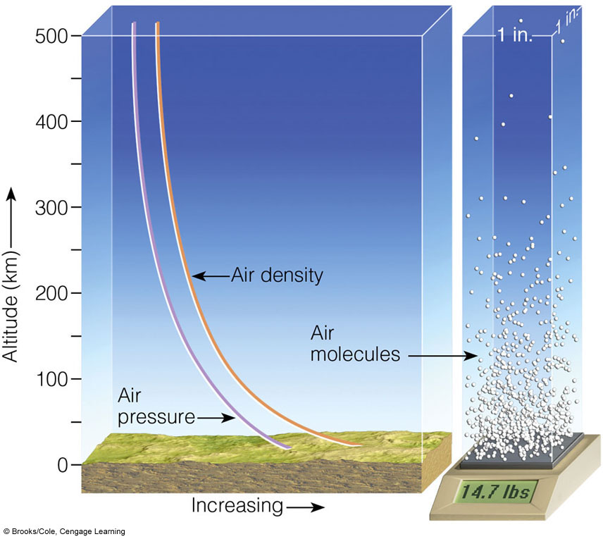
HYDROSTATIC BALANCE

Slide 14
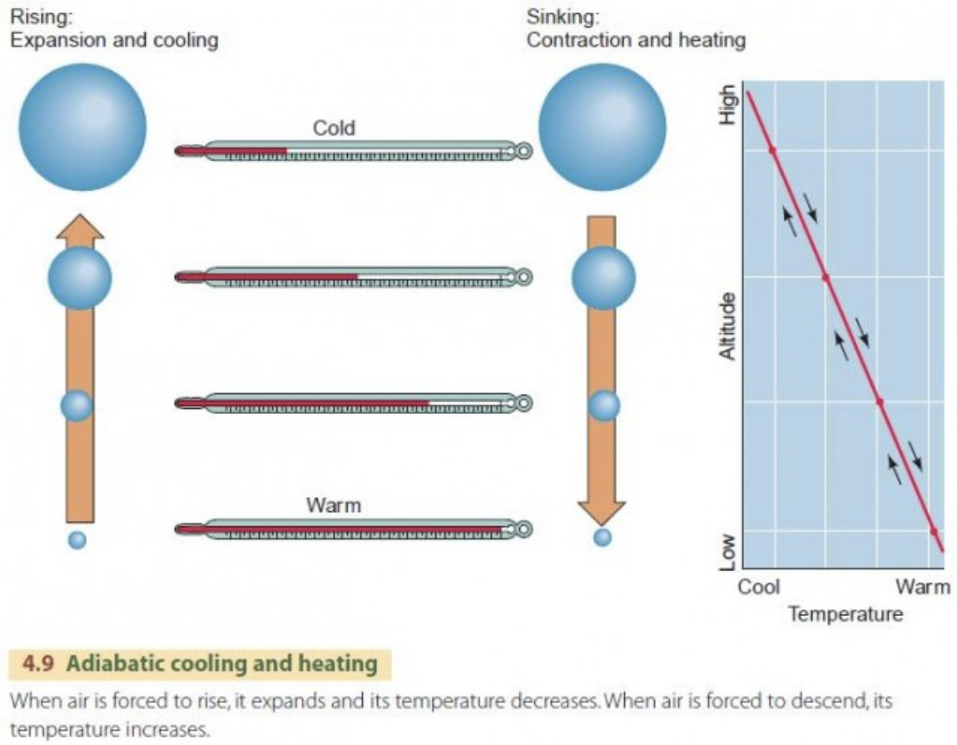
Low
High

Slide 15
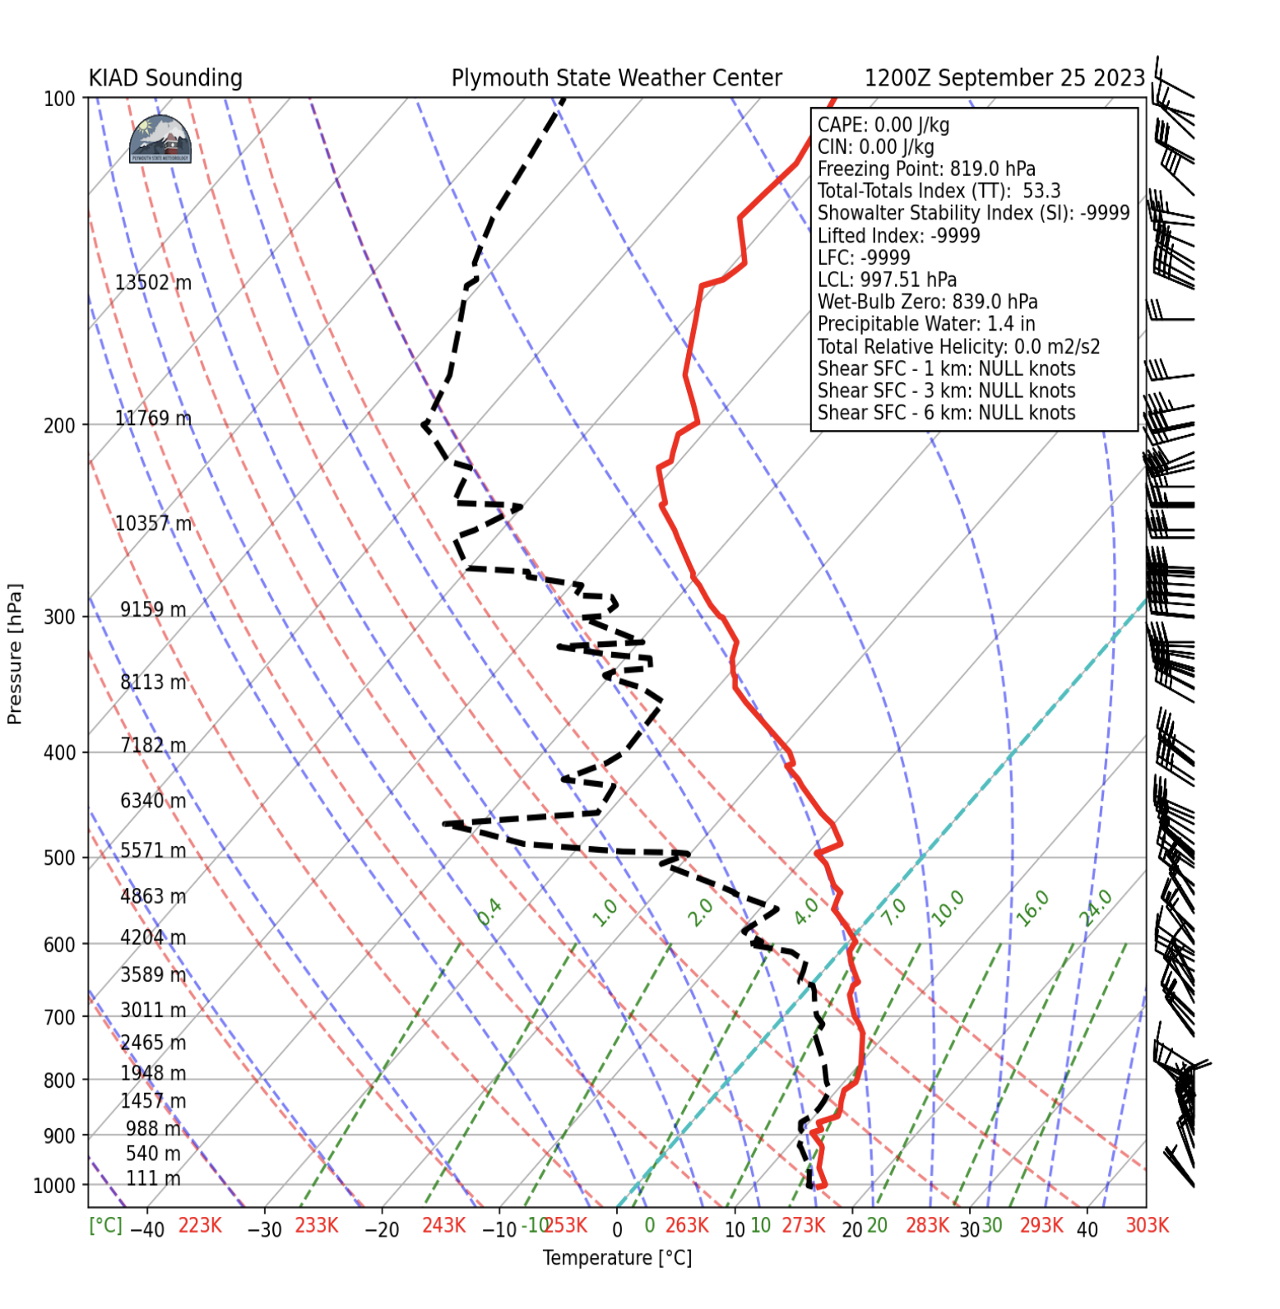
Example Skew T Log P (Washington, DC; 12 Z)

Slide 16
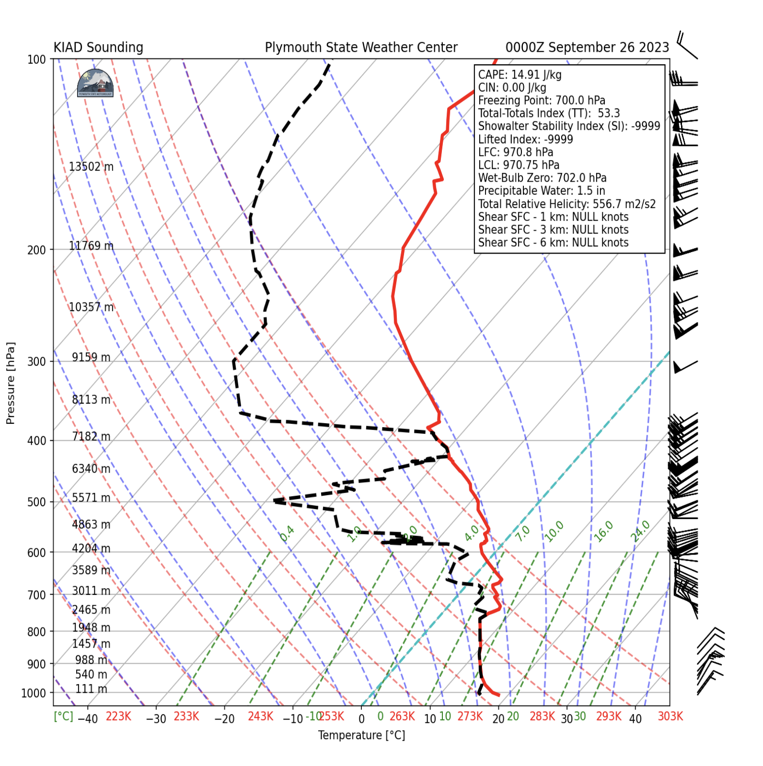
Example Skew T Log P (Washington, DC; 00 Z)

Slide 17
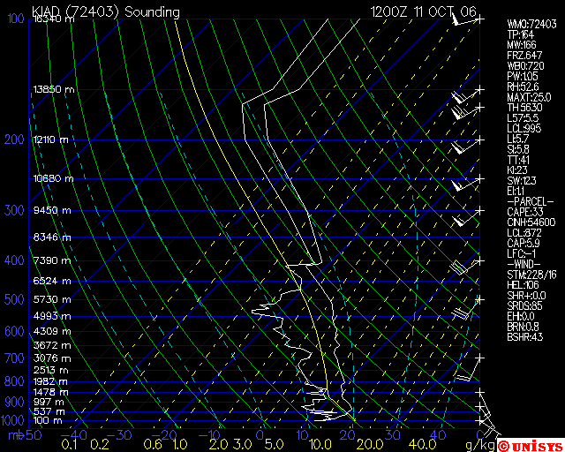
Isobars— Lines of equal pressure. They run horizontally from left to right and are labeled on the left side of the diagram. Pressure is given in increments of 100 mb and ranges from 1050 to 100 mb. Notice the spacing between isobars increases in the vertical (thus the name Log P).

Slide 18
Isotherms— Lines of equal temperature. They run from the southwest to the northeast (thus the name Skew T) across the diagram and are SOLID. Increment are given for every 10 degrees in units of Celsius. They are labeled at the bottom of the diagram.

Slide 19
Environmental sounding— Same as the actual measured temperatures in the atmosphere. This is the jagged line running from bottom to top on the diagram. This line is always to the right of the dew point plot.

Slide 20
Dew point plot— This is the jagged line running from bottom to top. It is the vertical plot of dew point temperature. This line is always to the left of the environmental sounding.

Slide 21
Dry adiabatic lapse rate— Rate of cooling (9.8 degrees Celsius per kilometer) of a rising unsaturated parcel of air. These lines slope from the bottom right to the top left and are SOLID. Lines gradually arc to the top with height.

Slide 22
Low
High

Slide 23
Wind barbs— Wind speed (knots) and direction at various pressure levels. Plotted on the right of the diagram.

Slide 24
Dalton’s Law of Partial Pressures
For a mixture of dry air with water vapor,
P = P_{d}+P_{v} = P_{d} + e where e = vapor pressure over water
i.e., P_{v} = e = ρ_{v} R_{v} T
(R_{v}= 461 Jkg⁻¹K^{–1)}

Slide 25
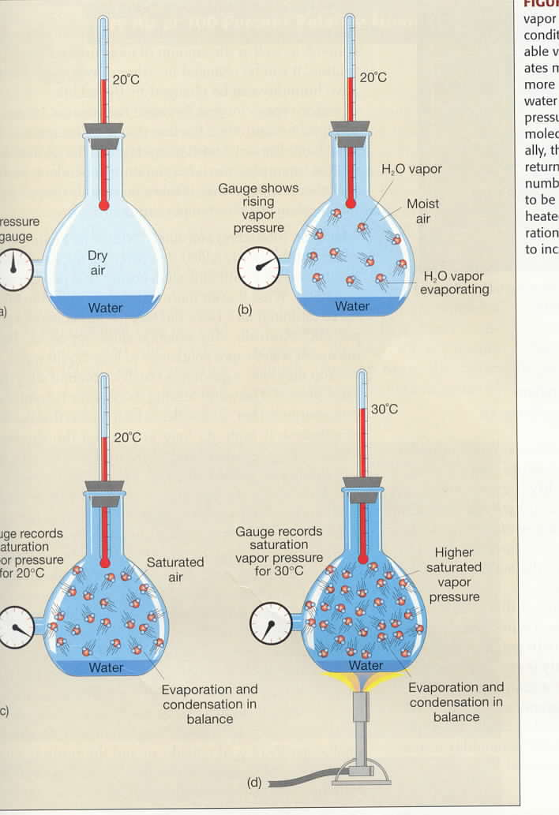
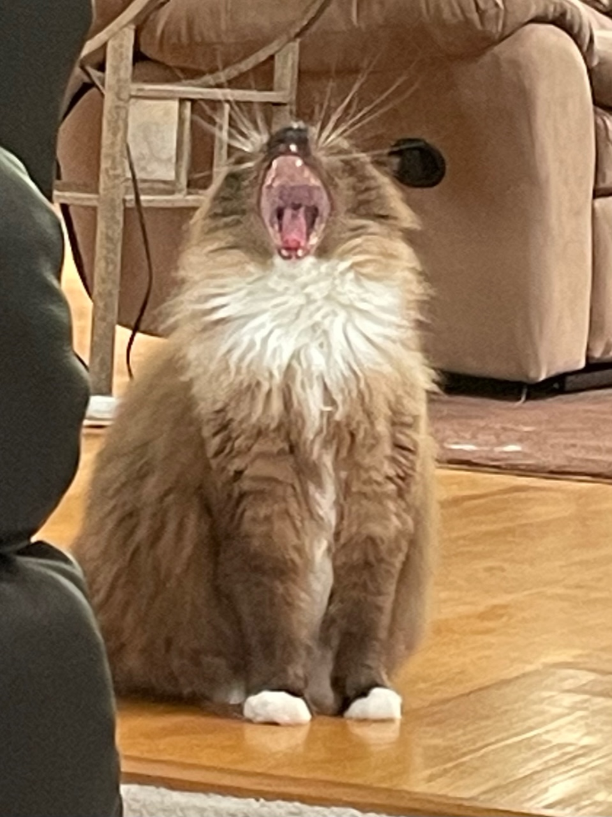
Vapor Pressure
and
Temperature
e = vapor pressure
e_{s} = saturation
vapor pressure
e_{s} = e_{s}(T)
(e_{s} is only a function
of T)

Slide 26
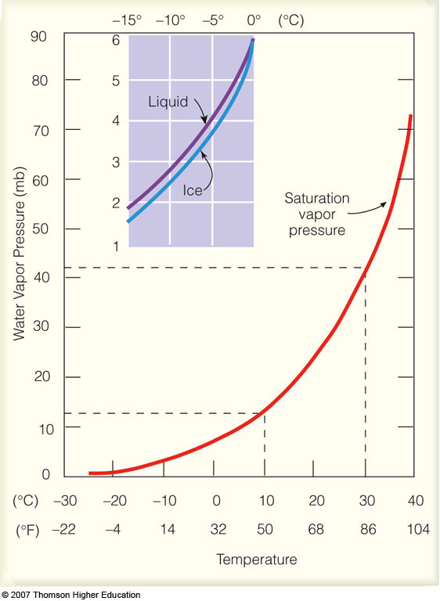
Saturation
Vapor Pressure
and
Temperature
e_{s liquid} >= e_{s ice}
e_{s} = e_{s}(T)
supercooled
water
Notes:
Figure 4.10
Saturation vapor pressure increases with increasing temperature. At a temperature of 10°C, the saturation vapor pressure is about 12 mb, whereas at 30°C it is about 42 mb. The insert illustrates that the saturation vapor pressure over water is greater than the saturation vapor pressure over ice.

Slide 27
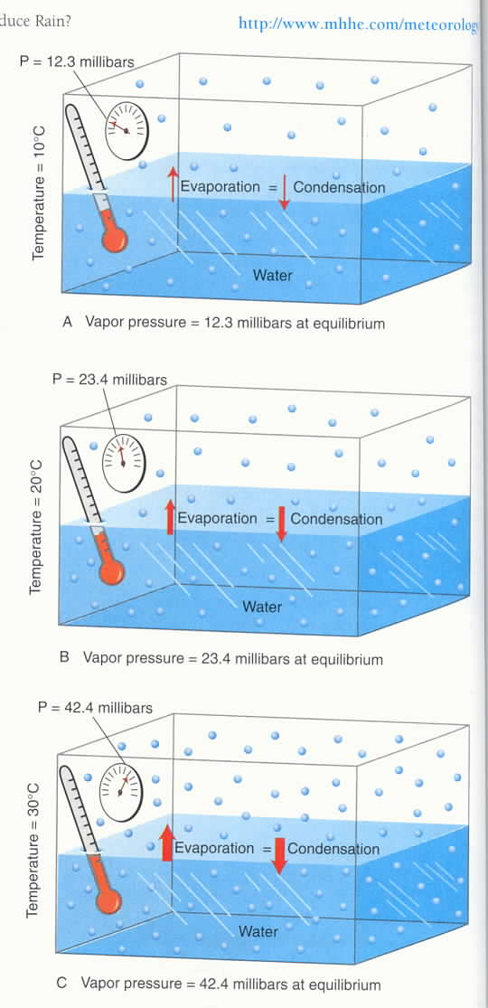
Saturation Vapor Pressure
and Temperature
e_{s} = 12.3 mb; T = 10°C
e_{s} = 23.4 mb; T = 20°C
e_{s} = 42.4 mb; T = 30°C

Slide 28
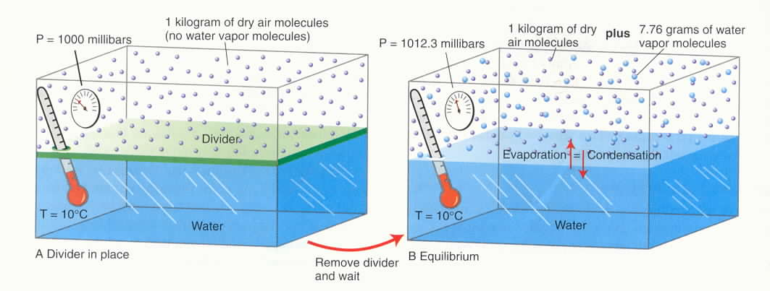
Air does not “hold” water
All gases co-exist in the same volume

Slide 29
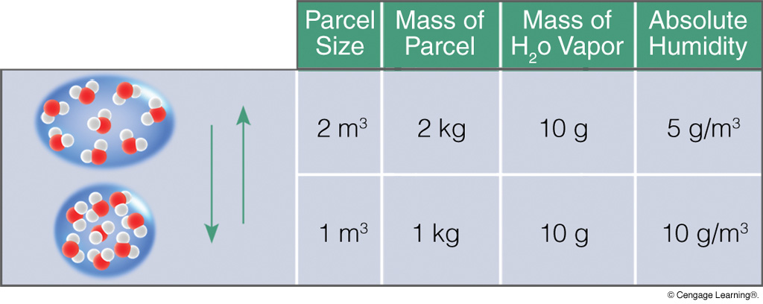
ABSOLUTE HUMIDITY
Absolute humidity is not conservative for pressure changes.
Notes:
Figure 4.7
With the same amount of water vapor in a parcel of air, an increase in volume decreases absolute humidity, whereas a decrease in volume increases absolute humidity.

Slide 30
SPECIFIC HUMIDITY
Specific humidity IS conservative for pressure changes.
Notes:
Figure 4.8
The specific humidity does not change as air rises and descends.

Slide 31
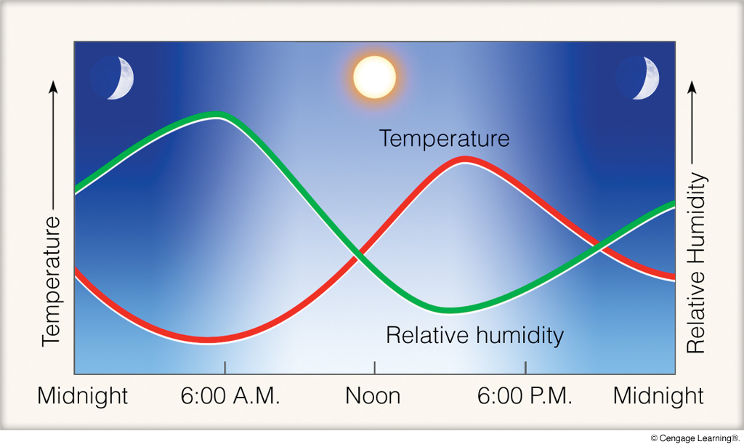
RELATIVE HUMIDITY
Relative humidity is not conservative for temperature changes.
Notes:
Figure 4.12
When the air is cool (morning), the relative humidity is high. When the air is warm (afternoon), the relative humidity is low. These conditions exist in clear weather when the air is calm or of constant wind speed.

Slide 32
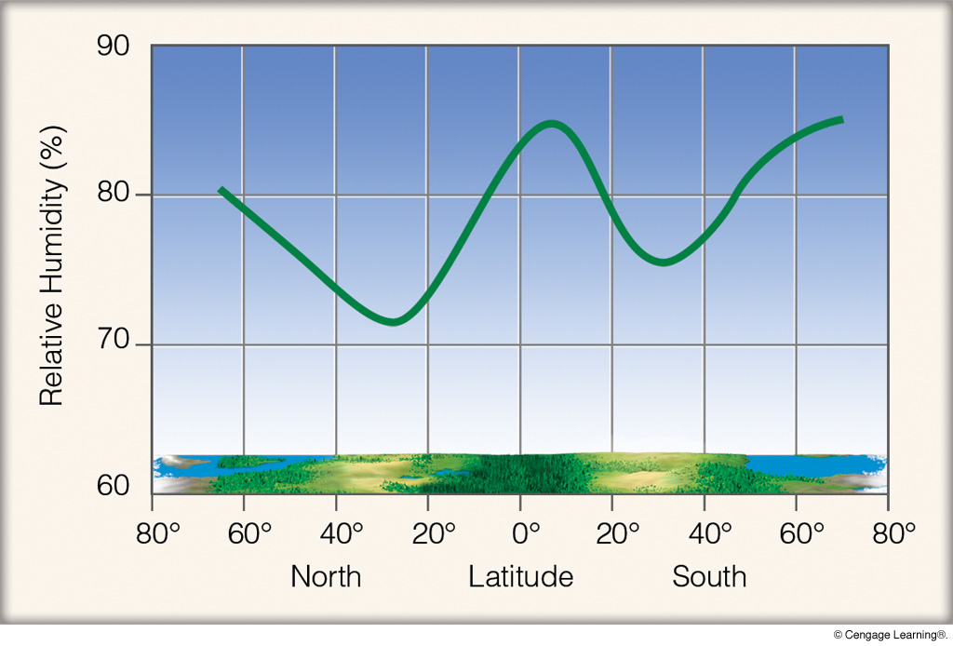
MEAN RELATIVE HUMIDITY BY LATITUDE
Notes:
Figure 4.15
Relative humidity averaged for latitudes north and south of the equator.

Slide 33
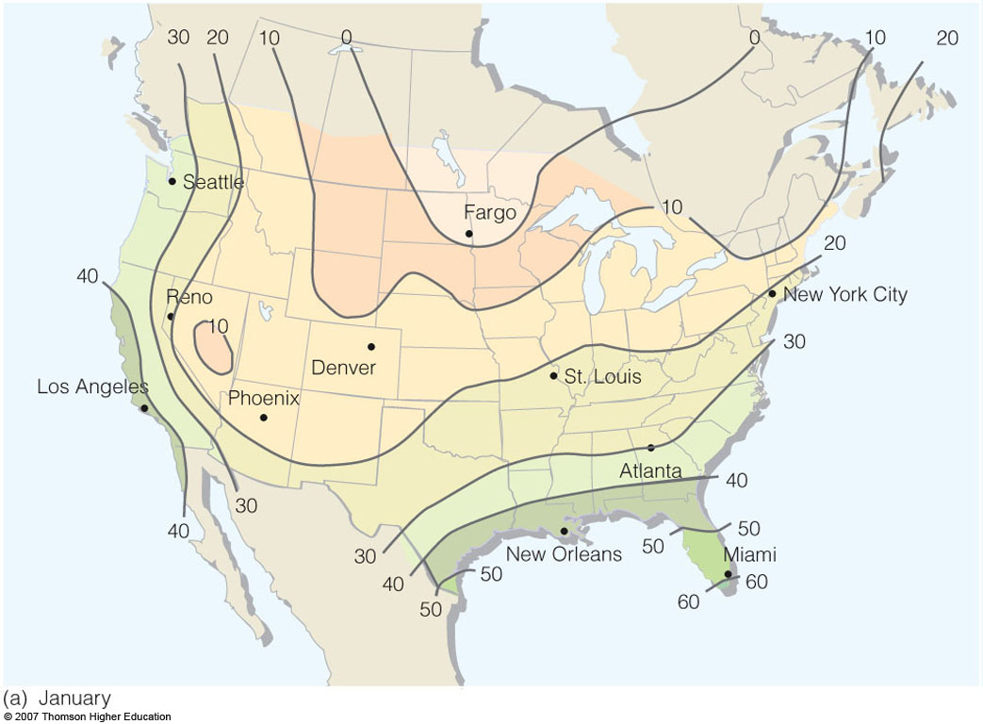
DEW POINT TEMPERATURE
Notes:
Figure 4.13
Average surface dew-point temperatures (ºF) for (a) January and for (b) July.

Slide 34
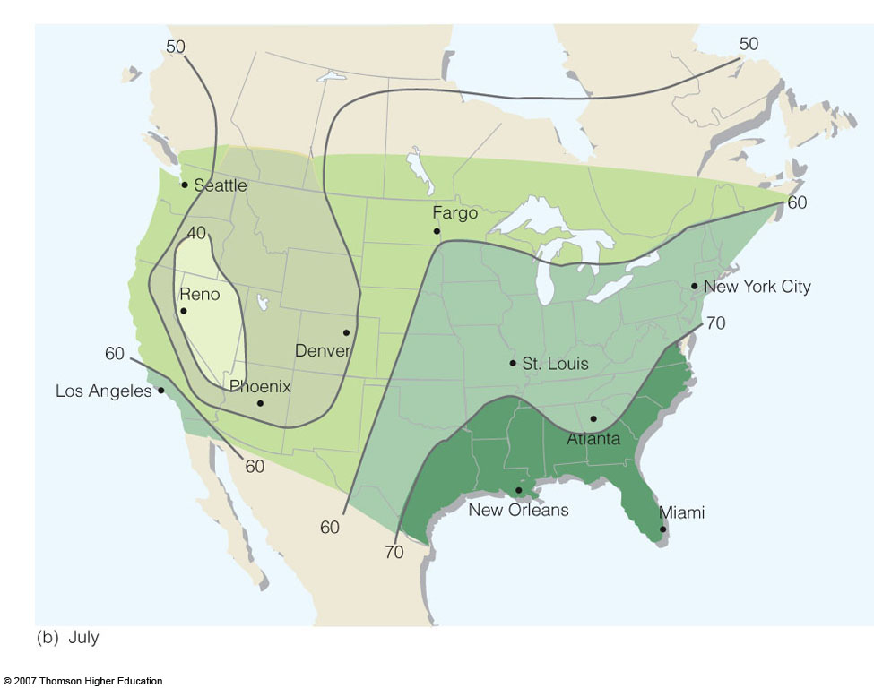
DEW POINT TEMPERATURE
Notes:
Figure 4.13
Average surface dew-point temperatures (ºF) for (a) January and for (b) July.

Slide 35
Dew Point and Minimum Temperature
With less water vapor in the air, radiational cooling is greater (more heat escapes through the atmospheric windows), lowering the surface temperature

Slide 36
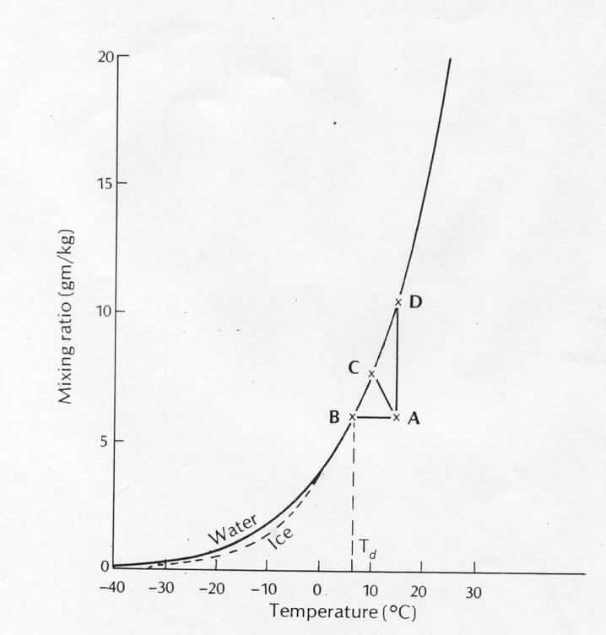
SATURATION EXAMPLES
saturation
curve (w_{s})
constant w
(unsaturated)
T

Slide 37
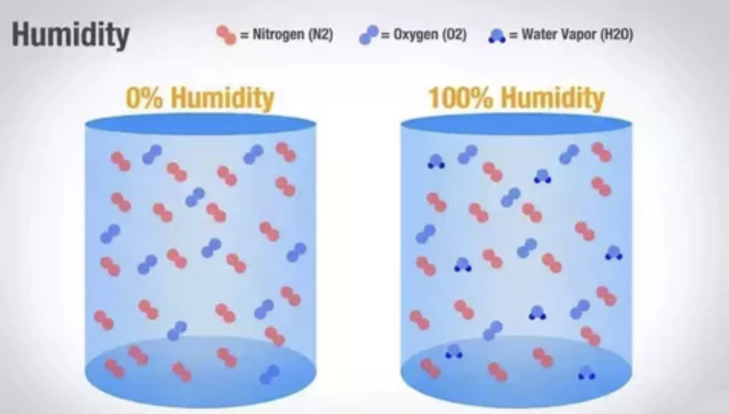
Which is denser? Dry air or humid air?
(assume identical temperature and pressure)
Avagadro’s Law: equal volumes of gas at same temperature
and pressure have the same NUMBER of molecules

Slide 38
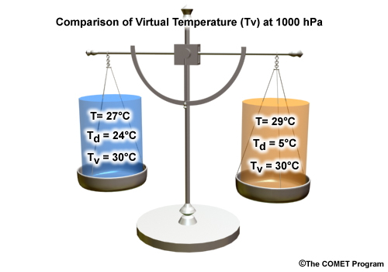
Air with the same Virtual Temperature has the same density.
Warm air is less dense than cold air; humid air is less
dense than dry air.

Slide 39
Low
High

Slide 40
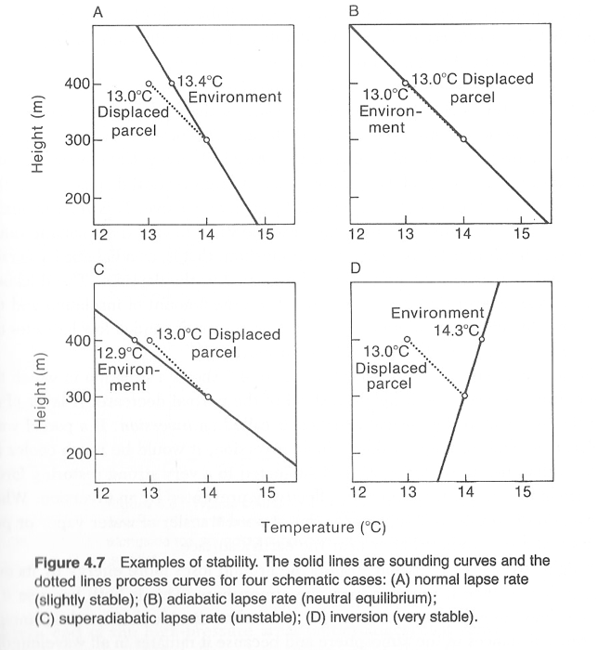
Layer
Stability
dotted line =
dry adiabatic
lapse rate
“process curve”
solid line =
observed (measured)
lapse rate
N: Chap. 4
A: p. 202, p. 222

Slide 41
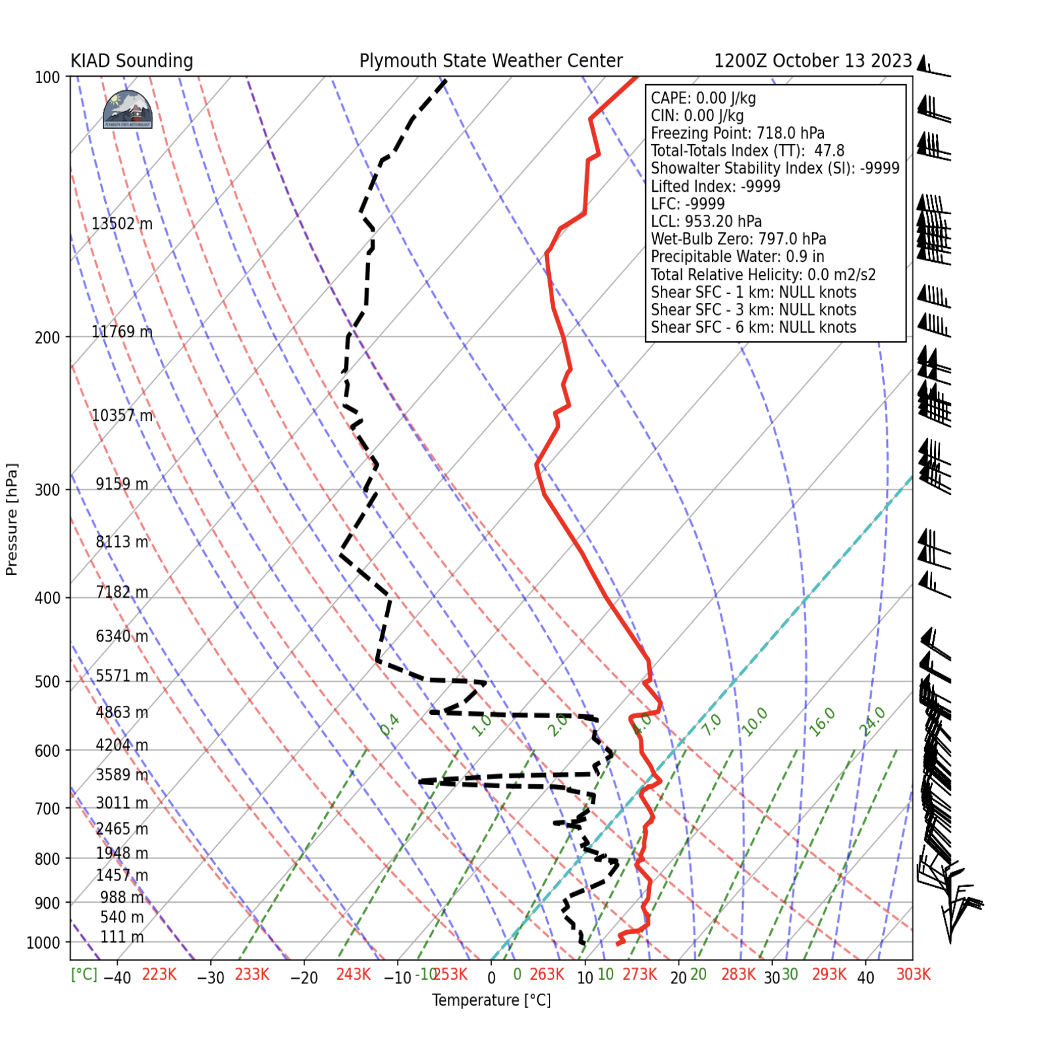

Slide 42
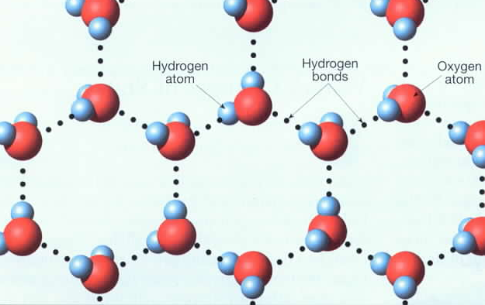
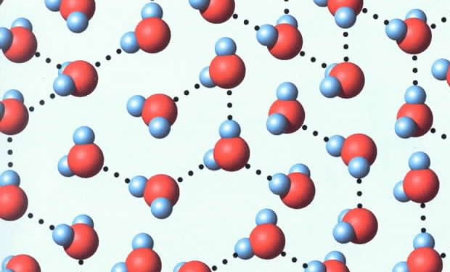
ICE
LIQUID WATER
(note higher density)

Slide 43
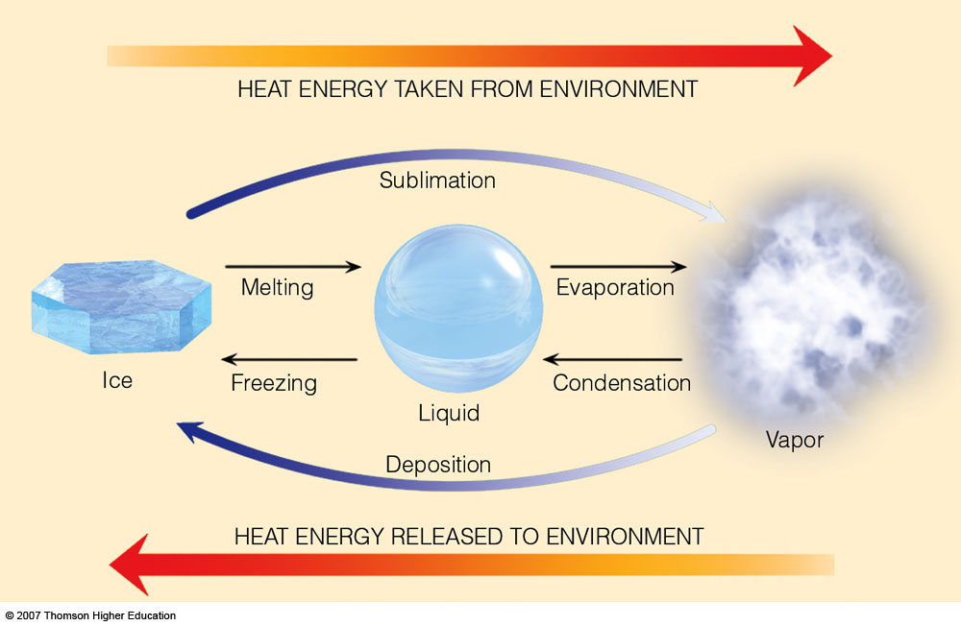
3.3 x 10⁵ J/kg
2.5 x 10⁶ J/kg
Latent heat (L) of water phase changes
Notes:
Figure 2.3
Heat energy absorbed and released.

Slide 44
Moist adiabatic lapse rate— Rate of cooling (depends on moisture content of air) of a rising saturated parcel of air. These lines slope from the bottom toward the top left. The MALR is less in warm air than cold because warm air has a higher vapor
pressure at saturation, and condensation is a warming process.

Slide 45
Saturation mixing ratio lines— Lines of equal mixing ratio (mass of water vapor divided by mass of dry air — grams per kilogram). These lines run from the bottom left to the top right and are DASHED. They are labeled on the bottom of the diagram.

Slide 46
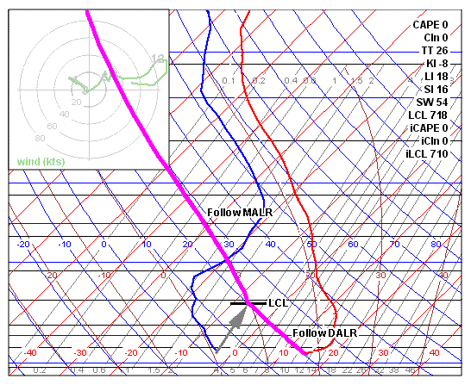
Example of a Stable Atmosphere
Parcel is ALWAYS cooler than surrounding environment.

Slide 47
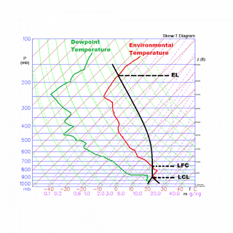
Example of a Conditionally Unstable Atmosphere

Slide 48
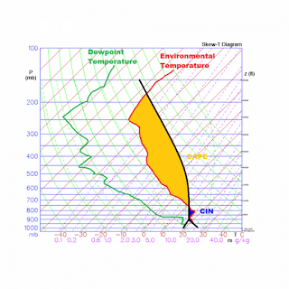
CAPE: Convective Available Potential Energy. Parcel gains
energy from the surrounding environment
CIN: Convective Inhibition. Stability parcel must overcome for deep convection. Rising parcel is losing energy to environment
(N: 128–135; A: 144–152)

Slide 49
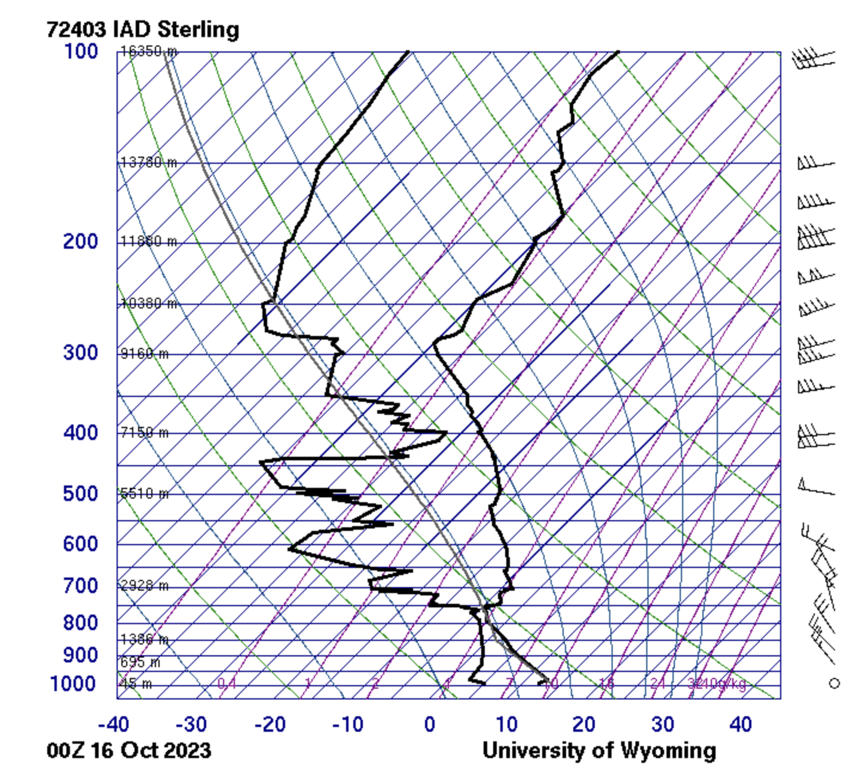

Slide 51
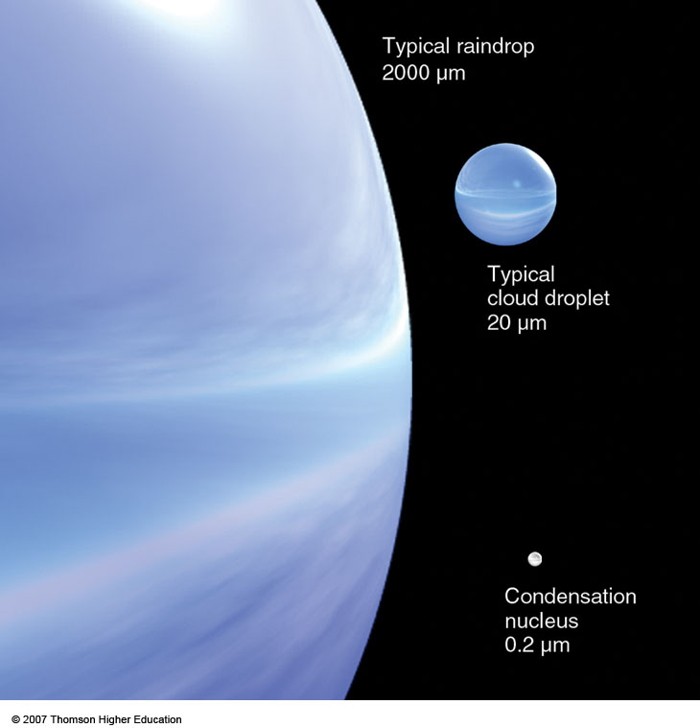
Notes:
Figure 7.1
Relative sizes of raindrops, cloud droplets, and condensation nuclei in micrometers (μm).

Slide 52
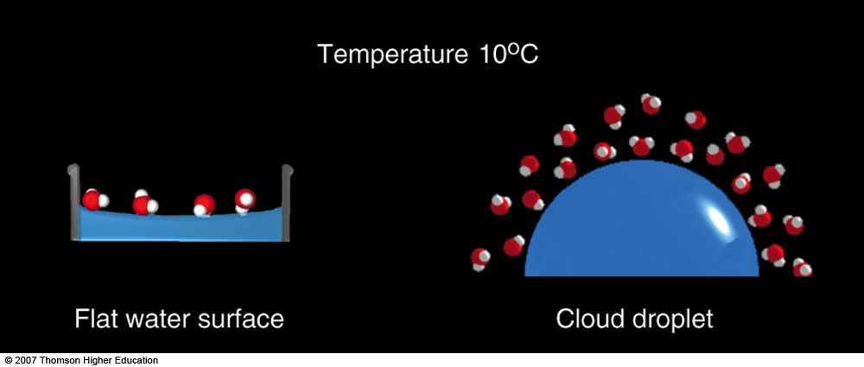
EFFECT OF DROPLET CURVATURE
ON SATURATION
SATURATION
(RH=100%)
SUPERSATURATION
(RH>100%)
If the surface is curved, then the amount of bonding between any one water molecule on the surface and its
neighbors is reduced.
Notes:
Figure 7.2
At equilibrium, the vapor pressure over a curved droplet of water is greater than that over a flat surface.

Slide 53
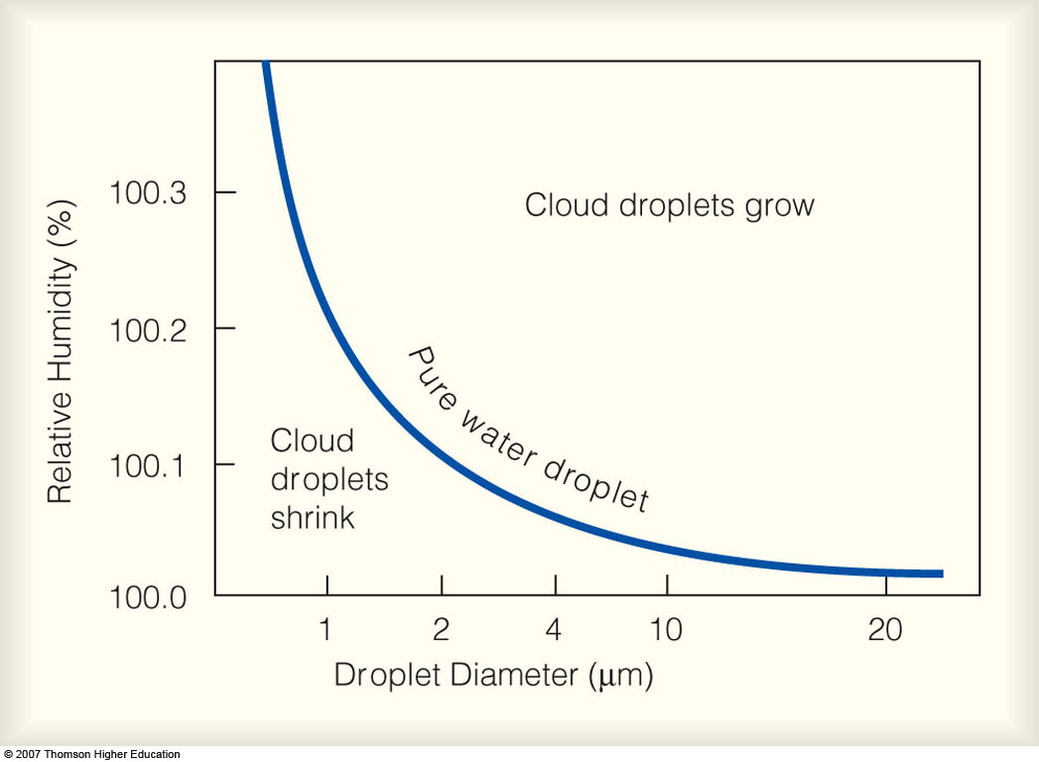
EQUILIBRIUM VAPOR PRESSURE RELATIVE TO
PURE WATER
e_{r}= equilibrium vapor pressure
a
b
Notes:
Figure 7.3
The curved line represents the relative humidity needed to keep a droplet in equilibrium with its environment. For a given droplet size, the droplet will evaporate and shrink when the relative humidity is less than that given by the curve. The droplet will grow by condensation when the relative humidity is greater than the value on the curve.

Slide 54
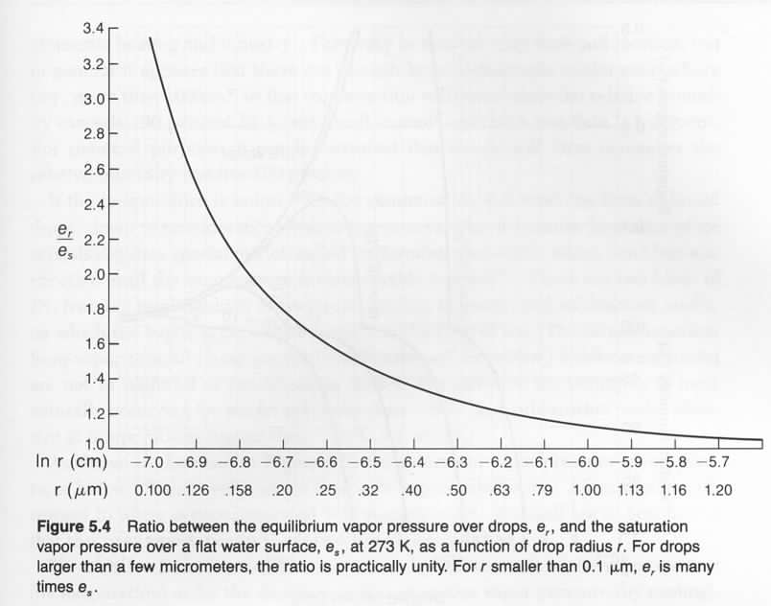
CURVATURE EFFECT

Slide 55
Atmospheric Aerosols and Cloud Condensation Nuclei
75% of total mass directly from natural or anthropogenic sources
Wind-generated dust (20%)
Sea spray (40%)
Forest fires (10%)
Combustion and other industry (5%)
25% of total mass from conversion of gaseous constituents
to small particles by photochemical and other chemical processes
SO_{2,} NO₂, NH₃
Size varies from 0.001 to 10 micrometers

Slide 56
Atmospheric Aerosols and Cloud Condensation Nuclei
Aerosols can be categorized according to their affinity for water.
Hydrophobic (“water-repelling”)
Nucleation is difficult and requires even higher super-saturation.
Neutral
Saturation when RH=100% (or e = e_{s})
Hygroscopic (“water-attracting”)
Much lower supersaturation required (RH ≥ 80%)
The “SOLUTE EFFECT!”

Slide 57
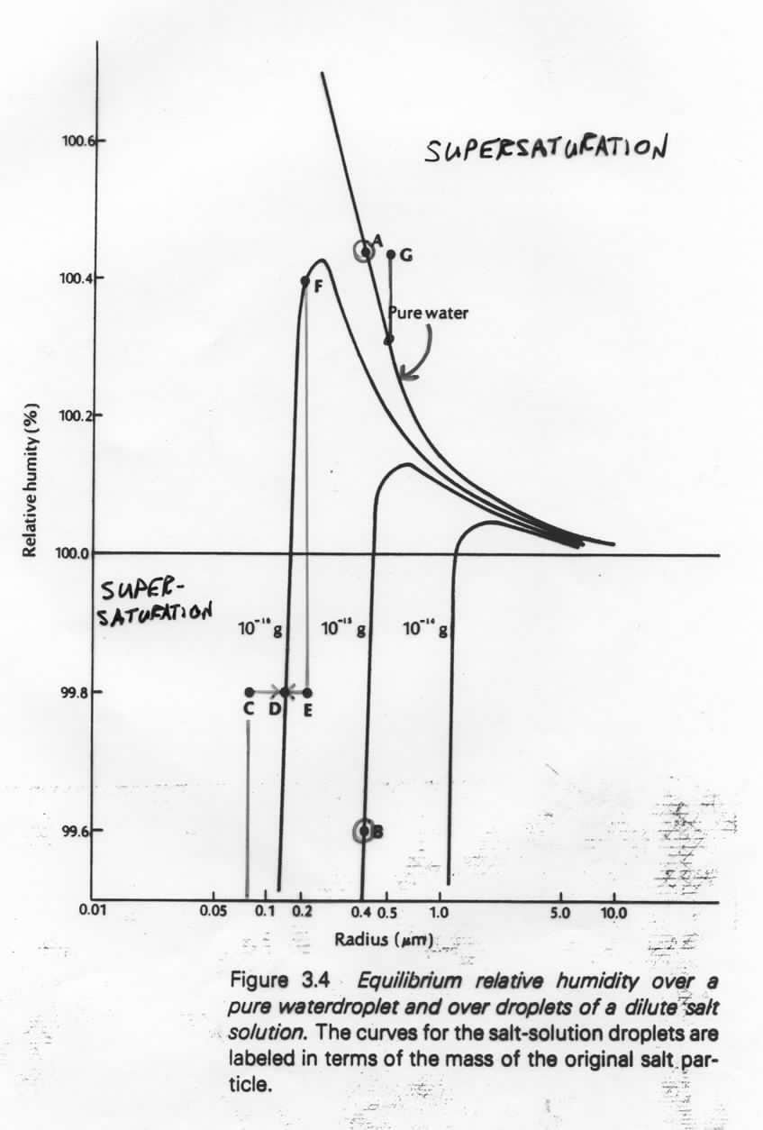
CURVATURE AND SOLUTE EFFECTS
A: r = 0.4 microns: saturated relative to pure water,
RH=100.42%
Supersaturation
B: r = 0.4 microns: w/ 10^{–15}g (solute), A is
supersaturated (equilibrium at 99.6%)
C: 10^{–16}g in solution; r=0.075 microns; RH=99.8%
supersaturated...grows to r=0.15 microns (D)
E: 10^{–16}g in solution; r=0.2 microns; RH=99.8%
unsaturated (equilibrium at 100.4% (F))
...evaporates to r=0.15 microns (D)
Super-
saturation
G: supersatured relative to both pure and solute
curves...would grow rapidly

Slide 58
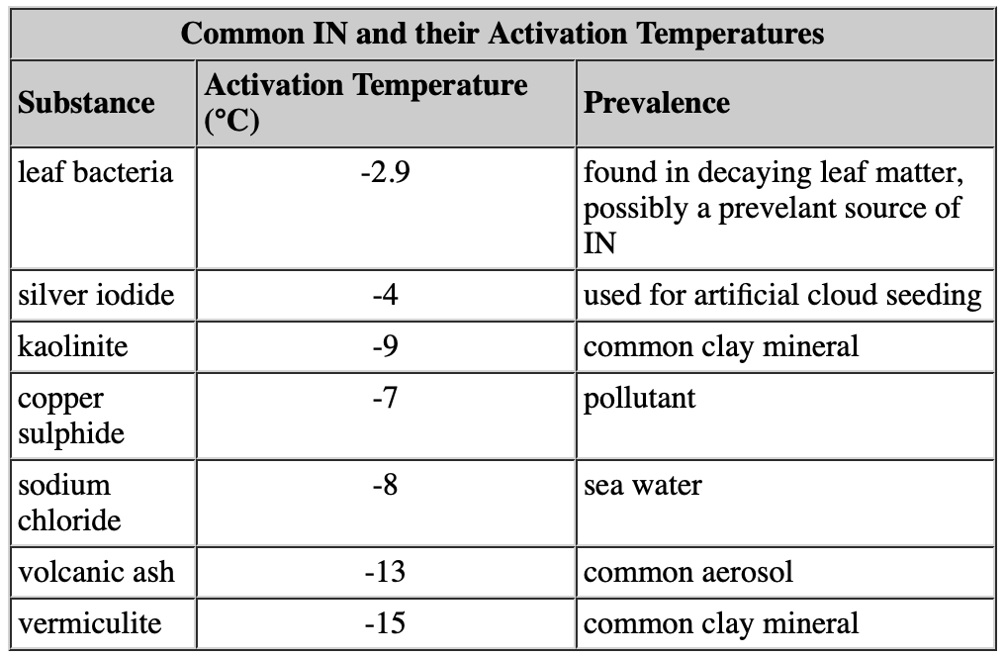
Ice Nucleii

Slide 59
Notes:
Figure 7.1
Relative sizes of raindrops, cloud droplets, and condensation nuclei in micrometers (μm).

Slide 60
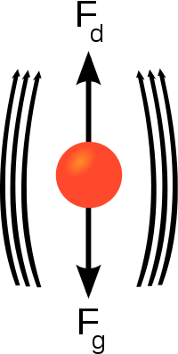
Collision-Coalescence Process
As soon as a cloud droplet becomes large enough, raindrops start to fall.
Terminal velocity: constant fall speed of a particle achieved through a balance of gravitational, drag, and buoyancy forces
Larger drops will have a higher terminal velocity than small drops so the large drops will fall faster.
$$v_{t}= \sqrt{\frac{2mg}{ρAC_{d}}}$$
$m$ is mass
$g$ is acceleration due to gravity
$ρ$ is density of fluid through which object is falling
$A$ is area of the object
$C_{d}$ is the drag coefficient
(equation is FYI)

Slide 61
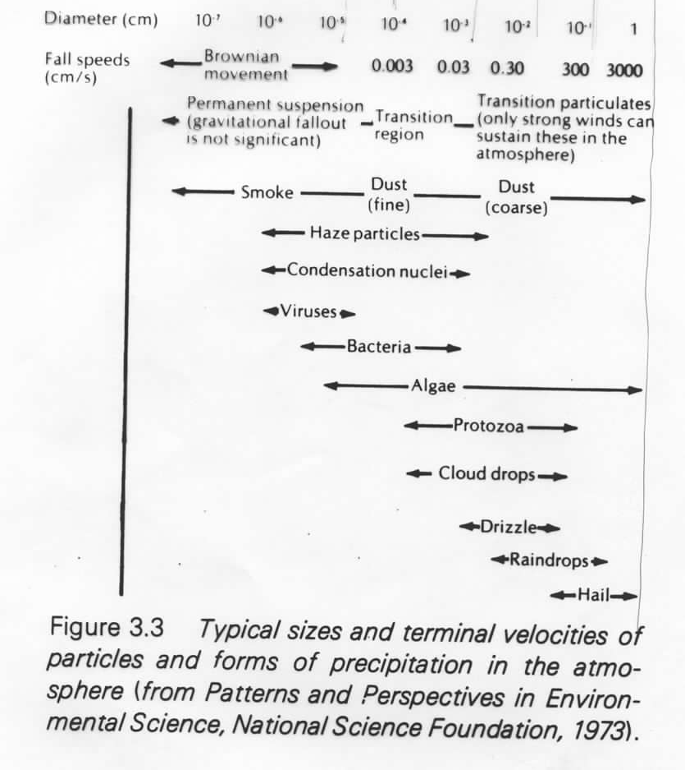
DIAMETERS AND FALL SPEEDS

Slide 62
Collision-Coalescence Process
As soon as a cloud droplet becomes large enough, raindrops start to fall.
Terminal velocity: constant fall speed of a particle achieved through a balance of gravitational, buoyancy, and drag forces
Larger drops will have a higher terminal velocity than small drops so the large drops will fall faster.
Collisions occur and droplets merge.

Slide 63
Collision-Coalescence Process
The collision-coalescence mechanism is most efficient in environments where cloud water content is large and large cloud droplets are plentiful (e.g. tropics).
Depends strongly on droplet size distribution, cloud water content/column moisture, updraft strength.
Drops make it to the ground when
The drop is large enough
The cloud base is low enough
The air between the cloud base and the ground is moist.

Slide 64
Saturation Vapor Pressure
e_{s liquid} < e_{s ice}
Notes:
Figure 4.10
Saturation vapor pressure increases with increasing temperature. At a temperature of 10°C, the saturation vapor pressure is about 12 mb, whereas at 30°C it is about 42 mb. The insert illustrates that the saturation vapor pressure over water is greater than the saturation vapor pressure over ice.

Slide 65
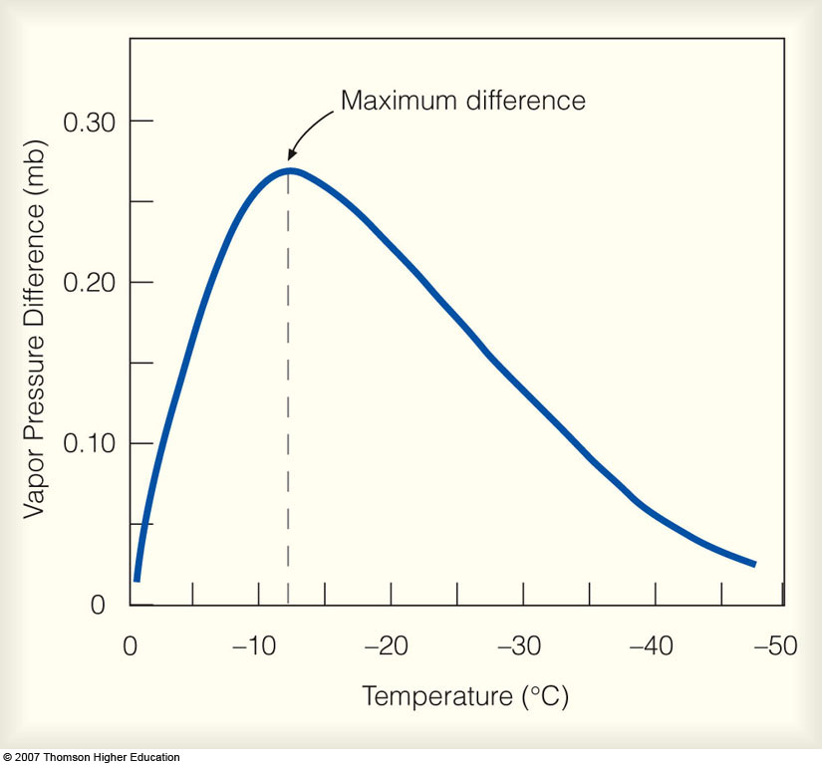
VAPOR PRESSURE DIFFERENCE BETWEEN SUPERCOOLED WATER AND ICE
Notes:
Figure 7.8
The difference in saturation vapor pressure between supercooled water and ice at different temperatures.

Slide 66
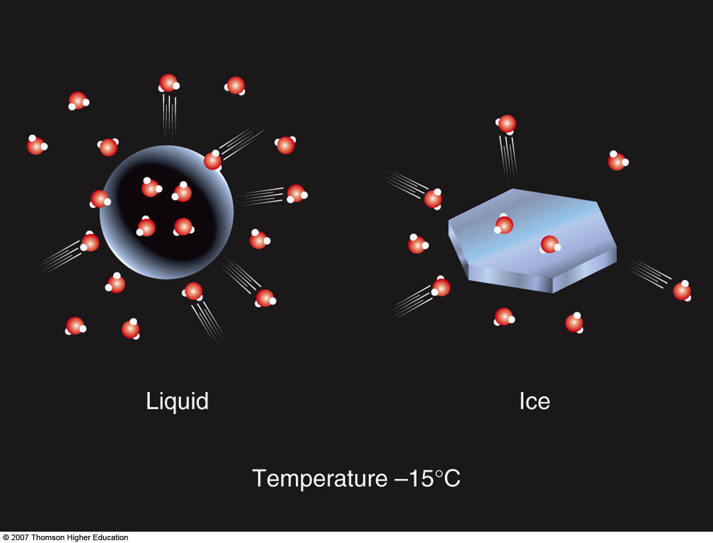
Saturation for Liquid and Ice
e_{s liquid} > e_{s ice}
Notes:
Figure 7.7
In a saturated environment, the water droplet and the ice crystal are in equilibrium, as the number of molecules leaving the surface of each droplet and ice crystal equals the number returning. The greater number of vapor molecules above the liquid indicates, however, that the saturation vapor pressure over water is greater than it is over ice.

Slide 67
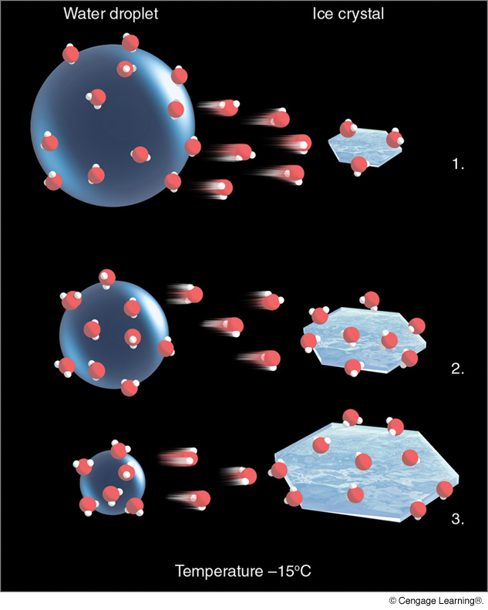
The Bergeron (Ice Crystal) Process
(N: 135–146;
A: Chap. 7)
Notes:
Figure 7.9
The ice-crystal process. The greater number of water vapor molecules around the liquid droplets causes water molecules to diffuse from the liquid drops toward the ice crystals. The ice crystals absorb the water vapor and grow larger, while the water droplets grow smaller.

Slide 68
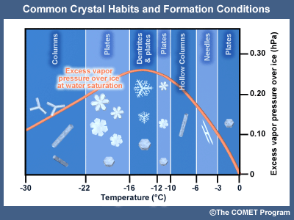
Ice Crystal Forms (“Habits”)

Slide 69
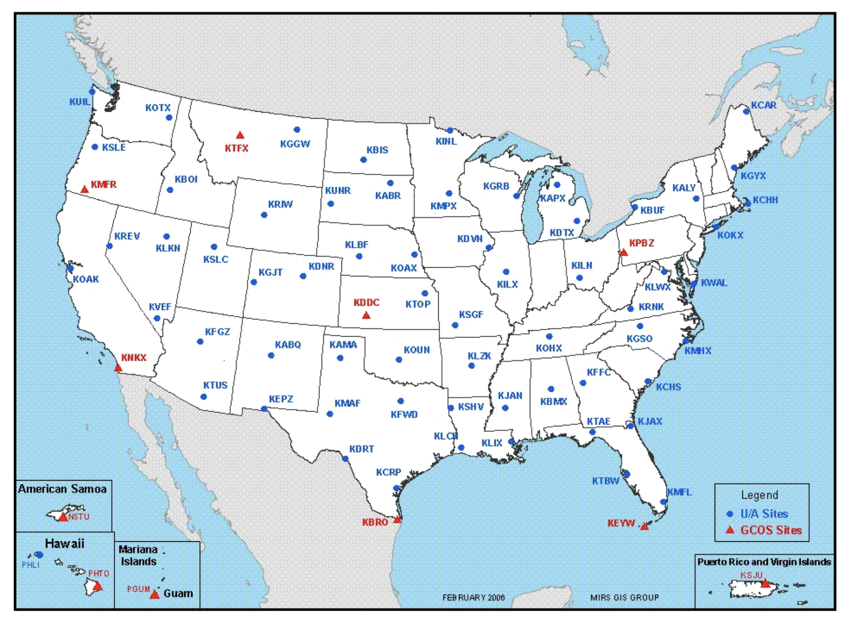
U.S. Rawinsonde Network

Slide 70
Notes:
Figure 8.11
When there are no horizontal variations in pressure, constant pressure surfaces are parallel to constant height surfaces. In the diagram, a measured pressure of 500 mb is 5600 m above sea level everywhere.

Slide 71
Notes:
Figure 8.12
The area shaded gray in the above diagram represents a surface of constant pressure, or isobaric surface. Because of the changes in air density, the isobaric surface rises in warm, less-dense air and lowers in cold, more-dense air. Where the horizontal temperature changes most quickly, the isobaric surface changes elevation most rapidly.

Slide 73
5520 m
5640 m

Slide 74
500 mb
map

Slide 75
L
R
T
Heights in dekameters (dam) (solid lines) / Temp (blue dotted) / RH (colors)

Slide 76
Example of Cloud
Formation via Mixing
Since w must be less than w_{s},
additional 0.5 g/kg of vapor is
condensed to liquid (cloud/fog)
Notes:
Figure 2
The mixing of two unsaturated air parcels can produce fog. Notice in the saturated mixed parcel that the actual mixing ratio (w) is too high. As the mixed parcel cools below its saturation point, water vapor will condense onto nuclei, producing liquid droplets. This would keep the actual mixing ratio close to the saturation mixing ratio, and the relative humidity of the mixed parcel would remain close to 100 percent.

Slide 77
Cloud Formation
Via Mixing
Notes:
Figure 6.29
The mixing of a moist layer of air near the surface can produce a deck of stratocumulus clouds.

Slide 78
Cloud Formation
Via Mixing
Notes:
Figure 6.29
The mixing of a moist layer of air near the surface can produce a deck of stratocumulus clouds.

Slide 79
Cloud Formation
Via Mixing
Notes:
Figure 6.29
The mixing of a moist layer of air near the surface can produce a deck of stratocumulus clouds.

Slide 80
Notes:
Figure 6.15
The primary ways clouds form: (a) surface heating and convection; (b) forced lifting along topographic barriers; (c) convergence of surface air; (d) forced lifting along weather fronts.

Slide 81
Notes:
Figure 6.15
The primary ways clouds form: (a) surface heating and convection; (b) forced lifting along topographic barriers; (c) convergence of surface air; (d) forced lifting along weather fronts.

Slide 82
Notes:
Figure 6.15
The primary ways clouds form: (a) surface heating and convection; (b) forced lifting along topographic barriers; (c) convergence of surface air; (d) forced lifting along weather fronts.

Slide 83
Notes:
Figure 6.15
The primary ways clouds form: (a) surface heating and convection; (b) forced lifting along topographic barriers; (c) convergence of surface air; (d) forced lifting along weather fronts.

Slide 84
Notes:
Figure 6.15
The primary ways clouds form: (a) surface heating and convection; (b) forced lifting along topographic barriers; (c) convergence of surface air; (d) forced lifting along weather fronts.

Slide 85
Convective Cloud Formation
Notes:
Figure 6.16
Cumulus clouds form as hot, invisible air bubbles detach themselves from the surface, then rise and cool to the condensation level. Below and within the cumulus clouds, the air is rising. Around the cloud, the air is sinking.

Slide 86
Convective Cloud Formation
Notes:
Figure 6.18
The development of a cumulus cloud.

Slide 87
Cumuliform Cloud Types
Notes:
Figure 6.19
The air’s stability greatly influences the growth of cumulus clouds.

Slide 88
Thunderstorm Stages

Slide 89
Entrainment: mixing of drier air along cloud edges, reducing buoyancy. This
is a diabatic process. (Detrainment: cloud outflow transferring its heat and moisture
to the surrounding atmosphere.)

Slide 90
Thunderstorm Stages

Slide 91
Supercell Thunderstorm

Slide 93
(N: Chap. 6, 3–14; A: 152–165)
Notes:
Figure 5.23
A generalized illustration of basic cloud types based on height above the surface and vertical development.

Slide 94
MEAN ANNUAL CLOUD COVER, 1981–2010

Slide 95
PRECIPITATION BY LATITUDE BAND
*
*S. Chile

Slide 96
AVERAGE PRECIPITATION (mm/year)
2000–2019

Slide 97
Mean Annual
Precipitation

Slide 98
Mean Annual
Precipitation

Slide 99
Mean Annual Precipitation

