Slide 1
EVSC 3300
ATMOSPHERIC RADIATION

Slide 2
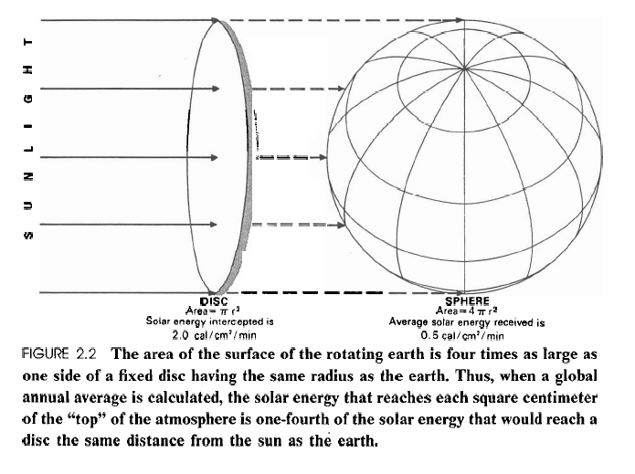
Solar Constant
1367 Wm^{–2}
1367/4 = 341.75 Wm^{–2}

Slide 3
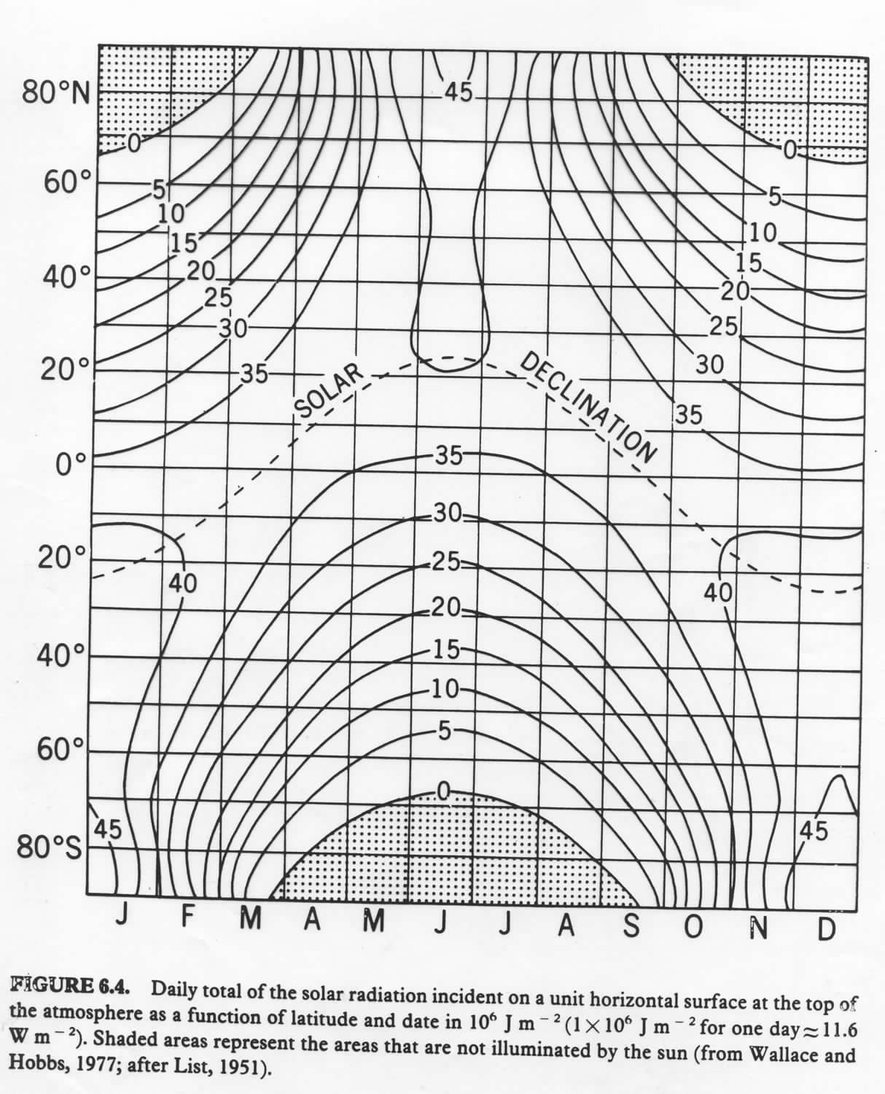
Top of Atmosphere Solar Irradiance

Slide 4
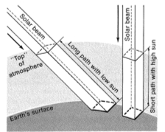
Effect of Solar Angle on Intensity and Path Length
Incident
Transmitted
Transmissivity (τ) = $\frac{E_{λ} transmitted}{E_{λ} incident} [$%]
$$E= E_{o}τcos⁡(Z)$$
Notes:
4

Slide 5
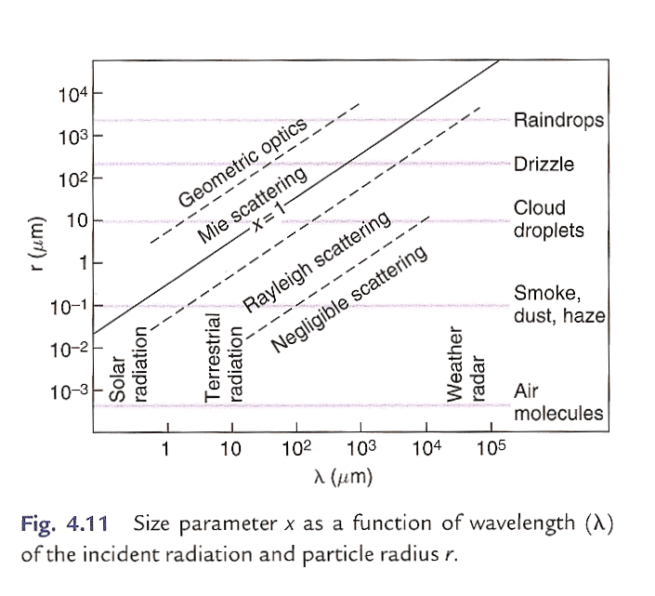
Type of Scattering

Slide 6
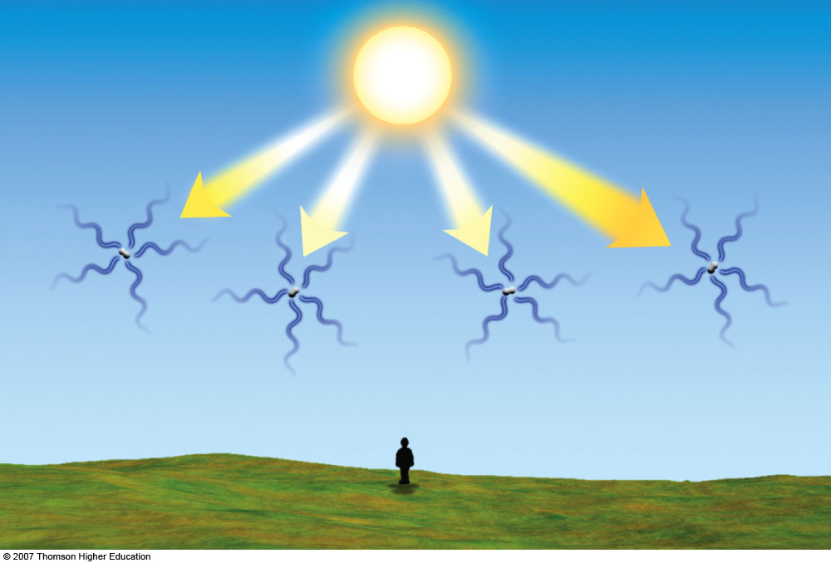
Rayleigh Scattering
Notes:
Figure 19.4
The sky appears blue because billions of air molecules selectively scatter the shorter wavelengths of visible light more effectively than the longer ones. This causes us to see blue light coming from all directions.

Slide 7
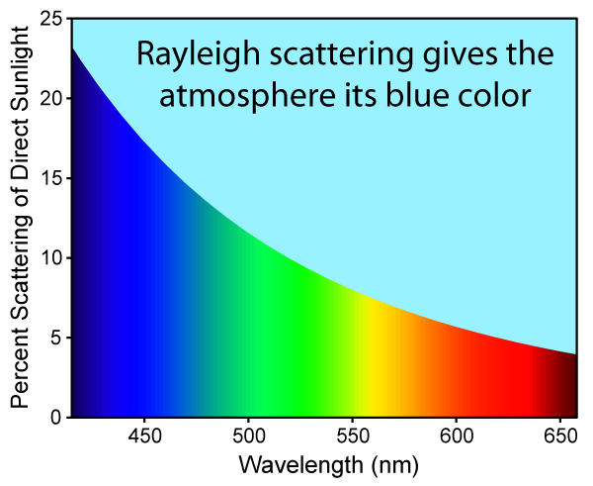
Clear Sky Rayleigh Scattering at Surface
Cyan sky is mix of visible intensities coupled with eye sensitivity

Slide 8
Mie Scattering
Notes:
Figure 19.2
Since tiny cloud droplets scatter visible light in all directions, light from many billions of droplets turns a cloud white.

Slide 9
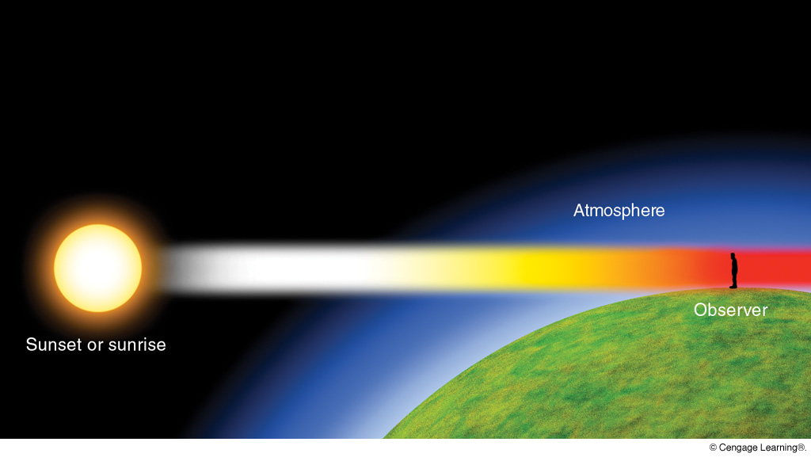
Low sun = low transmissivity (longer path of radiation through atmosphere)
Notes:
Page: 570
FIGURE 20.10 Because of the selective scattering of radiant energy by a thick section of atmosphere, the sun at sunrise and sunset appears either yellow, orange, or red. The more particles in the atmosphere, the more scattering of sunlight, and the redder the sun appears.

Slide 10
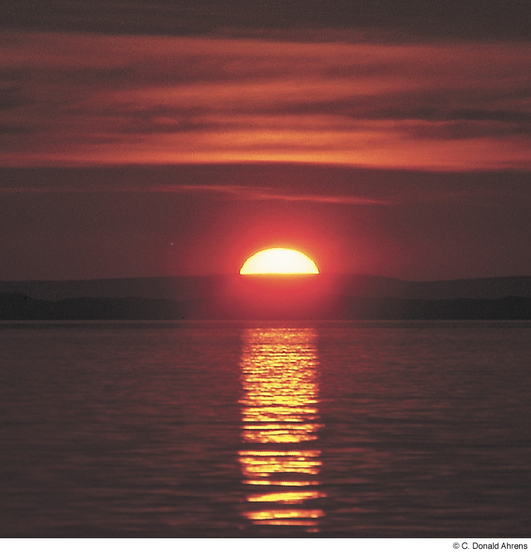
Setting sun
appears red
because
shorter
visible
wavelengths
(blue through
yellow/orange)
are
scattered
Notes:
Page: 570
FIGURE 20.11 Red sunset near the coast of Iceland. The reflection of sunlight off the slightly rough water is producing a glitter path.

Slide 11
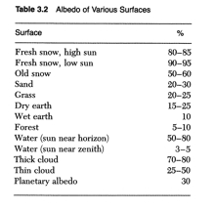
Albedos of Various Surfaces

Slide 12
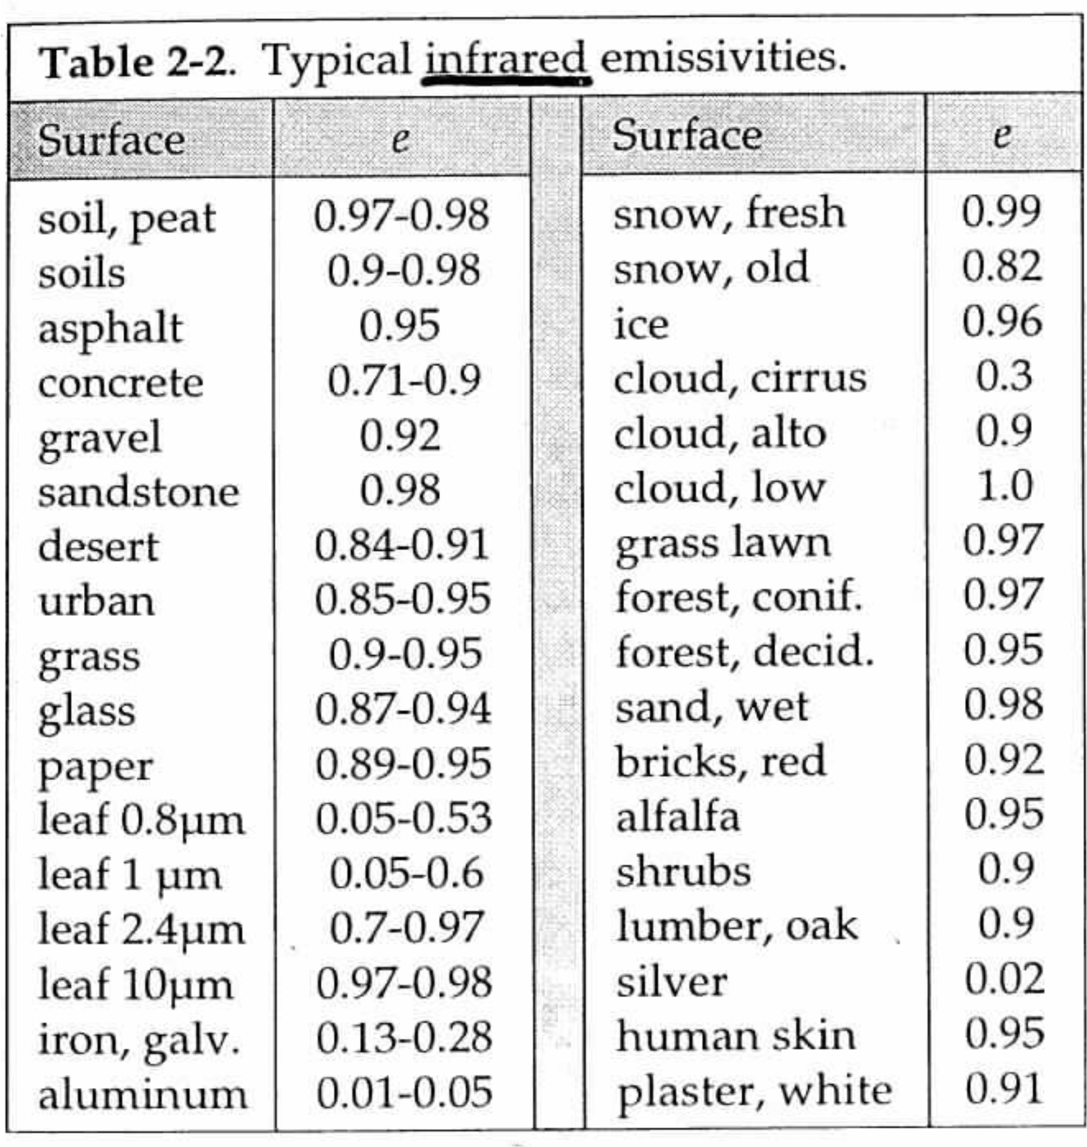

Slide 13
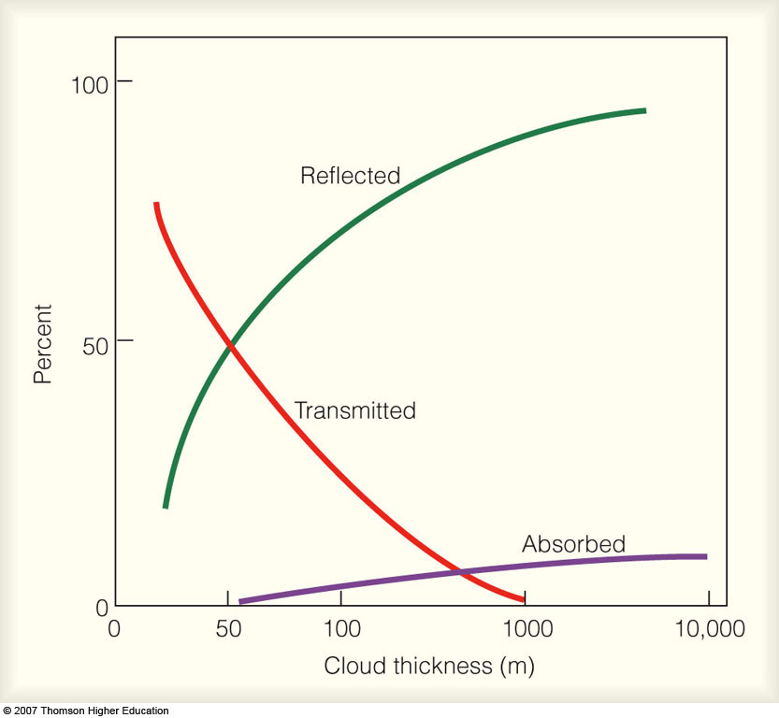
Cloud Impacts on Solar Radiation
Notes:
Figure 19.3
Average percent of radiation reflected, absorbed, and transmitted by clouds of various thickness.

Slide 14
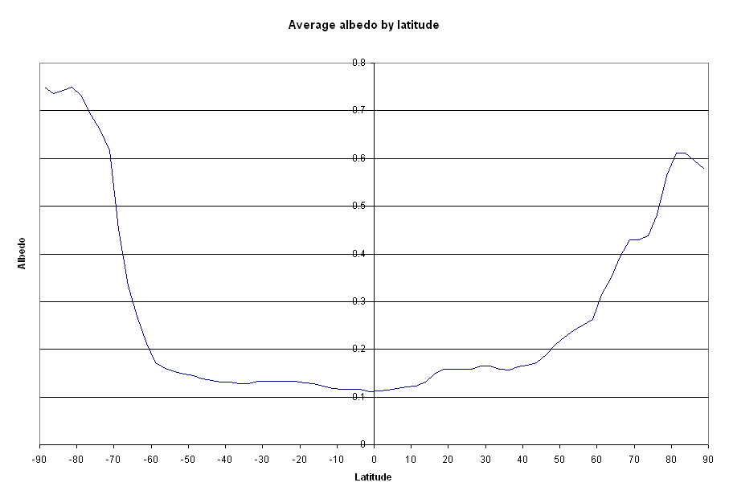
Mean Surface Reflectivity by Latitude Band
Permanent
Antarctic Ice
Seasonal
Arctic Sea Ice
Seasonal
Snowcover
Subtropical
Deserts
Oceans & Tropical Land
S. Pole
N. Pole
(ERBE, 1986–1990)

Slide 15
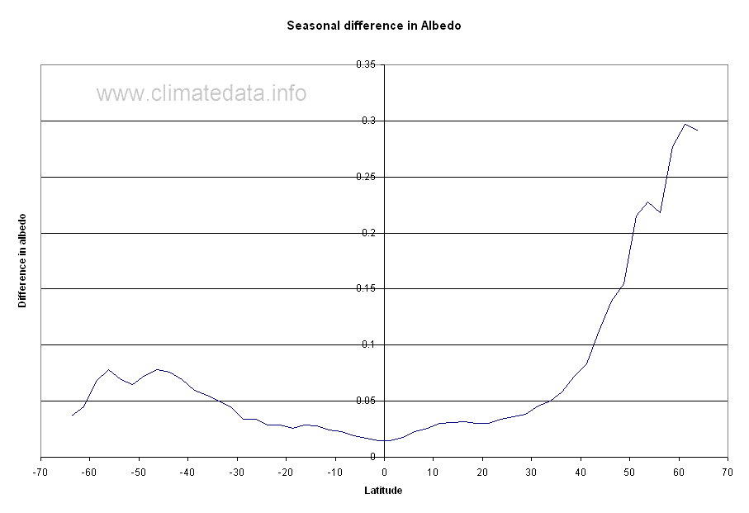
Maximum Monthly Sfc. Reflectivity Difference (4-year period)
S.H.
N.H.
(ERBE, 1986–1990)

Slide 16
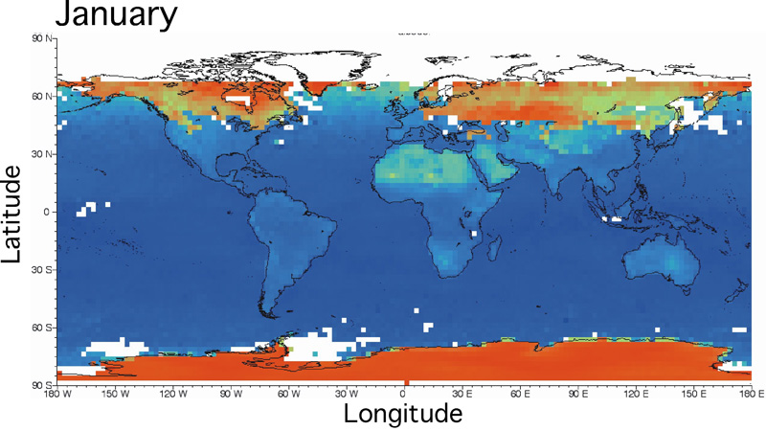
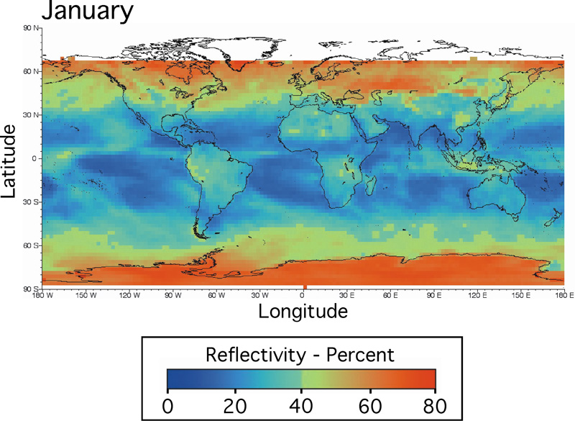
Reflectivity of
Earth’s surface
Reflectivity of
surface + atmosphere
(ERBE, Jan., 1987)

Slide 17
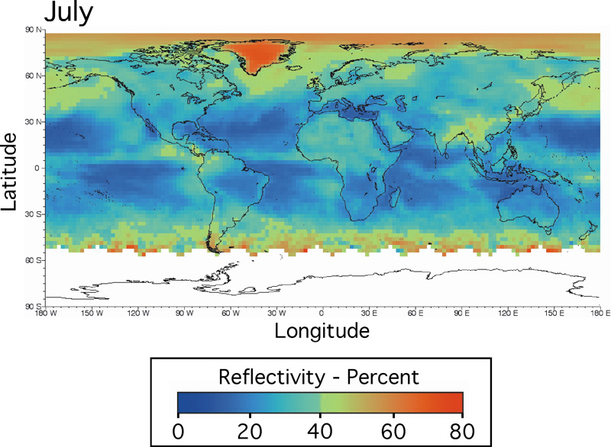
Reflectivity of
surface + atmosphere
(N: 68–78)
(A: 46–49, 58–66)
(ERBE, 1987)

Slide 18
Solar Constant
1367 Wm^{–2}
1367/4 = 341.75 Wm^{–2}

Slide 19
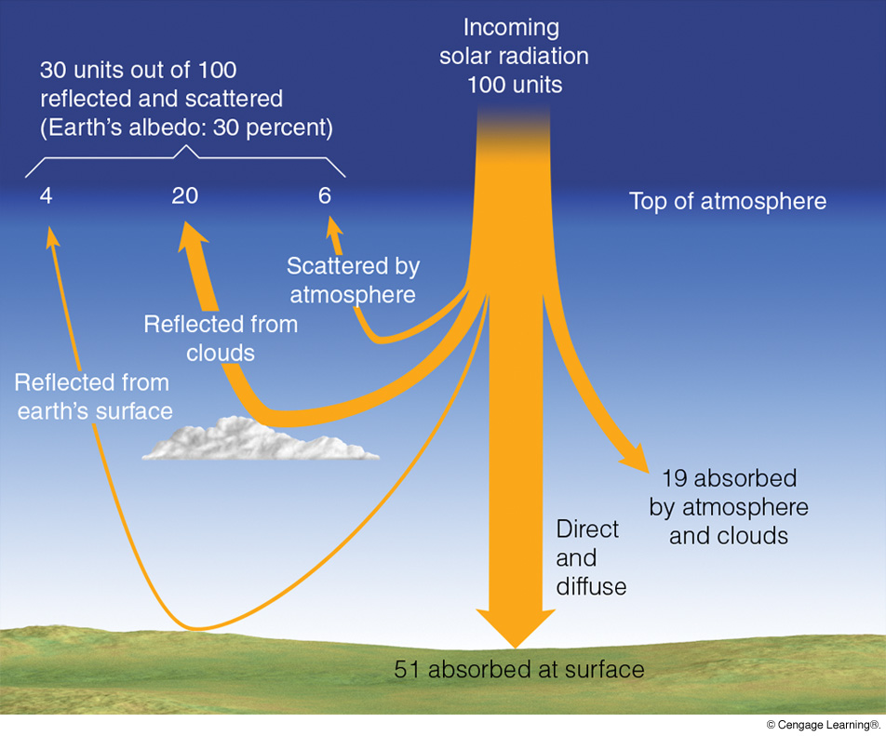
= 341.75 Wm^{–2}
Reflection and
Mie backscatter
Reflection and
Rayleigh backscatter
(Incl. Rayleigh and Mie forwardscatter)
Notes:
Figure 2.15
On the average, of all the solar energy that reaches the earth’s atmosphere annually, about 30 percent (³⁰⁄₁₀₀) is reflected and scattered back to space, giving the earth and its atmosphere an albedo of 30 percent. Of the remaining solar energy, about 19 percent is absorbed by the atmosphere and clouds, and 51 percent is absorbed at the surface.

Slide 20
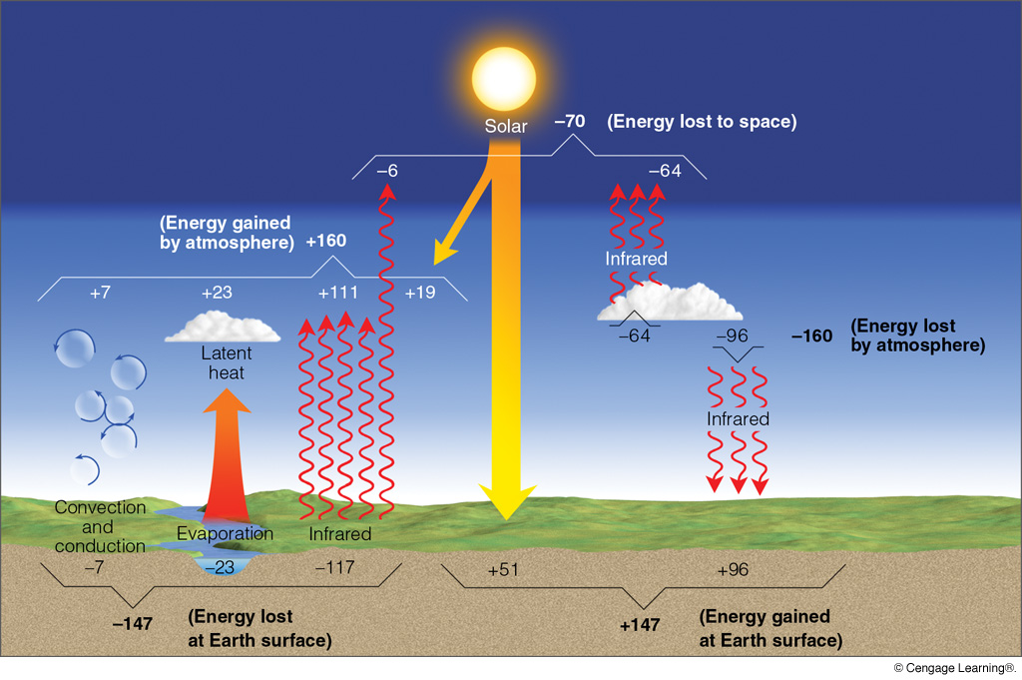
GLOBAL MEAN RADIATION BALANCE
(Note that these values differ, in some cases significantly, from those in Figure 3.19 in the Neiburger. The values in this figure are believed to be more accurate because they are based on more detailed, longer term measurements.)
Notes:
Figure 2.16
The earth-atmosphere energy balance. Numbers represent approximations based on surface observations and satellite data. While the actual value of each process may vary by several percent, it is the relative size of the numbers that is important.

Slide 21
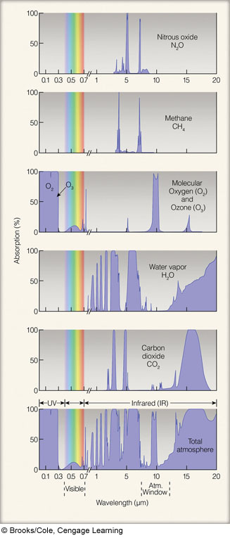
Absorption Spectra
of Primary
Greenhouse Gases
Notes:
Figure 2.11
Absorption of radiation by gases in the atmosphere. The shaded area for each gas represents the percent of radiation each gas can absorb. The strongest absorbers of infrared radiation are water vapor and carbon dioxide. The bottom figure represents the percent of radiation absorbed by all of the atmospheric gases.

Slide 22
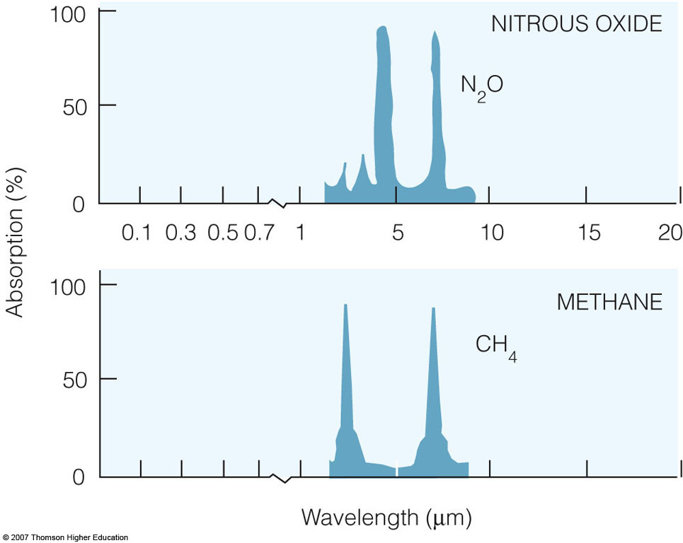
Notes:
Figure 2.11
Absorption of radiation by gases in the atmosphere. The shaded area for each gas represents the percent of radiation each gas can absorb. The strongest absorbers of infrared radiation are water vapor and carbon dioxide. The bottom figure represents the percent of radiation absorbed by all of the atmospheric gases.

Slide 23
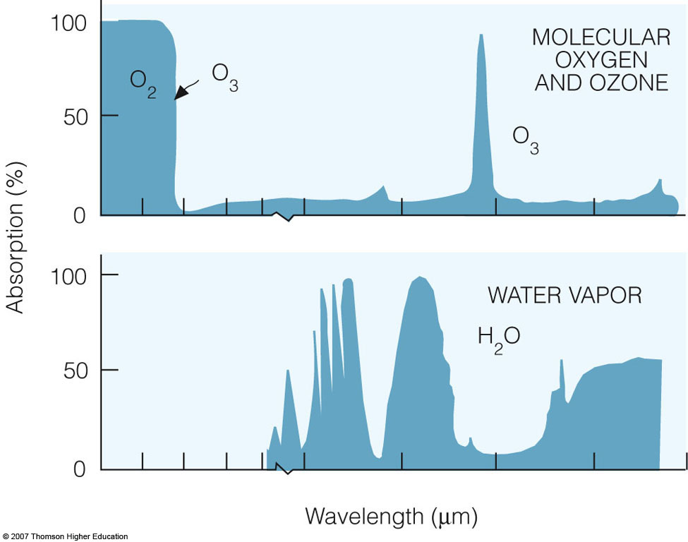
Notes:
Figure 2.11
Absorption of radiation by gases in the atmosphere. The shaded area for each gas represents the percent of radiation each gas can absorb. The strongest absorbers of infrared radiation are water vapor and carbon dioxide. The bottom figure represents the percent of radiation absorbed by all of the atmospheric gases.

Slide 24
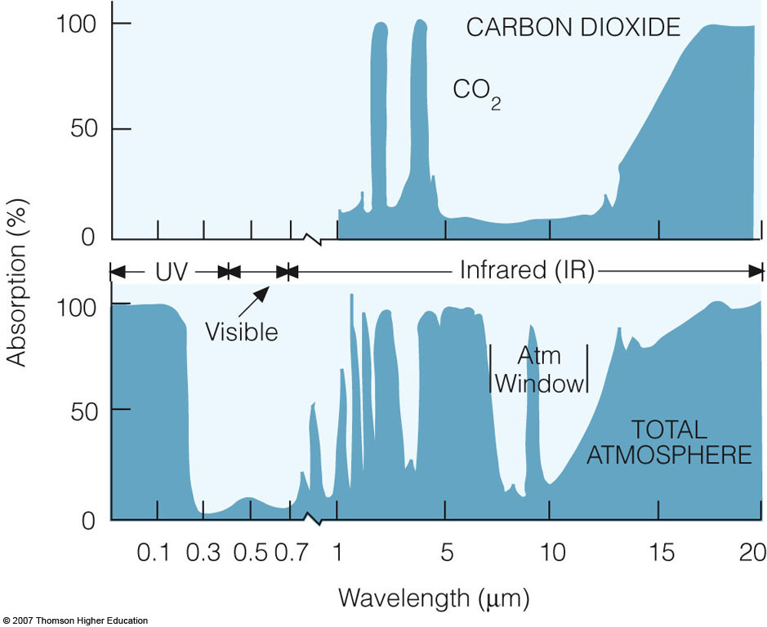
Notes:
Figure 2.11
Absorption of radiation by gases in the atmosphere. The shaded area for each gas represents the percent of radiation each gas can absorb. The strongest absorbers of infrared radiation are water vapor and carbon dioxide. The bottom figure represents the percent of radiation absorbed by all of the atmospheric gases.

Slide 25
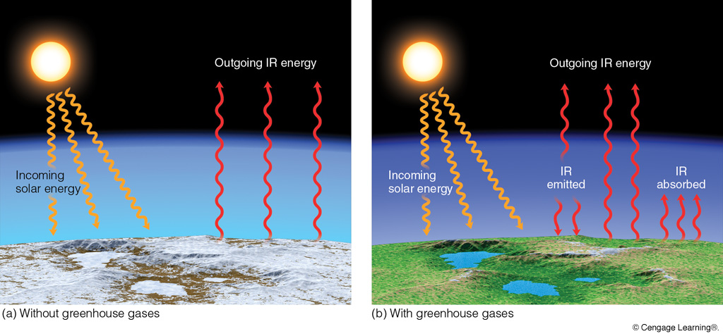
Impact of Greenhouse Gases
Radiative Equilibrium
Temperature = 255 K
Mean Surface Temperature = 288 K
Notes:
Figure 2.12
Sunlight warms the earth’s surface only during the day, whereas the surface constantly emits infrared radiation upward during the day and at night.
(a) Near the surface without water vapor, CO₂, and other greenhouse gases, the earth’s surface would constantly emit infrared radiation (IR) energy; incoming energy from the sun would be equal to outgoing IR energy from the earth’s surface. Since the earth would receive no IR energy from its lower atmosphere (no atmospheric greenhouse effect), the earth’s average surface temperature would be a frigid –18°C (0°F).

Slide 26
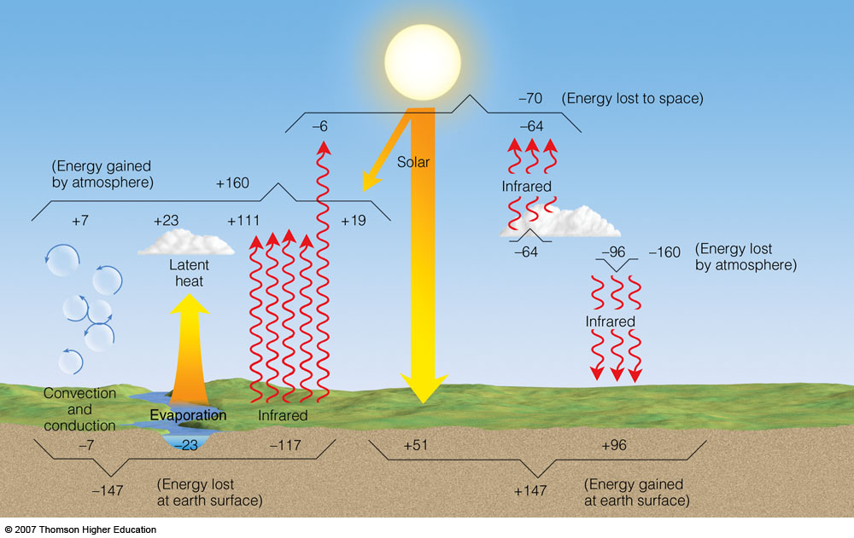
(Note that these values differ, in some cases significantly, from those in Figure 3.19 in the Neiburger text. The values in this figure are believed to be more accurate because they are based on more detailed, longer term measurements.)
Notes:
Figure 2.16
The earth-atmosphere energy balance. Numbers represent approximations based on surface observations and satellite data. While the actual value of each process may vary by several percent, it is the relative size of the numbers that is important.

Slide 27
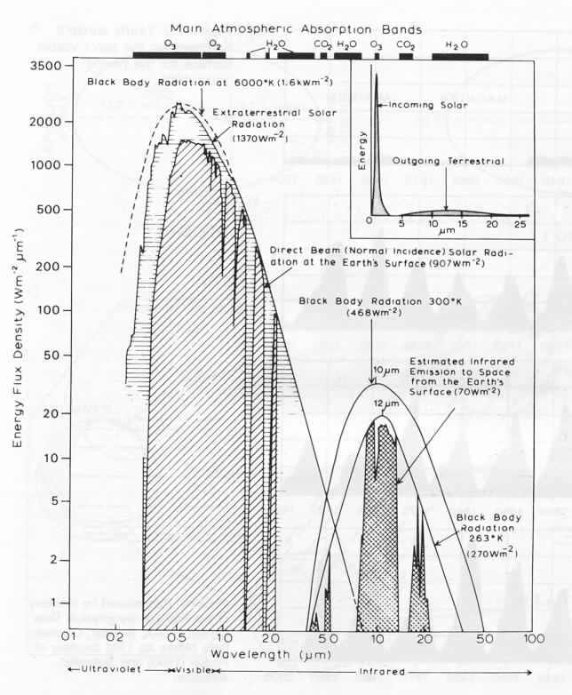
Radiation Overview
In
Equals
Out
Peak
Emission
Transparent
(Note: this figure contains
some errors; focus on
general ideas rather
than specifics)
Sun
Earth
Atm. Window
Opaque
Opaque
Opaque

Slide 28
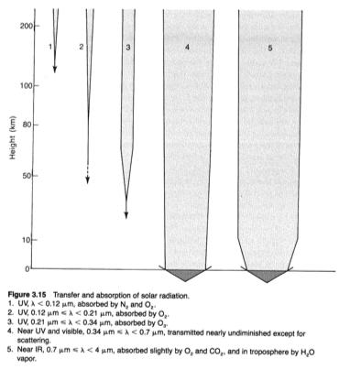
Solar Radiation Absorption and Transmission
Line Thickness is Proportional to Transmission
UV-C
VIS
Near IR
UV-B
UV-A
(N: 78–91)
(A: 36–38, 43–46,
49–51)

Slide 29
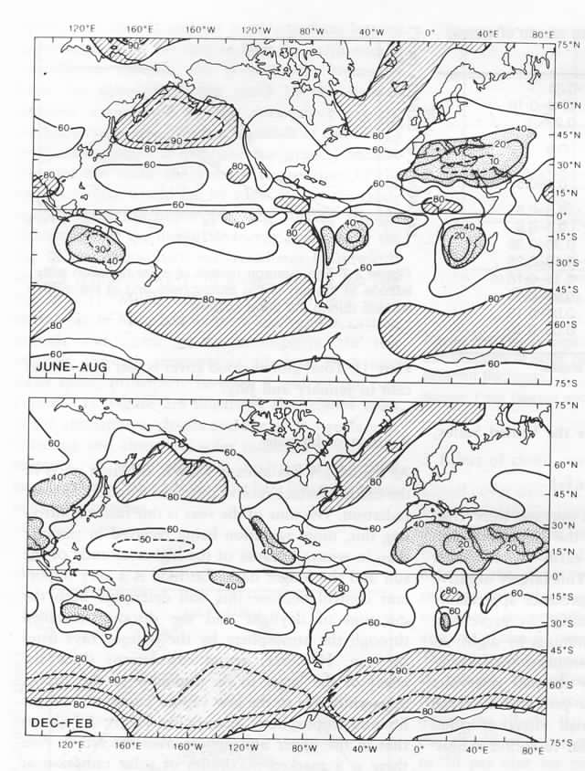
Mean
Global
Cloud Cover
June-Aug
>80%
<40%
Dec-Feb

Slide 30
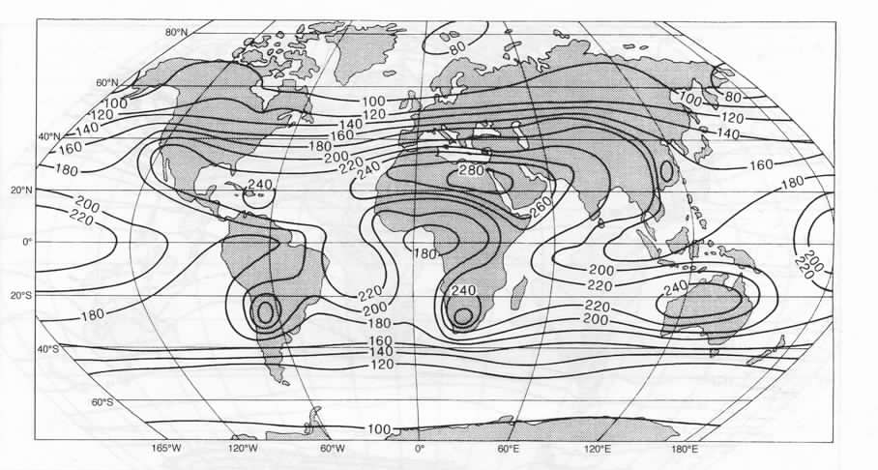
Mean Annual Solar Radiation at Surface
Direct + Diffuse (W/m²)

Slide 31
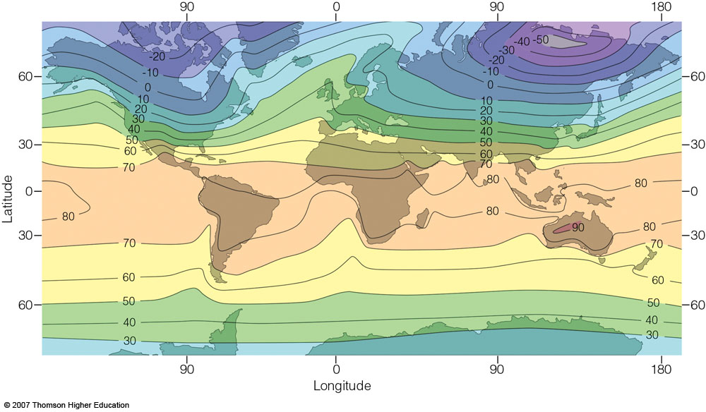
Mean January Surface Temperature
Strong mid-latitude gradient
Weak mid-latitude gradient
Notes:
Figure 3.20
Average air temperature near sea level in January (°F).

Slide 32
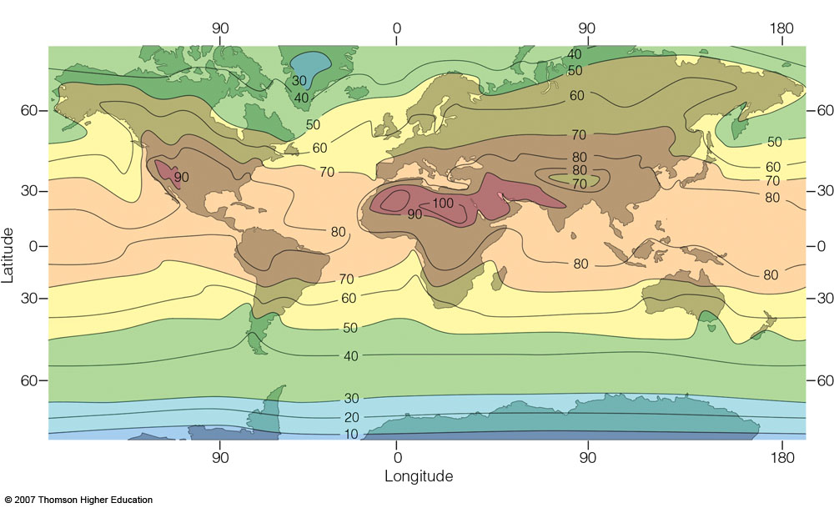
Mean July Surface Temperature
Weaker mid-latitude gradient
Relatively weak
mid-latitude gradient
Notes:
Figure 3.21
Average air temperature near sea level in July (°F).

Slide 33
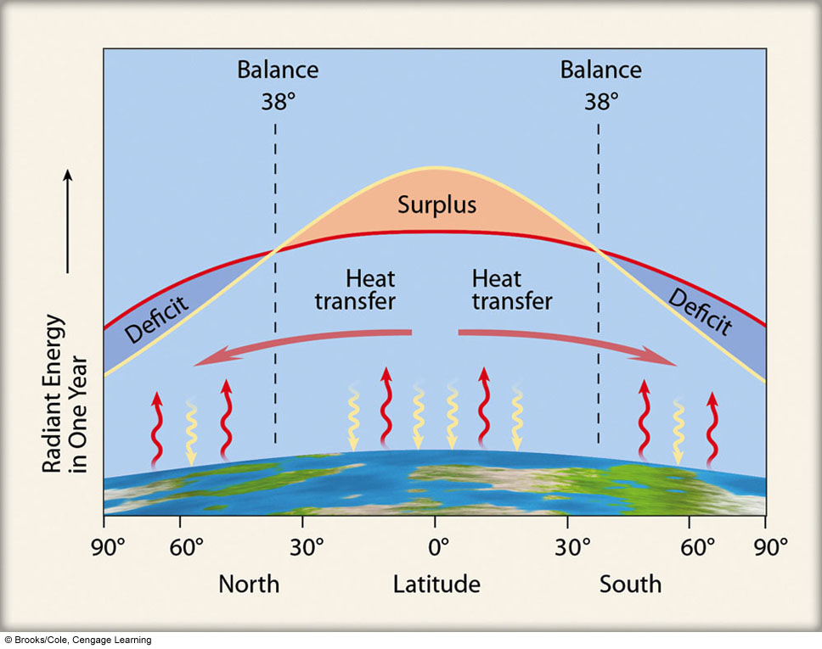
Notes:
Figure 2.17
The average annual incoming solar radiation (red line) absorbed by the earth and the atmosphere along with the average annual infrared radiation (blue line) emitted by the earth and the atmosphere.

Slide 34
SPECIFIC HEAT CAPACITIES
(assume constant pressure)
SUBSTANCE cal/g°C J/kgK
LIQUID WATER (fresh) 1.0 4184 (saline 3993)
ICE 0.5 2113
AIR (dry) 0.24 1004
SAND 0.2 837
CLAY 0.17–0.20 711–837
LIMESTONE 0.2 837
WOOD (oak) 0.48 2008
WOOD (white pine) 0.6 2510

Slide 35
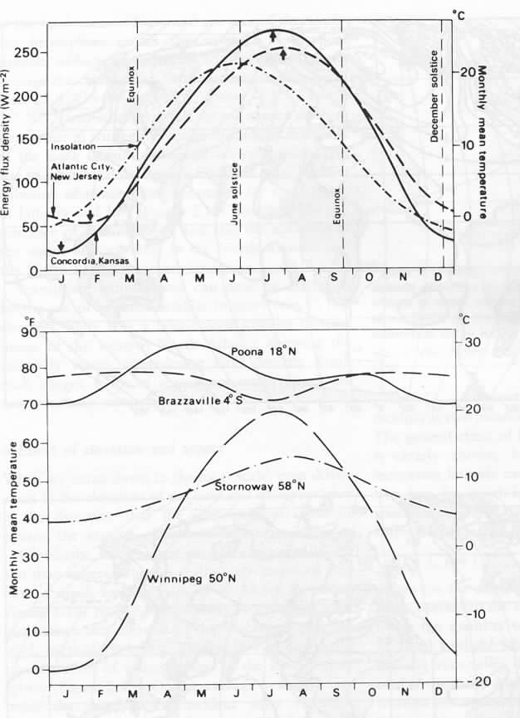
Continentality
New Jersey Max Temp
Kansas Max Temp
Pune

Slide 36
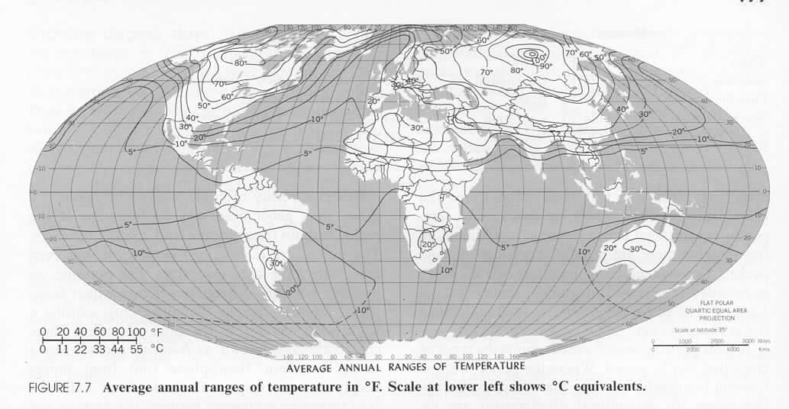
Continentality
Mean temperature of warmest minus coldest month

Slide 37
DIURNAL RADIATION BALANCE
Cloudless Day, Midlatitudes, Equinox
Absorbed Solar (K)
L
L
L
L
Irradiance
0
0
Lnet
Lnet
00
06
12
18
24
Hour
Temperature
Temperature
Net radiation (R_{n})
Irradiance
Temperature
Surplus
Deficit
00
06
12
18
24
Hour

Slide 38
Top-of-Atmosphere Net Radiation
January
Units: Watts per square meter

Slide 39
Top-of-Atmosphere Net Radiation
July
Units: Watts per square meter

Slide 40
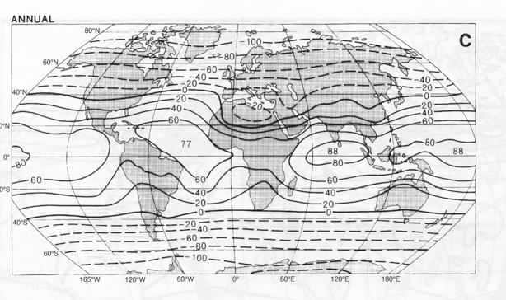
Top-of-Atmosphere Net Radiation
Mean Annual
Units: Watts per square meter

Slide 41
Notes:
Figure 2.17
The average annual incoming solar radiation (red line) absorbed by the earth and the atmosphere along with the average annual infrared radiation (blue line) emitted by the earth and the atmosphere.

Slide 42
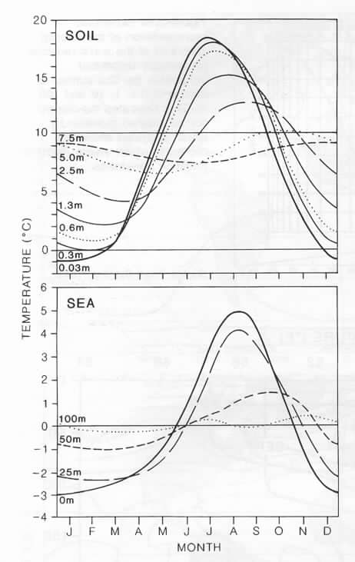
Seasonal Temperature
Variation
at Depth
Land vs. Water
(N: 47–50, 223–225;
A: 77–80)

