Slide 1
Climate Change

Slide 2
Paleoclimate Reconstructions
Fossils
Shells in ocean sediments
Oxygen isotopes in ice cores
Tree rings (dendrochronology)
Pollen trapped in ice, sediments
Historical documents
Borehole temperatures
Ice cores

Slide 3
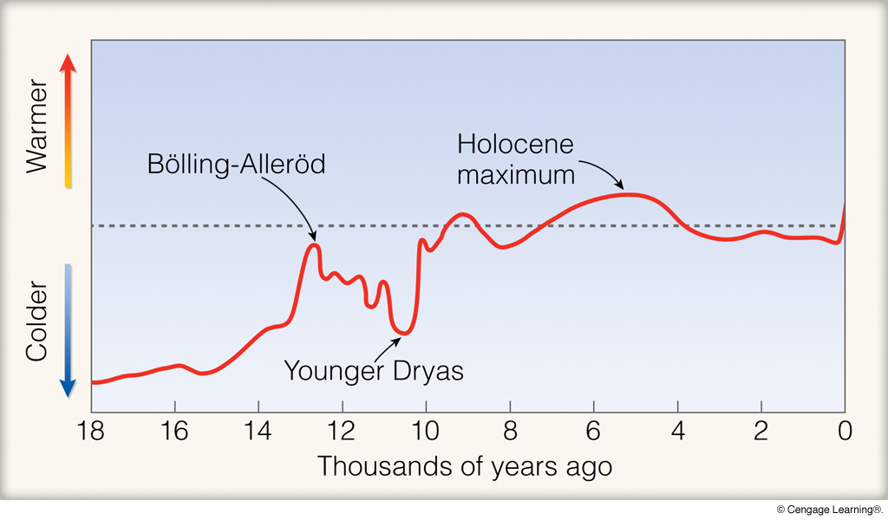
Notes:
Page: 505
FIGURE 18.6 Relative air temperature variations (warmer and cooler periods) during the past 18,000 years. These data, which represent temperature records compiled from a variety of sources, only give an approximation of temperature changes. Some regions of the world experienced a cooling and other regions a warming that either preceded or lagged behind the temperature variations shown in the diagram.

Slide 4
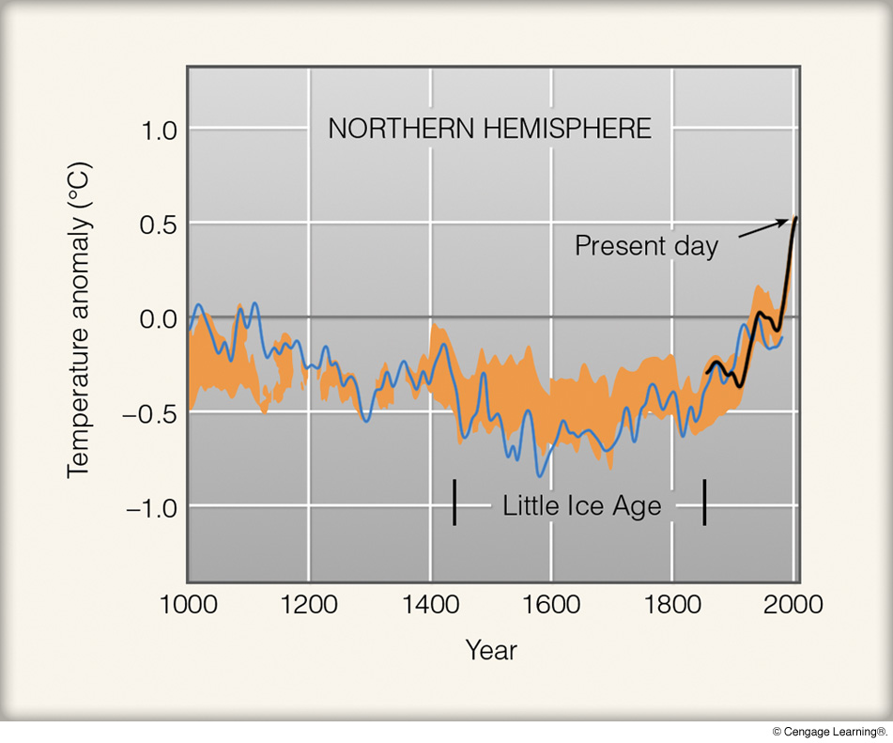
Notes:
Page: 505
FIGURE 18.7 The average temperature variations over the Northern Hemisphere for the last 1000 years relative to the 1961 to 1990 average (zero line). The blue line represents air temperatures constructed from tree rings, corals, ice cores, and pollen. Yearly temperature data measured by thermometers are in black. This reconstruction has been compared to other similar reconstructions. The area shaded orange represents where these reconstructions overlap the data by 50 percent or more. (Source: Adapted from Climate Change 2007: The Physical Science Basis. Contribution of Working Group I to the Fourth Assessment Report of the Intergovernmental Panel on Climate Change,2007. Reprinted by permission of the Intergovernmental Panel on Climate Change.)

Slide 5
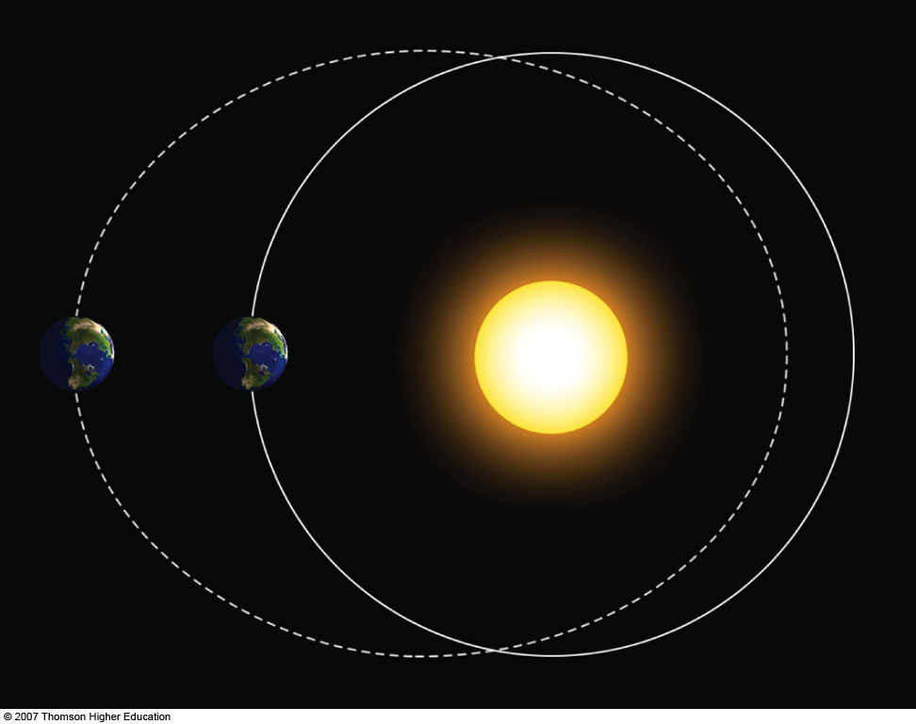
ELLIPTICITY

Slide 6
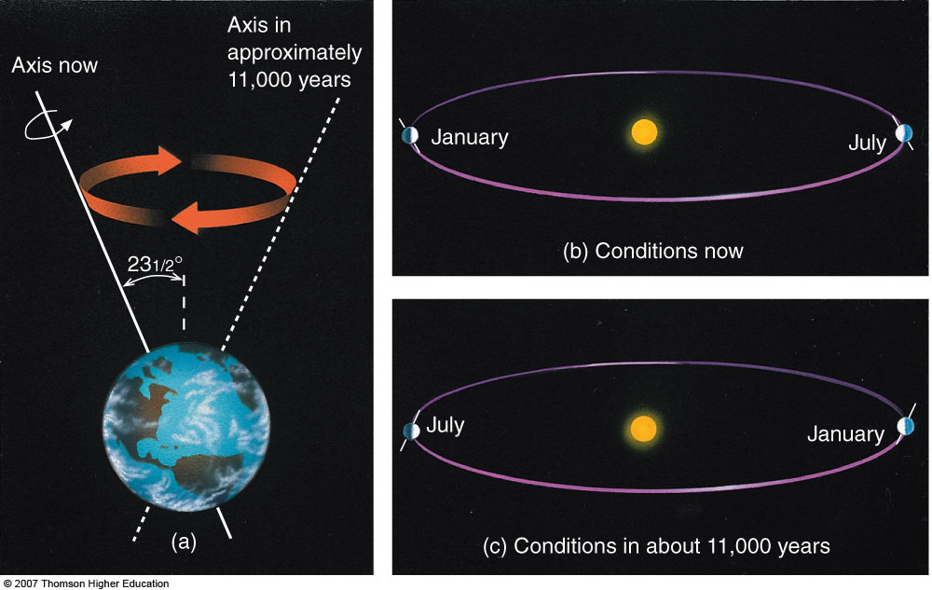
PRECESSION OF THE EQUINOXES

Slide 7
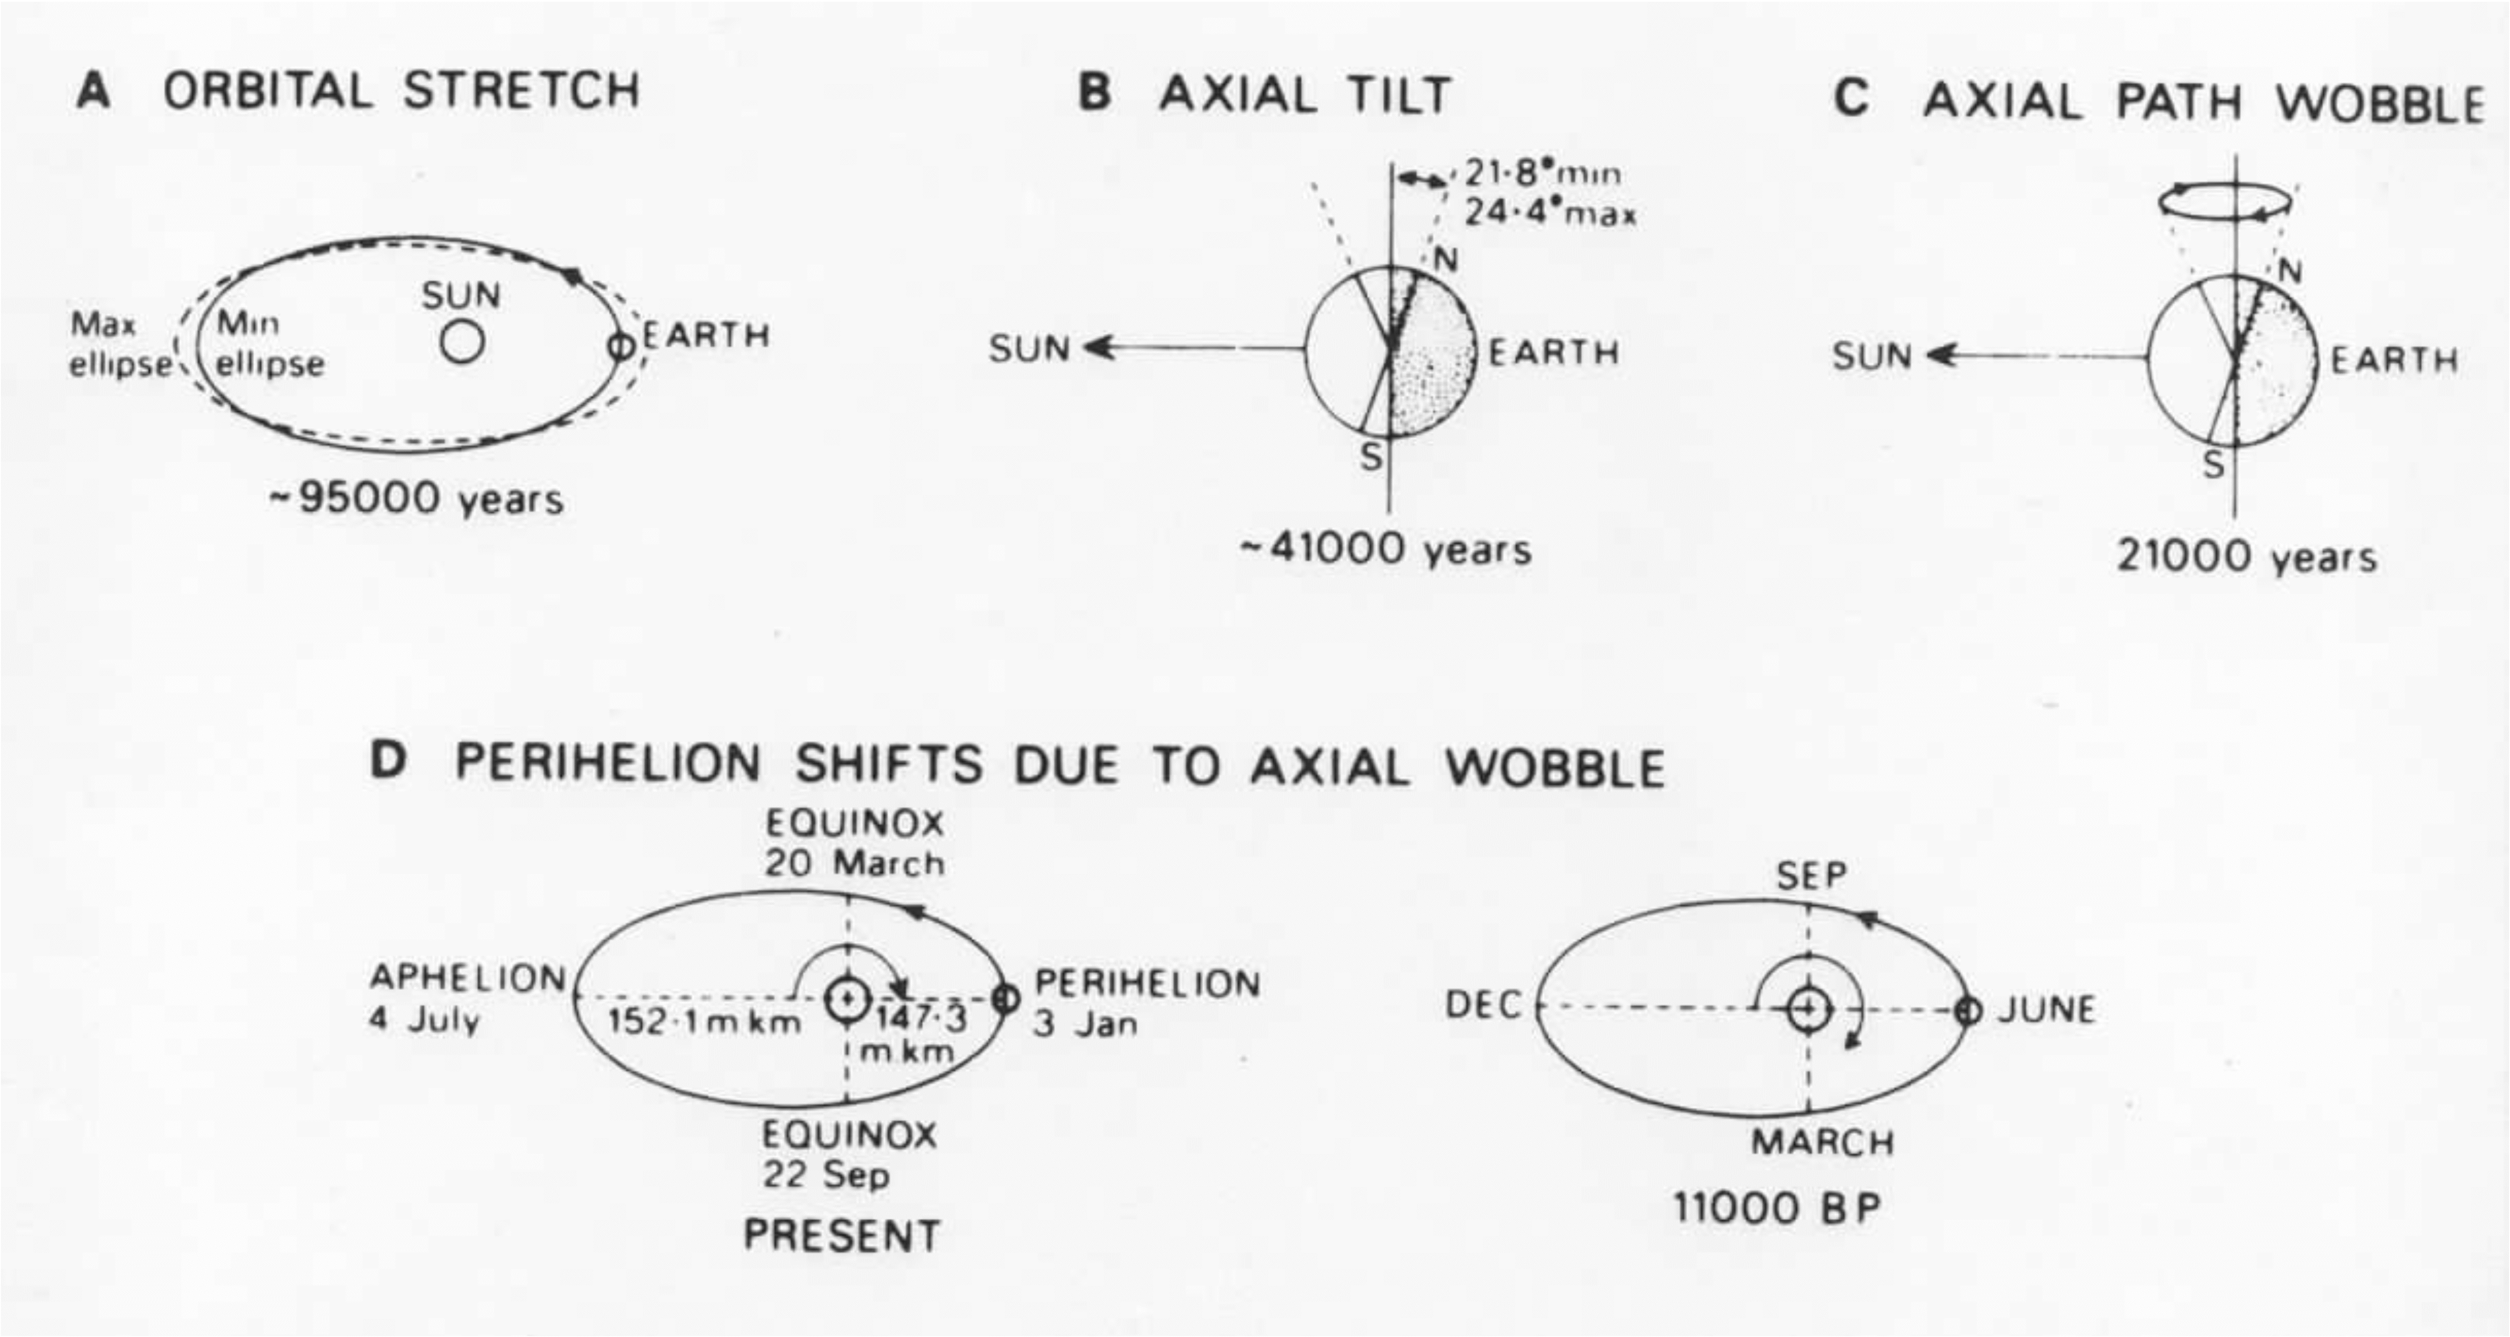
MILANKOVITCH CYCLE COMPONENTS

Slide 8
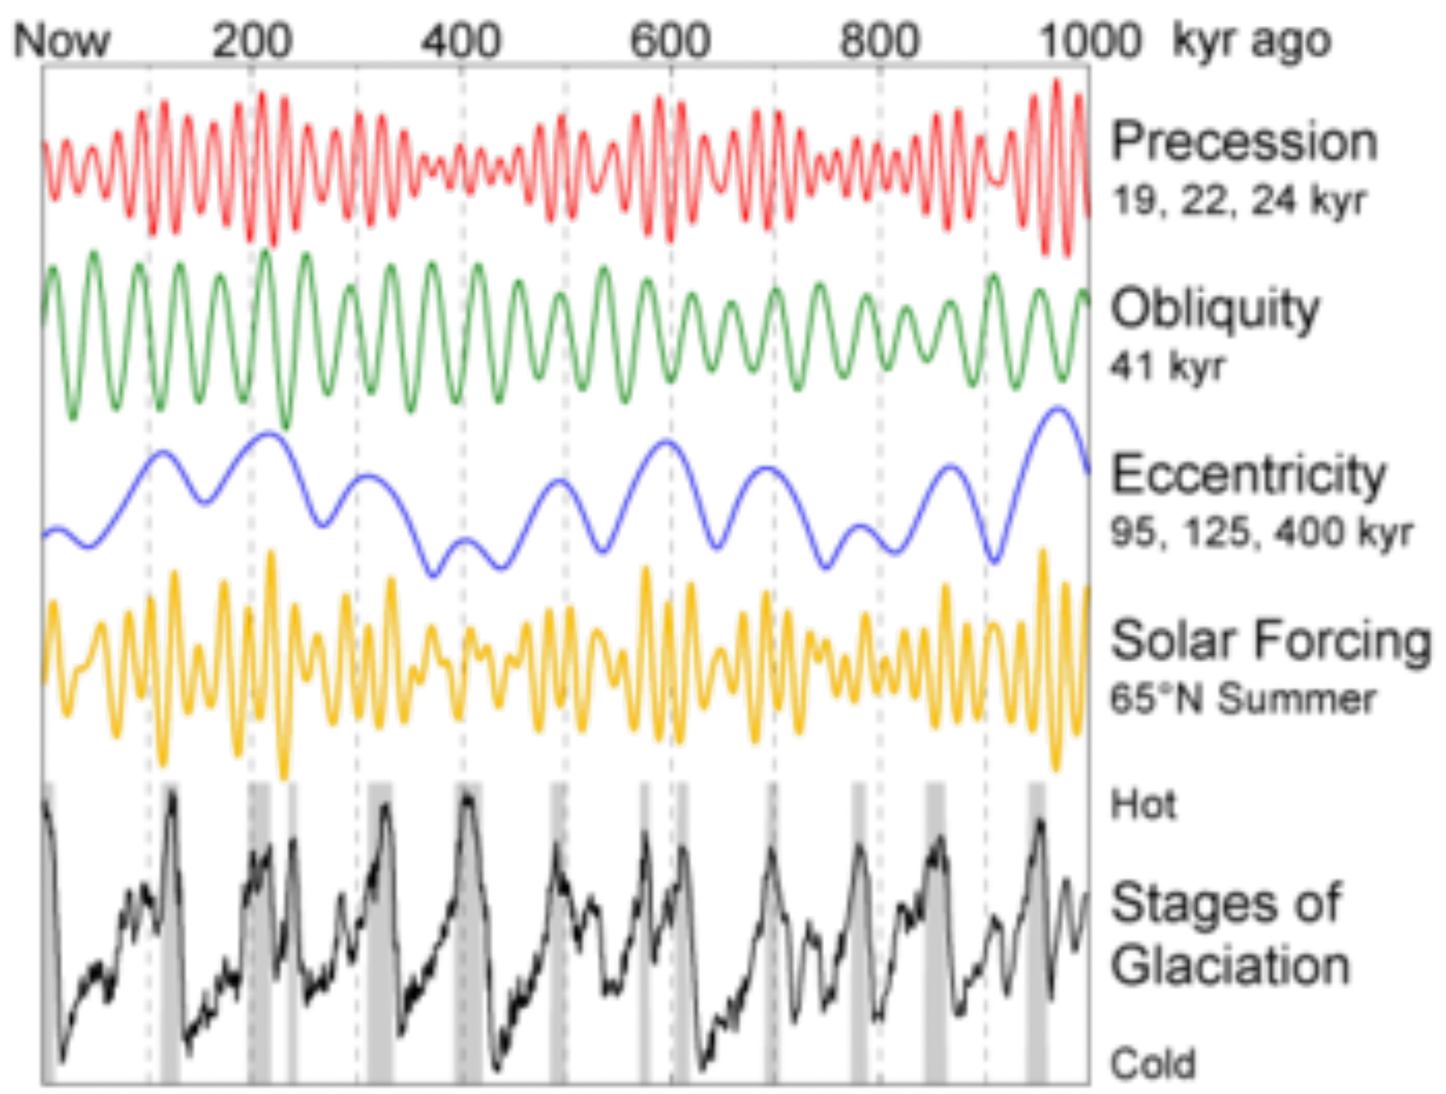
MILANKOVITCH CYCLES

Slide 9
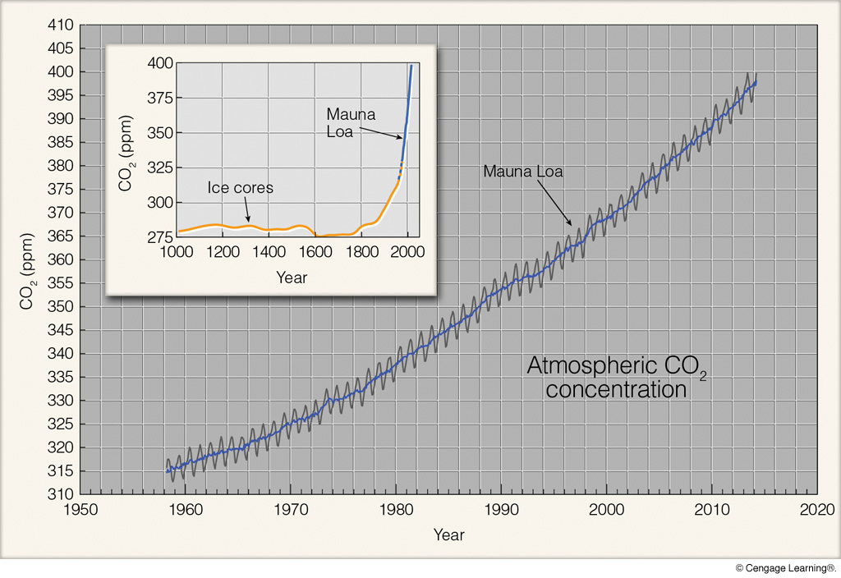
Mauna Loa Carbon Dioxide Record
Pre-industrial background
280 ppm
Current level
420 ppm
Notes:
FIGURE 1.5
Measurements of CO2
in parts per million
(ppm) at Mauna Loa
Observatory, Hawaii.
Higher readings
occur in winter when
plants die and release
CO2 to the atmosphere.
Lower readings
occur in summer
when more abundant
vegetation absorbs
CO2 from the atmosphere.
The solid line
is the average yearly
value. Notice that the
concentration of CO2
has increased by more
than 20 percent since
1958.

Slide 10
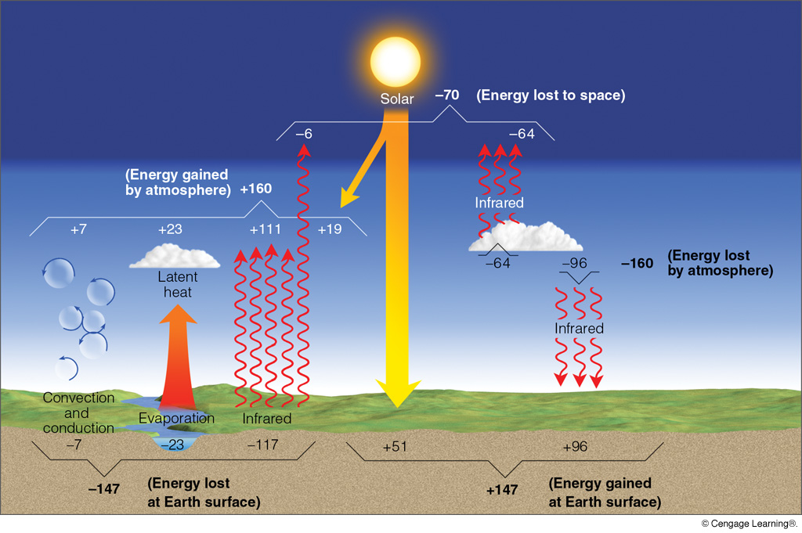
GLOBAL MEAN RADIATION BALANCE
(Note that these values differ, in some cases significantly, from those in Figure 3.19 in the Neiburger. The values in this figure are believed to be more accurate because they are based on more detailed, longer term measurements.)
Notes:
Figure 2.16
The earth-atmosphere energy balance. Numbers represent approximations based on surface observations and satellite data. While the actual value of each process may vary by several percent, it is the relative size of the numbers that is important.

Slide 11
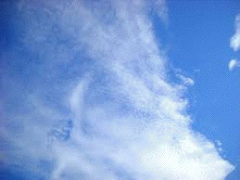
Clouds and Radiation
*
*
*
*
*
*
*
*
*
*
Ice clouds are
net warmers.
Absorption of
infrared is greater
than solar reflection.

Slide 12
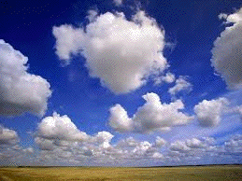
Clouds and Radiation
Water clouds are
net coolers.
Absorption of
infrared is less
than solar reflection.

Slide 13
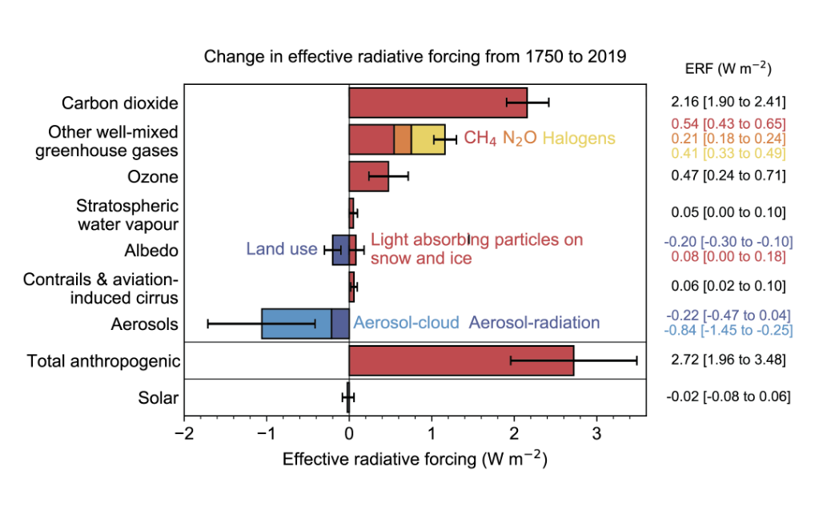
IPCC AR6 ESTIMATES OF RADIATIVE FORCING (RF)

Slide 14
Radiative Forcing (Definition)
*change in net radiation arising from some external factor (e.g., greenhouse gases, aerosols, etc.)
positive → more energy in system → warmer
negative → less energy in system → cooler
*relative to 1750 (pre-industrial baseline)
*global annual average values

Slide 15
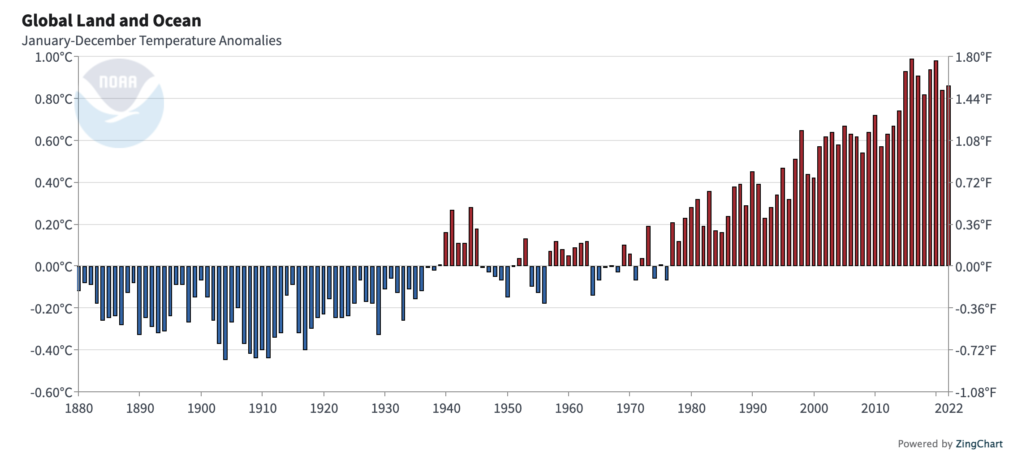
Global Annual Temperature Anomalies (°C)
?
(Annual values are departures from the 20th century mean temperature)
https://www.ncei.noaa.gov/access/monitoring/climate-at-a-glance/global/time-series/globe/land_ocean/12/12/1880-2022

Slide 16
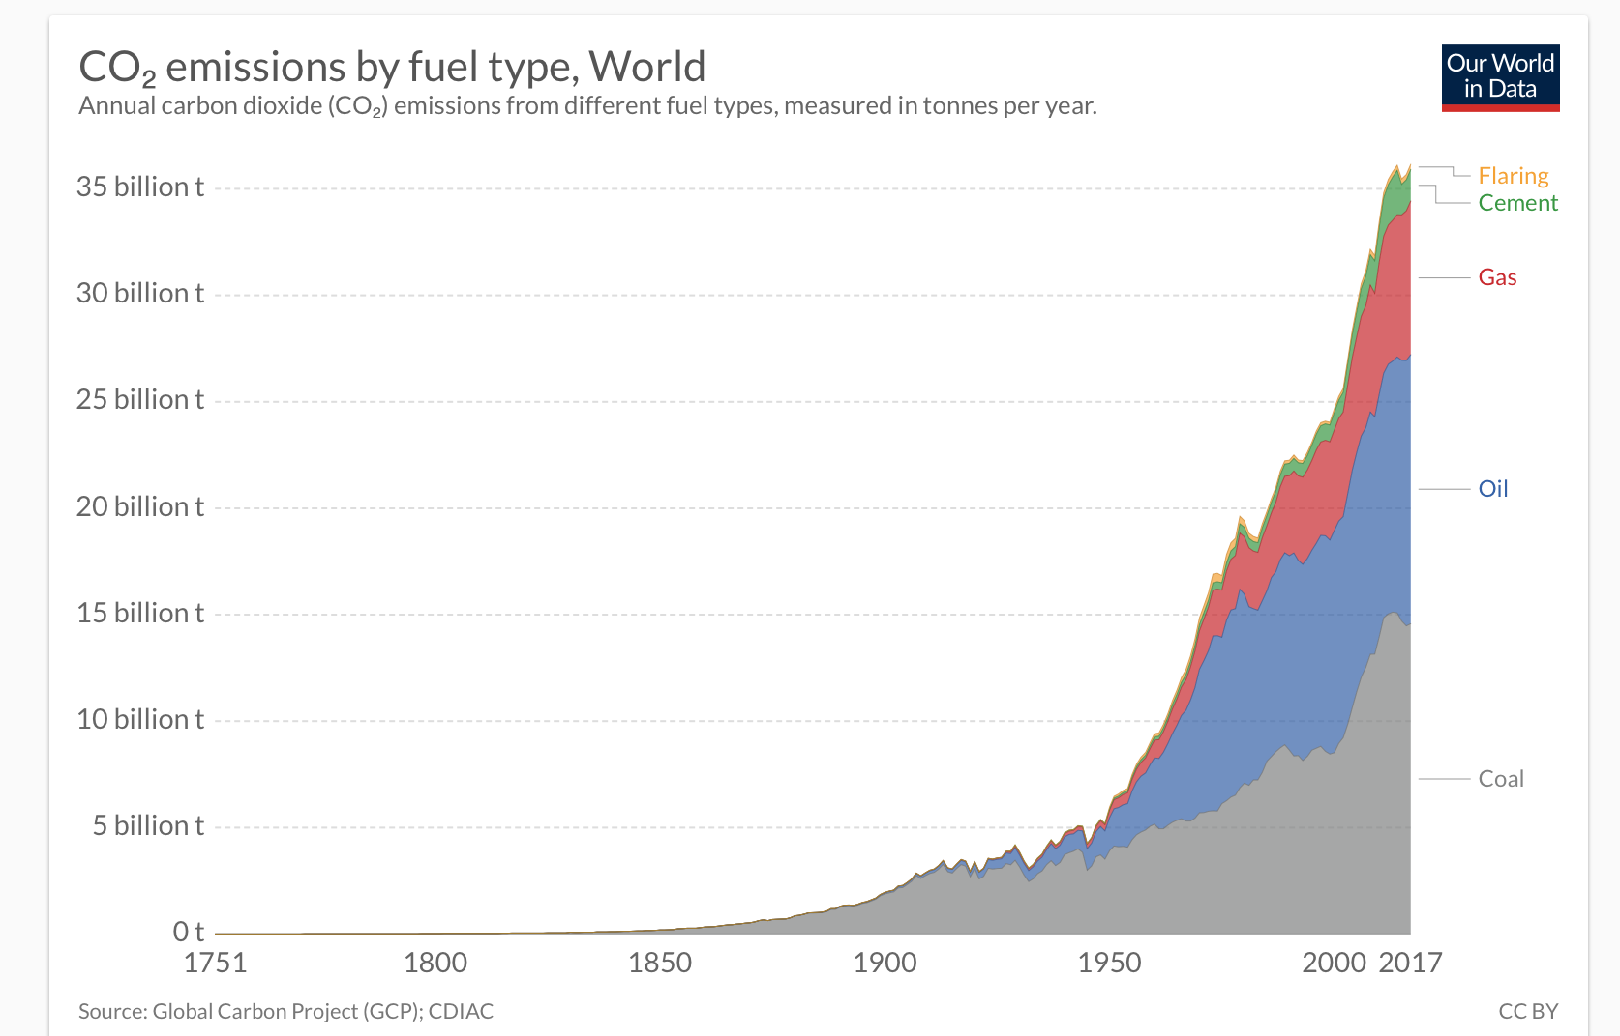
Global Carbon Emission Estimates
Source: CDIAC

Slide 17
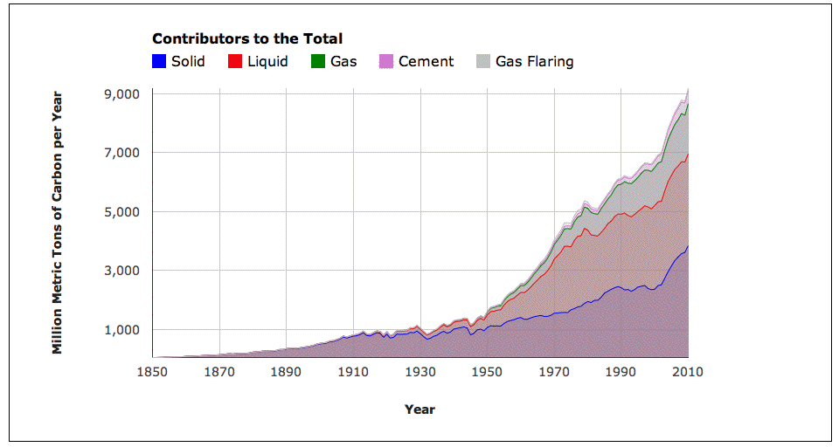
Global Annual Temperature Anomalies

Slide 18
Global Solar Radiation
Global Temperature

Slide 19
Reconstructed Solar Output
1370
0.2
Reconstructed Solar Output
Reconstructed Temperature History
Thermometer Temperature History
1368
0.0
Temperature Departure (°C)
Solar Output (W/sq. m)
–0.2
1366
–0.4
1364
–0.6
1600
1700
1800
1900
2000

Slide 20
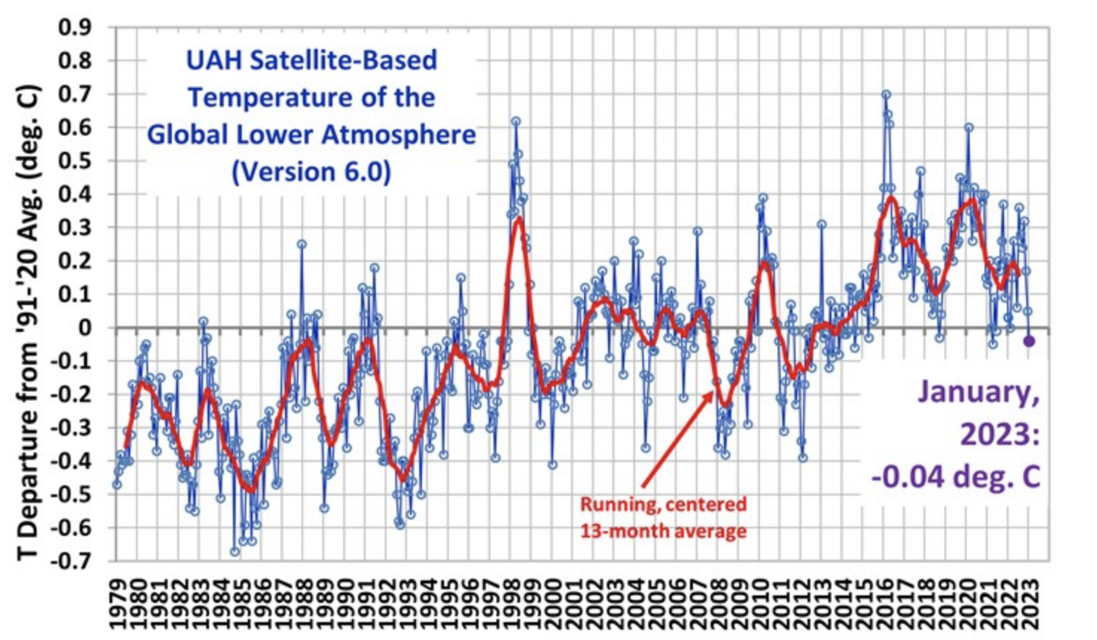
GLOBAL SATELLITE TEMPERATURES
1978–2023
El Niño
El Niño
Volcano
Volcano

Slide 21
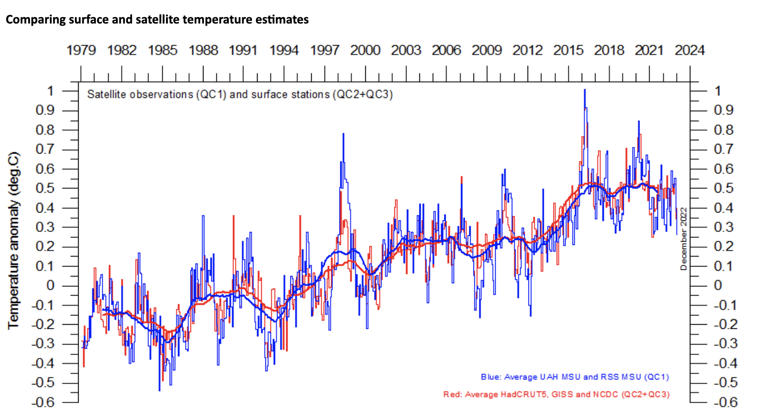
COMPARISON OF SURFACE AND SATELLITE TEMPERATURES
1979–2022
Surface vs. Satellite Temperatures
(Climate4you.com)

Slide 22
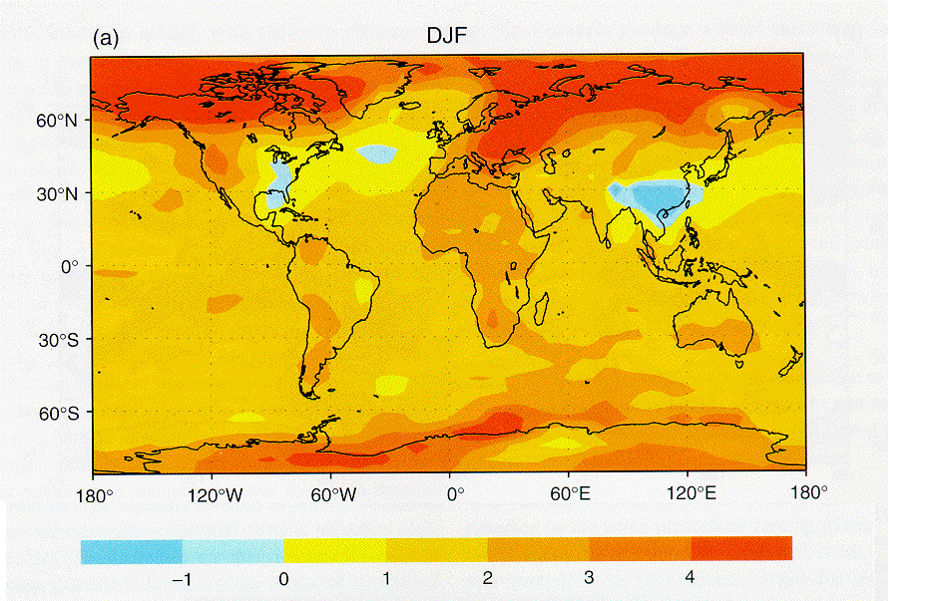
DJF Temperature Change from 1880-1889 mean by 2040-2049 predicted by the Max-Plank Institute model

Slide 23
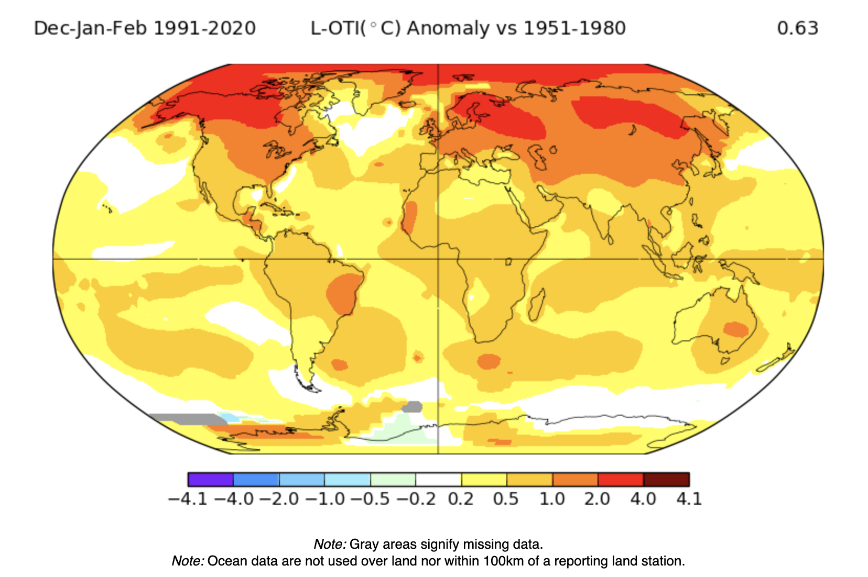
Observed December-February Temperature Change
(1991–2020 minus 1951-1980)
http://data.giss.nasa.gov/gistemp/maps/

Slide 24
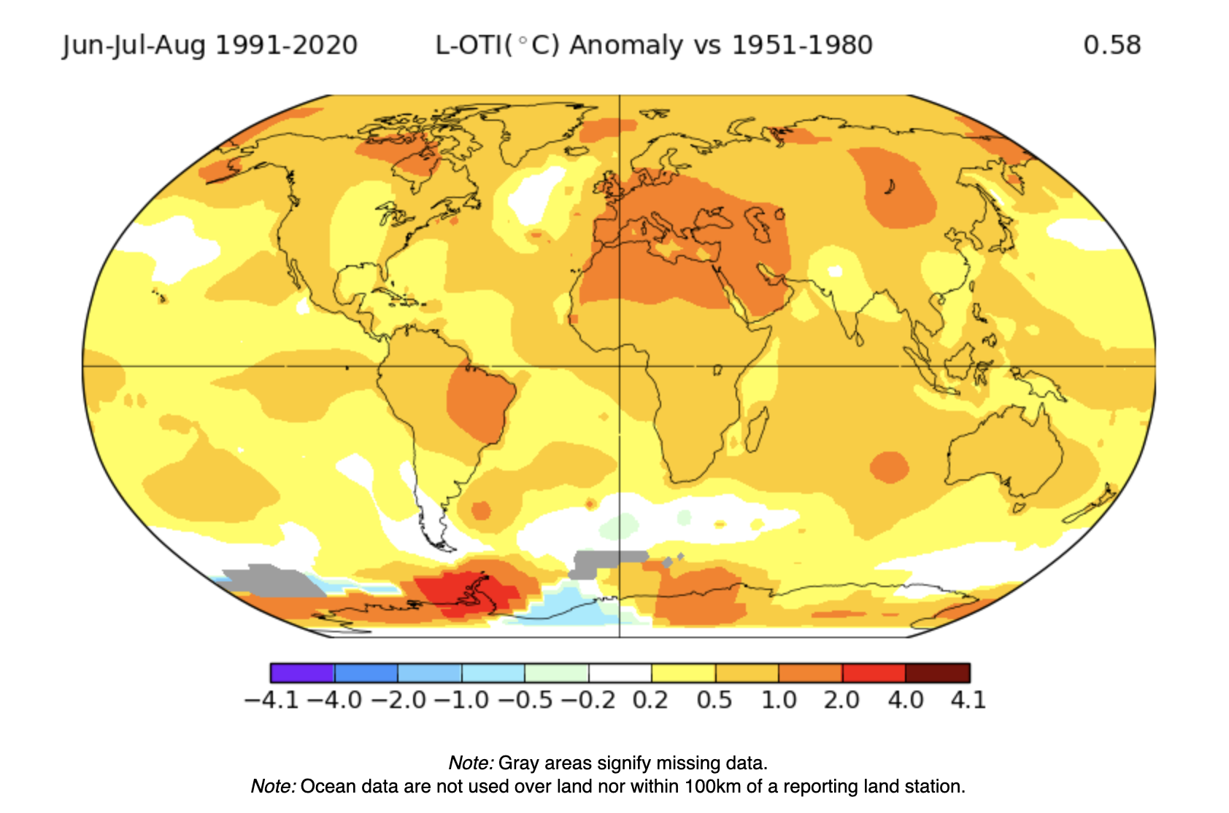
Observed June–August Temperature Change
(1991–2020 minus 1951–1980)
http://data.giss.nasa.gov/gistemp/maps/

Slide 25
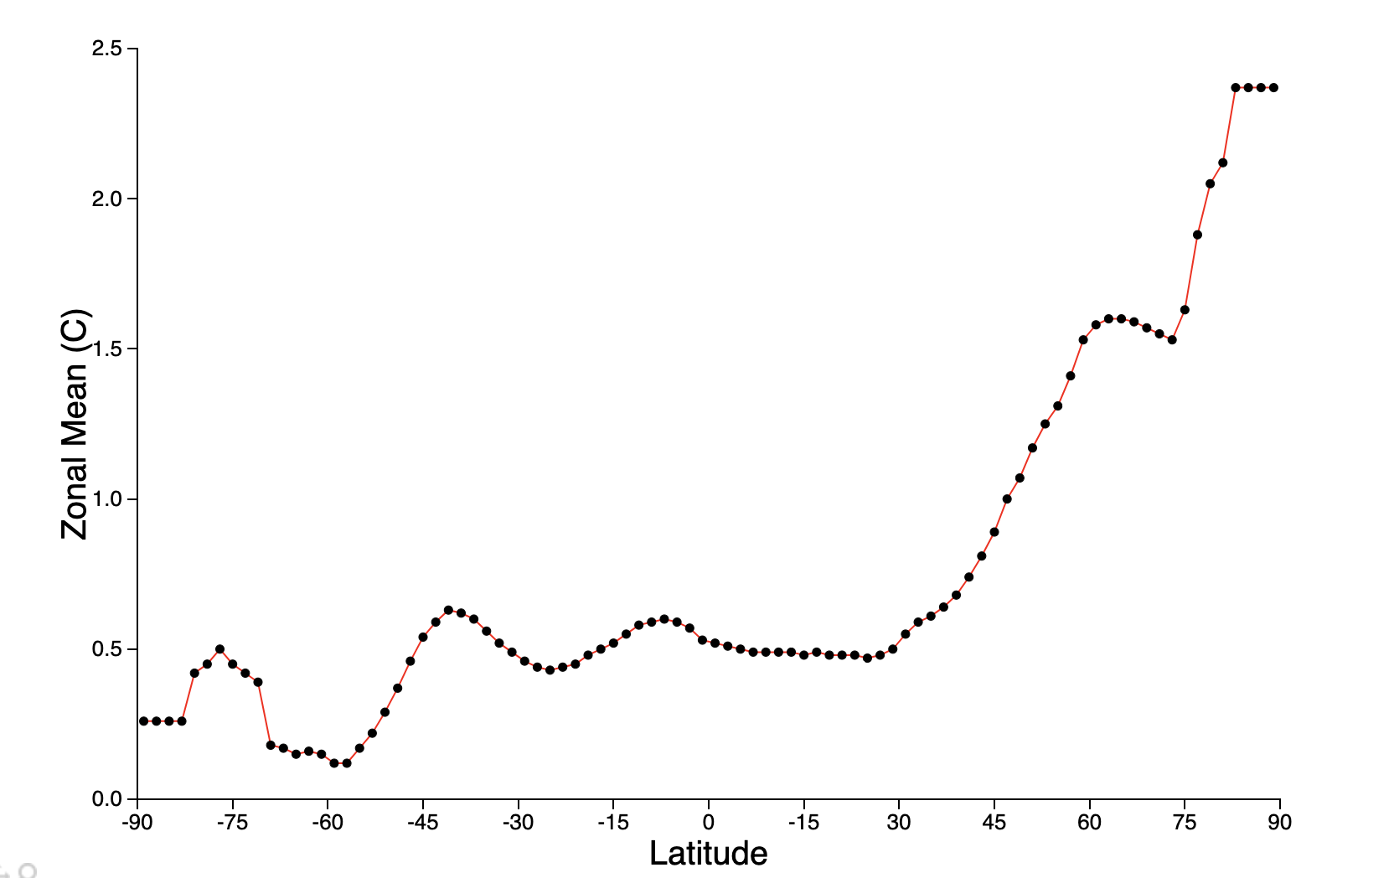
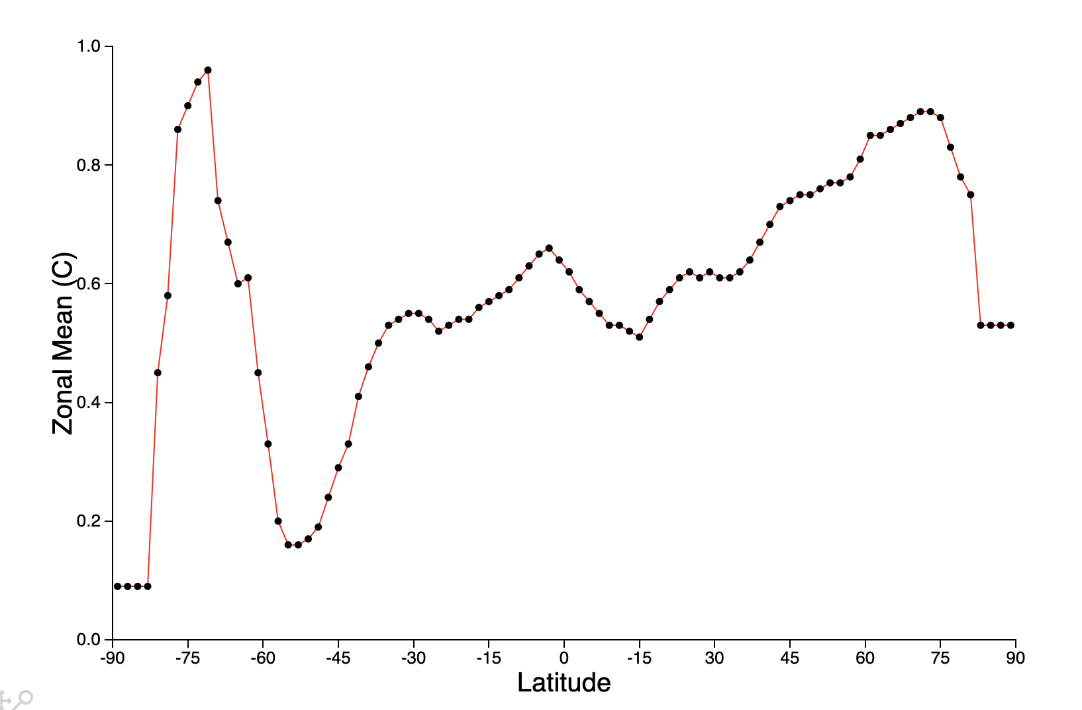
Temperature
Change by Latitude
South
Pole
North
Pole

Slide 26
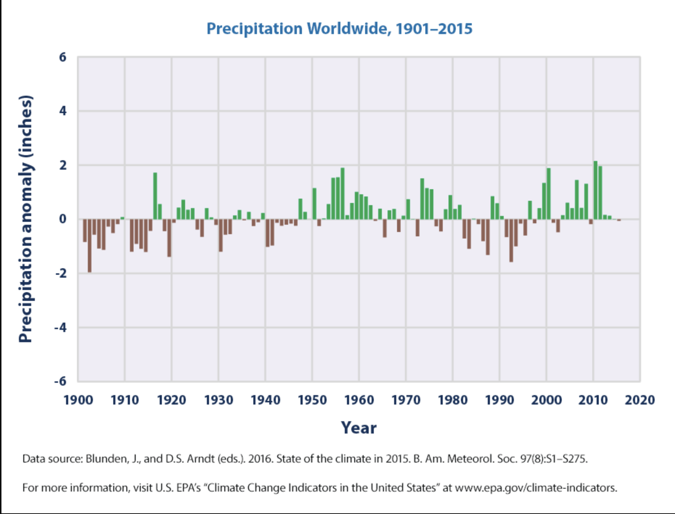
Global Precipitation over Continents
Wetter
Drier

