Slide 1
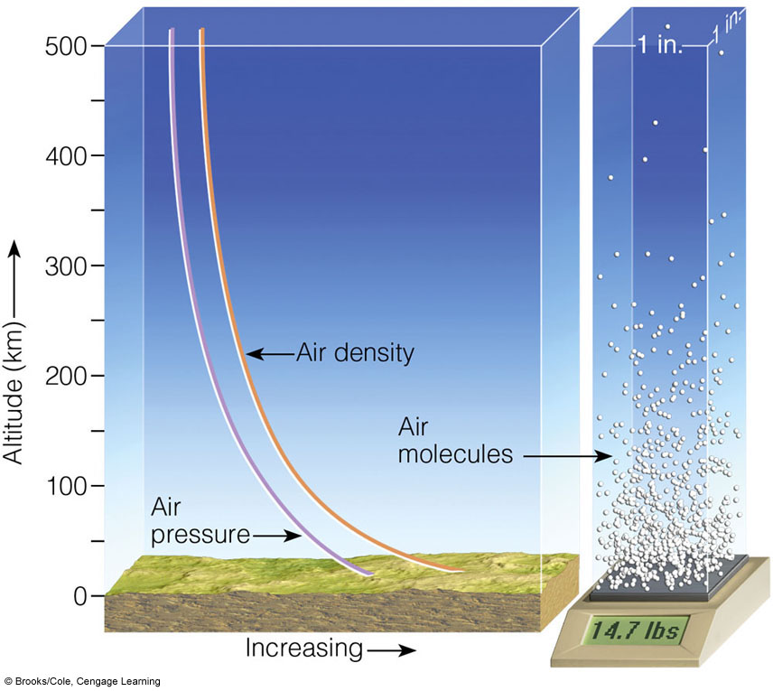
VARIATION OF PRESSURE/DENSITY WITH HEIGHT
Notes:
FIGURE 1.9 Both air pressure and air density decrease with
increasing altitude. The weight of all the air molecules above the earth’s
surface produces an average pressure near 14.7 lbs/in.2

Slide 2
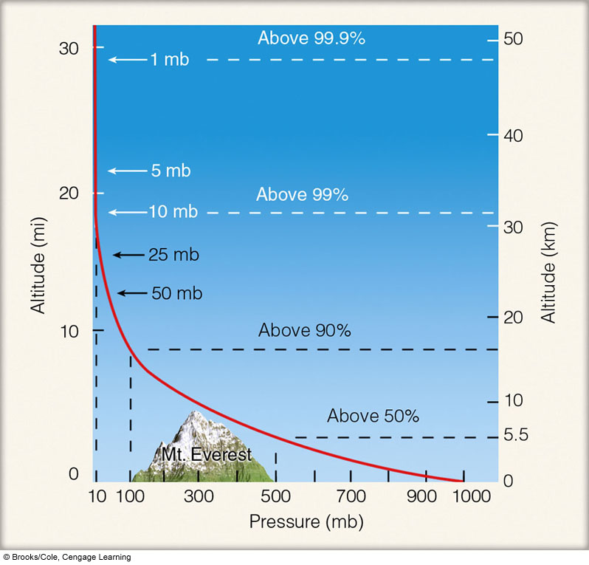
Variation of Pressure with Height
N (94–96,
99–101)
A (198–203)
Pressure can be used as a meaningful vertical scale.
Notes:
FIGURE 1.10 Atmospheric pressure decreases rapidly with
height. Climbing to an altitude of only 5.5 km, where the pressure is
500 mb, would put you above one-half of the atmosphere’s molecules.

Slide 3
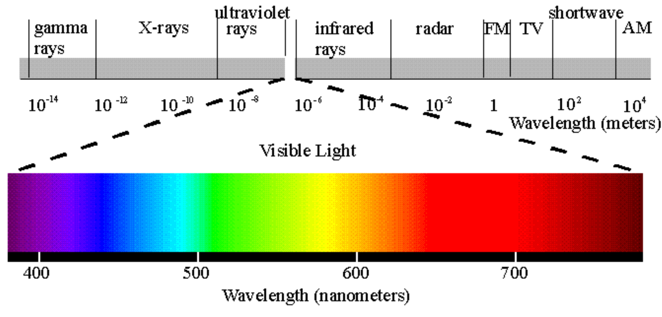
Electromagnetic Spectrum (i.e., Light)
microwaves
radio
1 micron = 10^{–6}m = 10^{–3}nanometers

Slide 4
Emissivity (ε): for a body at a given temperature,
radiation emitted divided by blackbody emission
= 1 (blackbody)
= 0 (whitebody, or perfect reflector)
Emissivity can be defined for a specific wavelength
(e.g., infrared emissivity = 0.7) or over an entire spectrum
of radiation (e.g., atmosphere’s emissivity from UV through
IR = 0.93)
Absorptivity (a): for a body at a given temperature,
radiation absorbed divided by blackbody absorption

Slide 5
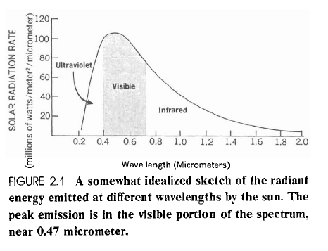
Solar Radiation
Planck Curve
Irradiance
Radiant Flux Density

Slide 6
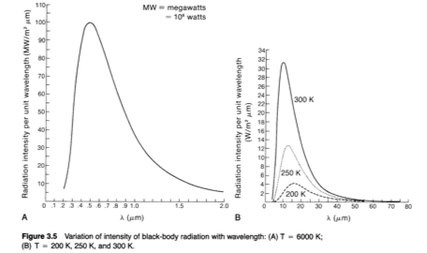
Blackbody Planck Curves
6000 K
Notes:
The hotter sun not only radiates more energy than that of the cooler earth (the area under the curve), but it also radiates the majority of its energy at much shorter wavelengths. (The area under the curves is equal to the total energy emitted, and the scales for the two curves differ by a factor of 100,000.)

Slide 7
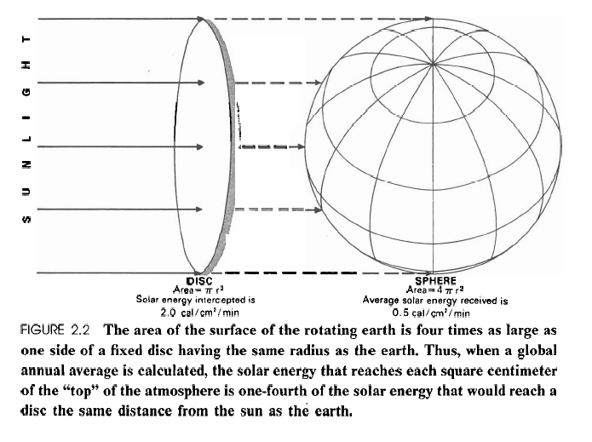
Solar Constant
1367 Wm^{–2}
1367/4 = 341.75 Wm^{–2}

Slide 8
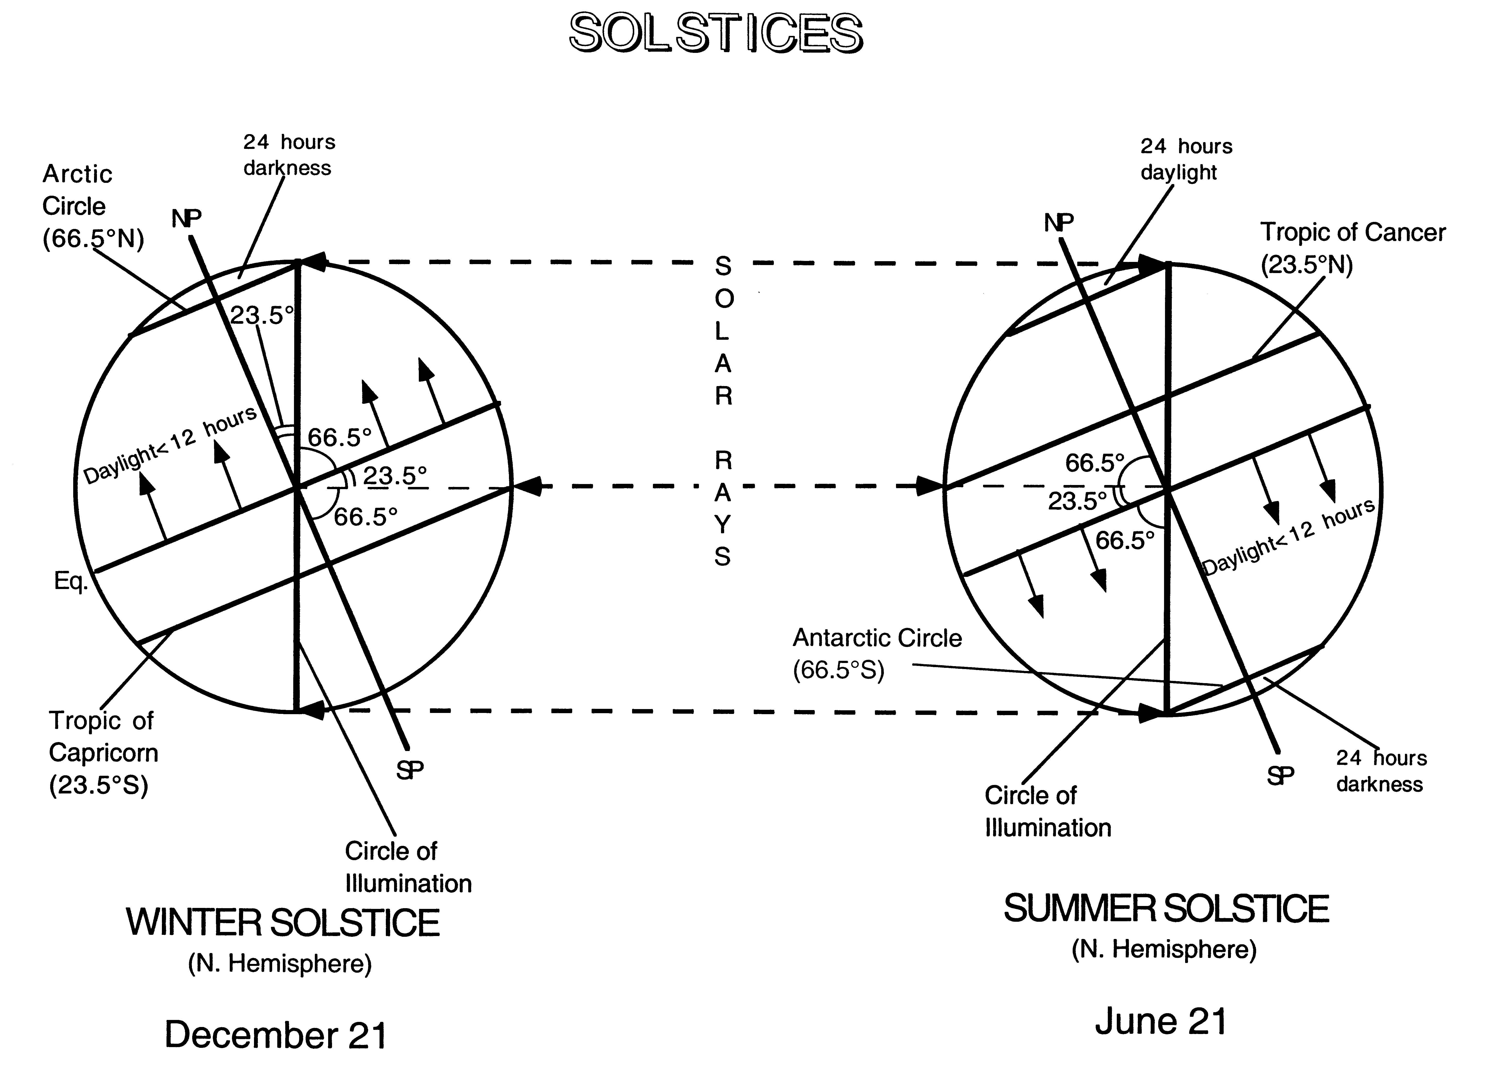

Slide 9
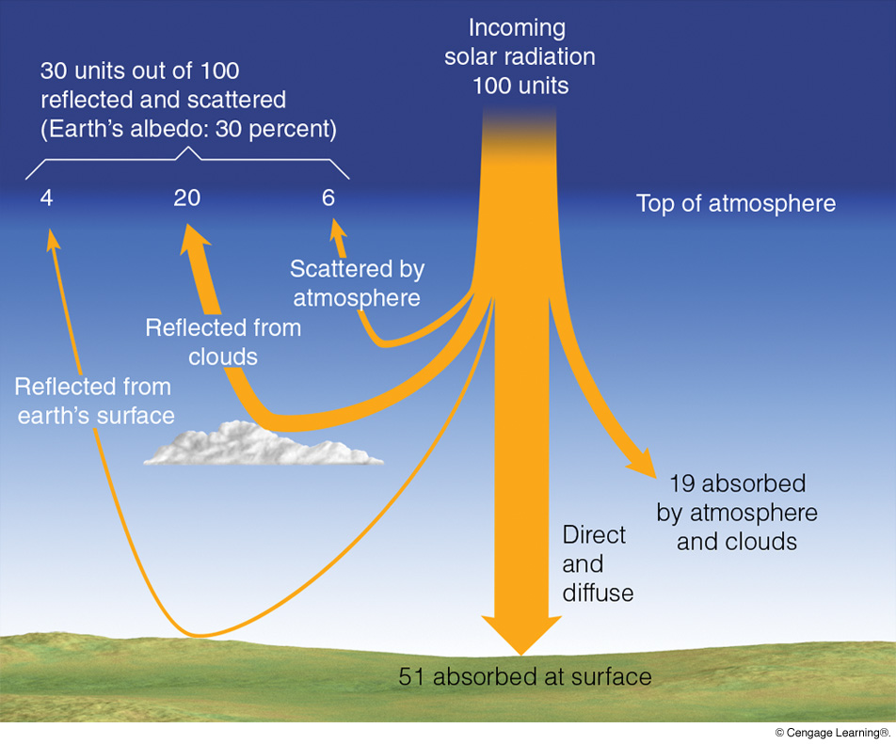
= 341.75 Wm^{–2}
Reflection and
Mie backscatter
Reflection and
Rayleigh backscatter
(Incl. Rayleigh and Mie forwardscatter)
Notes:
Figure 2.15
On the average, of all the solar energy that reaches the earth’s atmosphere annually, about 30 percent (³⁰⁄₁₀₀) is reflected and scattered back to space, giving the earth and its atmosphere an albedo of 30 percent. Of the remaining solar energy, about 19 percent is absorbed by the atmosphere and clouds, and 51 percent is absorbed at the surface.

Slide 10
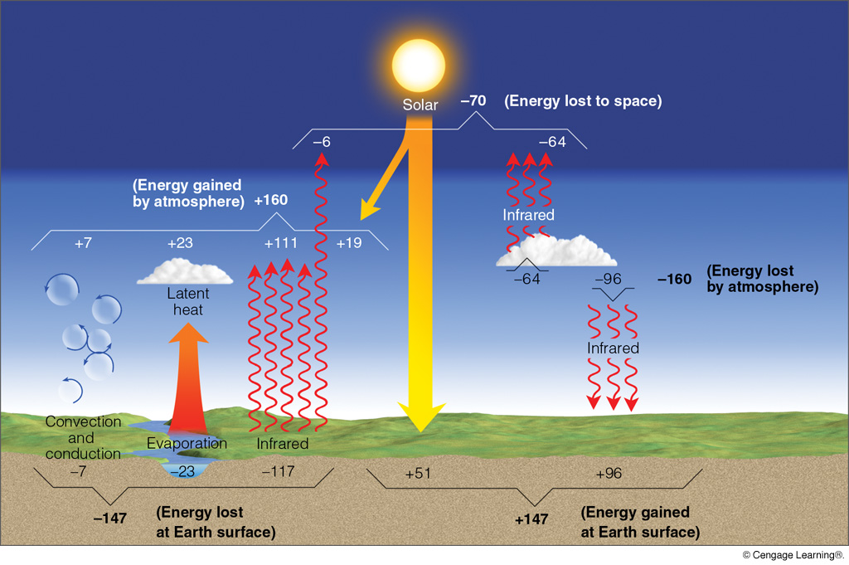
GLOBAL MEAN RADIATION BALANCE
(Note that these values differ, in some cases significantly, from those in Figure 3.19 in the Neiburger. The values in this figure are believed to be more accurate because they are based on more detailed, longer term measurements.)
Notes:
Figure 2.16
The earth-atmosphere energy balance. Numbers represent approximations based on surface observations and satellite data. While the actual value of each process may vary by several percent, it is the relative size of the numbers that is important.

Slide 11
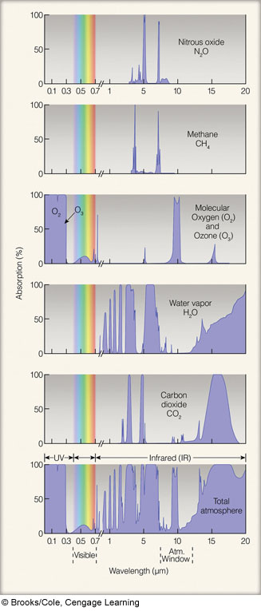
Absorption Spectra
of Primary
Greenhouse Gases
Notes:
Figure 2.11
Absorption of radiation by gases in the atmosphere. The shaded area for each gas represents the percent of radiation each gas can absorb. The strongest absorbers of infrared radiation are water vapor and carbon dioxide. The bottom figure represents the percent of radiation absorbed by all of the atmospheric gases.

Slide 12
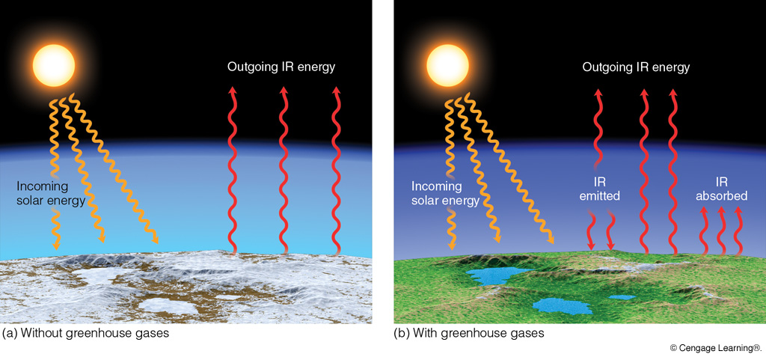
Impact of Greenhouse Gases
Radiative Equilibrium
Temperature = 255 K
Mean Surface Temperature = 288 K
Notes:
Figure 2.12
Sunlight warms the earth’s surface only during the day, whereas the surface constantly emits infrared radiation upward during the day and at night.
(a) Near the surface without water vapor, CO₂, and other greenhouse gases, the earth’s surface would constantly emit infrared radiation (IR) energy; incoming energy from the sun would be equal to outgoing IR energy from the earth’s surface. Since the earth would receive no IR energy from its lower atmosphere (no atmospheric greenhouse effect), the earth’s average surface temperature would be a frigid –18°C (0°F).

Slide 13
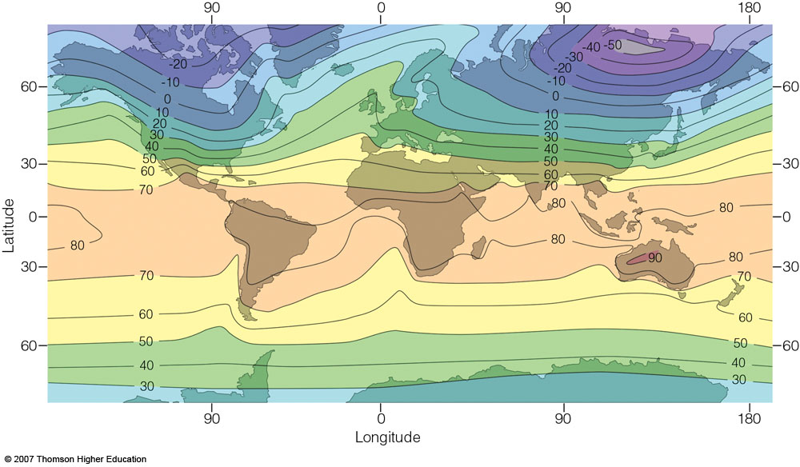
Mean January Surface Temperature
Strong mid-latitude gradient
Weak mid-latitude gradient
Notes:
Figure 3.20
Average air temperature near sea level in January (°F).

Slide 14
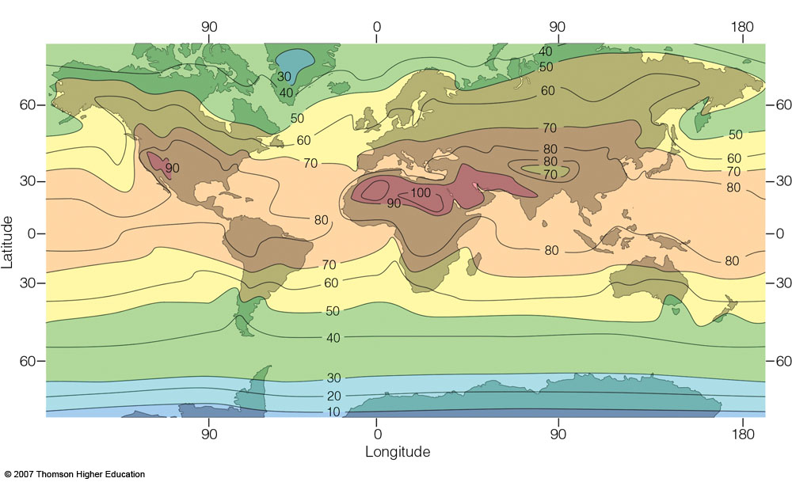
Mean July Surface Temperature
Weaker mid-latitude gradient
Relatively weak
mid-latitude gradient
Notes:
Figure 3.21
Average air temperature near sea level in July (°F).

Slide 15
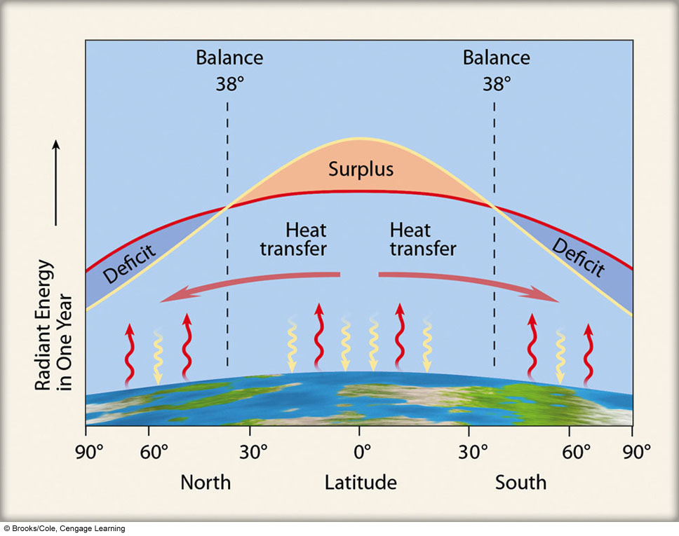
Notes:
Figure 2.17
The average annual incoming solar radiation (red line) absorbed by the earth and the atmosphere along with the average annual infrared radiation (blue line) emitted by the earth and the atmosphere.

Slide 16
DIURNAL RADIATION BALANCE
Cloudless Day, Midlatitudes, Equinox
Absorbed Solar (K)
L
L
L
L
Irradiance
0
0
Lnet
Lnet
00
06
12
18
24
Hour
Temperature
Temperature
Net radiation (R_{n})
Irradiance
Temperature
Surplus
Deficit
00
06
12
18
24
Hour

