Slide 1
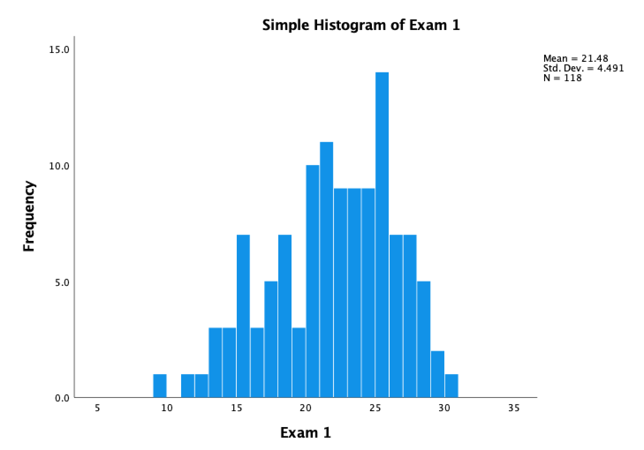
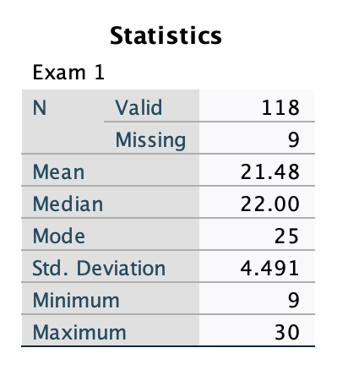
EVSC 1300—Exam 1
Spring, 2023
≥ 26 A
22–25 B
19–22 C
15–18 D
≤ 14 F

