Slide 1
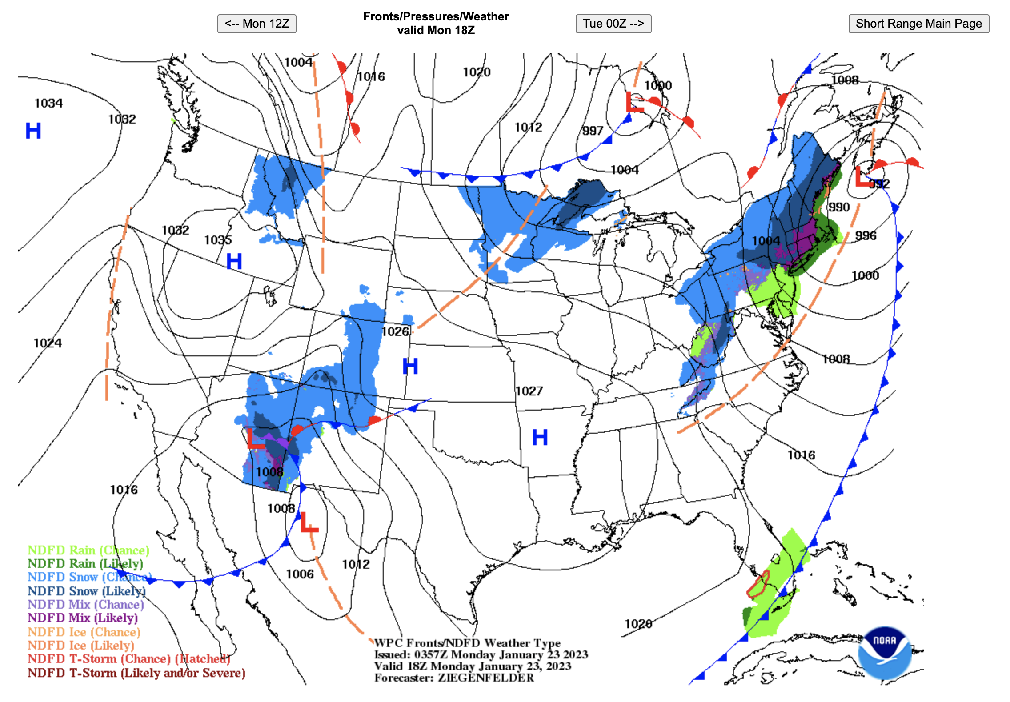
Wind direction
at A?
2. Wind direction
at B?
Wind direction
at C?
Where is the wind
weakest? (A-D)?
What kind of front
is this and where is the
cold air?
cold, to the north
warm, to the south
stationary, to the north
occluded, to the south
B
D
5
A
C

Slide 2
Wind direction
at A? northwest (NW)
2. Wind direction
at B? east (E)
Wind direction
at C? southeast (SE)
B
D
Where is the wind
weakest? (A-D)? D
5
A
cold
What kind of front
is this and where is the
cold air?
cold, to the north
warm, to the south
stationary, to the north
occluded, to the south
C

