Slide 1
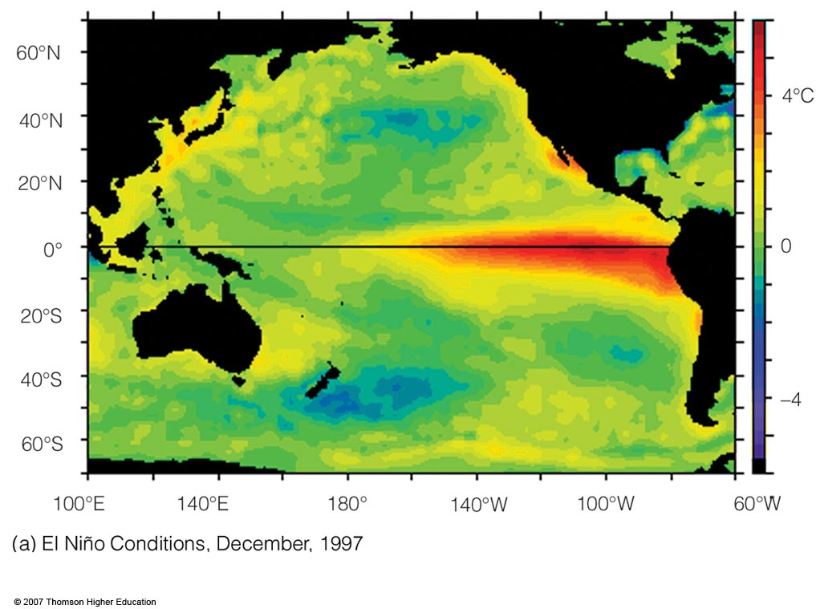
EL NINO
Notes:
Figure 10.21
(a) Average sea surface temperature departures from normal as measured by satellite. During El Niño conditions upwelling is greatly diminished and warmer than normal water (deep red color) extends from the coast of South America westward, across the Pacific.

Slide 2
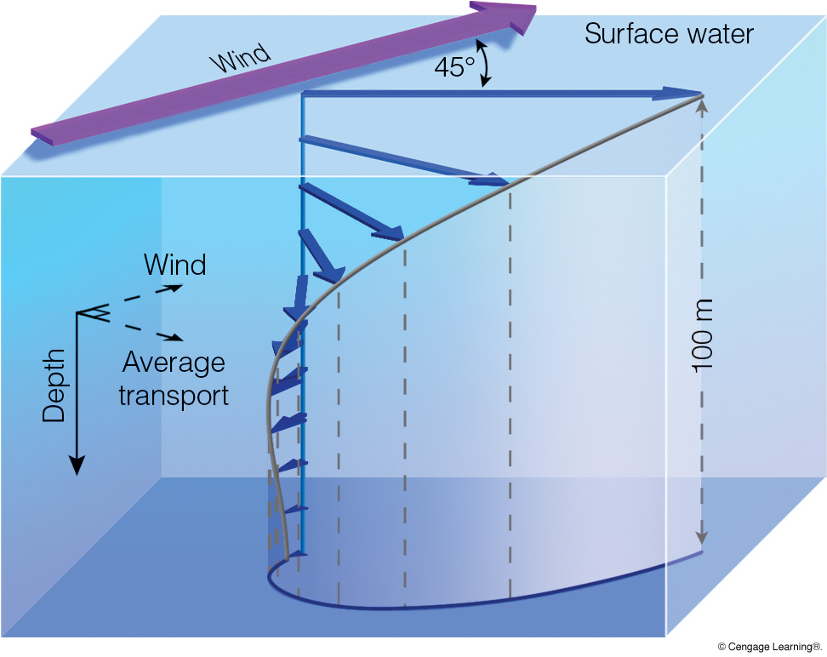
Ekman Spiral
Notes:
Page: 281
FIGURE 10.20 The Ekman spiral. Winds move the water, and the Coriolis force deflects the water to the right (Northern Hemisphere). Below the surface each successive layer of water moves more slowly and is deflected to the right of the layer above. The average transport of surface water in the Ekman layer is at right angles to the prevailing winds.

Slide 3
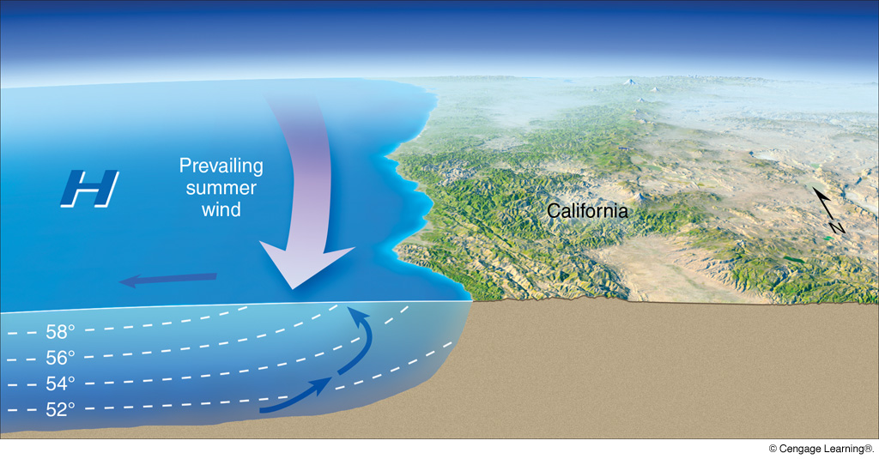
Cold Water Upwelling
Notes:
Page: 281
FIGURE 10.21 As winds blow parallel to the west coast of North America, surface water is transported to the right (out to sea). Cold water moves up from below (upwells) to replace the surface water. The large H represents the position of the Pacific High in summer. Blue arrows show the movement of water.

Slide 4
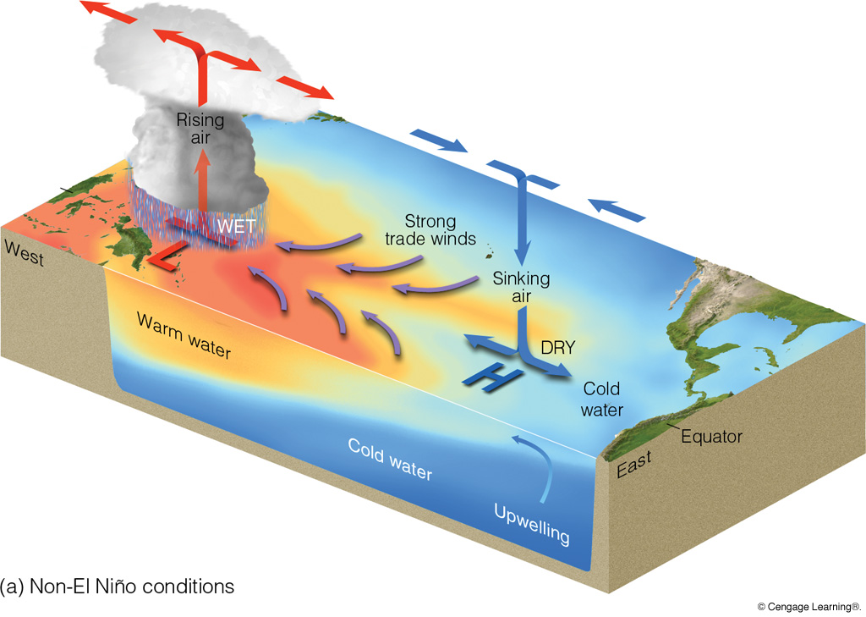
“Normal” Conditions
Notes:
Page: 282
FIGURE 10.22 In diagram (a), under non–El Niño conditions higher pressure over the southeastern Pacific and lower pressure near Indonesia produce easterly trade winds along the equator. These winds promote upwelling and cooler ocean water in the eastern Pacific, while warmer water prevails in the western Pacific. The trades are part of a circulation that typically finds rising air and heavy rain over the western Pacific and sinking air and generally dry weather over the eastern Pacific. If the trades are exceptionally strong (not shown here), water along the equator in the eastern Pacific becomes quite cool. This cool event is called La Niña. During El Niño conditions—diagram (b)—atmospheric pressure decreases over the eastern Pacific and rises over the western Pacific. This change in pressure causes the trades to weaken or reverse direction. This situation enhances the countercurrent that carries warm water from the west over a vast region of the eastern tropical Pacific.

Slide 5
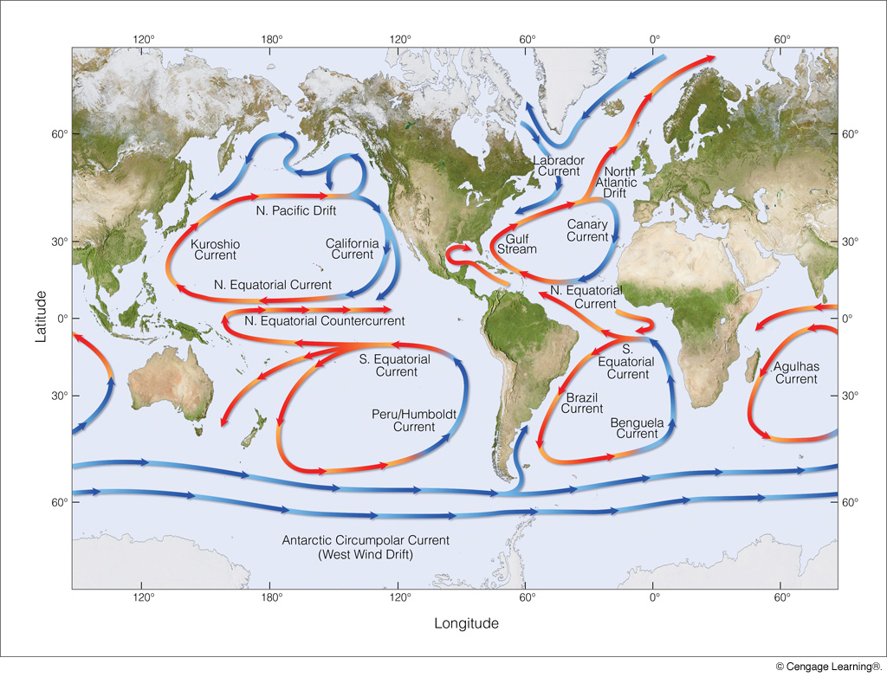
Global Ocean Currents
Notes:
Page: 279
FIGURE 10.17 Average position and extent of the major surface ocean currents. Cold currents are shown in blue; warm currents are shown in red.

Slide 6
Walker Cells
The Walker Circulation is comprised of east–west oriented cells
along the Equator, such that some equatorial areas are wet and
others are dry.

Slide 7
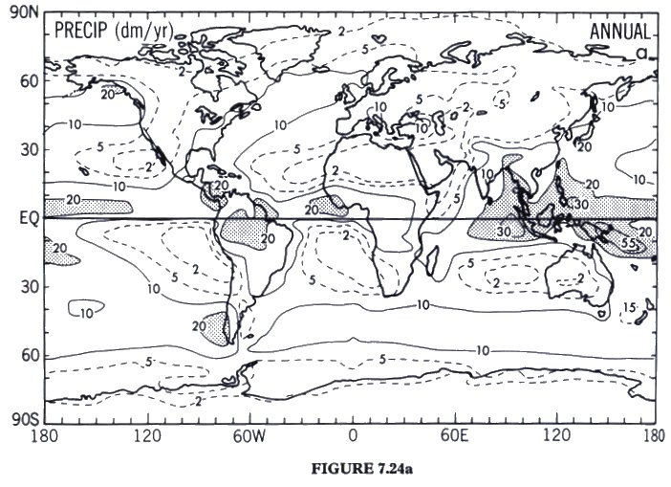
Global Average Precipitation

Slide 8
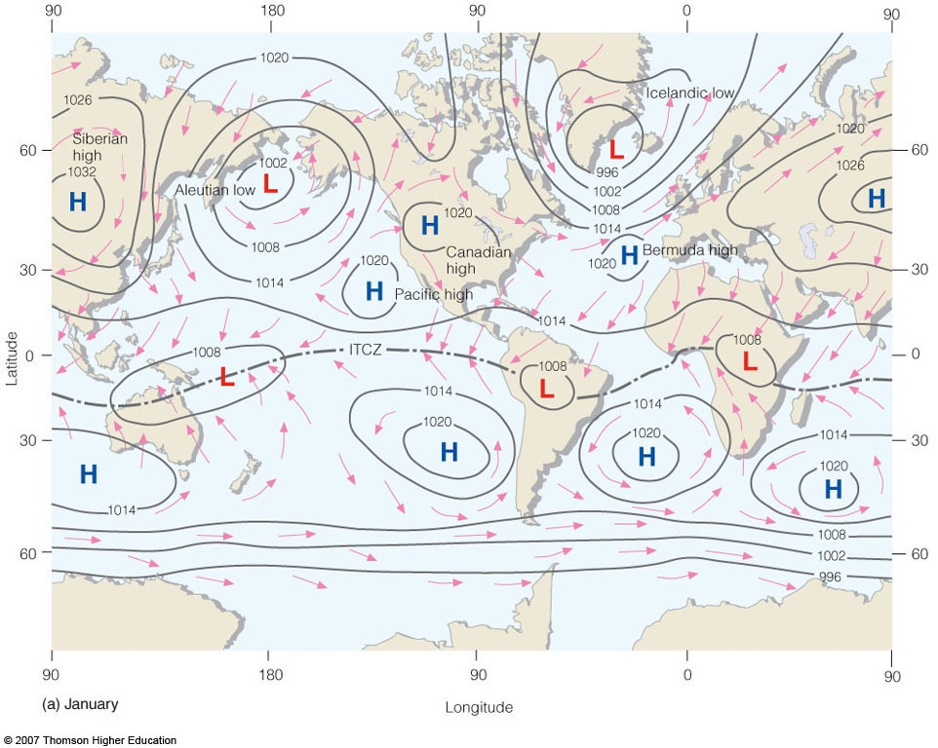
AVERAGE JANUARY SEA-LEVEL PRESSURE
Darwin
Tahiti
Southern Oscillation = Tahiti Surface Pressure — Darwin Surface Pressure

Slide 9
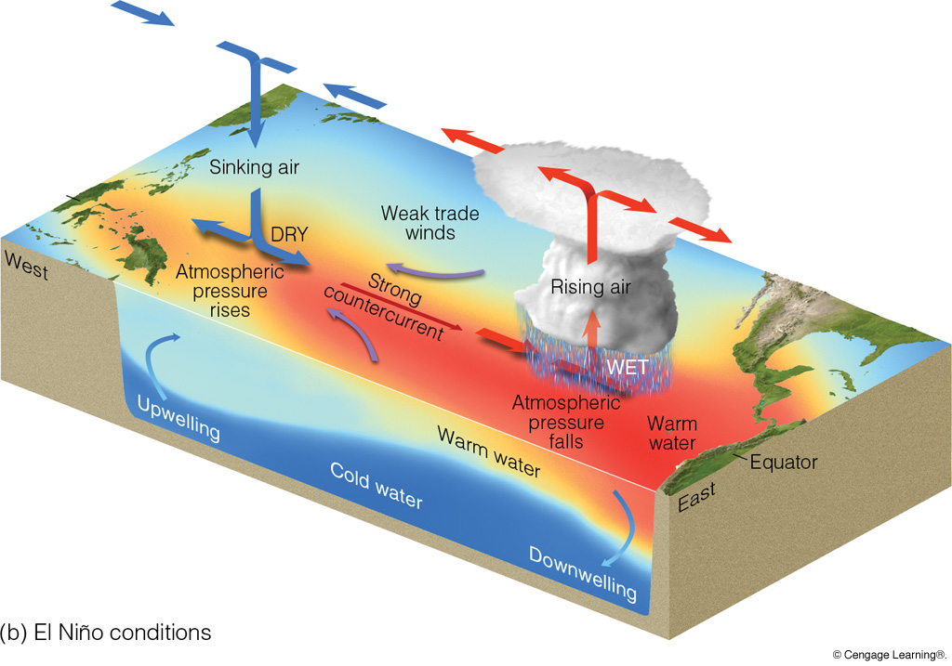
EL NINO CONDITIONS
Notes:
Page: 282
FIGURE 10.22 In diagram (a), under non–El Niño conditions higher pressure over the southeastern Pacific and lower pressure near Indonesia produce easterly trade winds along the equator. These winds promote upwelling and cooler ocean water in the eastern Pacific, while warmer water prevails in the western Pacific. The trades are part of a circulation that typically finds rising air and heavy rain over the western Pacific and sinking air and generally dry weather over the eastern Pacific. If the trades are exceptionally strong (not shown here), water along the equator in the eastern Pacific becomes quite cool. This cool event is called La Niña. During El Niño conditions—diagram (b)—atmospheric pressure decreases over the eastern Pacific and rises over the western Pacific. This change in pressure causes the trades to weaken or reverse direction. This situation enhances the countercurrent that carries warm water from the west over a vast region of the eastern tropical Pacific.

Slide 10
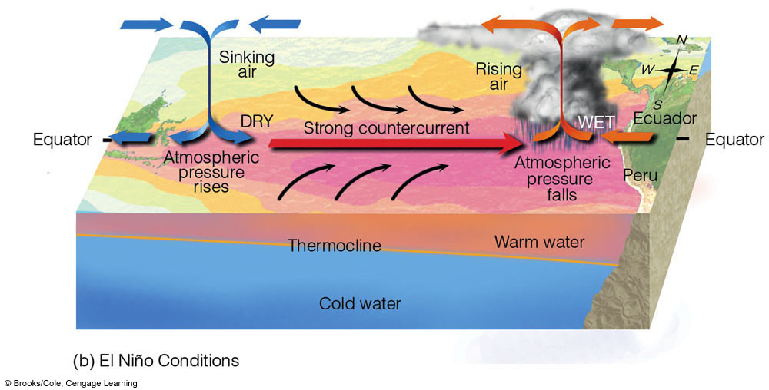
EL NINO CONDITIONS
Atmosphere:
Anomalously high pressure over western Pacific (Darwin)
Anomalously low pressure
over central/eastern Pacific
(Tahiti)
Easterly trades weaken or even reverse direction
Higher than normal rainfall over central/eastern Pacific
Lower than normal rainfall over western Pacific

Slide 11
EL NINO CONDITIONS
Ocean:
Anomalously high SSTs in eastern Pacific (off Peru)
Higher sea-level in eastern Pacific
Relaxation in slope of thermocline
Reduced cold water upwelling in eastern Pacific
Strengthened equatorial counter-current

Slide 12
LA NINA CONDITIONS
Notes:
Page: 282
FIGURE 10.22 In diagram (a), under non–El Niño conditions higher pressure over the southeastern Pacific and lower pressure near Indonesia produce easterly trade winds along the equator. These winds promote upwelling and cooler ocean water in the eastern Pacific, while warmer water prevails in the western Pacific. The trades are part of a circulation that typically finds rising air and heavy rain over the western Pacific and sinking air and generally dry weather over the eastern Pacific. If the trades are exceptionally strong (not shown here), water along the equator in the eastern Pacific becomes quite cool. This cool event is called La Niña. During El Niño conditions—diagram (b)—atmospheric pressure decreases over the eastern Pacific and rises over the western Pacific. This change in pressure causes the trades to weaken or reverse direction. This situation enhances the countercurrent that carries warm water from the west over a vast region of the eastern tropical Pacific.

Slide 14
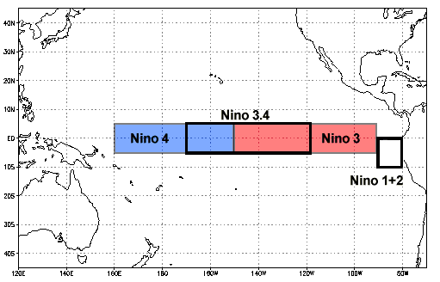
El Niño and the Southern Oscillation (ENSO)
El Niño: 5 consecutive months of
sea-surface temperatures in region
“Nino 3.4” at least 0.5°C above average
(La Niña: 0.5°C below average)
Southern Oscillation: Tahiti surface
pressure minus Darwin surface pressure
positive = strong easterly trades
negative = weak easterly trades or westerlies
Darwin
Tahiti

Slide 15
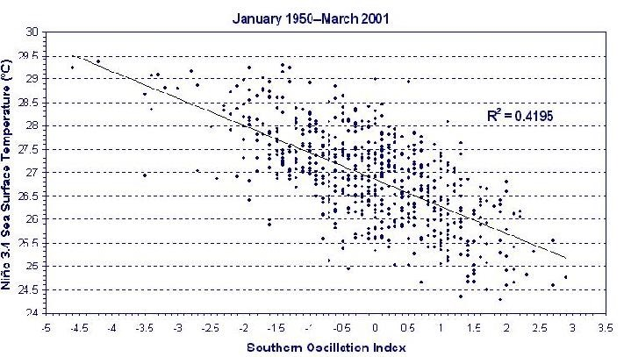
Relationship between El Niño and Southern Oscillation
Nino 3.4 Sea Surface Temperature (°C)
Southern Oscillation Index
ENSO = El Niño Southern Oscillation

Slide 16
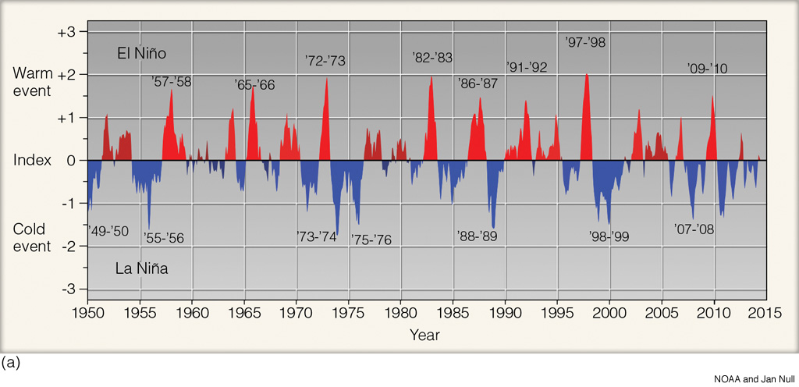
ENSO Over Time
1950–2015
Notes:
Page: 284
FIGURE 10.24 The Oceanic Niño Index (ONI). The numbers on the left side of the diagram represent a running 3-month mean for sea surface temperature variations (from normal) over the tropical Pacific Ocean from latitude 5°N to 5°S and from longitude 120°W to 170°W (area outlined in adjacent map). Warm EI Niño episodes are in red; cold La Niña episodes are in blue. Warm and cold events occur when the deviation from the normal is 0.5 or greater. An index value between 0.5 and 0.9 is considered weak; an index value between 1.0 and 1.4 is considered moderate, and an index value of 1.5 or greater is considered strong.

Slide 17
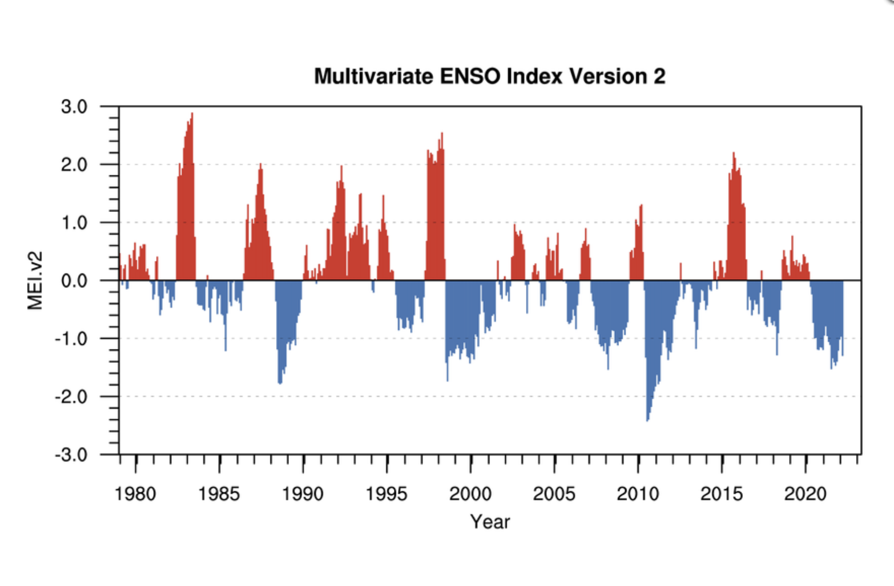
Updated El Niño Time Series
Red = high SSTs
Blue = low SSTs
Notes:
FIGURE 10.22 The Ocean
Nino Index (ONI). The numbers on
the left side of the diagram represent a
running 3-month mean for sea surface
temperature variations (from normal)
over the tropical Pacific Ocean from
latitude 5ｰN to 5ｰS and from longitude
120ｰW to 170ｰW. Warm E1 Nino episodes
are in red; cold La Nina episodes
are in blue. Warm and cold events occur
when the deviation from the normal
is 0.5 or greater. An index value
between 0.5 and 0.9 is considered
weak; an index value between 1.0 and
1.4 is considered moderate, and an index
value of 1.5 or greater is considered
strong. (Courtesy of NOAA and
Jan Null.)

Slide 18
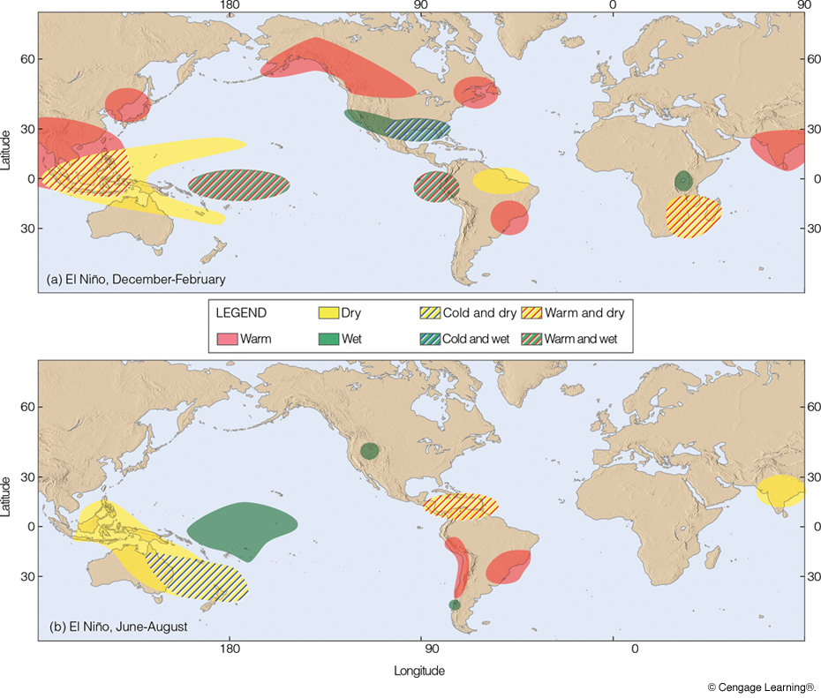
ENSO Impacts
Notes:
Page: 286
FIGURE 10.26 Regions of climatic abnormalities associated with El Niño conditions (a) during December through February and (b) during June through August. A strong El Niño event may trigger a response in nearly all indicated areas, whereas a weak event will likely play a role in only some areas. (After NOAA Climate Prediction Center.)

Slide 19
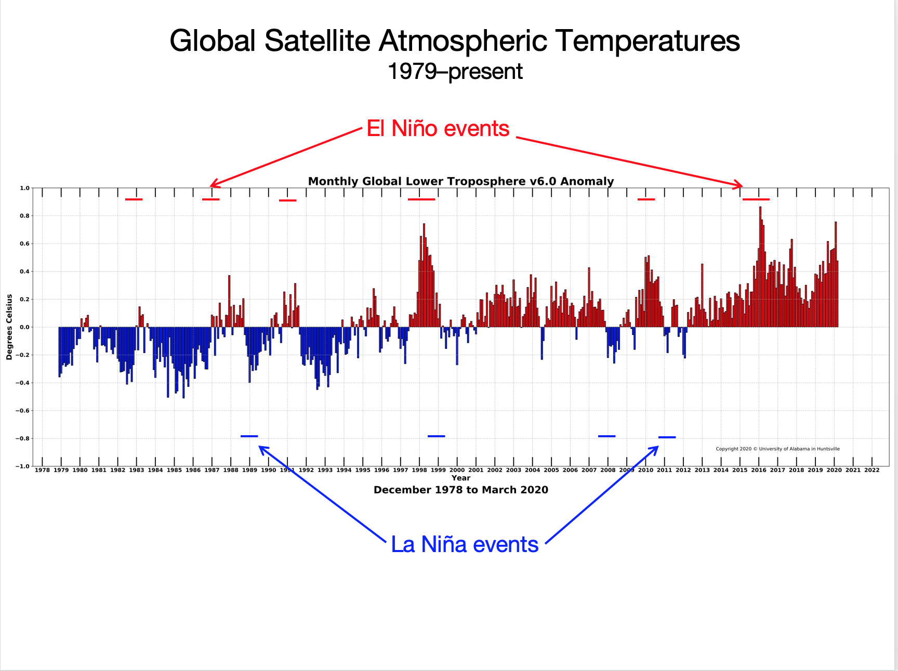

Slide 20
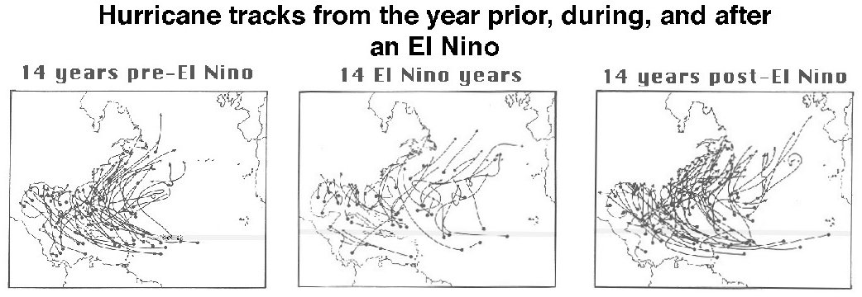
During El Niño events, North Atlantic hurricanes
are less common.
From Gray

Slide 21
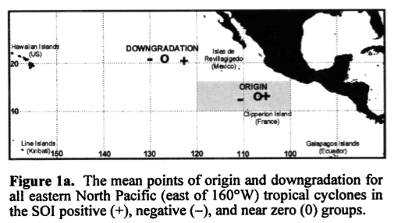
SOI and North Pacific Hurricanes
When SOI is negative (El Niño), Eastern Pacific hurricanes
are farther from the coast.
Irwin and Davis (1999)

Slide 22
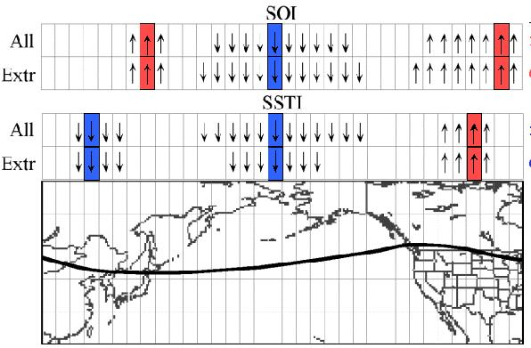
ENSO and Circumpolar Vortex
During El Niño, polar vortex (and jet stream) expands over
the North Pacific and contracts over western North America.
Frauenfeld and Davis (2000)

Slide 23
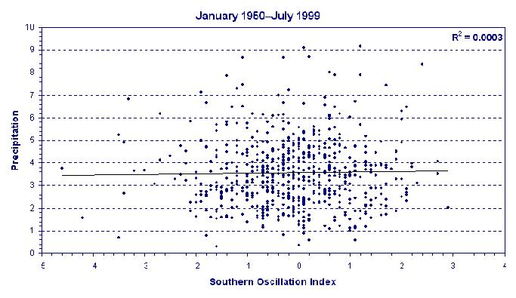
SOI and Virginia Precipitation

Slide 24
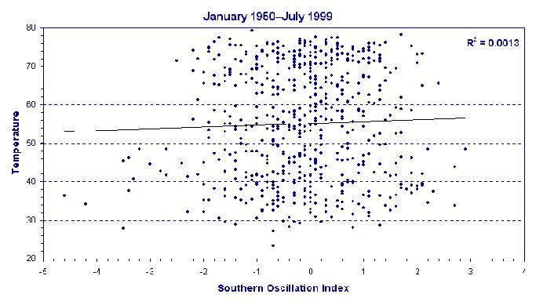
SOI and Virginia Temperatures
(Chap. 10, pp. 279–284)

Slide 25
Quick Summary—El Niño and the Southern Oscillation:
El Niño events
warmer than normal surface ocean in the tropical eastern Pacific
slackening of easterly trades, reduced upwelling, deeper thermocline
negative SOI (H over Darwin, L over Tahiti), Walker Cell reversal
extend from December well into following year or longer
La Niña events
lower than normal water temperatures
strong easterly trades, strong upwelling, thermocline near the surface
positive SOI (L over Darwin, H over Tahiti)
Can impact climate at locations far from the tropics

