Slide 1
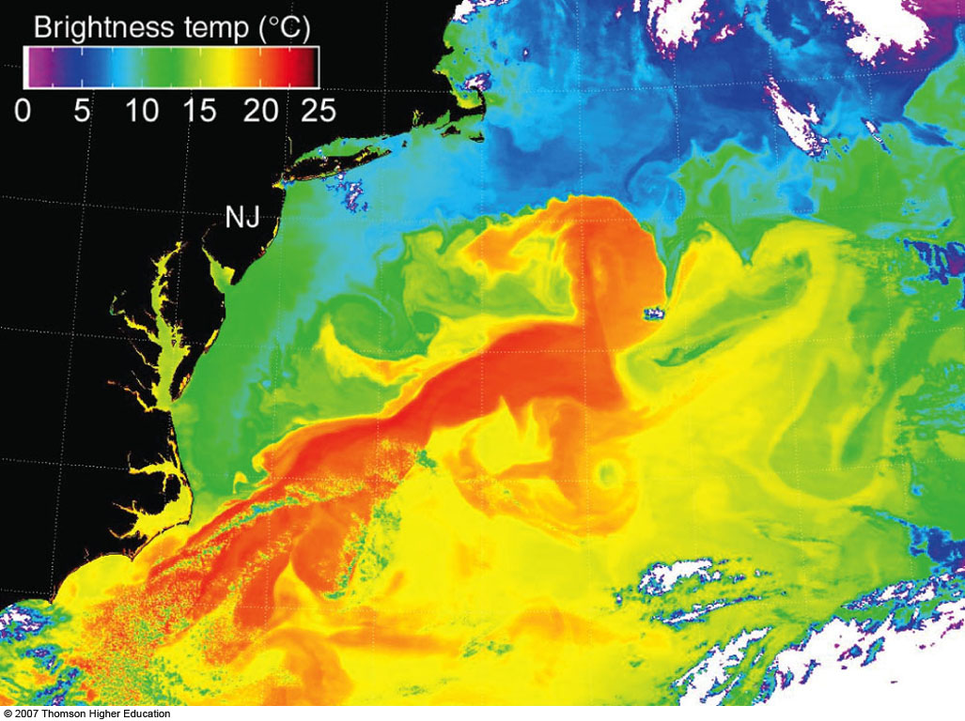
MONSOONS
AND
OCEAN CURRENTS
Notes:
Figure 10.15
The Gulf Stream (dark red band) and its eddies are revealed in this satellite mosaic of sea surface temperatures of the western North Atlantic during May, 2001. Bright red shows the warmest water, followed by orange and yellow. Green, blue, and purple represent the coldest water.

Slide 2
Summer (NH)
Wet Monsoon
Continent
Ocean
Ocean
Hottest
to south
L
Ocean
Equator
Equator

Slide 3
Winter (NH)
Dry Monsoon
Coldest
to north
H
Ocean
Ocean
Continent
Ocean
Equator
Equator

Slide 4
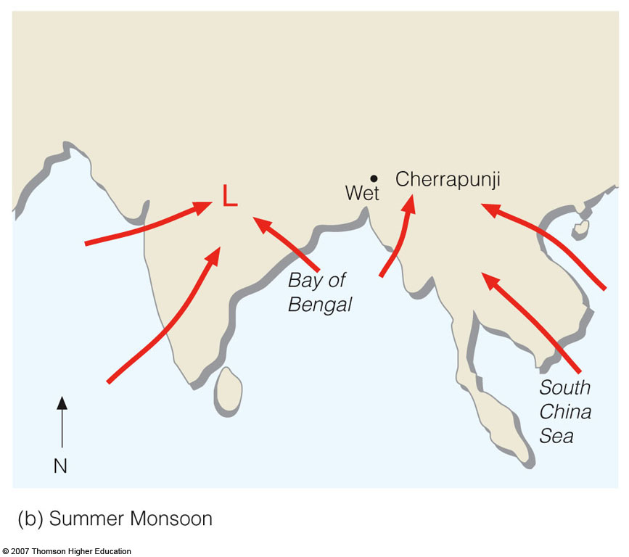
Asian Summer Monsoon
Notes:
Figure 9.27
Changing annual wind flow patterns associated with the winter and summer Asian monsoon.

Slide 5
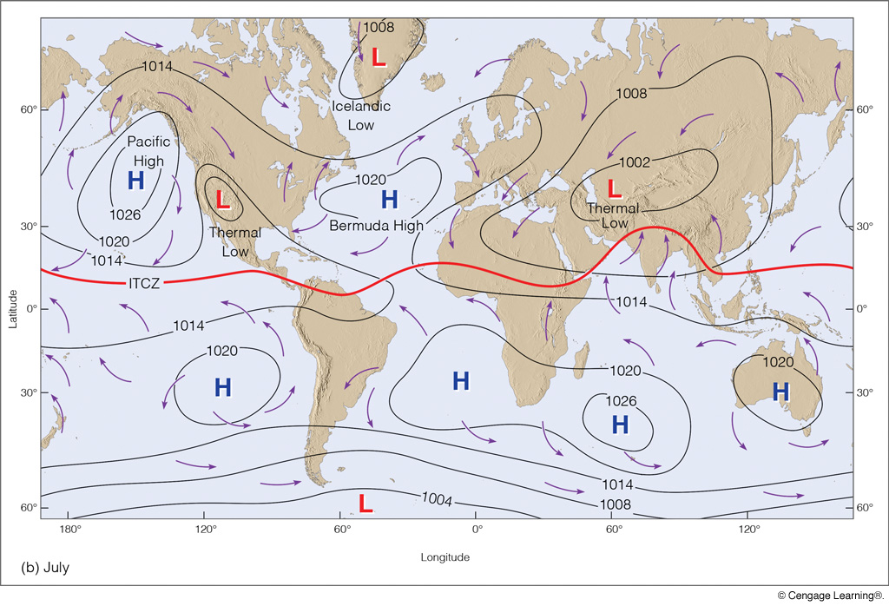
Average Surface Pressure and Wind in July
Notes:
Page: 270
FIGURE 10.5 Average sea-level pressure distribution and surface wind-flow patterns for January (a) and for July (b). The solid red line represents the position of the ITCZ.

Slide 6
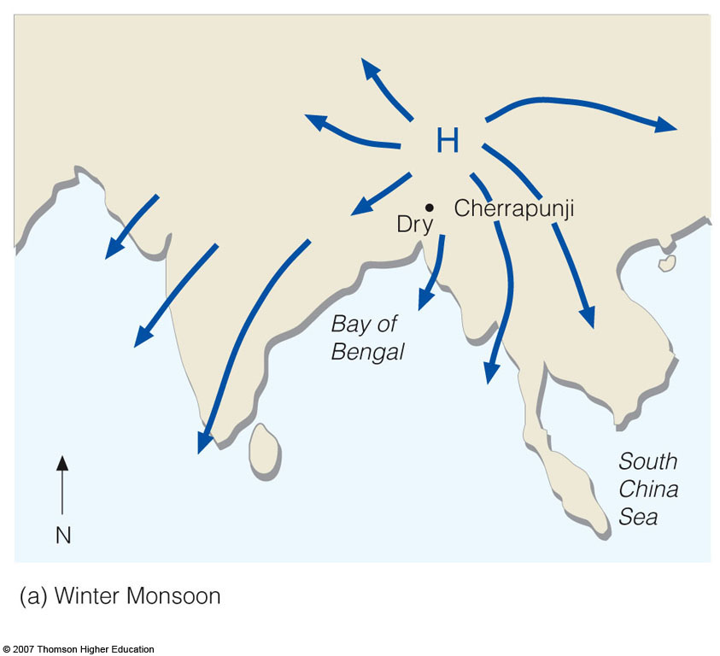
Asian Winter Monsoon
Notes:
Figure 9.27
Changing annual wind flow patterns associated with the winter and summer Asian monsoon.

Slide 7
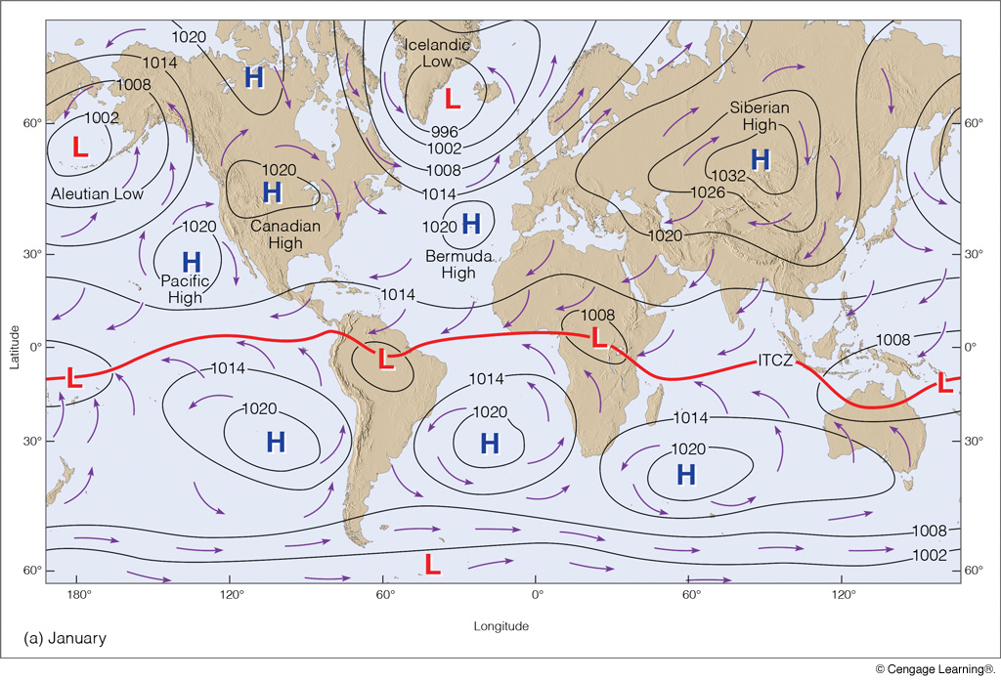
Average Surface Pressure and Wind in January
Notes:
Page: 270
FIGURE 10.5 Average sea-level pressure distribution and surface wind-flow patterns for January (a) and for July (b). The solid red line represents the position of the ITCZ.

Slide 8
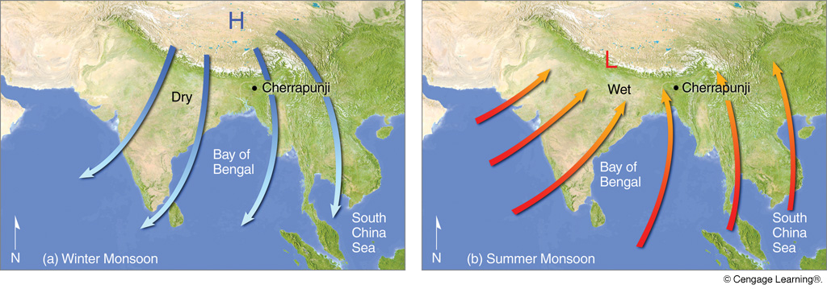
Winter Monsoon
Summer Monsoon
Notes:
Page: 252
FIGURE 9.38 Changing annual surface wind-flow patterns associated with the winter and summer Asian monsoon.

Slide 9
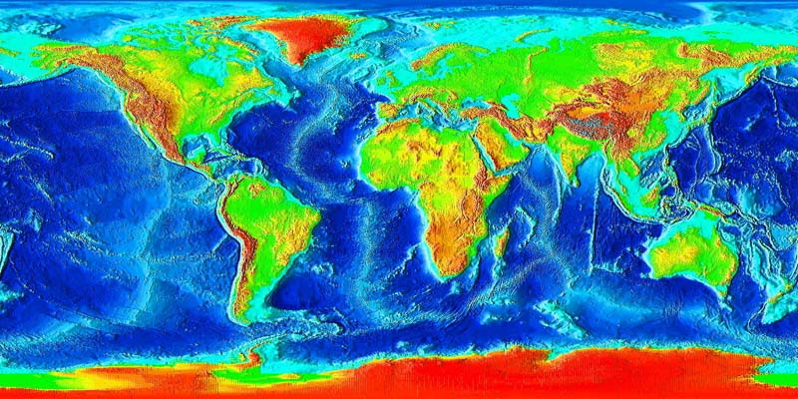
GLOBAL TOPOGRAPHY

Slide 10
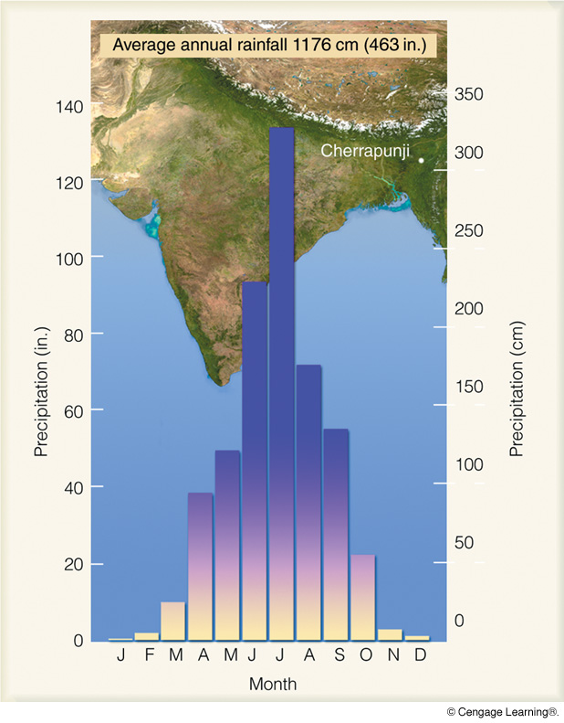
Mean Monthly
Rainfall
Cherrapunji, India
38.6 FEET of rain
(Charlottesville = 44 inches)
Notes:
Page: 253
FIGURE 9.39 Average annual precipitation for Cherrapunji, India. Note the abundant rainfall during the summer monsoon (April through October) and the lack of rainfall during the winter monsoon (November through March).

Slide 11
Some Other Monsoonal Regions
Notes:
Page: 270
FIGURE 10.5 Average sea-level pressure distribution and surface wind-flow patterns for January (a) and for July (b). The solid red line represents the position of the ITCZ.

Slide 12
Some Other Monsoonal Regions
(Chap. 9, pp. 249–251)
(Chap. 10, pp. 278–281)
Notes:
Page: 270
FIGURE 10.5 Average sea-level pressure distribution and surface wind-flow patterns for January (a) and for July (b). The solid red line represents the position of the ITCZ.

Slide 13
Heat Capacity
Heat capacity = heat absorbed/temperature change
Ocean
Continent
Water = 1
Soil = 0.2

Slide 14
Heat Capacity
Heat capacity = heat absorbed/temperature change
Heat Capacity of Water = 1
(1 calorie of heat is needed to raise the temperature of
1 gram of water by 1°C)
Ocean
Continent
Oceans warm up and cool off slower than adjacent continents.

Slide 15
Effect of Isolation from Oceans
Kansas Max Temp
New Jersey Max Temp

Slide 16
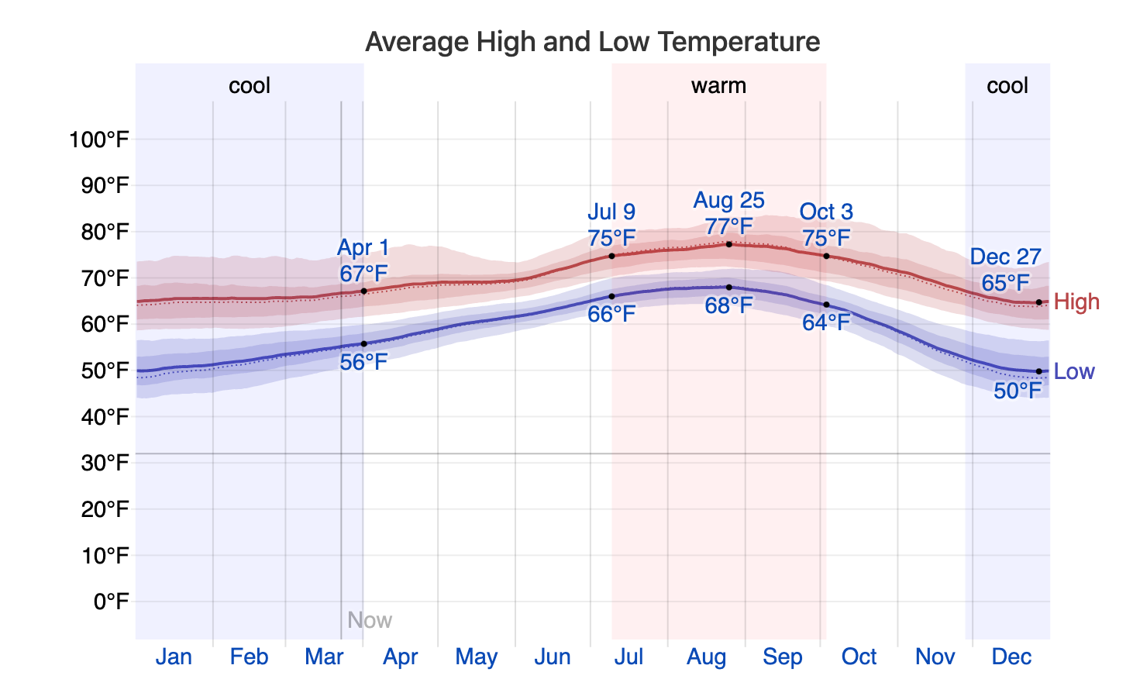
Effect of Isolation from Oceans
San Diego, CA

Slide 17
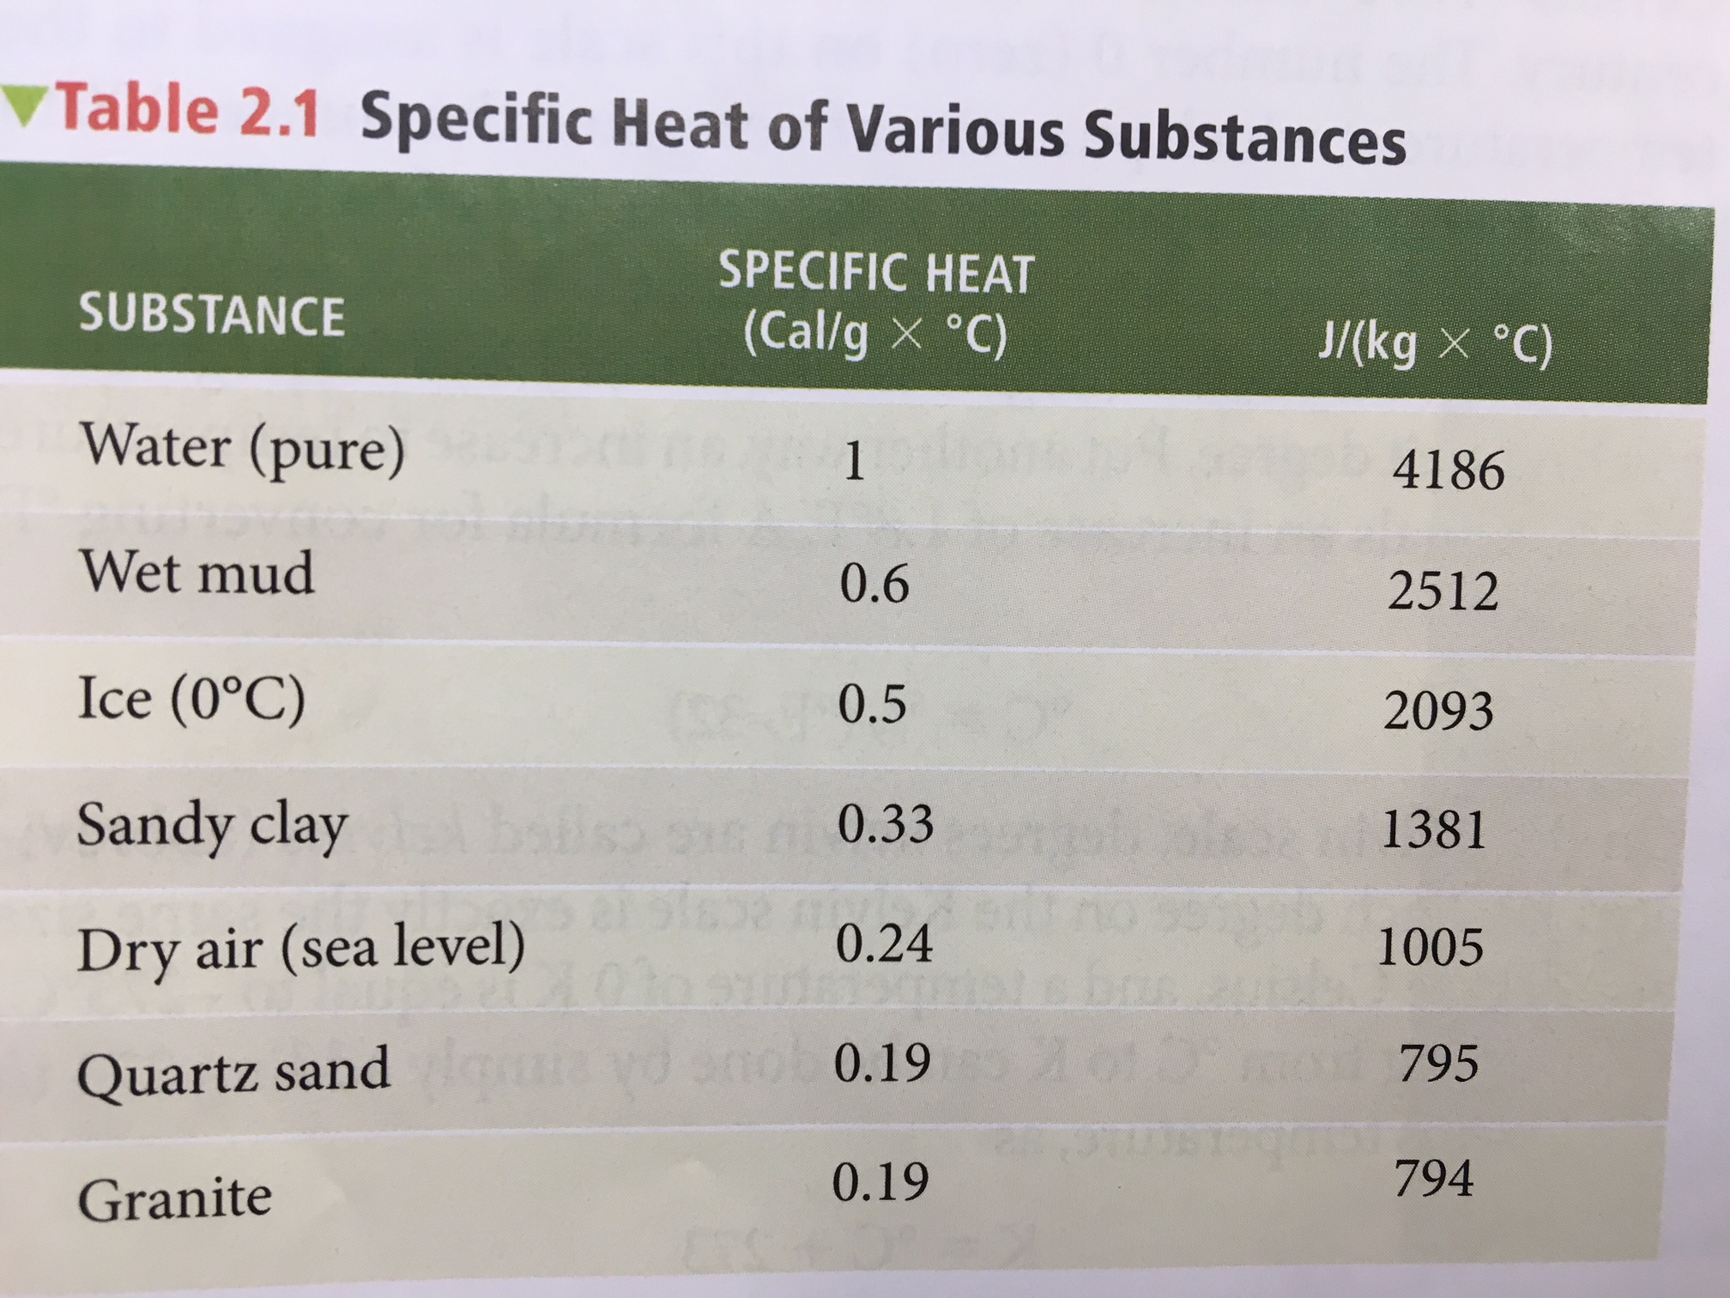
(“Specific Heat” is heat capacity per unit mass)

Slide 18
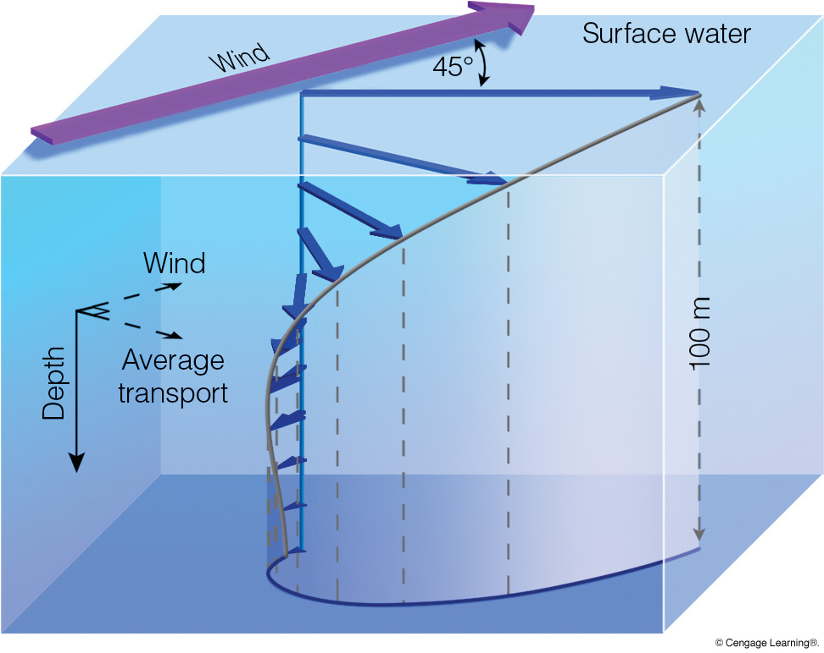
Ekman Spiral
Surface water moves at 45 degree angle to prevailing wind
Notes:
Page: 281
FIGURE 10.20 The Ekman spiral. Winds move the water, and the Coriolis force deflects the water to the right (Northern Hemisphere). Below the surface each successive layer of water moves more slowly and is deflected to the right of the layer above. The average transport of surface water in the Ekman layer is at right angles to the prevailing winds.

Slide 19
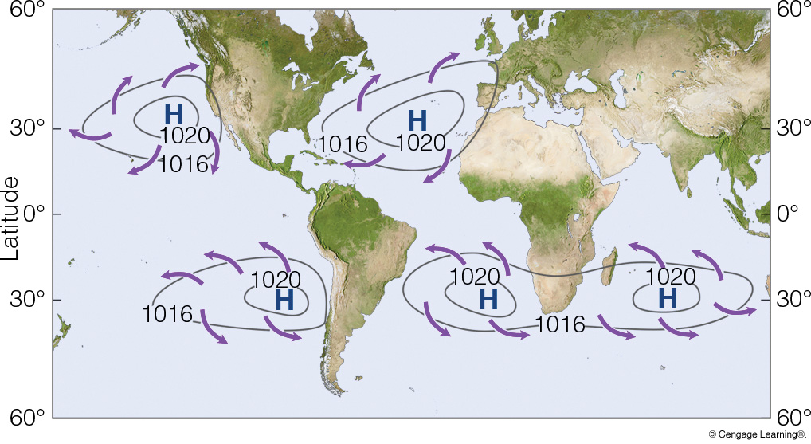
Subtropical Anticyclones
mean surface wind
wind-driven ocean currents
Notes:
Page: 278
FIGURE 10.16 Annual average global wind patterns and surface high-pressure areas over the oceans.

Slide 20
Ocean Currents
60°N
L
CONTINENT
CONTINENT
30°N
H
Eq.
L
30°S
H
warm current
cold current

Slide 21
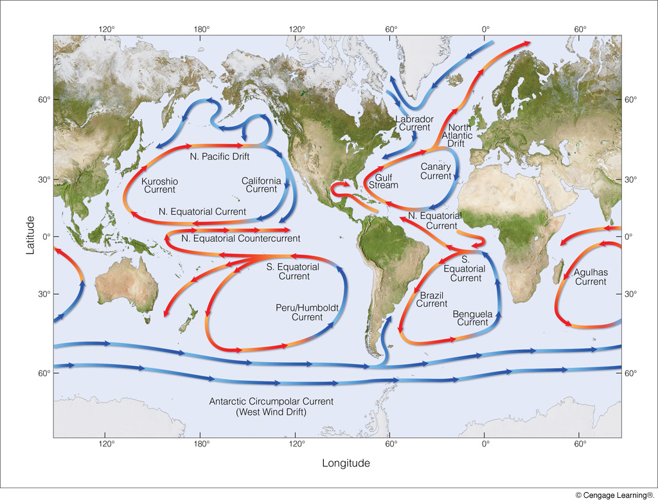
Ocean Currents
red = warm current
blue = cold current
Notes:
Page: 279
FIGURE 10.17 Average position and extent of the major surface ocean currents. Cold currents are shown in blue; warm currents are shown in red.

Slide 22
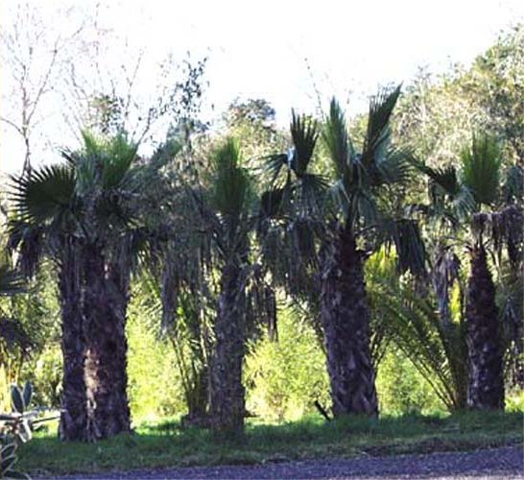

Slide 23
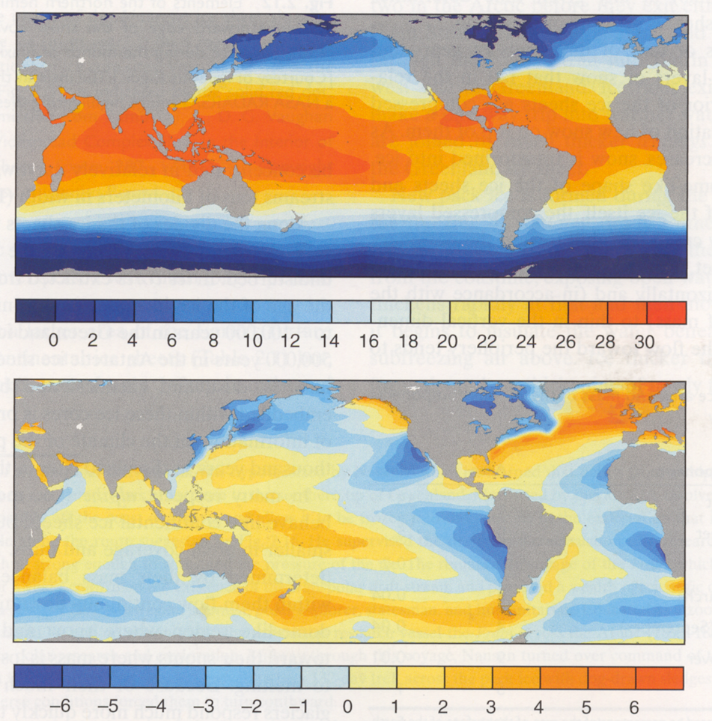
Average
sea-surface
temp. (°C)
(SST)
SST
variation
from latitude
average
(Chap. 10, pp. 276–279)

Slide 24
Quick Summary—Monsoons and Ocean Currents:
Monsoonal climates have major seasonal shifts in the prevailing wind direction
These wind shifts are driven by seasonal heating and cooling of land and resulting pressure pattern changes
warm season = wet monsoon (low pressure)
cool season = dry monsoon (high pressure)
Surface ocean currents move about 45 degrees from prevailing surface wind direction
Currents circulate in closed loops (“gyres”)
Ocean currents moving poleward are warm currents
Ocean currents moving equatorward are cold currents

