Slide 1
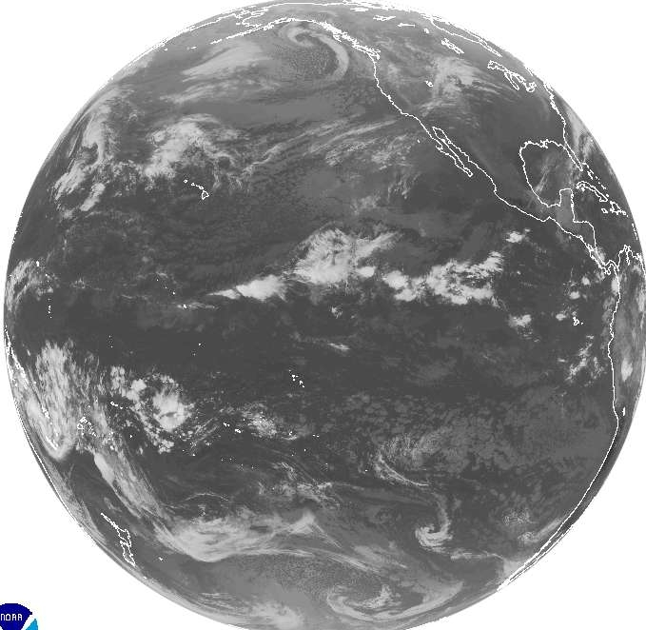
GLOBAL WINDS
(Chapter 10)

Slide 2
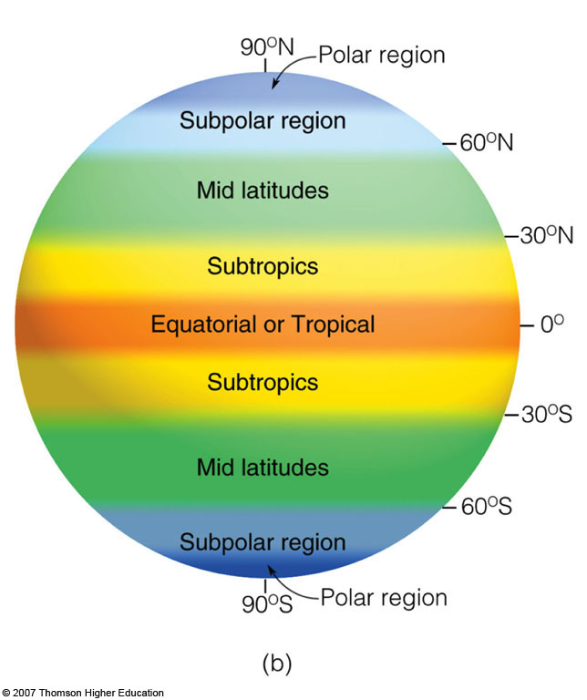
Names of
Latitude Bands
Notes:
Figure 10.1
Diagram (b) shows the names that apply to the different regions of the world and their approximate latitudes.

Slide 3
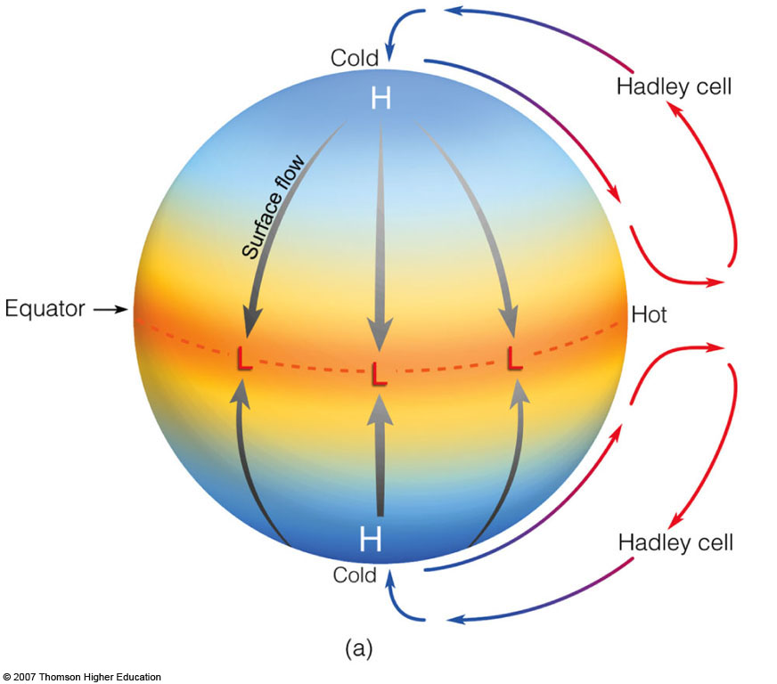
Non-Rotating
Homogeneous
Planet
surface wind
follows PGF
Notes:
Figure 10.1
Diagram (a) shows the general circulation of air on a nonrotating earth uniformly covered with water and with the sun directly above the equator. (Vertical air motions are highly exaggerated in the vertical.)

Slide 4
Rotating
Homogeneous
Planet
60°N
30°N
H
Coriolis causes air parcel
to turn to its right
pgf
Hadley
Cells
0°
L
Coriolis causes air parcel
to turn to its left
pgf
30°S
H
60°S
tropopause

Slide 5
Hadley Cell (N. Hemisphere)
aloft (SW)
As air aloft moves poleward,
Coriolis turns the air parcel
to its right. The air piles up
aloft at 30°N.
sinking
30°N
rising
Northeast Trades
Equator

Slide 6
Rotating
Homogeneous
Planet
Polar
Easterlies
H
(Polar Front)
60°N
L
Midlatitude
Westerlies
(Horse Latitudes)
30°N
H
NE Trades
(Intertropical
Convergence
Zone)
Hadley
Cells
(ITCZ)
0°
L
SE Trades
30°S
H
Midlatitude
Westerlies
(Polar Front)
60°S
L
Polar
Easterlies
H

Slide 7
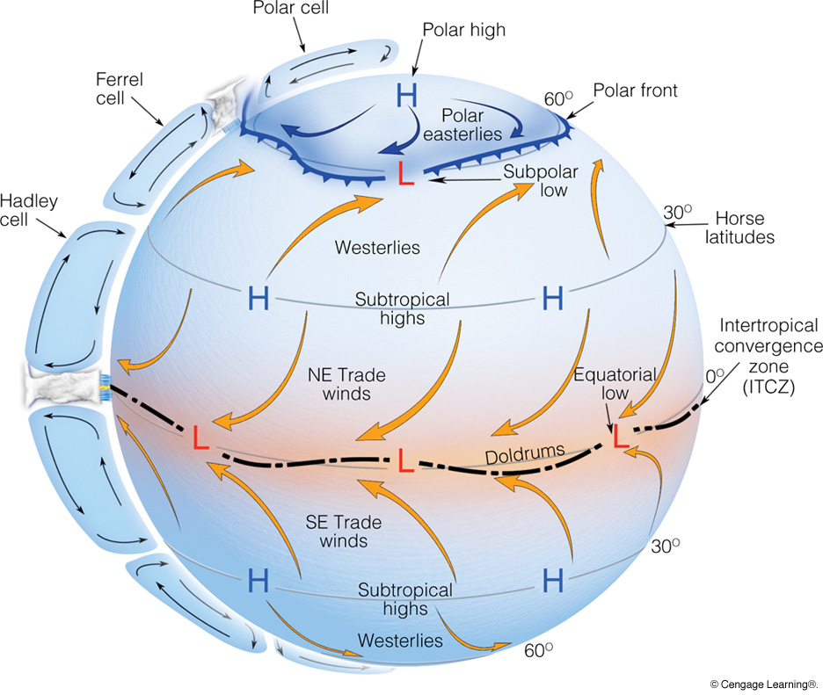
Rotating
Homogeneous
Planet
Notes:
Page: 267
FIGURE 10.2 The idealized wind and surfacepressure distribution over a uniformly water-covered rotating Earth.

Slide 8
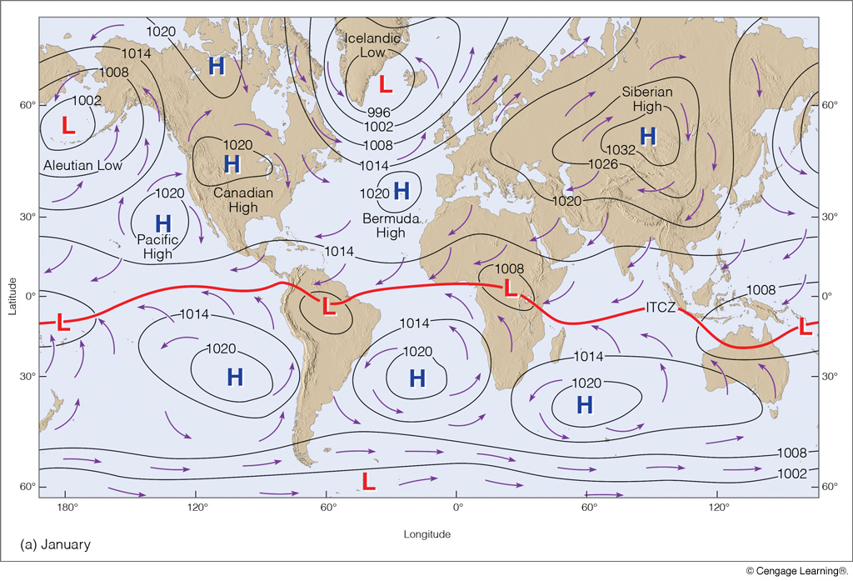
Average Surface Pressure and Wind in January
Notes:
Page: 270
FIGURE 10.5 Average sea-level pressure distribution and surface wind-flow patterns for January (a) and for July (b). The solid red line represents the position of the ITCZ.

Slide 9
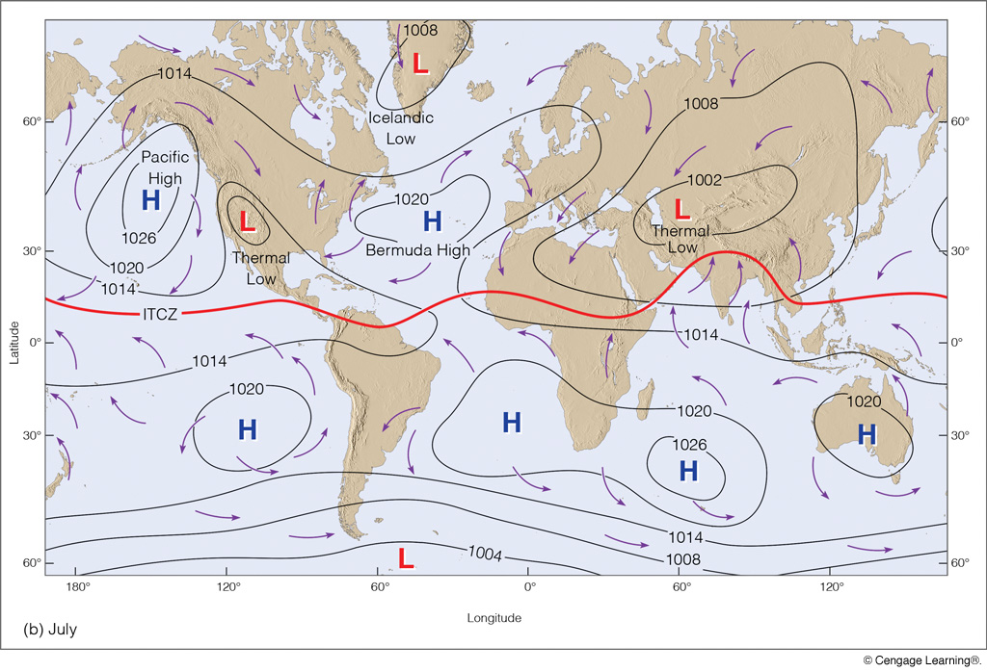
Average Surface Pressure and Wind in July
Notes:
Page: 270
FIGURE 10.5 Average sea-level pressure distribution and surface wind-flow patterns for January (a) and for July (b). The solid red line represents the position of the ITCZ.

Slide 10
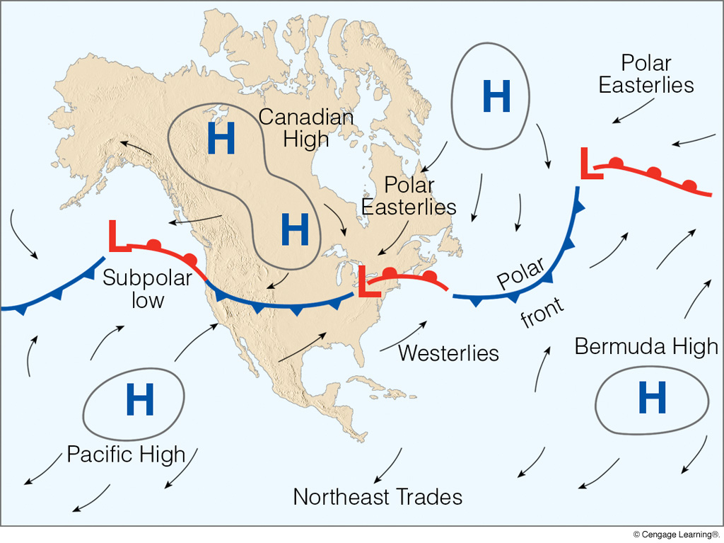
Climate Features on a Weather Map
Notes:
Page: 271
FIGURE 10.6 A winter weather map depicting the main features of the general circulation over North America. Notice that the Canadian high, polar front, and subpolar lows have all moved southward into the United States, and that the prevailing westerlies exist south of the polar front. The arrows on the map illustrate wind direction.

Slide 11
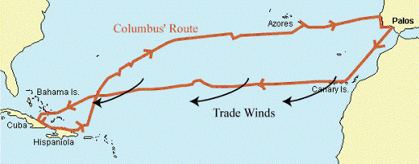
Columbus’ First Voyage (1492–93)
Mid-latitude Westerlies

Slide 12
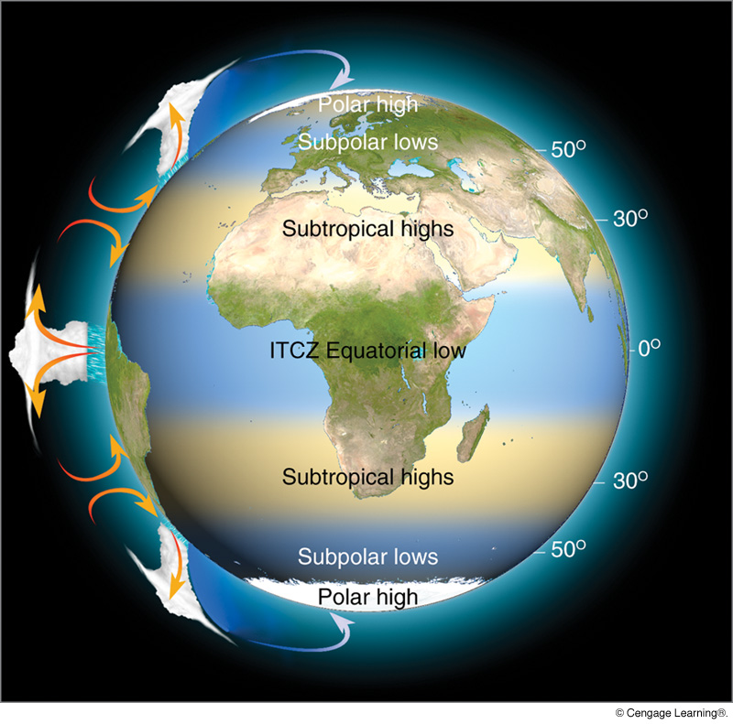
Average
Precipitation
Variation by
Latitude
(Chap. 10,
pp. 262–272)
Notes:
Page: 271
FIGURE 10.7 Rising and sinking air associated with the major pressure systems of Earth’s general circulation. Where the air rises, precipitation tends to be abundant (blue shade); where the air sinks, drier regions prevail (tan shade). Note that the sinking air of the subtropical highs produces the major desert regions of the world.

Slide 13
Quick Summary—Large-scale Winds (Chapter 10):
Large-scale prevailing winds vary by latitude about every 30 degrees.
The Hadley Cell is a very persistent feature associated with rising air at the equator, sinking air at 30°, and easterly trade winds at the surface from 0–30° in each hemisphere.
The latitude zone from 30°–60° has prevailing westerly winds.
Polar latitudes have highly variable winds that tend to be easterly, with cold, high pressure systems over the poles.
This simple, zonal (west–east) wind pattern is altered by the presence of coasts, continents, and mountain ranges.

