Slide 1
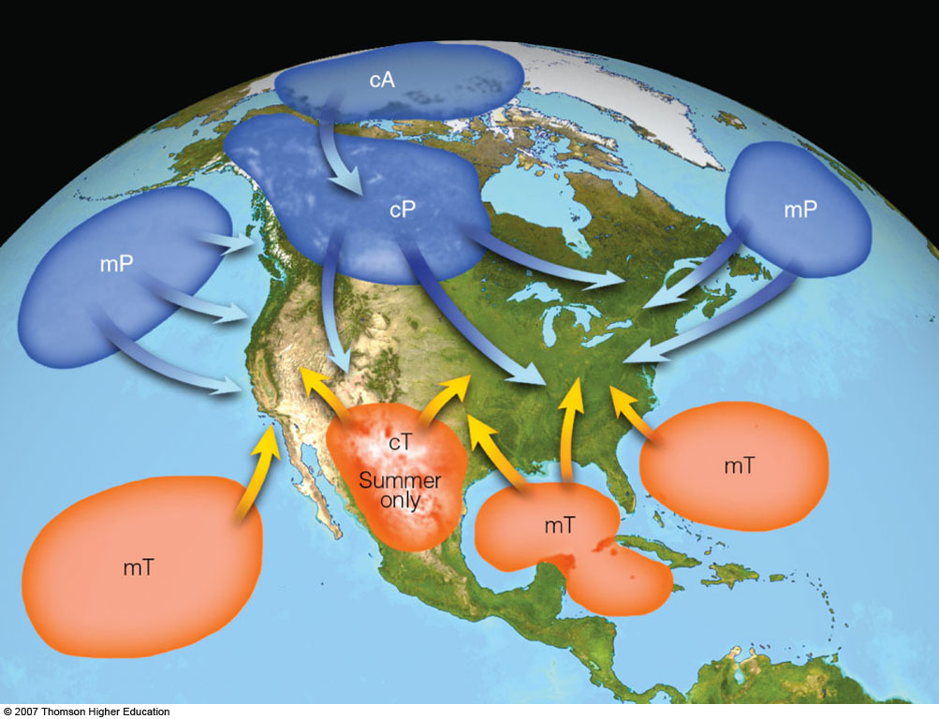
AIR MASSES
(Chapter 11, pp. 292–305)
Notes:
Figure 11.2
Air mass source regions and their paths.

Slide 2
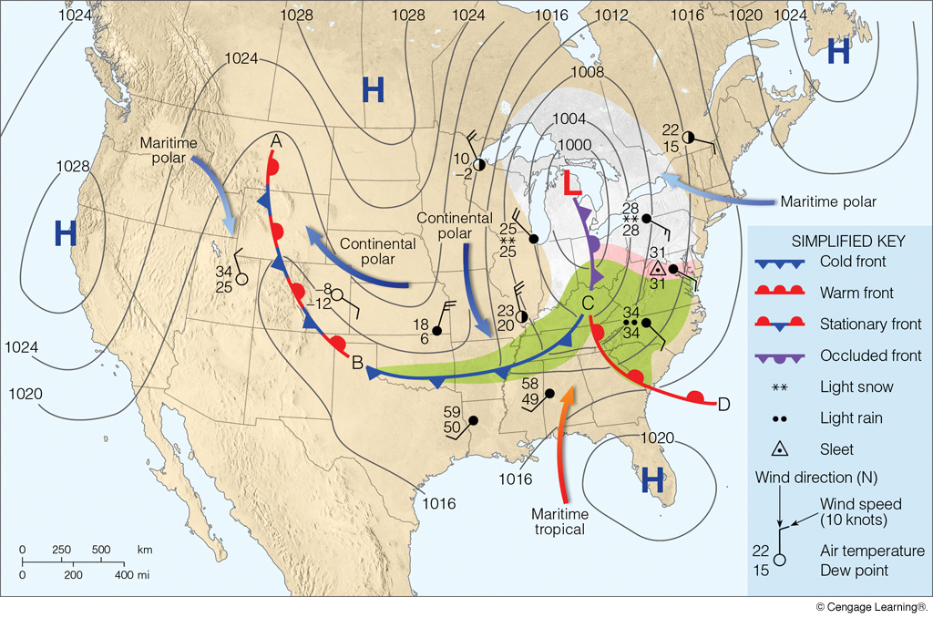
Notes:
Page: 307
FIGURE 11.15 A surface weather map showing surface-pressure systems, air masses, fronts, and isobars (in millibars) as solid gray lines. Large arrows in color show airflow. (Green-shaded area represents rain; pink-shaded area represents freezing rain and sleet; white-shaded area represents snow.)

Slide 3
Air Mass Definition
Large body of air with fairly consistent temperature and humidity over large horizontal distances
Air needs to remain in place long enough to acquire the characteristics of the underlying surface

Slide 4
Air Mass Source Regions
Extensive and relatively homogeneous surfaces
Good Source Regions
Poor Source Regions
deserts
snow/ice-covered land
oceans
coastlines
mountains
lakes (too small)
mid-latitudes (especially
continents)

Slide 5
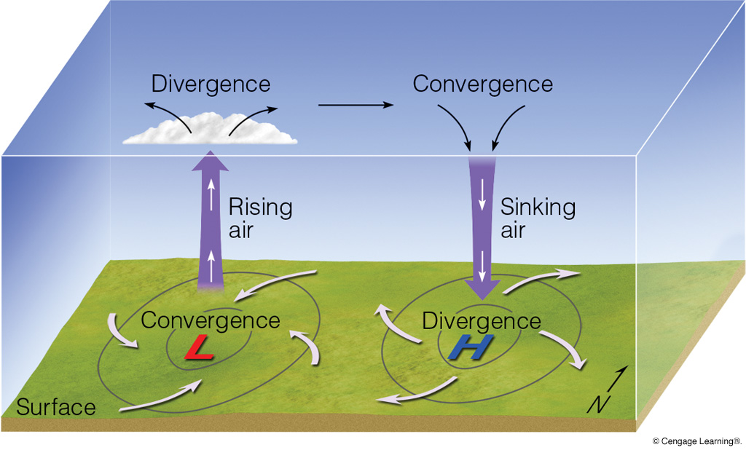
Source regions are associated with anticyclones.
weak, divergent surface winds
often stationary or slow-moving

Slide 6
Bergeron Air Mass Classification
1st letter: humidity
  maritime (m): humid
  continental (c): dry
2nd letter: temperature
  Tropical (T): warm
  Polar (P): cold
3rd letter: modification (optional)
  air is colder than surface (k)
  Air is warmer than surface (w)
  (Not used in this class)

Slide 7
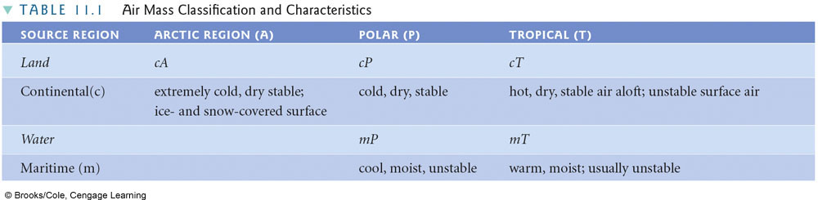
Bergeron Air Mass Classification
continental Arctic (cA) is an extreme version of cP
Temperature
 | LOW | HIGH
LOW | continental Polar | continental Tropical
HIGH | maritime Polar | maritime Tropical
Humidity
Notes:
TABLE 11.1 Air Mass Classification and Characteristics

Slide 8
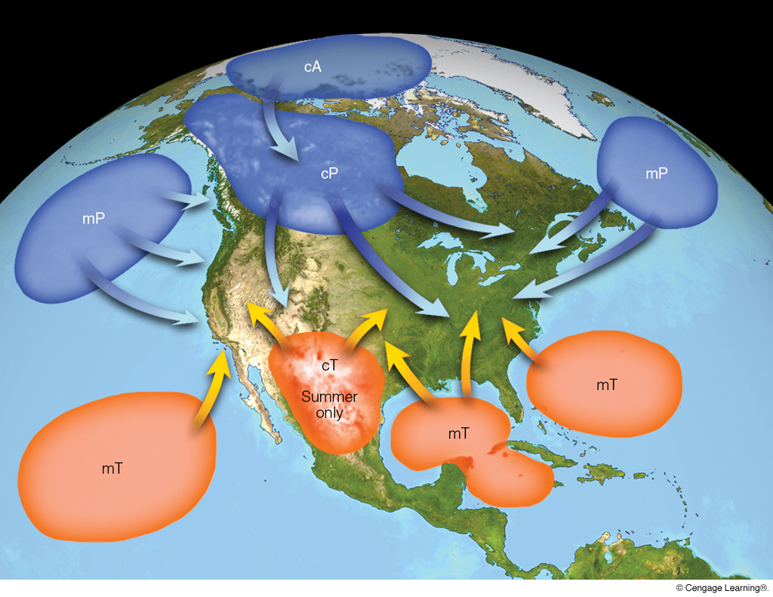
North America Air Masses and Source Regions
Notes:
Page: 297
FIGURE 11.2 Air mass source regions and their paths.

Slide 9
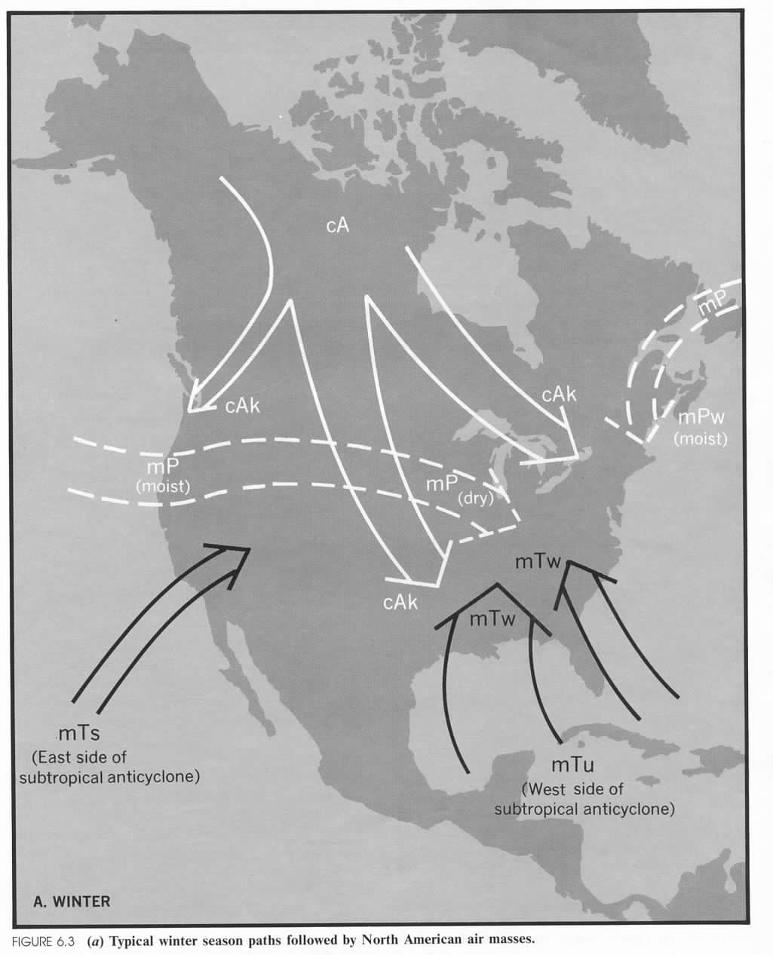
Typical
North American
Winter
Air Masses
cP
cP
cP
mP
mT
cP
mT
cP dominates
in winter
mT
mT

Slide 10
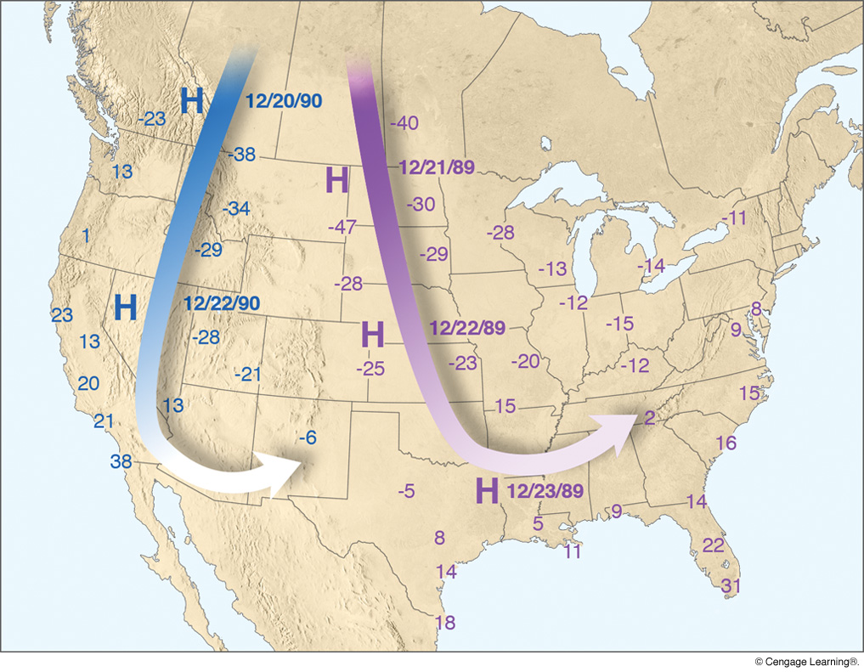
Minimum Temperatures During Two Cold Air Outbreaks
Notes:
Page: 300
FIGURE 11.4 Average upper-level wind flow (heavy arrows) and surface position of anticyclones (H) associated with two extremely cold outbreaks of arctic air during late December 1989 and 1990. Numbers on the map represent minimum temperatures (°F) measured during each cold snap.

Slide 11
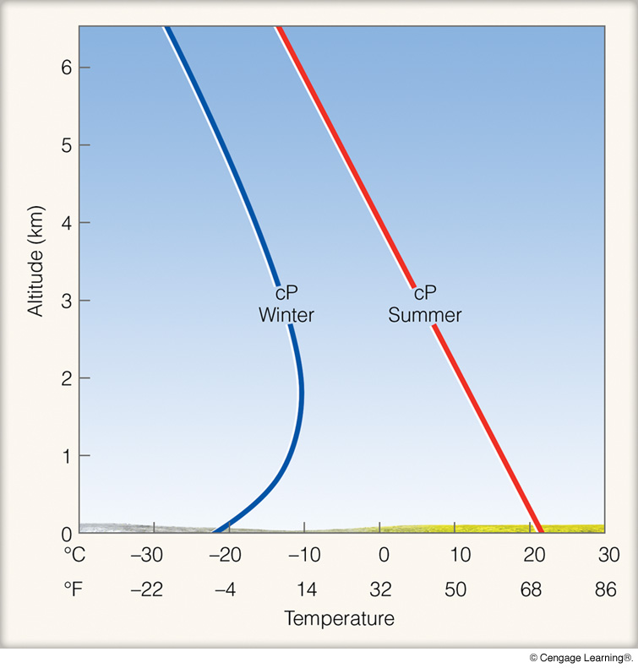
Seasonal
Differences
or
Air Mass
Modification
(cP)
OR
Air mass becomes
more unstable
as the air mass
moves south
N
S
Notes:
Page: 300
FIGURE 11.5 Typical vertical temperature profile over land for a summer and a winter cP air mass.

Slide 12
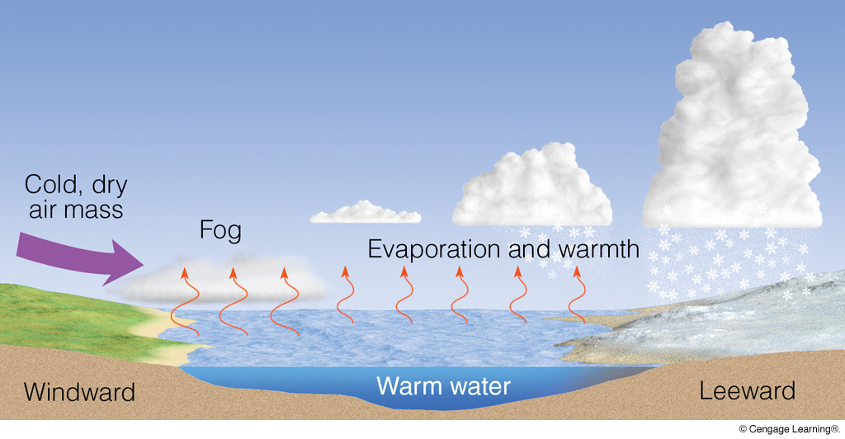
LAKE EFFECT SNOWFALL
(cP)
(air becomes
more unstable)
(upward motion
& convergence)
(mixing)
Notes:
Page: 299
FIGURE 1 The formation of lake-effect snows. Cold, dry air crossing the lake gains moisture and warmth from the water. The more buoyant air now rises, forming clouds that deposit large quantities of snow on the lake’s leeward (downwind) shores.

Slide 13
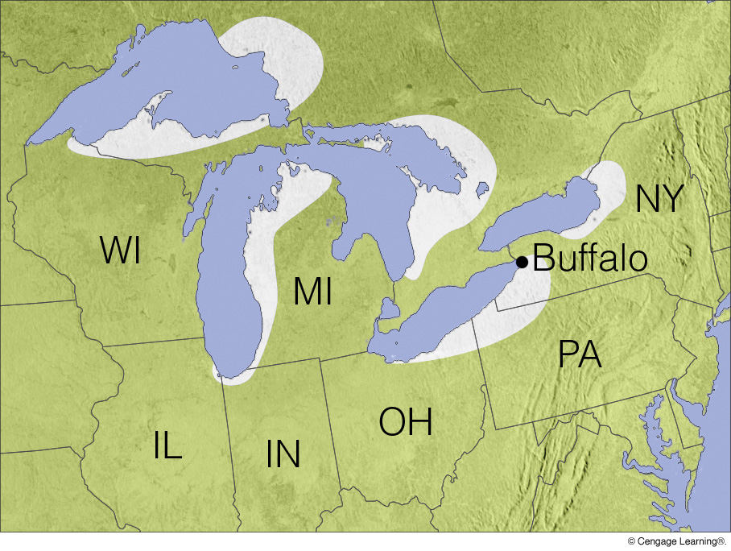
Typical
Lake Effect
Snow Regions
Notes:
Page: 299
FIGURE 2 Areas shaded white show regions that experience heavy lake-effect snows.

Slide 14
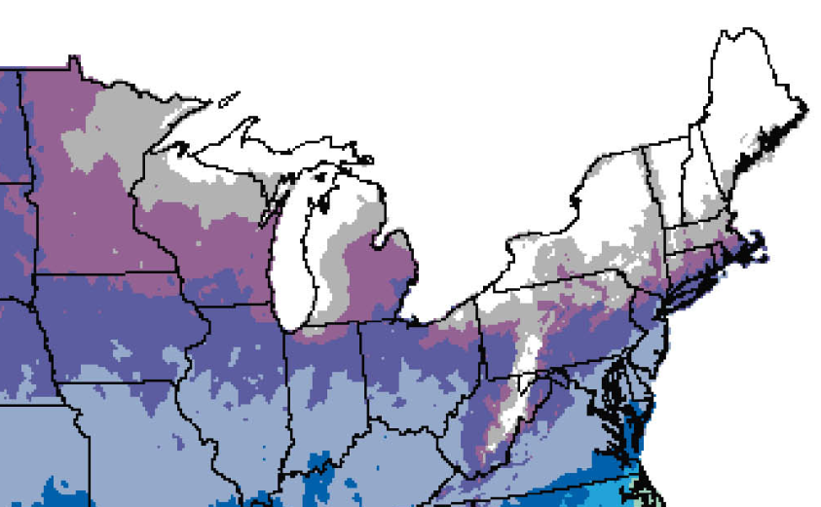
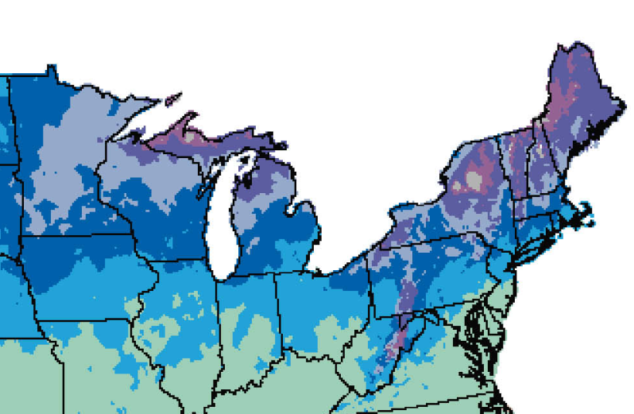
Average Snowfall
Annual
Lake effect snowfall declines in late winter after the
Great Lakes freeze.
December
March
Source: NCDC

Slide 15
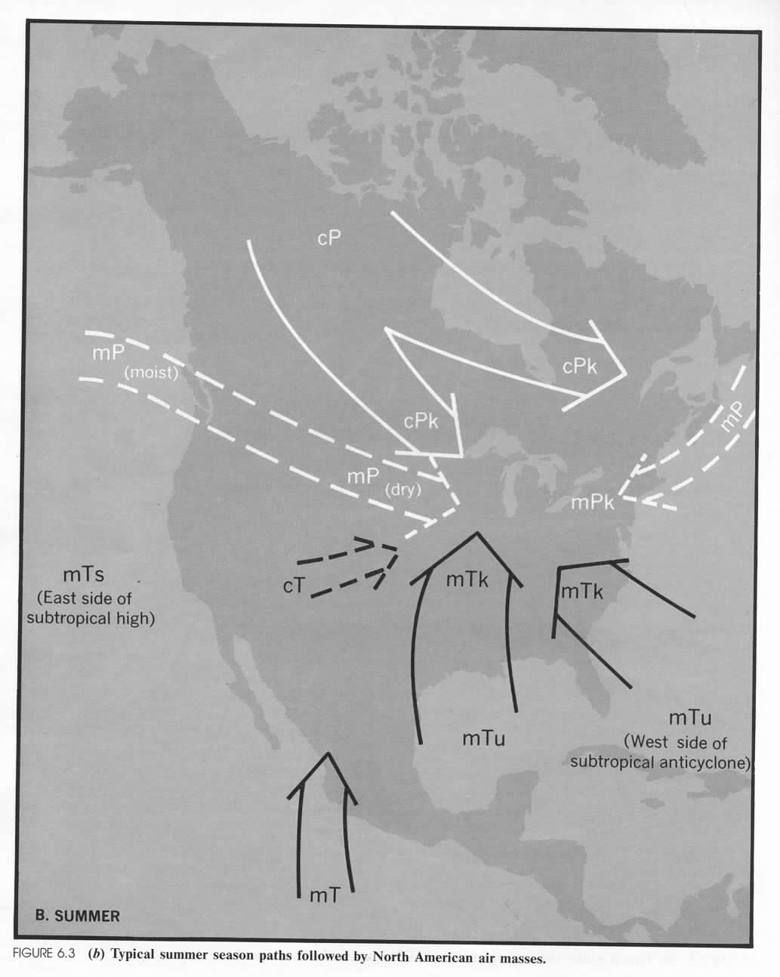
Typical
North American
Summer
Air Masses
cP
cP
mP
mT
mT
mT
mT
mT
mT dominates
in summer

Slide 16
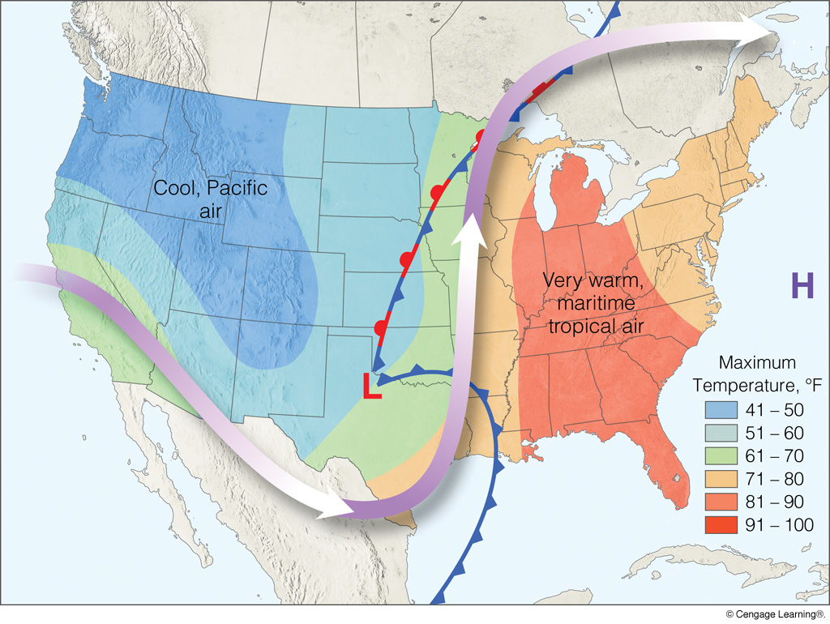
Eastern U.S. Heat Wave; March, 2012
upper air flow
Ridge
Trough
Notes:
Page: 305
FIGURE 11.12 Weather conditions during an unseasonably warm spell in the eastern portion of the United States that occurred in the second half of March 2012. The surface low-pressure area, fronts, and maximum temperatures are shown for March 21. The heavy arrow is the average upper-level flow during the warm period.

Slide 17
Winter
Summer
cP
cP
cP
cP
cP
mP
mP
mT
mT
mT
mT
cP
mT
mT
mT
mT
mT

Slide 18
North America Air Masses and Source Regions
Notes:
Page: 297
FIGURE 11.2 Air mass source regions and their paths.

Slide 19
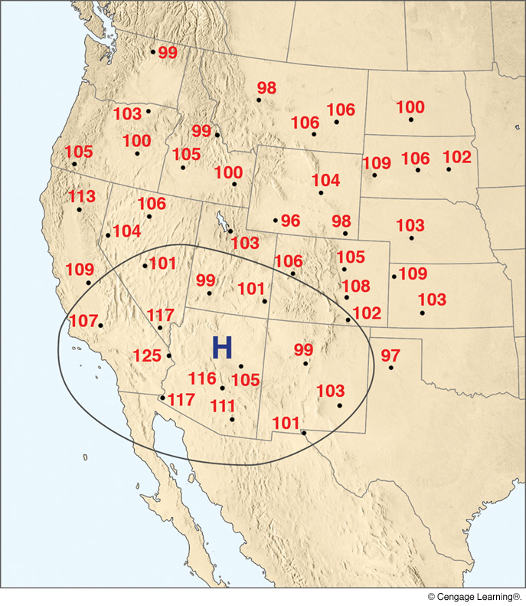
July, 2005
cT Air
Mass
Maximum
Temperatures
Notes:
Page: 306
FIGURE 11.13 From July 14 through July 22, 2005, continental tropical air covered a large area of the southwestern United States. Numbers on the map represent maximum temperatures (°F) during this period. The large H with the isobar shows the upperlevel position of the subtropical high. Sinking air associated with the high contributed to the hot, dry weather. Winds aloft were weak, with the main flow over central Canada.

Slide 20
North America Air Masses and Source Regions
Notes:
Page: 297
FIGURE 11.2 Air mass source regions and their paths.

Slide 21
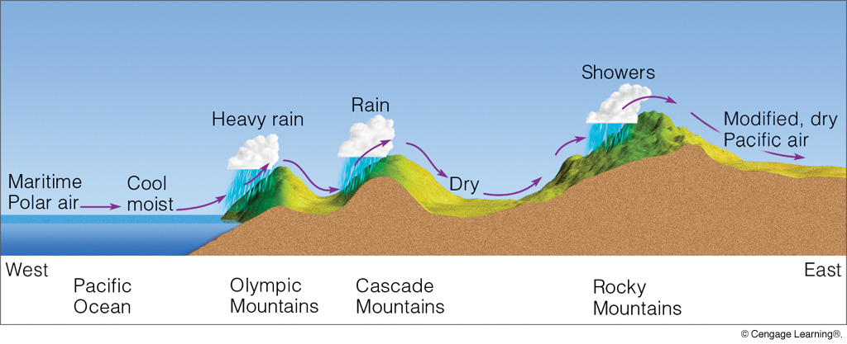
mP (Pacific) Air Mass and Its Modification
mP (Pacific) in Virginia is warm (not hot) and dry
Notes:
Page: 301
FIGURE 11.8 After crossing several mountain ranges, cool, moist maritime polar (mP) air from off the Pacific Ocean descends the eastern side of the Rockies as modified, relatively dry Pacific air.

Slide 22
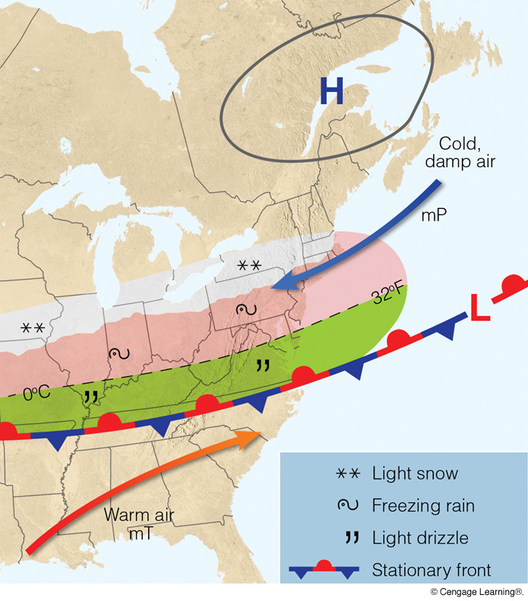
mP (Atlantic)
Air Mass
in
Winter
mP (Atlantic) in Virginia
is cool and very
humid, often with
extensive precipitation
Notes:
Page: 303
FIGURE 11.9 Winter and early spring surface weather pattern that usually prevails during the invasion of cold, moist maritime polar (mP) air into the mid-Atlantic and New England states. (Green-shaded area represents light rain and drizzle; pink-shaded region represents freezing rain and sleet; white-shaded area is experiencing snow.)

Slide 23
cP
mP
(Atlantic)
mP
(Pacific)
mT
Notes:
Page: 307
FIGURE 11.15 A surface weather map showing surface-pressure systems, air masses, fronts, and isobars (in millibars) as solid gray lines. Large arrows in color show airflow. (Green-shaded area represents rain; pink-shaded area represents freezing rain and sleet; white-shaded area represents snow.)

Slide 24
North America Air Masses and Source Regions
Notes:
Page: 297
FIGURE 11.2 Air mass source regions and their paths.

Slide 25
Quick Summary—Air Masses (Chapter 11):
Air masses are large bodies of air with consistent temperature and humidity, as characterized by their source region.
Main air mass types: cP (cold, dry, polar land), cT (hot, dry, subtropical land), mP (cool, moist, high latitude ocean), mT (warm, moist, low latitude ocean)
The U.S. is dominated by cP in the winter and mT in the summer.
Air masses can modify as they move out of their source regions and alter their thermal and moisture properties.

