Slide 1
HOW DO CLOUDS FORM?

Slide 2
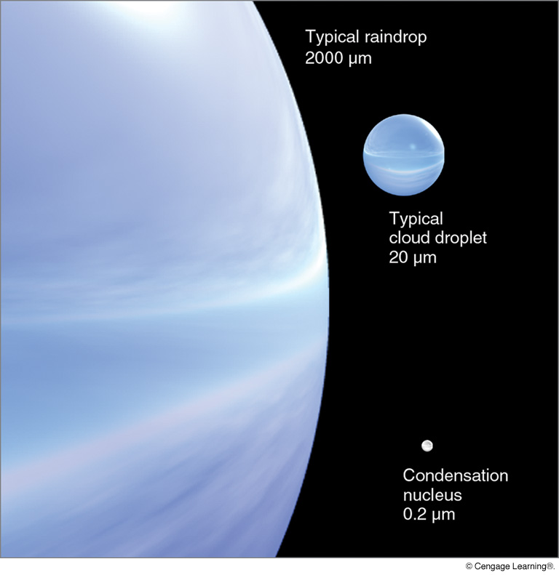
Notes:
Page: 170
FIGURE 7.1 Relative sizes of raindrops, cloud droplets, and condensation nuclei in micrometers (μm).

Slide 3
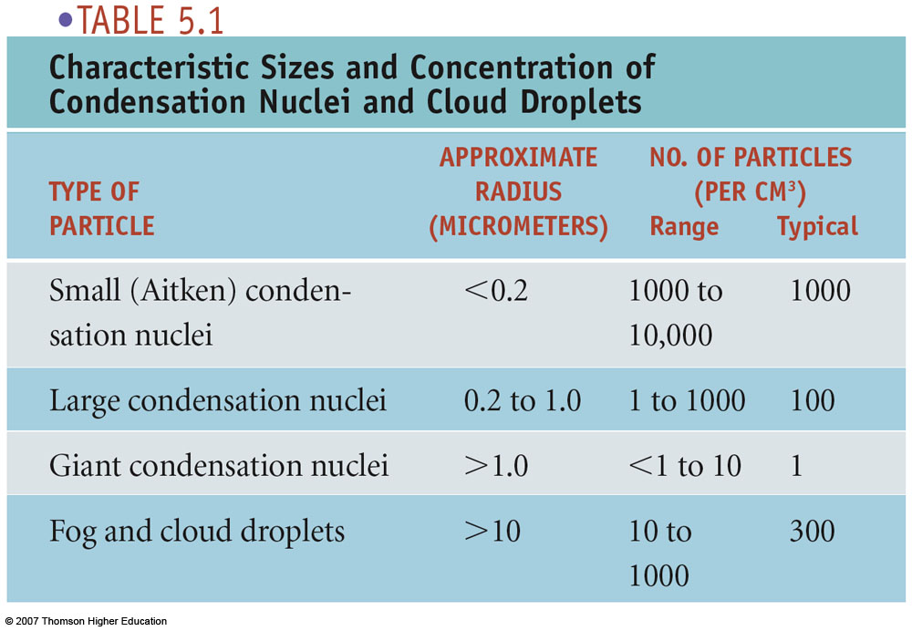
0.1
0.1

Slide 4
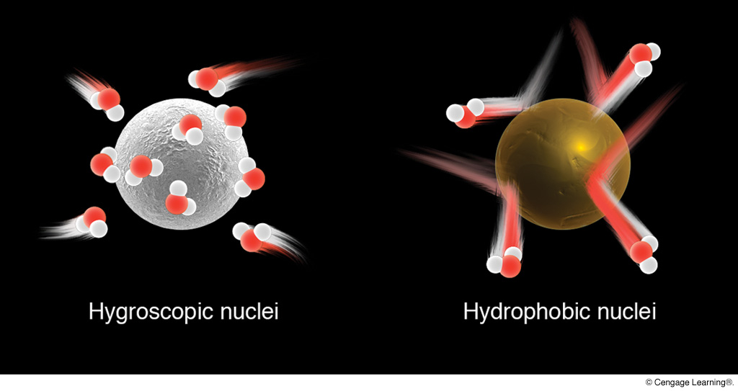
Hygroscopic vs. Hydrophobic Cloud Condensation Nuclei
Water-attracting (e.g., salts)
Water-repelling (e.g., waxes)
(Chap. 5, pp. 113–115)
Notes:
Page: 117
FIGURE 5.3 Hygroscopic nuclei are “water-seeking,” and water vapor rapidly condenses on their surfaces. Hydrophobic nuclei are “water-repelling” and resist condensation.

Slide 5
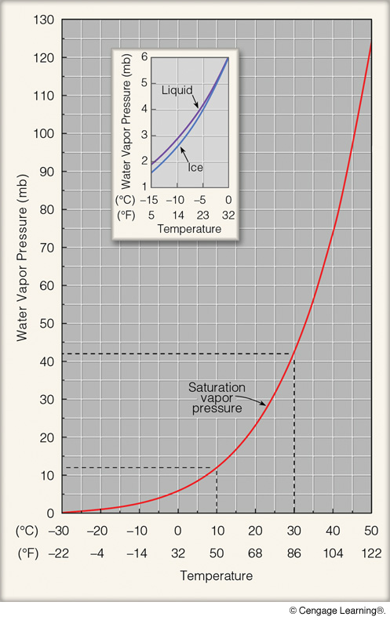
Cloud Formation
Assuming sufficient
cloud condensation nuclei,
Mixing: add enough moisture
to unsaturated air to raise
RH to 100% (saturate it)
Cooling: cool unsaturated air
Until it becomes saturated
(RH=100%)
or some combination.
Notes:
Page: 99
FIGURE 4.10 Saturation vapor pressure increases with increasing temperature. At a temperature of 10°C, the saturation vapor pressure is about 12 mb, whereas at 30°C it is about 42 mb. The inset illustrates that the saturation vapor pressure over water is greater than the saturation vapor pressure over ice. Why would

Slide 6
What caused these clouds to form?

Slide 7
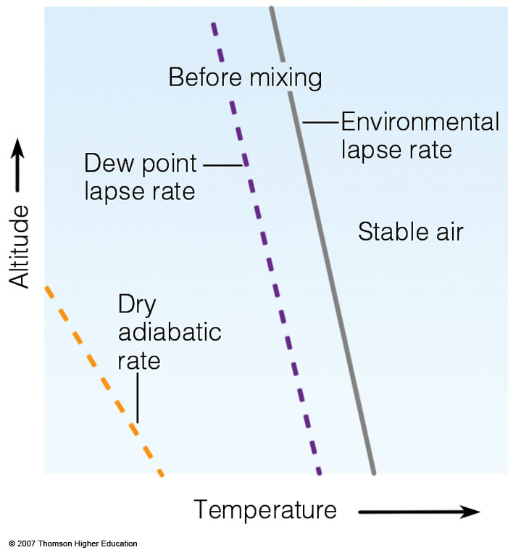
Mixing Cloud
Formation
air is unsaturated
RH is high
(T is near T_{d})
temperature and
humidity decline
with height
Notes:
Figure 6.29
The mixing of a moist layer of air near the surface can produce a deck of stratocumulus clouds.

Slide 8
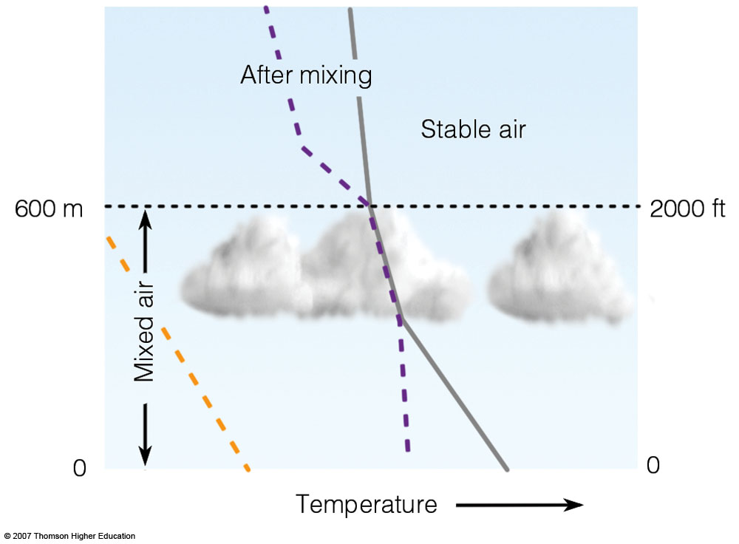
Mixing Cloud
Formation
Notes:
Figure 6.29
The mixing of a moist layer of air near the surface can produce a deck of stratocumulus clouds.

Slide 9
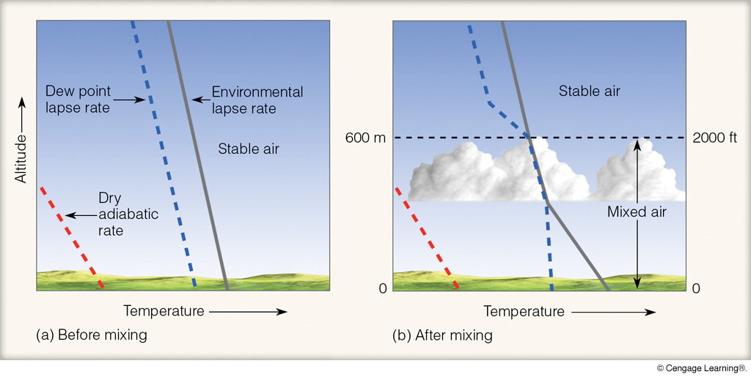
Mixing Cloud Formation
Humid air from below moistens air above cloud base.
(pp. 120–121 (Special Topic 5.2), pp. 162–163)
Notes:
Page: 165
FIGURE 6.29 The mixing of a moist layer of air near the surface can produce a deck of stratocumulus clouds.

Slide 10
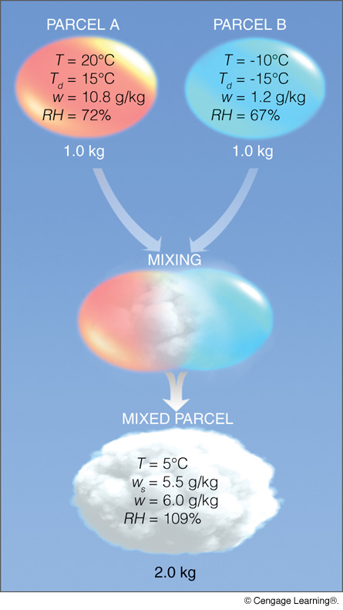
Mixing Cloud
Formation
Final Parcel
w cannot be greater
than w_{s}!
RH = 100%
T=T_{d} = 5°C
w_{s}=w_{final} = 5.5 g/kg
Visible cloud
condense excess
vapor into liquid
(cloud forms)
Notes:
Page: 124
FIGURE 2 Mixing two unsaturated air parcels can produce fog. Notice that the mixed parcel has an actual mixing ratio (W) that is greater than the saturation mixing ratio (Ws). This produces an RH of 109% and results in fog. (As the mixed parcel cools below its dew point temperature, water vapor will condense onto condensation nuclei, producing the liquid droplets that create fog.)

Slide 11
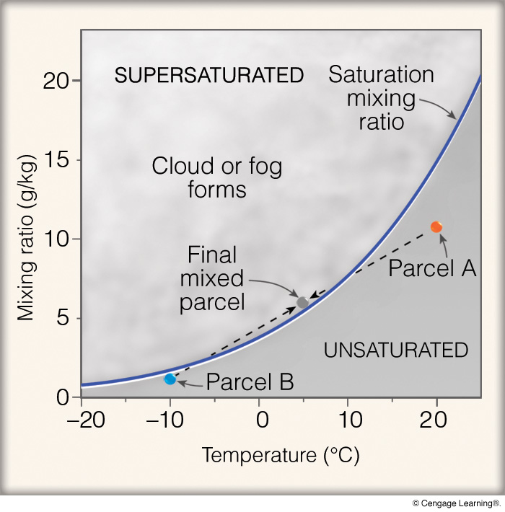
(pp. 120–121 (Special Topic 5.2), pp. 162–163)
Notes:
Page: 125
FIGURE 3 The blue line is the saturation mixing ratio. The mixing of two unsaturated air parcels (A and B) can produce a saturated air parcel and fog.

Slide 12
Stratocumulus

Slide 13
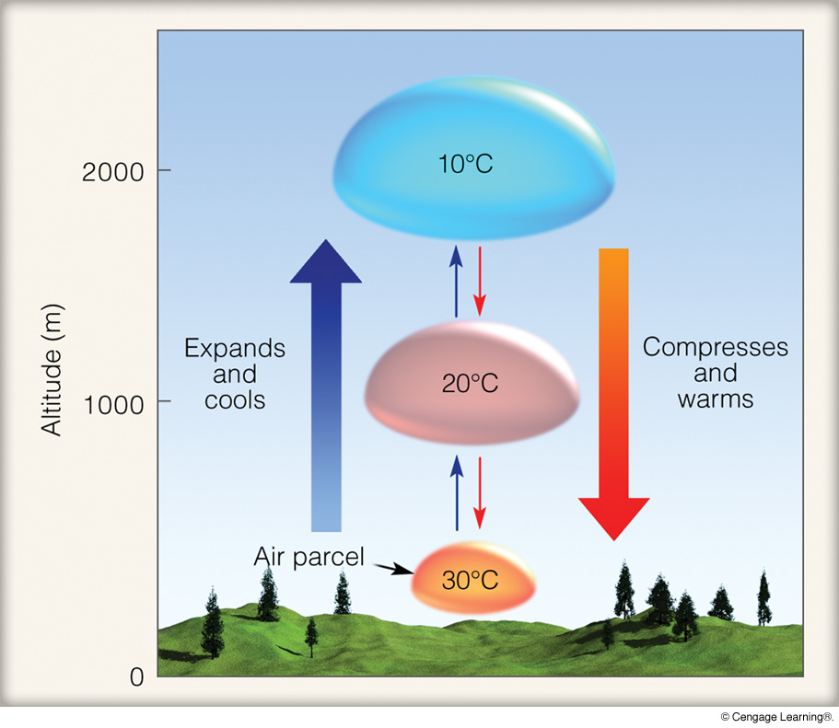
Rising and Sinking Parcels
1) as air rises, pressure
declines
2) volume increases
3) air cools
as air sinks, pressure
increases
2) volume decreases
3) air warms
Rising and cooling air is the primary method of cloud formation.
Notes:
Page: 146
FIGURE 6.2 The dry adiabatic rate. As long as the air parcel remains unsaturated, it expands and cools by 10°C per 1000 m; the sinking parcel compresses and warms by 10°C per 1000 m.

Slide 14
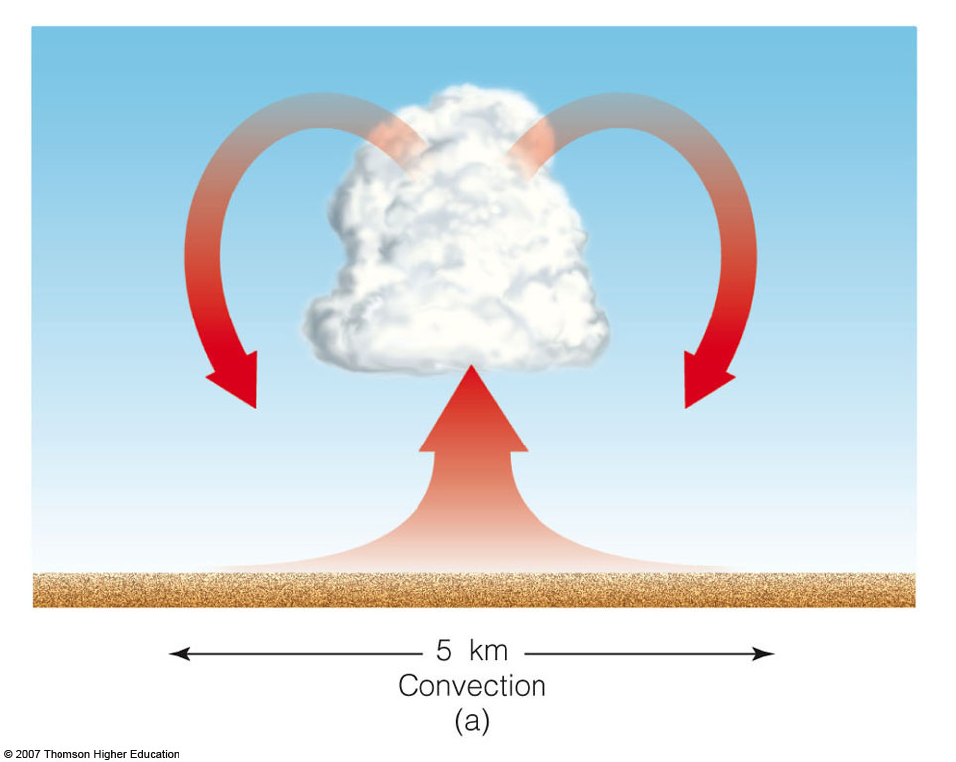
Primary Methods of Cloud Formation
Atmosphere is warmed from below in unstable air.
Notes:
Figure 6.15
The primary ways clouds form: (a) surface heating and convection; (b) forced lifting along topographic barriers; (c) convergence of surface air; (d) forced lifting along weather fronts.

Slide 15
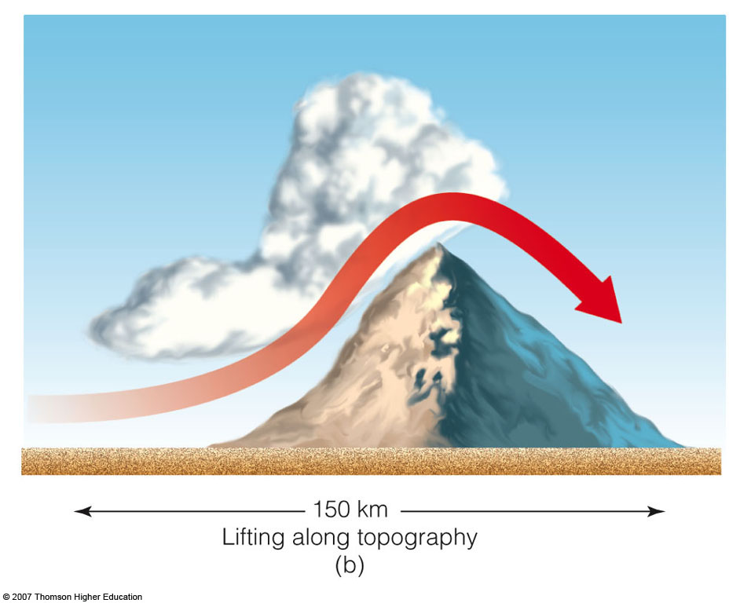
Primary Methods of Cloud Formation
Orographic lifting.
Notes:
Figure 6.15
The primary ways clouds form: (a) surface heating and convection; (b) forced lifting along topographic barriers; (c) convergence of surface air; (d) forced lifting along weather fronts.

Slide 16
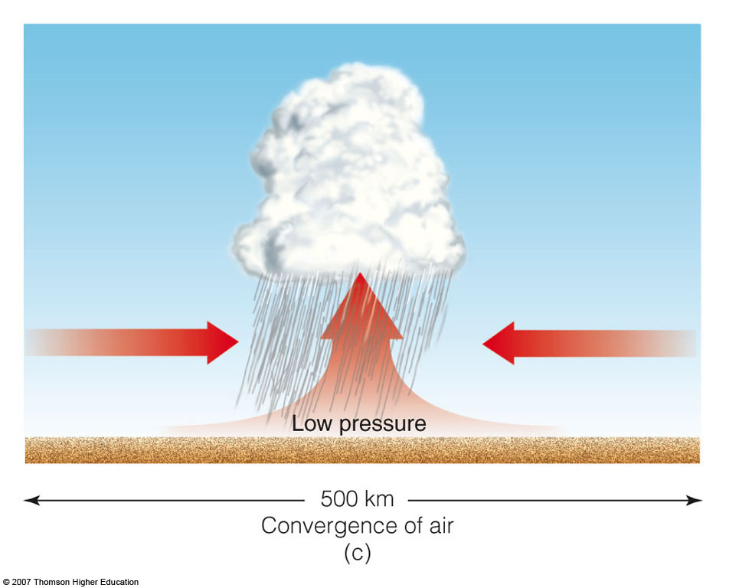
Primary Methods of Cloud Formation
Notes:
Figure 6.15
The primary ways clouds form: (a) surface heating and convection; (b) forced lifting along topographic barriers; (c) convergence of surface air; (d) forced lifting along weather fronts.

Slide 17
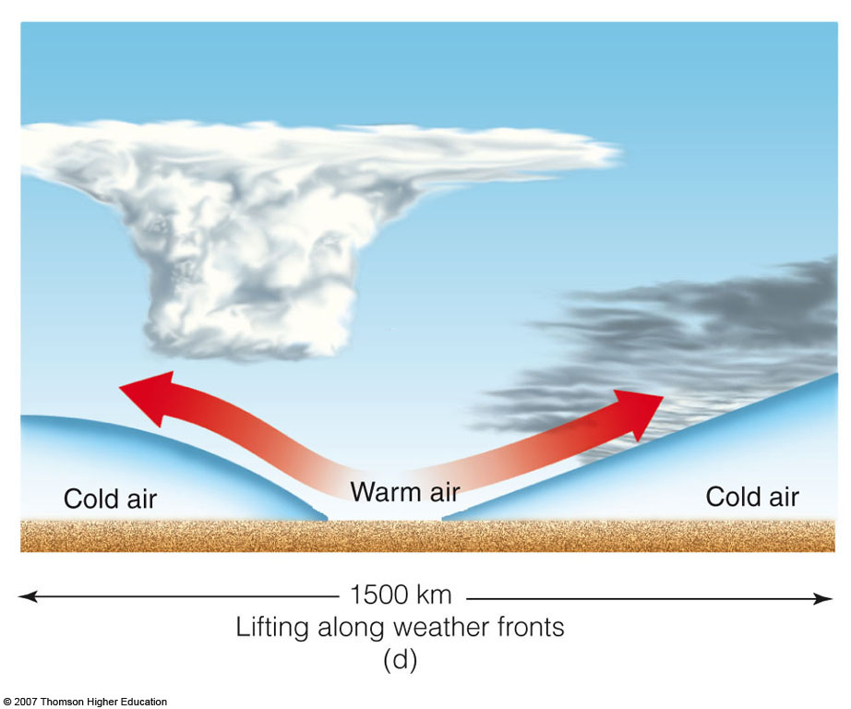
Primary Methods of Cloud Formation
Notes:
Figure 6.15
The primary ways clouds form: (a) surface heating and convection; (b) forced lifting along topographic barriers; (c) convergence of surface air; (d) forced lifting along weather fronts.

Slide 18
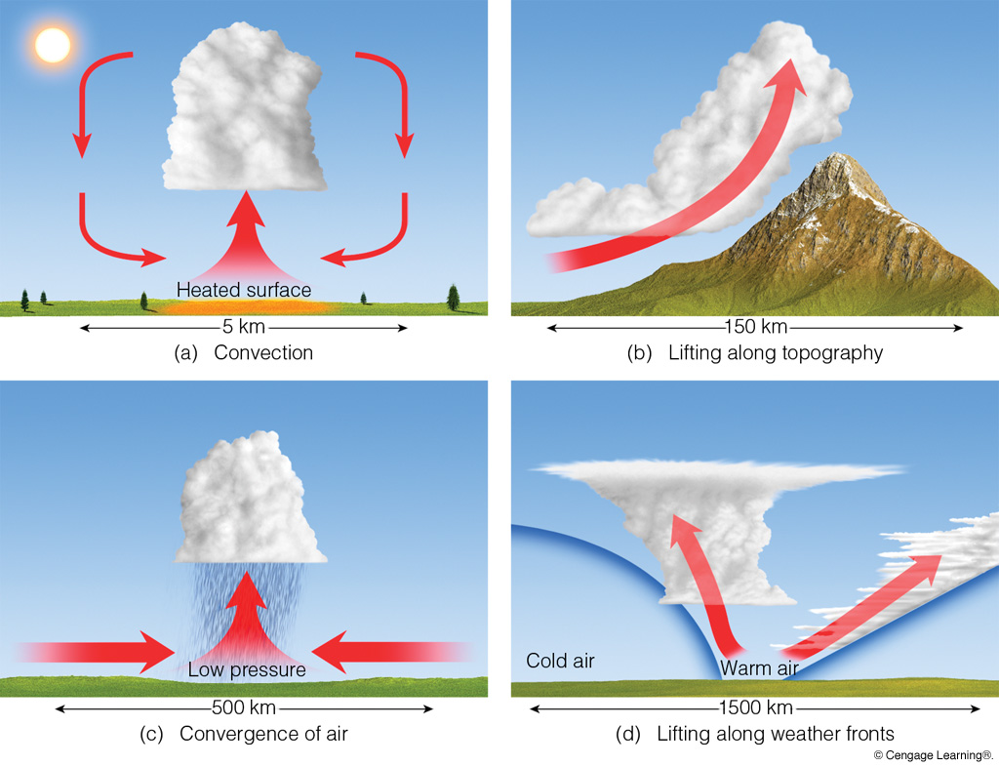
Primary Methods of Cloud Formation
Notes:
Page: 155
FIGURE 6.15 The primary ways clouds form: (a) surface heating and convection; (b) forced lifting along topographic barriers; (c) convergence of surface air; (d) forced lifting along weather fronts.

Slide 19
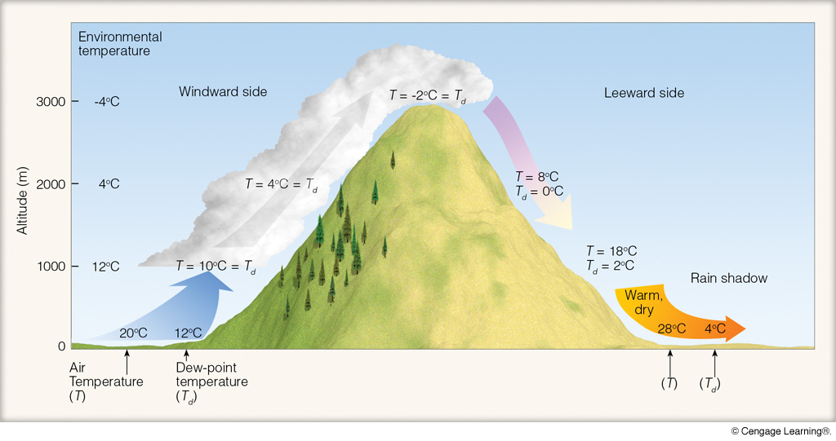
Orographic Clouds and Rain Shadow
Notes:
Page: 160
FIGURE 6.22 Orographic uplift, cloud development, and the formation of a rain shadow.

Slide 20
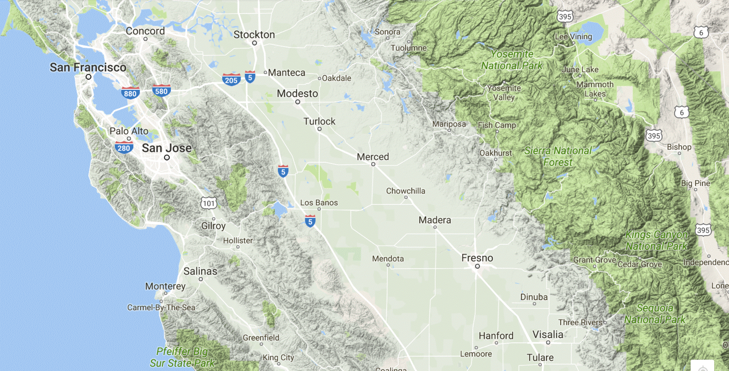
Orographic Clouds and Rain Shadow
(Central California Transect)
Mt. Hamilton
Santa Cruz

Slide 21
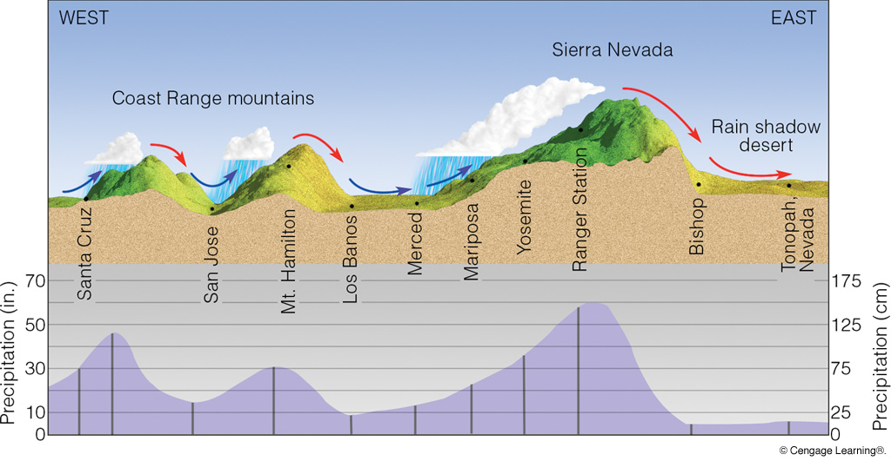
Orographic Precipitation along Western U.S.
Notes:
Page: 475
FIGURE 17.5 The effect of topography on average annual precipitation along a line running from the Pacific Ocean through central California into western Nevada.

Slide 22
Convective Cloud Formation
condensation, visible cumulus cloud
forms
T=T_{d}=66°F
T=68°F
T_{t}=69°F
T=68°F
air rises, expands, and cools
thermals form
T=69°F
T_{t}=70°F
T=69°F

Slide 23
Fair Weather Cumulus (Cumulus Humilis)

Slide 24
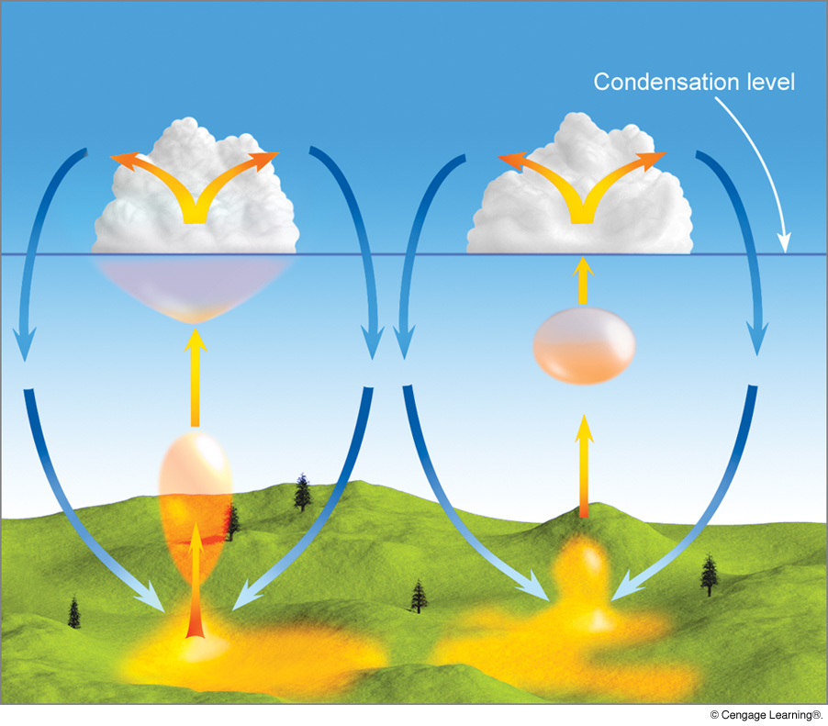
Convective Cloud Formation
Notes:
Page: 156
FIGURE 6.16 Cumulus clouds form as warm, invisible air bubbles detach themselves from the surface, then rise and cool to the condensation level. Below and within the cumulus clouds, the air is rising. Around the cloud, the air is sinking.

Slide 25
Cumulus Congestus

Slide 26
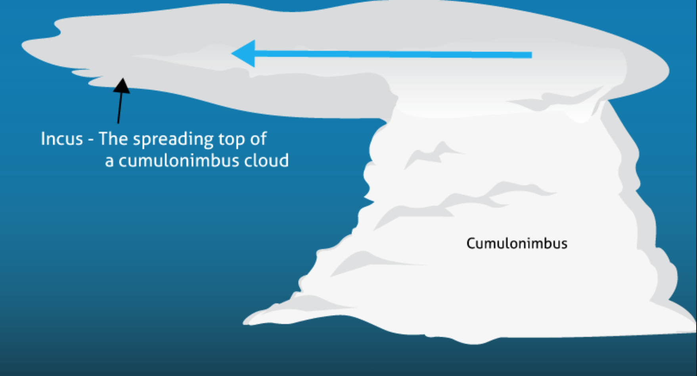
Cumulonimbus
wind
ice crystals
glaciated
anvil
precipitation

Slide 27
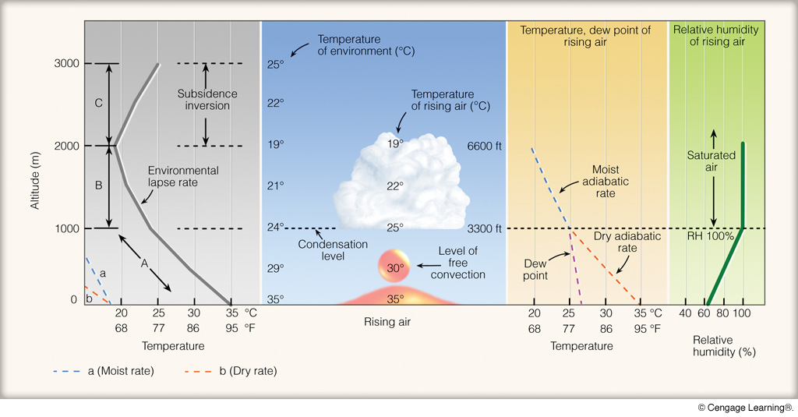
Convective Cloud Formation
Notes:
Page: 157
FIGURE 6.18 The development of a cumulus cloud.

Slide 28
Convective Cloud Formation
Notes:
FIGURE 6.17 Cumulus clouds building on a warm summer
afternoon. Each cloud represents a region where thermals are rising
from the surface. The clear areas between the clouds are regions where
the air is sinking.

Slide 29
Convective Cloud Formation
(Chap. 6, pp. 152–158)

Slide 30
Quick Summary—Cloud Formation:
Clouds form when air that contains cloud condensation nuclei is saturated via cooling or mixing.
Mixing clouds form when moist air is added to unsaturated air, raising the humidity to saturation.
Most clouds form via cooling and rising motion.
Rising air expands (because pressure is lower) and is thus cooler (less dense). A cloud forms when the air is cooled to the dew point temperature (saturation; RH = 100%).
Rising motion in the atmosphere occurs at many different scales, from local (convection) to frontal.

Slide 31
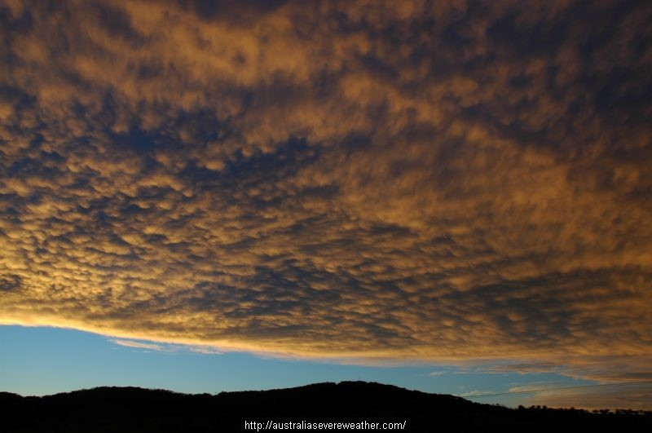
CLOUD
CLASSIFICATION

Slide 32
Cloud Classification
I. Stratiform: large-scale lifting of
stable air; no vertical development
II. Cumuliform: vertical development
caused by convection; flat cloud base; form in unstable air

Slide 33
Stratiform Clouds
A. High (>23,000 feet), “cirro-,” composed of high crystals only, no shadow cast
1. cirrus
2. cirrostratus (status = layer)
3. cirrocumulus (cumulus = puffy)
(note: this is a stratiform cloud, not cumuliform)

Slide 34
Stratiform Clouds
B. Middle (6,500–23,000 feet), “alto-,” water only or water/ice mix, clouds
block direct sunlight, shadow at base
1. altostratus
2. altocumulus

Slide 35
Stratiform Clouds
C. Low (<6,600 feet), “strato-,” composed of liquid water only
1. stratus
2. stratocumulus
3. nimbostratus (nimbo=rain)

Slide 36
Cumuliform Clouds
Flat cloud base, caused by convection, form in
unstable air
fair weather cumulus (cumulus humilis); cloud tops 3000–5000 feet above surface
cumulus congestus; 10,000–15,000 feet
cumulonimbus; tops > 20,000 feet; thunderstorm, possible glaciated anvil, precipitation

Slide 37
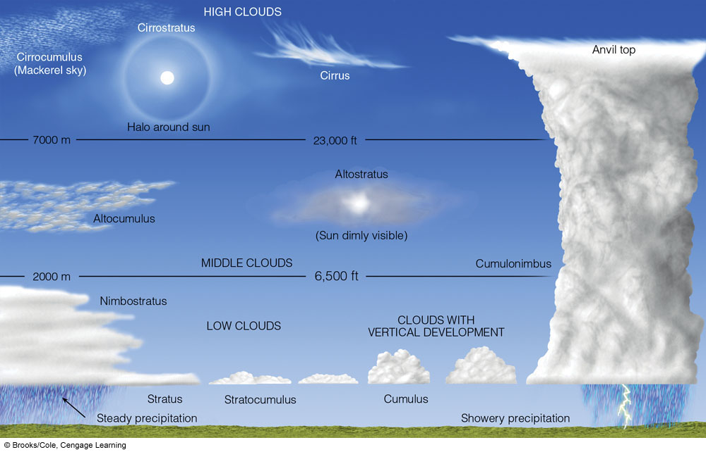
Basic Cloud Types
Notes:
FIGURE 5.24 A generalized illustration of basic cloud types based on height above the surface and vertical development.

Slide 38
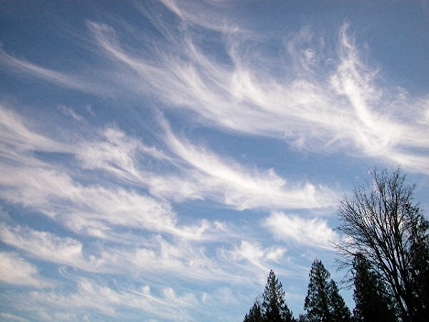
CIRRUS

Slide 39
CIRRUS

Slide 40
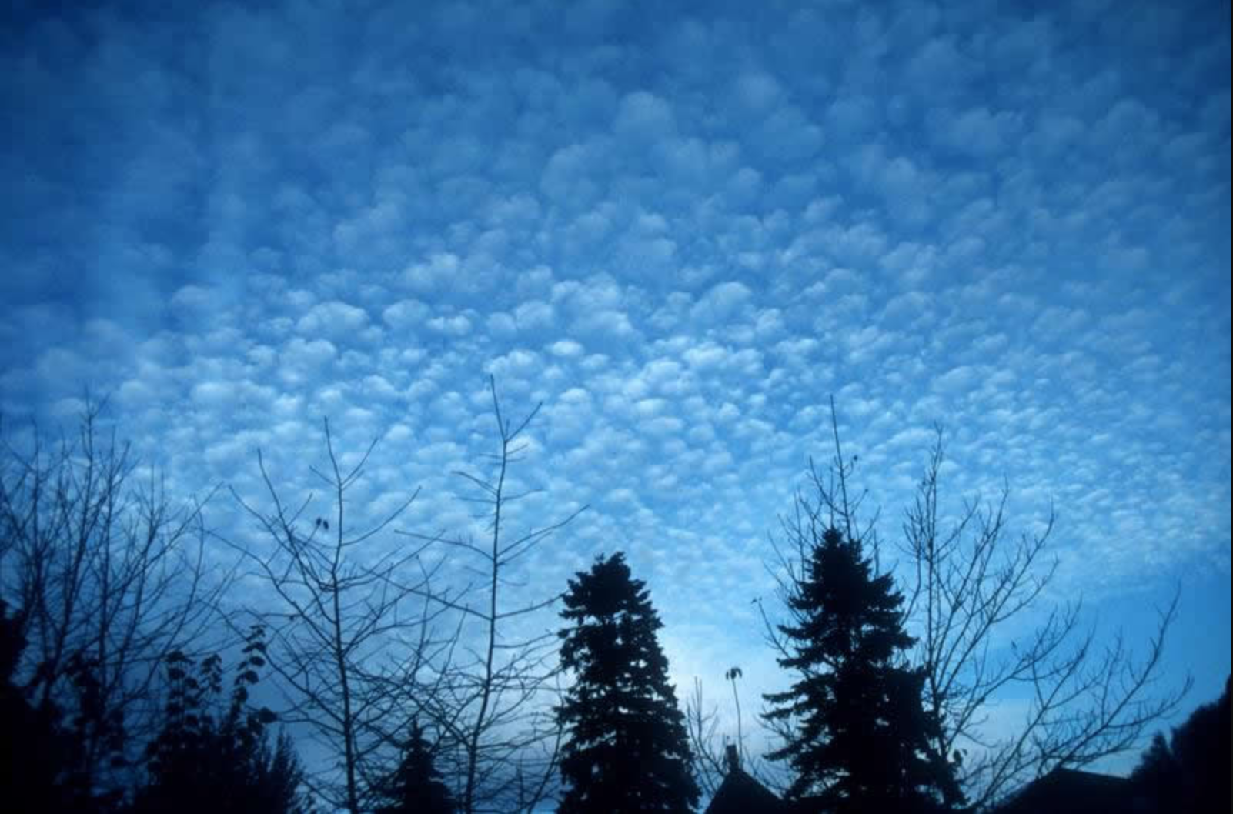
CIRROCUMULUS

Slide 41
CIRROCUMULUS

Slide 42
CIRROSTRATUS

Slide 43
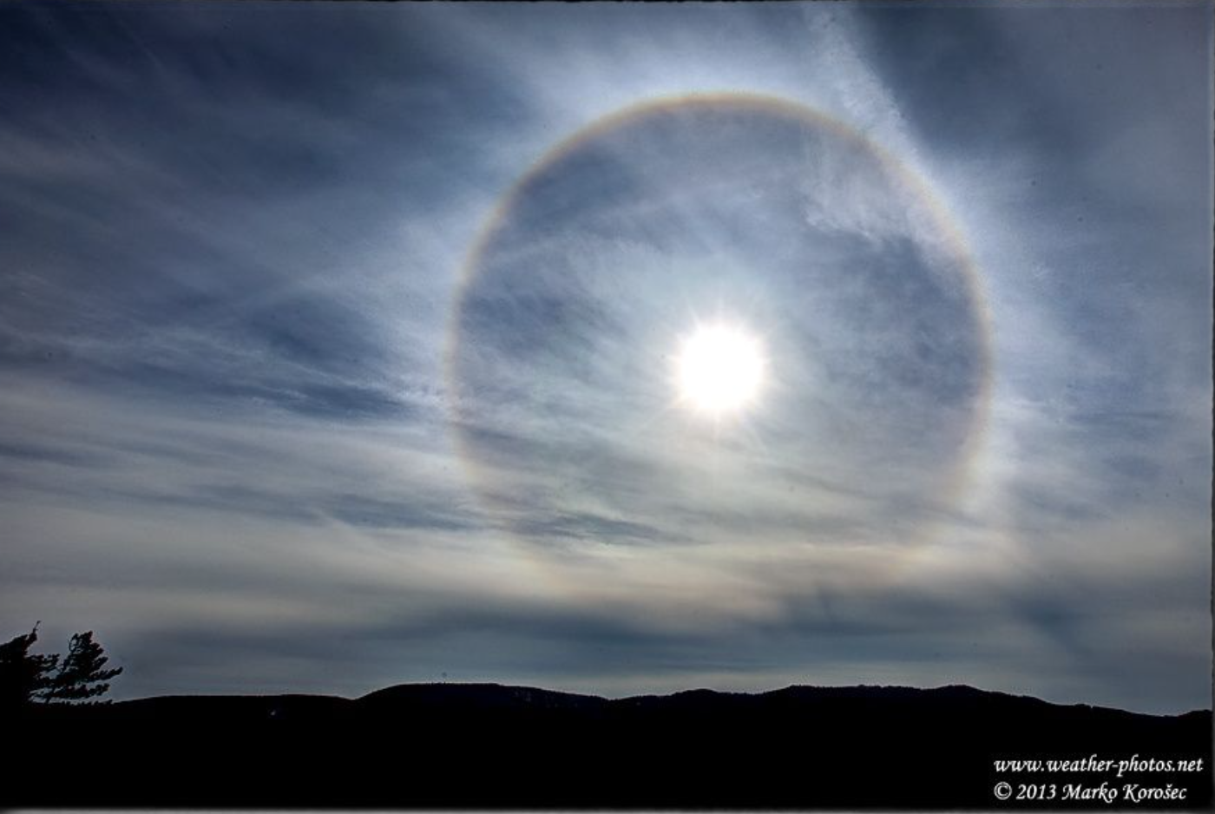
CIRROSTRATUS

Slide 44
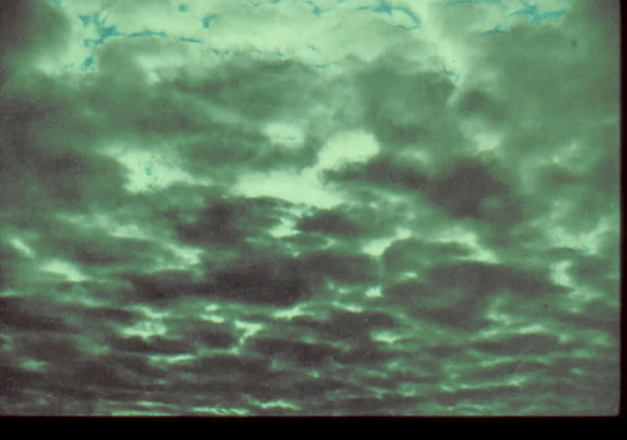
ALTOCUMULUS

Slide 45
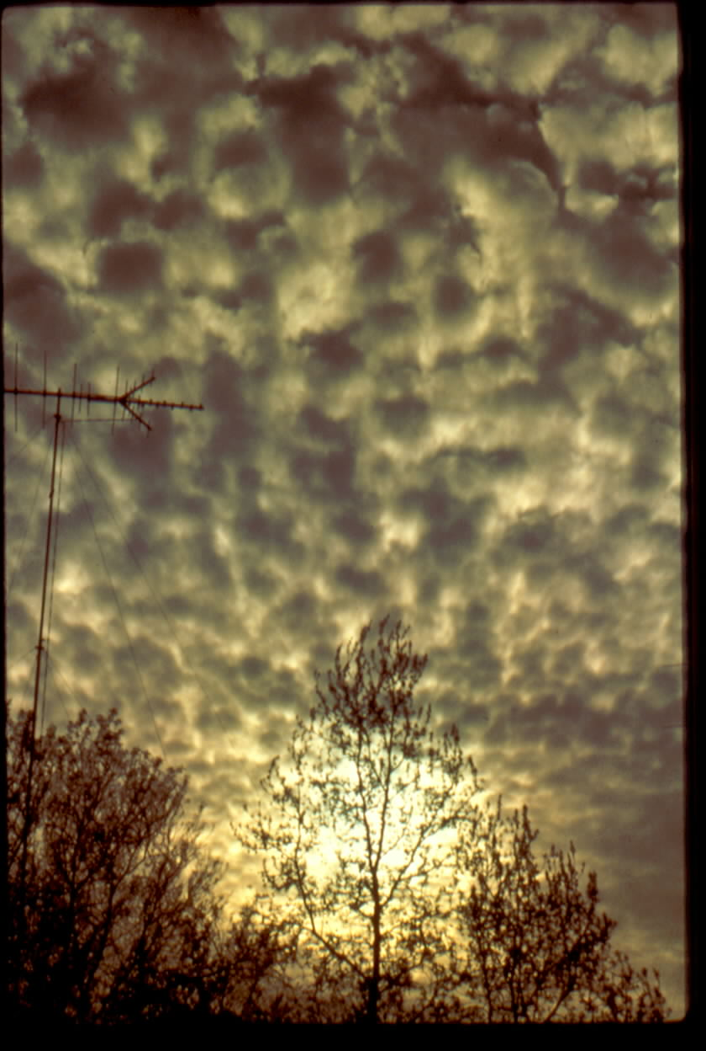
ALTOCUMULUS

Slide 46
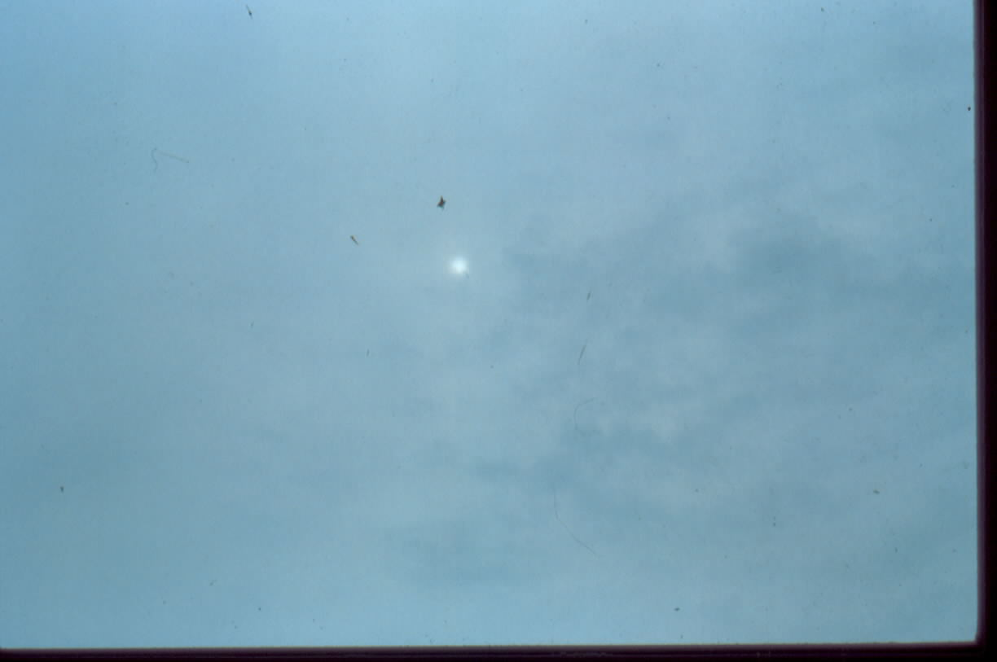
ALTOSTRATUS

Slide 47
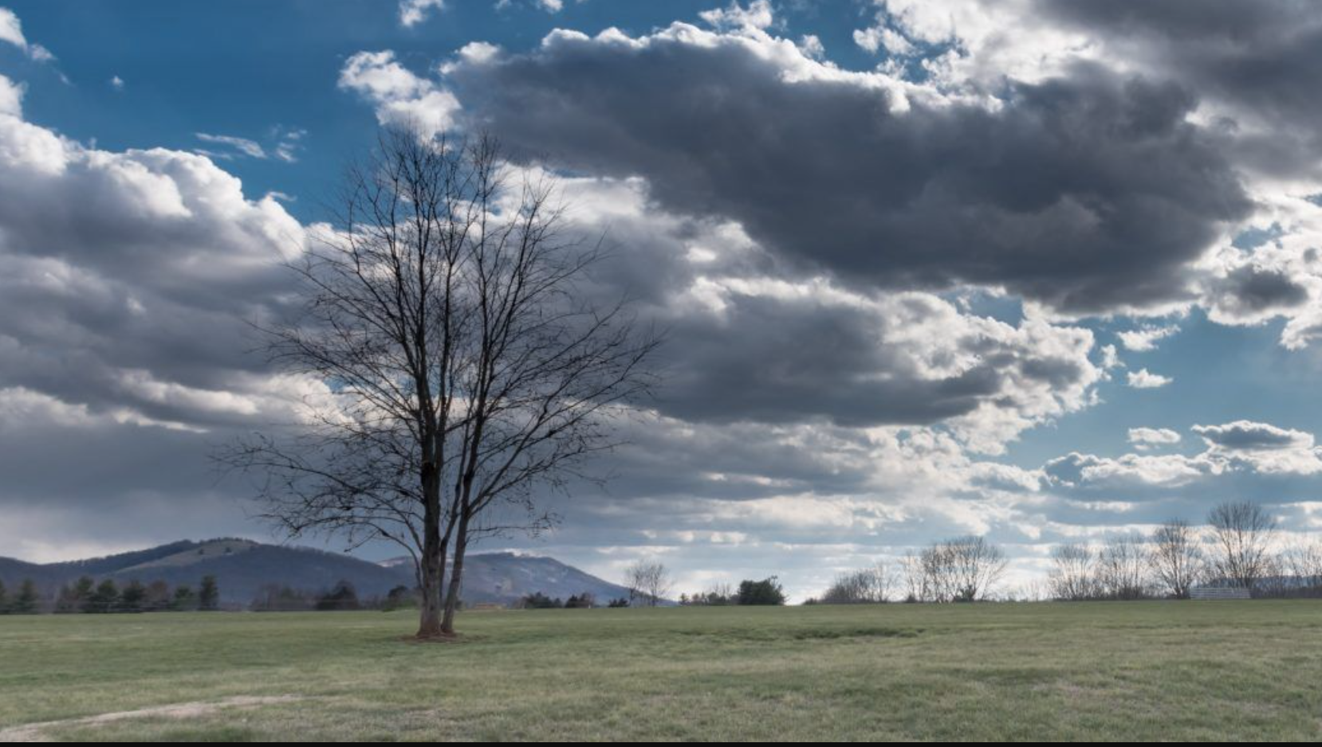
STRATOCUMULUS

Slide 48
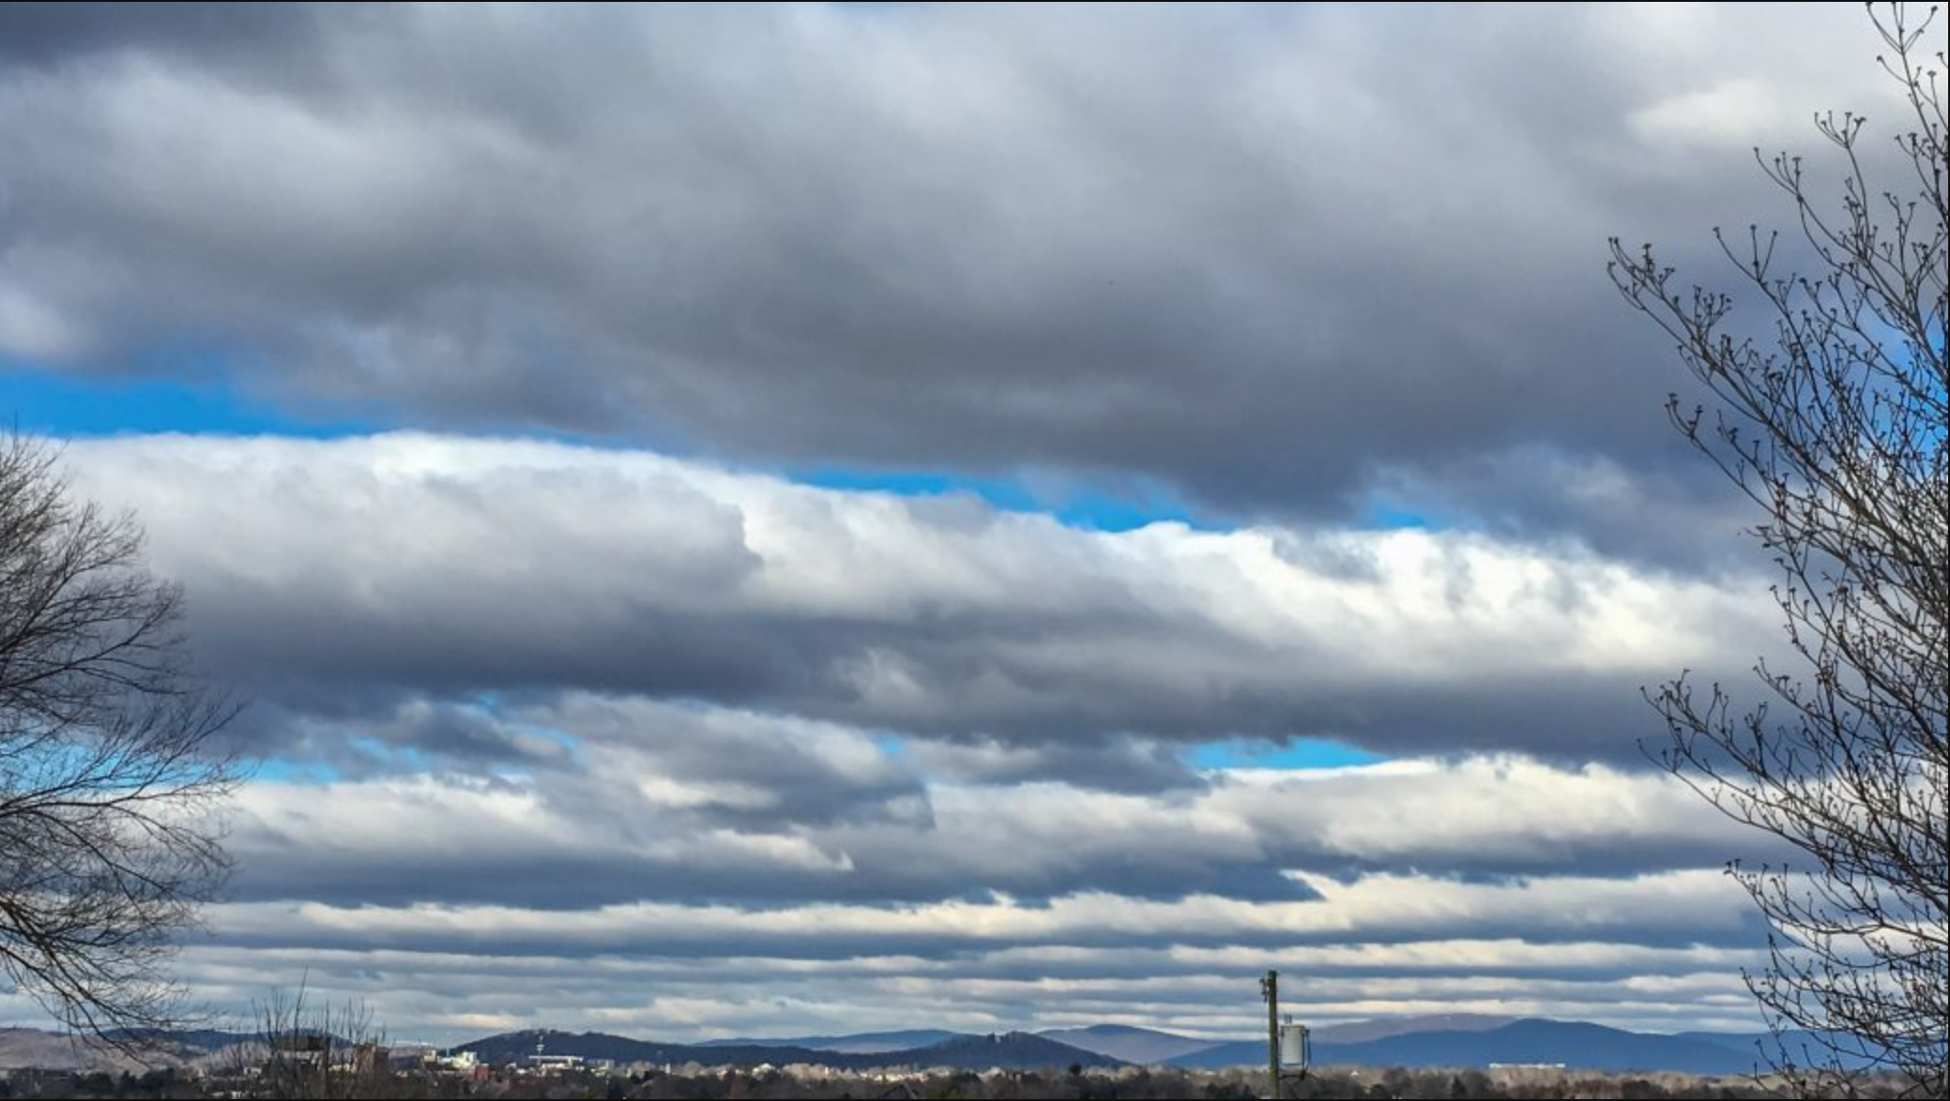
STRATOCUMULUS

Slide 49
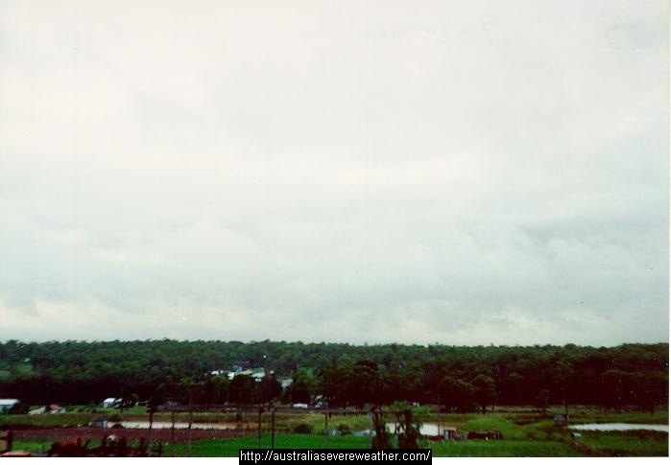
STRATUS

Slide 50
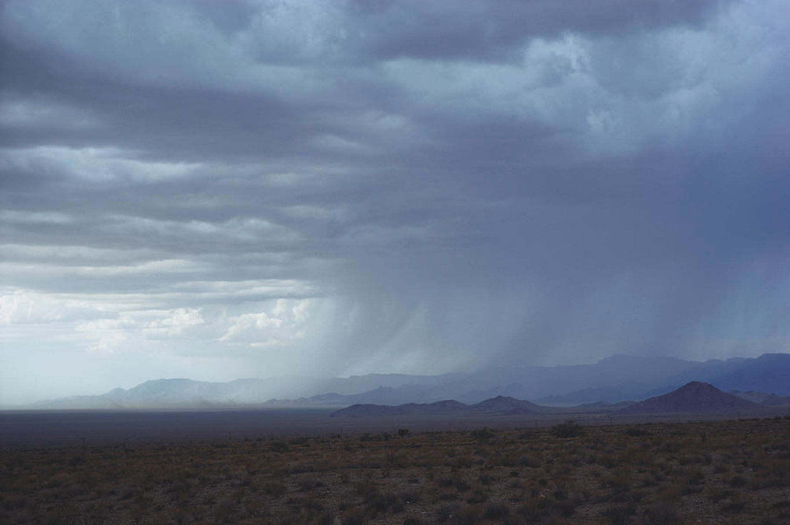
NIMBOSTRATUS

Slide 51
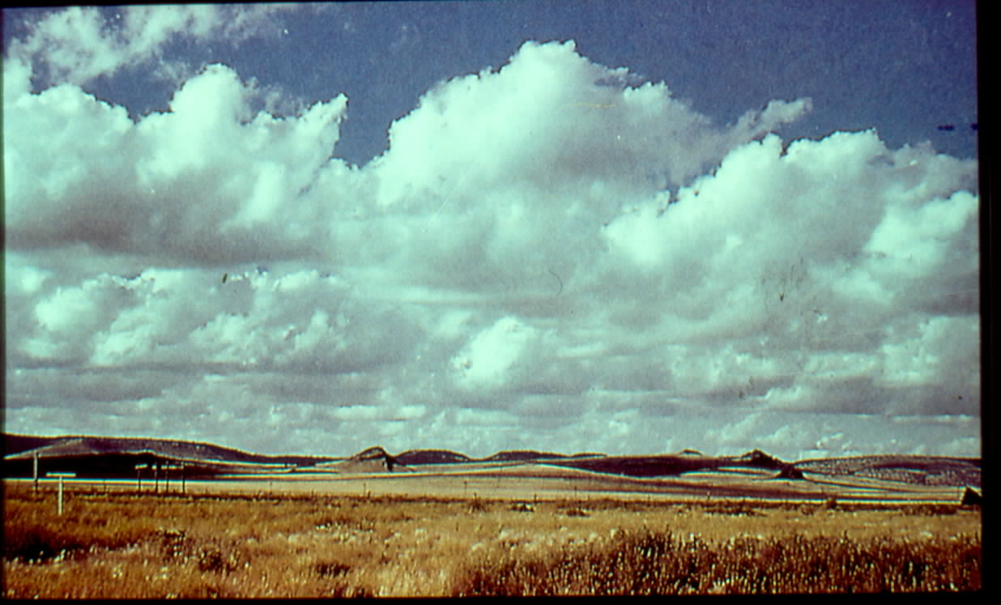
CUMULUS HUMILIS (FAIR WEATHER CUMULUS)

Slide 52
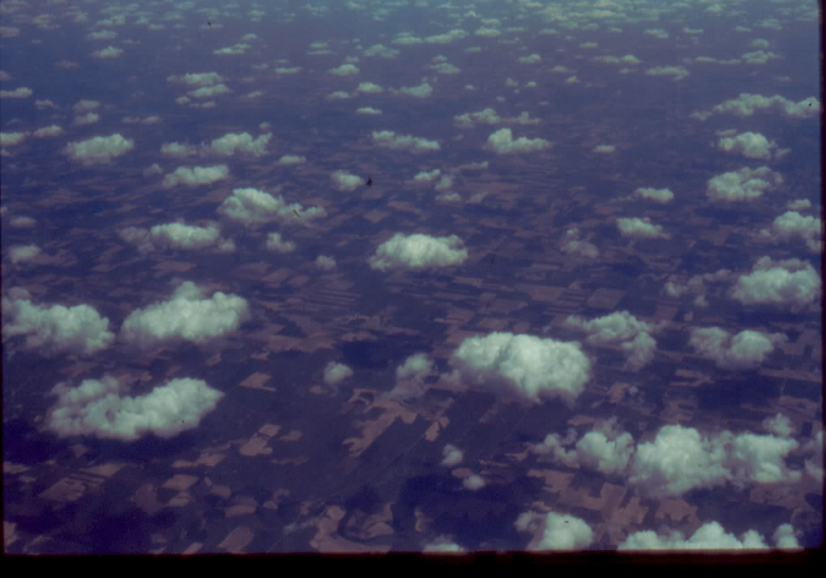
CUMULUS HUMILIS

Slide 53
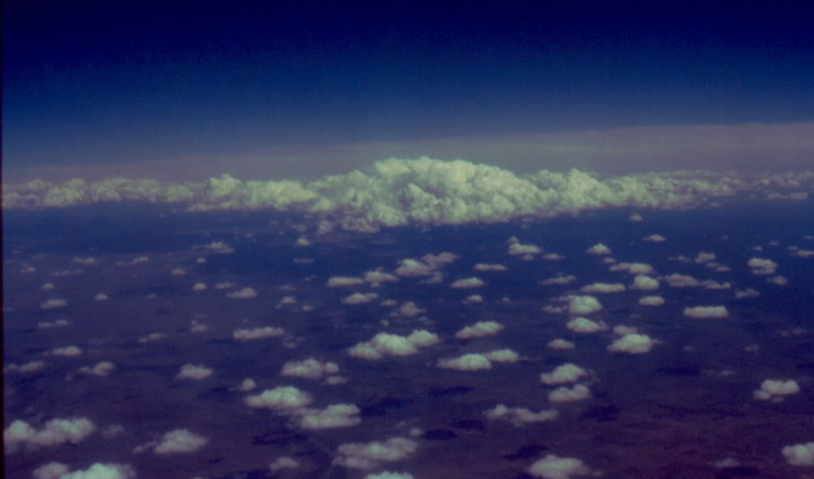
CUMULUS CONGESTUS (IN BACKGROUND)
CUMULUS HUMILIS (IN FOREGROUND)

Slide 54
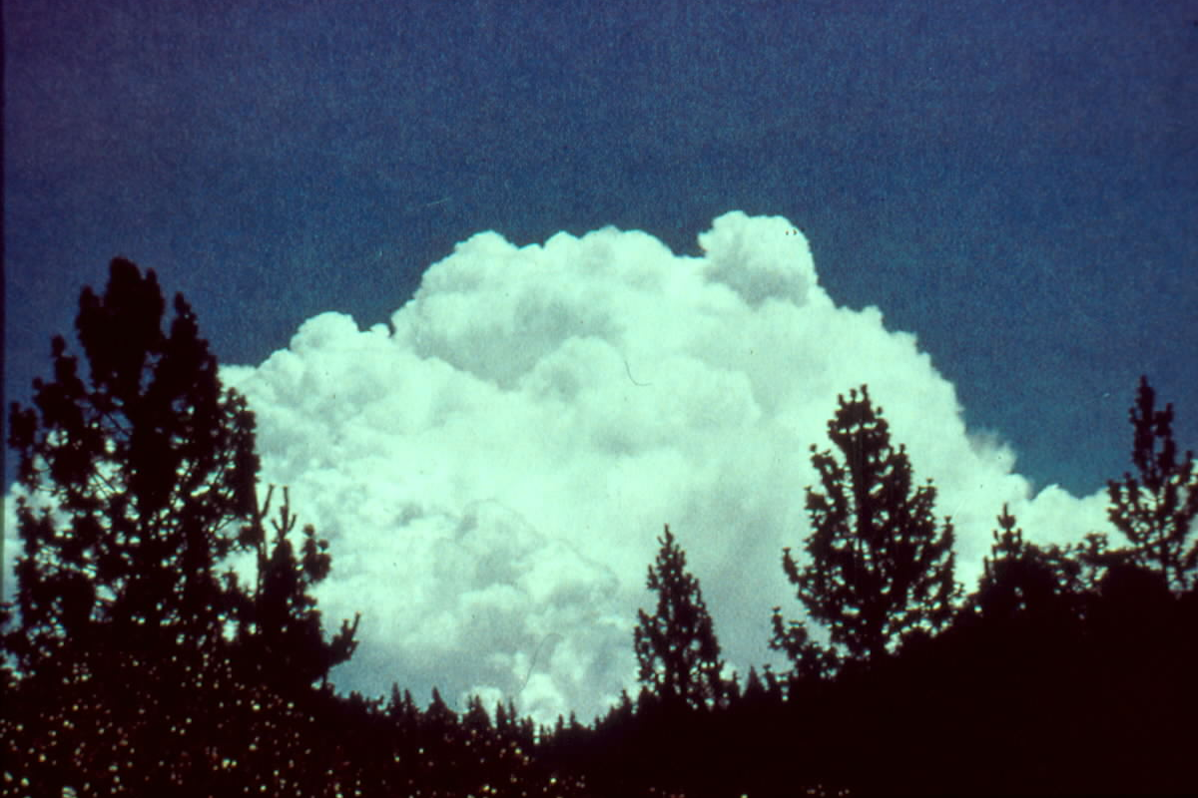
CUMULUS CONGESTUS

Slide 55
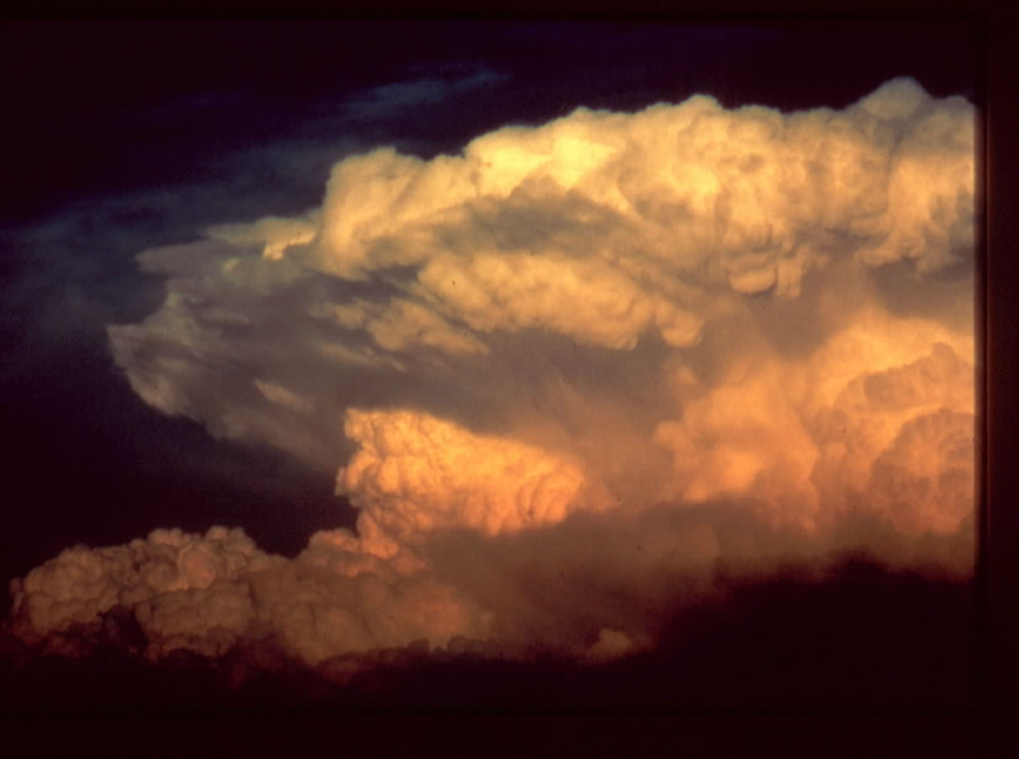
CUMULONIMBUS

Slide 56
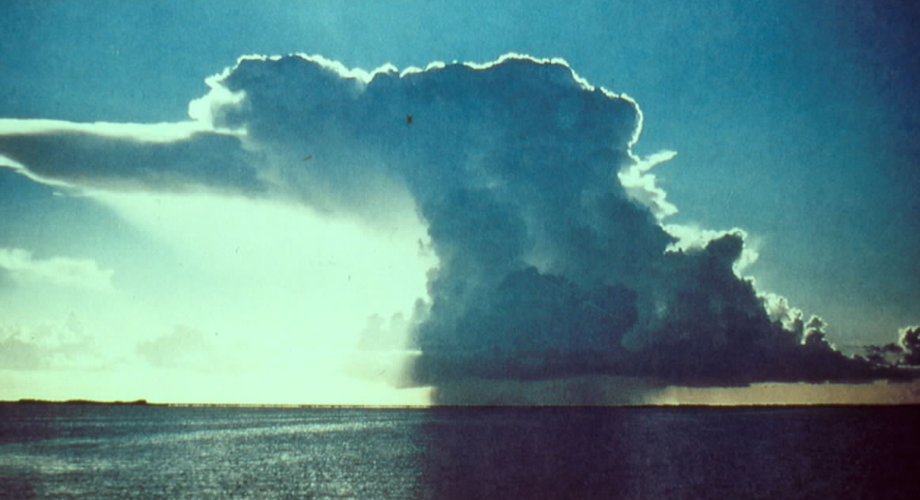
CUMULONIMBUS

Slide 57
The same type of cloud will typically be at a lower altitude in the polar regions and higher in the tropics.
(Chap. 5, pp. 124–130)
Notes:
TABLE 5.3 Approximate Height of Cloud Bases Above the Surface for Various Locations

Slide 58
Nerdy Cloud Classification Details
Just like animals and plants, clouds are classified according to their
genus, species, and variety.
1. Genera: e.g., stratus, cumulonimbus (the types discussed today)
2. Species: e.g., humilis, congestus, castellanus, lenticularis (later)
3. Variety: e.g., undulatus, translucidus, opacus
So a cloud might be classified as altocumulus castellanus opacus.
(For examples, see Table 5.4 (page 130) and
https://cloudatlas.wmo.int/principles-of-cloud-classification.html )

Slide 59
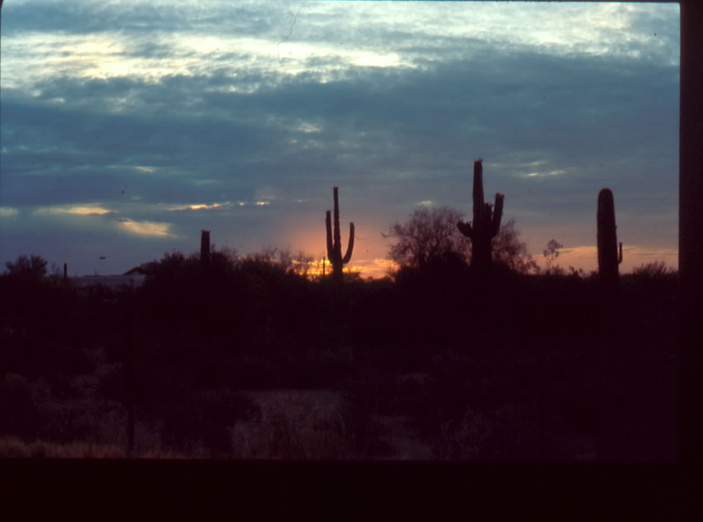
ALTOSTRATUS

Slide 60
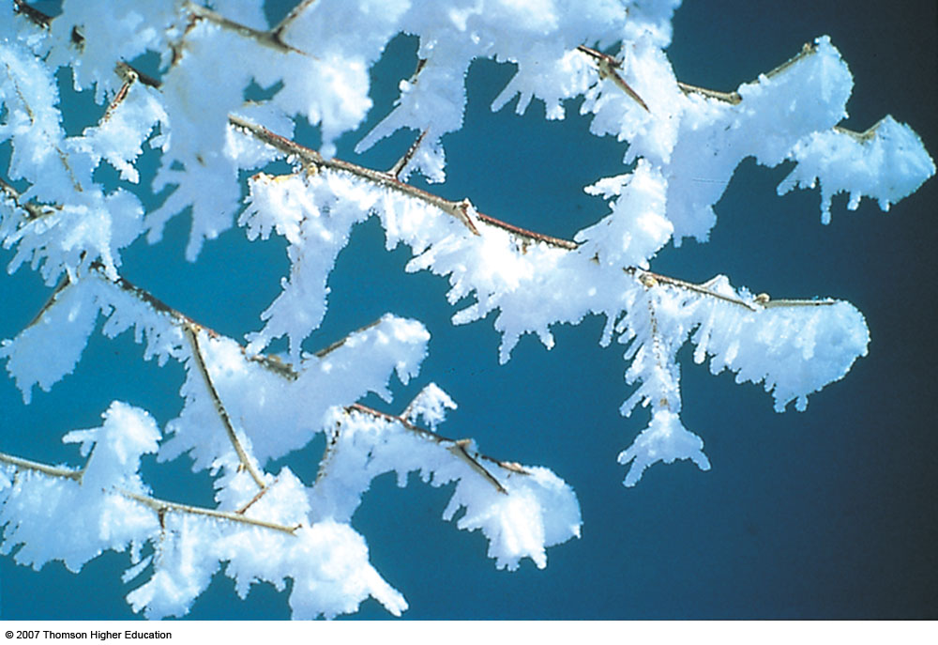
PRECIPITATION
(Chap. 7)

Slide 61
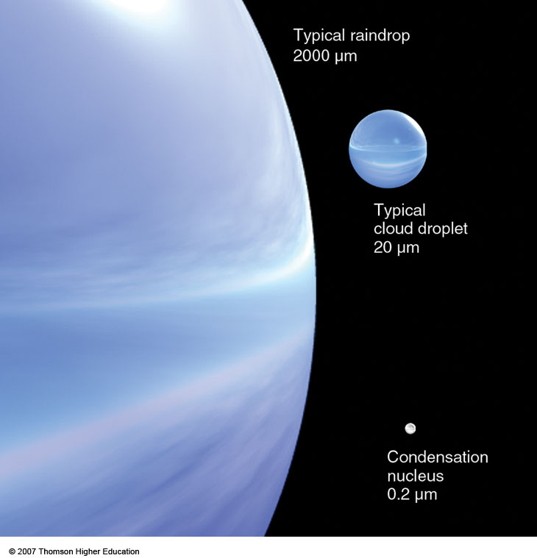
Notes:
Figure 7.1
Relative sizes of raindrops, cloud droplets, and condensation nuclei in micrometers (μm).

Slide 62
Collision and Coalescence
Notes:
FIGURE 7.4 Collision and coalescence. (a) In a warm cloud composed only of small cloud droplets of uniform size, the droplets are less likely to collide as they all fall very slowly at about the same speed. Those droplets that do collide, frequently do not coalesce because of the strong surface tension that holds together each tiny droplet. (b) In a cloud composed of droplets of varying sizes, larger droplets fall faster than smaller droplets. Although some tiny droplets are swept aside, some collect on the larger droplet’s forward edge, while others (captured in the wake of the larger droplet) coalesce on the droplet’s back side.

Slide 63
Collision and Coalescence
Notes:
FIGURE 7.5 A cloud droplet rising then falling through a warm cumulus cloud can grow by collision and coalescence, and emerge from the cloud as a large raindrop.

Slide 64
Supercooled Water
Liquid water at temperatures below freezing
Below –40°C (–40°F), only ice exists
Cloud Temperature | Cloud Contents
Above 0 C (32 F) | Liquid Water
-10 to 0 C (12-32 F) | Supercooled Water
-40 to -10 C (-4-14 F) | Supercooled Water and Ice Crystals Coexist
Below -40 C (-4 F) | Mainly Ice Crystals
Warm clouds
Cold
clouds

Slide 65
Saturation Vapor Pressure and Temperature
e_{s ice} < e_{s liquid water}
Notes:
Page: 99
FIGURE 4.10 Saturation vapor pressure increases with increasing temperature. At a temperature of 10°C, the saturation vapor pressure is about 12 mb, whereas at 30°C it is about 42 mb. The inset illustrates that the saturation vapor pressure over water is greater than the saturation vapor pressure over ice. Why would

Slide 66
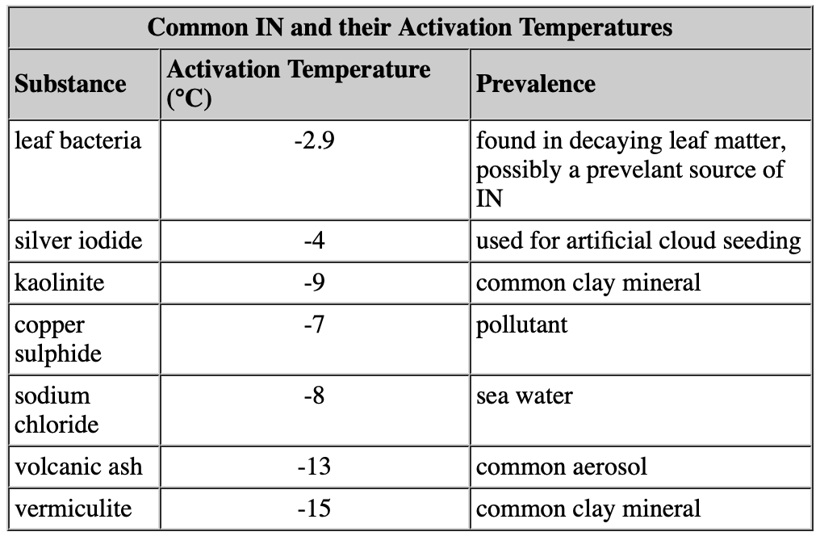
Ice Nuclei (IN)
Similar to cloud condensation nuclei, except ice crystal forms instead of cloud droplet
In the atmosphere, supercooled water droplets will freeze almost instantly if they come into contact with a solid particle that resembles an ice nucleus

Slide 67
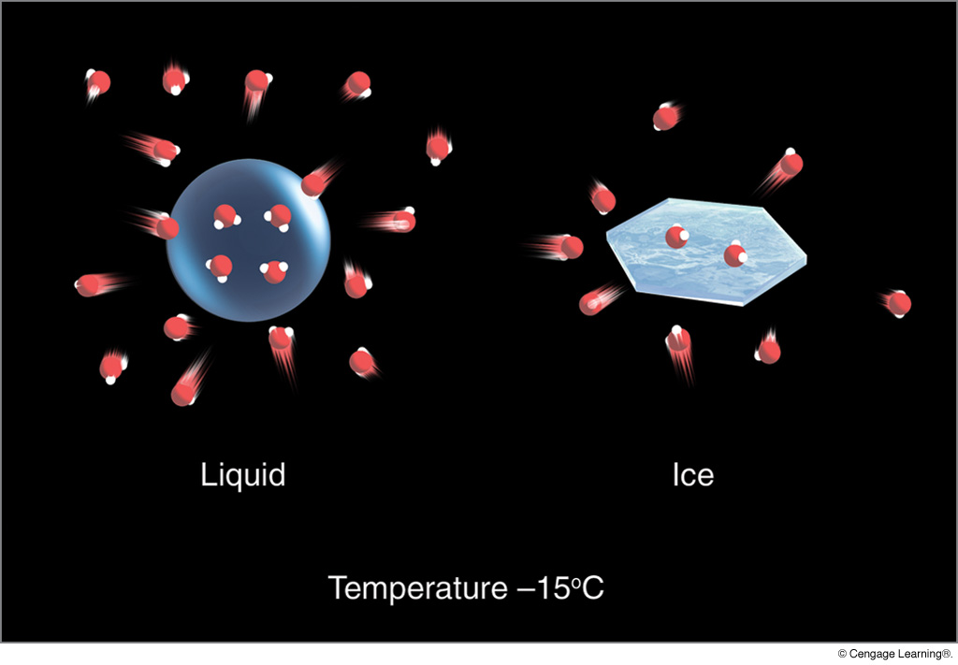
Saturation for Supercooled Water and Ice
e_{s ice} < e_{s liquid water}
Notes:
Page: 175
FIGURE 7.7 In a saturated environment, the water droplet and the ice crystal are in equilibrium, as the number of molecules leaving the surface of each droplet and ice crystal equals the number returning. There are more water vapor molecules above the droplet than above the ice, which produces a greater vapor pressure above the droplet. This situation means that, at saturation, the pressure exerted by the water molecules is greater over the water droplet than over the ice crystal.

Slide 68
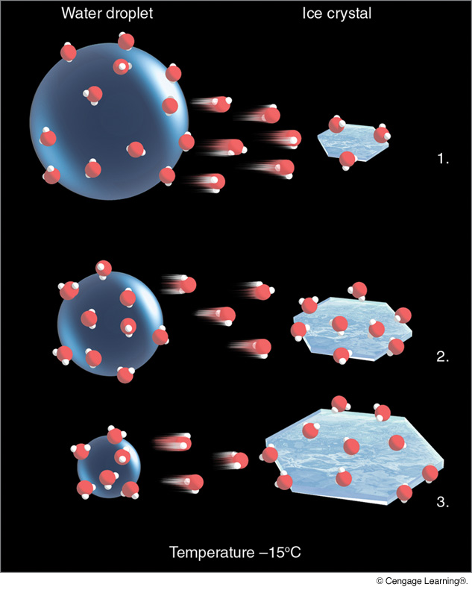
Ice Crystal Process
(Bergeron Process)
Air is supersaturated
with respect to ice;
unsaturated with
respect to supercooled
water drop
e_{s ice} < e_{s liquid water}
Notes:
Page: 175
FIGURE 7.9 The ice-crystal (Bergeron) process. (1) The greater number of water vapor molecules around the liquid droplet causes water molecules to diffuse from the liquid droplet toward the ice crystal. (2) The ice crystal absorbs the water vapor and grows larger, while (3) the water droplet grows smaller.

Slide 69
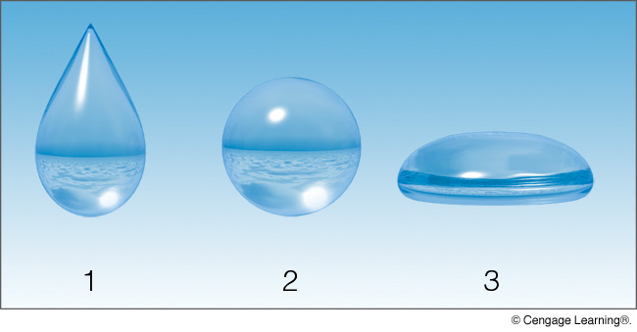
Shape of Raindrop?
Notes:
Page: 181
FIGURE 3 Which of the three drops shown here represents the real shape of a falling raindrop?

Slide 70
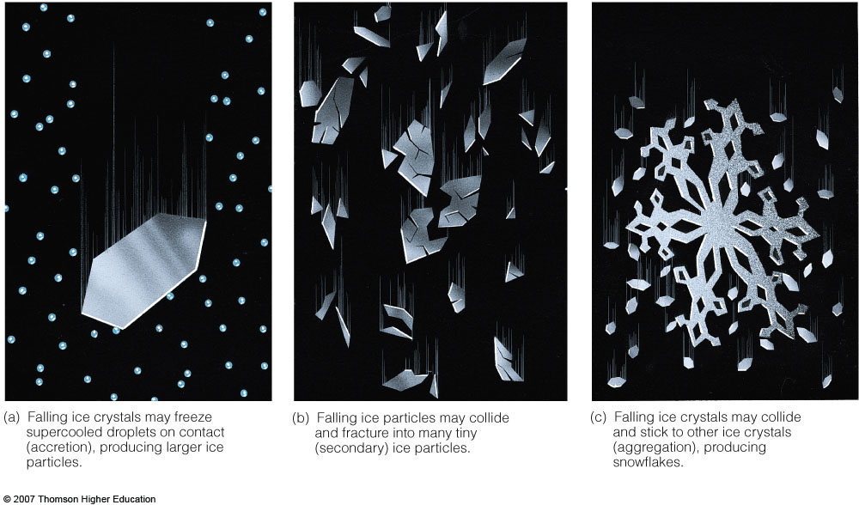
Notes:
Figure 7.10
Ice particles in clouds.

Slide 71
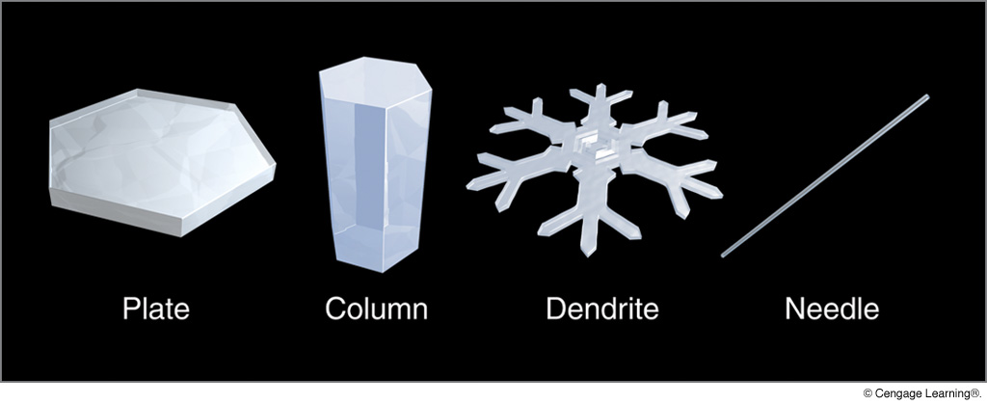
Typical Ice Crystals Forms
Notes:
Page: 183
FIGURE 7.18 Common ice crystal forms (habits).

Slide 72
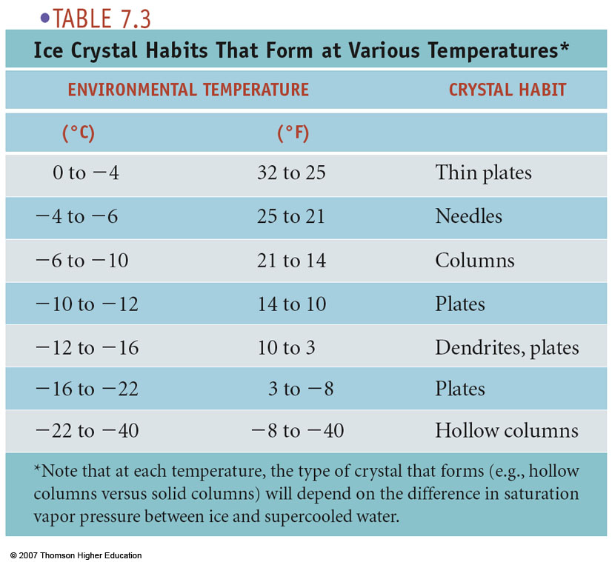
(Not on exam.)

Slide 73
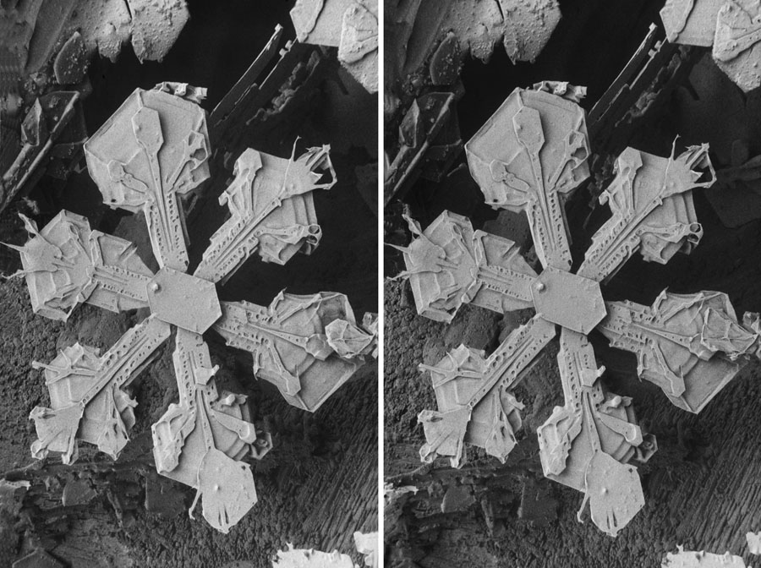

Slide 74
MEAN ANNUAL SNOWFALL
Notes:
Page: 184
FIGURE 7.21 Average annual snowfall over the United States and southern Canada.

Slide 75
What kind of precipitation would you expect in the following four situations?
0°C
0°C
Ht
Ht
32°F
32°F
Temp
Temp
0°C
0°C
Ht
Ht
32°F
32°F
Temp
Temp

Slide 76
Notes:
Figure 7.23
Vertical temperature profiles (solid red line) associated with different forms of precipitation.

Slide 77
Notes:
Figure 7.23
Vertical temperature profiles (solid red line) associated with different forms of precipitation.

Slide 78
ice crystals
partially melt
refreeze in
thick cold layer
Notes:
Figure 7.23
Vertical temperature profiles (solid red line) associated with different forms of precipitation.

Slide 79
ice crystals
completely melt
supercooled
water freezes
on contact
Notes:
Figure 7.23
Vertical temperature profiles (solid red line) associated with different forms of precipitation.

Slide 80
Notes:
Page: 187
FIGURE 7.26 Vertical temperature profiles (solid red line) associated with different forms of precipitation.

Slide 81
Number of Freezing Rain/Drizzle Days per Year
Notes:
Page: 186
FIGURE 7.25 Average annual number of days with freezing rain and freezing drizzle over the United States. (NOAA)

Slide 82
Cumulonimbus Cloud
Notes:
Page: 173
FIGURE 7.6 The distribution of ice and water in a cumulonimbus cloud.

Slide 83
Graupel (Snow Pellet) Formation
Notes:
Page: 188
FIGURE 7.27 The formation of snow pellets. In the cold air of a convective cloud, with a high liquid-water content, ice particles collide with supercooled cloud droplets, freezing them into clumps of icy matter called graupel. Upon reaching the relatively cold surface, the graupel is classified as snow pellets.

Slide 84
Notes:
Page: 188
FIGURE 7.28 A snowflake becoming a rimed snowflake, then finally graupel

Slide 85
Graupel

Slide 86
Hailstone Formation
Notes:
Page: 189
FIGURE 7.31 Hailstones begin as embryos (usually ice particles called graupel) that remain suspended in the cloud by violent updrafts. The updrafts (or a single broad updraft, as illustrated here) can sweep the ice particles horizontally through the cloud, producing the optimal trajectory for hailstone growth. Along their path, the ice particles collide with supercooled liquid droplets, which freeze on contact. The ice particles eventually grow large enough and heavy enough to fall toward the ground as hailstones.

Slide 87
Record Hailstone from Vivian, South Dakota
Notes:
Page: 189
FIGURE 7.30 This whopping hailstone fell on Vivian, South Dakota, on July 23, 2010. It had a record diameter of 8 inches, weighed a record 1.94 pounds, and had a circumference of 18.6 inches.

Slide 88
Notes:
Page: 190
FIGURE 7.32 A large hailstone first cut then photographed under regular light (left) and polarized light (right). This procedure reveals its layered structure.

Slide 89
Hailstone Structure
(rapid freezing)
(slow freezing)
Notes:
Page: 197
FIGURE 7.39

Slide 90
NUMBER OF HAIL DAYS PER YEAR
?
?
?
Notes:
Page: 402
FIGURE 14.31 The average number of days each year on which hail is observed throughout the United States and southern Canada.

Slide 92
STRANGE
CLOUDS
(Chaps. 5 & 6)

Slide 95
Contrails

Slide 96
Contrails

Slide 98
This enhanced infrared image from NASA's Terra satellite shows a widespread outbreak of contrails over the southeastern United States during the morning of January 29, 2004. Satellite data are critical for studying the effects of contrails. The crisscrossing white lines are contrails that form from planes flying in different directions at different altitudes. Each contrail spreads and moves with the wind. Contrails often form over large areas during winter and spring. CREDIT: NASA

Slide 99
Distrail (Dissipation Trail, Canal Cloud)

Slide 100
Hole Punch Cloud

Slide 102
© Vicki Harrison

Slide 103
Mountain Waves and Lee Waves (Lenticular)
Notes:
Page: 161
FIGURE 6.24 Lenticular clouds that form in the wave directly over the mountain are called mountain wave clouds, whereas those that form downwind of the mountain are called lee wave clouds. On the underside of the lee wave’s crest a turbulent rotor cloud may form.

Slide 105
Mark J. Madigan, Walsenburg, CO

Slide 106
Pileus

Slide 107
Pileus
stable
unstable

Slide 110
Lenticular Clouds
Notes:
FIGURE 6.25 Lenticular clouds forming one on top of the other
over the Sierra Nevada.

Slide 111
Lenticular Clouds

Slide 112
Lenticular Clouds

Slide 113
Lenticular Cloud

Slide 114
Lenticular Cloud
© Brian Holden

Slide 116
Stratocumulus Castellanus

Slide 117
Entrainment: mixing of dry air along cloud edges
Addition of dry air causes cloud droplets to evaporate.

Slide 118
Stratocumulus Castellanus
unstable
stable

Slide 119
Mammatus

Slide 120
Pendules on Contrails

Slide 121
Mammatus

Slide 122
Mammatus

Slide 123
Mammatus

Slide 124
Mammatus

Slide 125
Fractostratus (“Scud”)

Slide 126
Fractostratus (“Scud”)

Slide 127
Virga

Slide 128
Virga

Slide 129
Billows

Slide 130
up

Slide 131
Billows
Notes:
Page: 164
FIGURE 6.27 Billow clouds forming in a region where wind speed changes rapidly with altitude. This is a region of strong vertical wind shear. (More on the topic of wind shear and the formation of these clouds is given in Chapter 9, p. 235.)

Slide 132
Cloud Streets

Slide 133
Cloud Streets
STABLE
cold ice
wind
UNSTABLE
wind
warm water

Slide 134
Cloud Streets

