Slide 1
Tawny &
Daisy’s
Review
of
THERMODYNAMICS
AND
MOISTURE

Slide 2
IDEAL GAS LAW (EQUATION OF STATE)
R is called the specific gas constant. Its value depends on the molecular weight of the gas, so it varies from gas to gas.

Slide 3
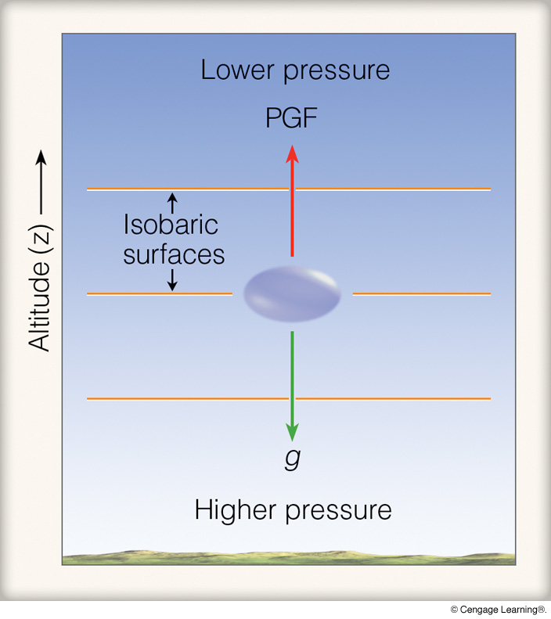
HYDROSTATIC BALANCE
so

Slide 4
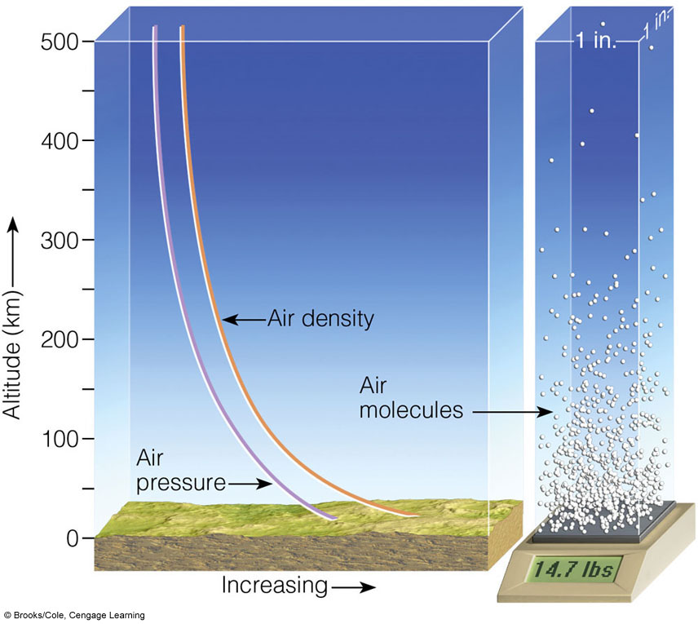
HYDROSTATIC BALANCE

Slide 5
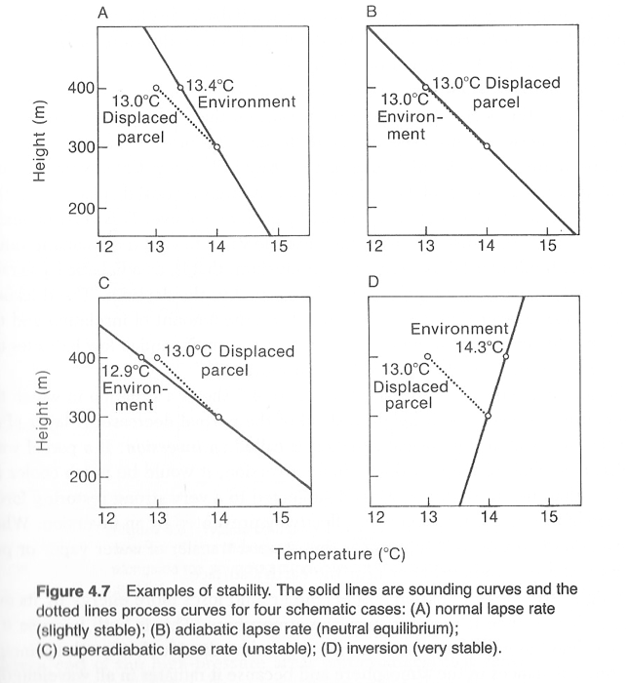
Layer
Stability
dotted line =
dry adiabatic
lapse rate
“process curve”
solid line =
observed (measured)
lapse rate
N: Chap. 4
A: p. 204, p. 224

Slide 6
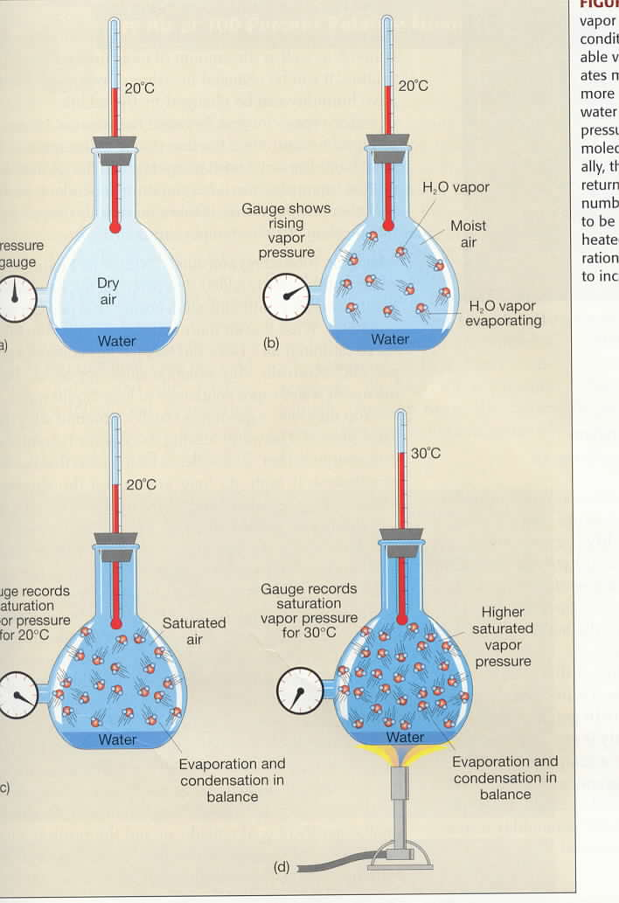
Vapor Pressure
and
Temperature
e = vapor pressure
e_{s} = saturation
vapor pressure
e_{s} = e_{s}(T)
(e_{s} is only a function
of T)

Slide 7
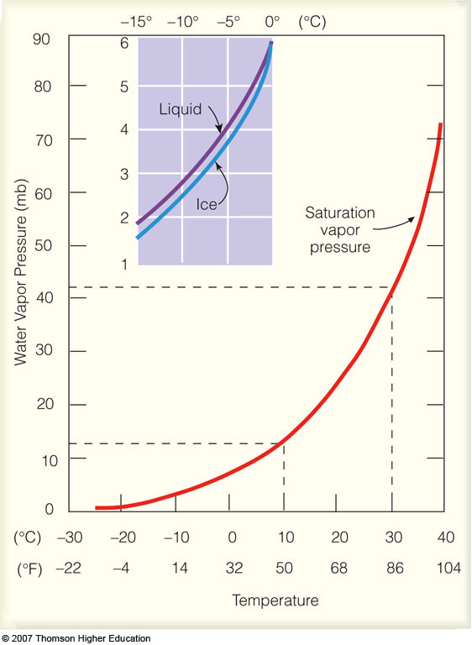
Saturation
Vapor Pressure
and
Temperature
e_{s liquid} >= e_{s ice}
e_{s} = e_{s}(T)
supercooled
water
Notes:
Figure 4.10
Saturation vapor pressure increases with increasing temperature. At a temperature of 10°C, the saturation vapor pressure is about 12 mb, whereas at 30°C it is about 42 mb. The insert illustrates that the saturation vapor pressure over water is greater than the saturation vapor pressure over ice.

Slide 8
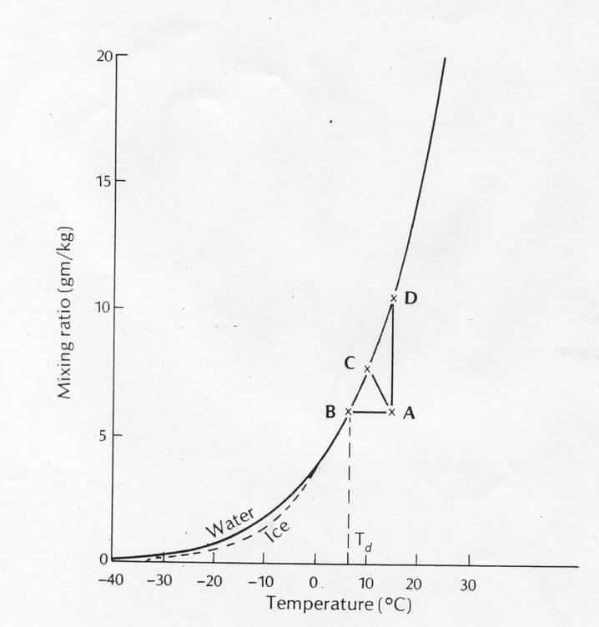
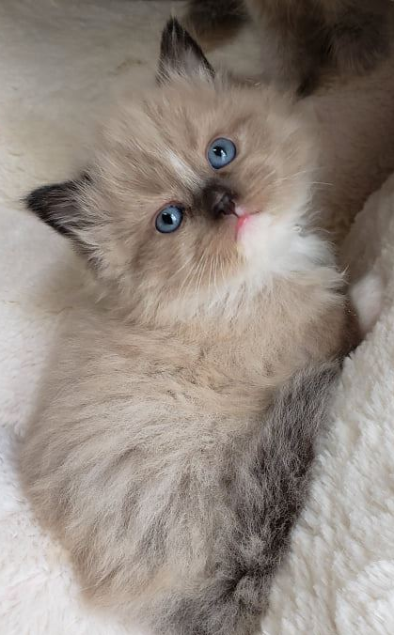
SATURATION EXAMPLES
saturation
curve (w_{s})
constant w
(unsaturated)
T

Slide 9
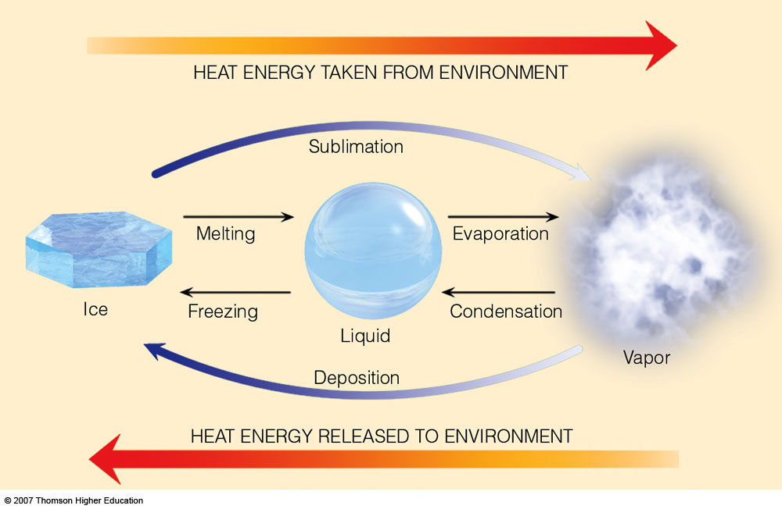
3.3 x 10⁵ J/kg
2.5 x 10⁶ J/kg
Latent heat (L) of water phase changes
Notes:
Figure 2.3
Heat energy absorbed and released.

Slide 10
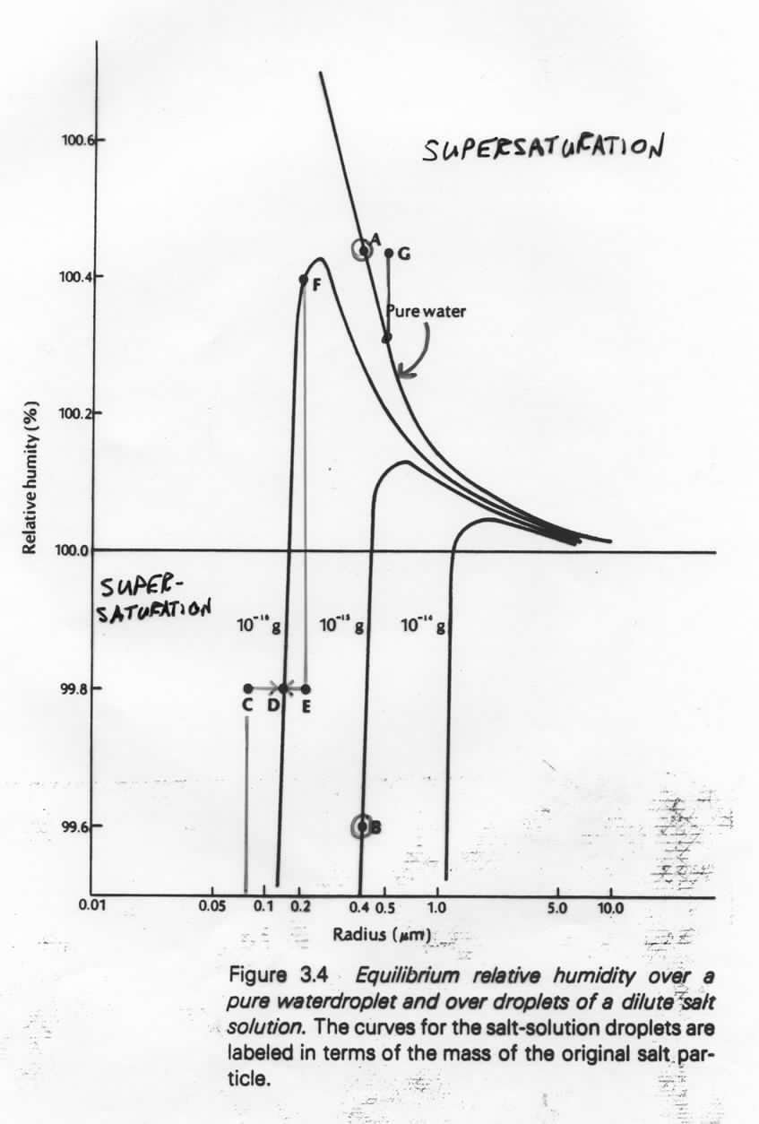
CURVATURE AND SOLUTE EFFECTS
A: r = 0.4 microns: saturated relative to pure water,
RH=100.42%
Supersaturation
B: r = 0.4 microns: w/ 10^{–15}g (solute), A is
supersaturated (equilibrium at 99.6%)
C: 10^{–16}g in solution; r=0.075 microns; RH=99.8%
supersaturated...grows to r=0.15 microns (D)
E: 10^{–16}g in solution; r=0.2 microns; RH=99.8%
unsaturated (equilibrium at 100.4% (F))
...evaporates to r=0.15 microns (D)
Super-
saturation
G: supersaturated relative to both pure and solute
curves...would grow rapidly

Slide 11
Condensation is a necessary but insufficient condition for precipitation formation.

Slide 12
Collision-Coalescence Process
As soon as a cloud droplet becomes large enough, raindrops start to fall.
Terminal velocity: constant fall speed of a particle achieved through a balance of gravitational and drag forces
Larger drops will have a faster terminal velocity than small drops so the large drops will fall faster.
Collisions occur and droplets merge.

Slide 13
Collision-Coalescence Process
The collision-coalescence mechanism is most efficient in environments where cloud water content is large and large cloud droplets are plentiful (e.g. tropics).
Depends strongly on droplet size distribution, cloud water content/column moisture, updraft strength.
Drops make it to the ground when
The drop is large enough
The cloud base is low enough
The air between the cloud base and the ground is moist.

Slide 14
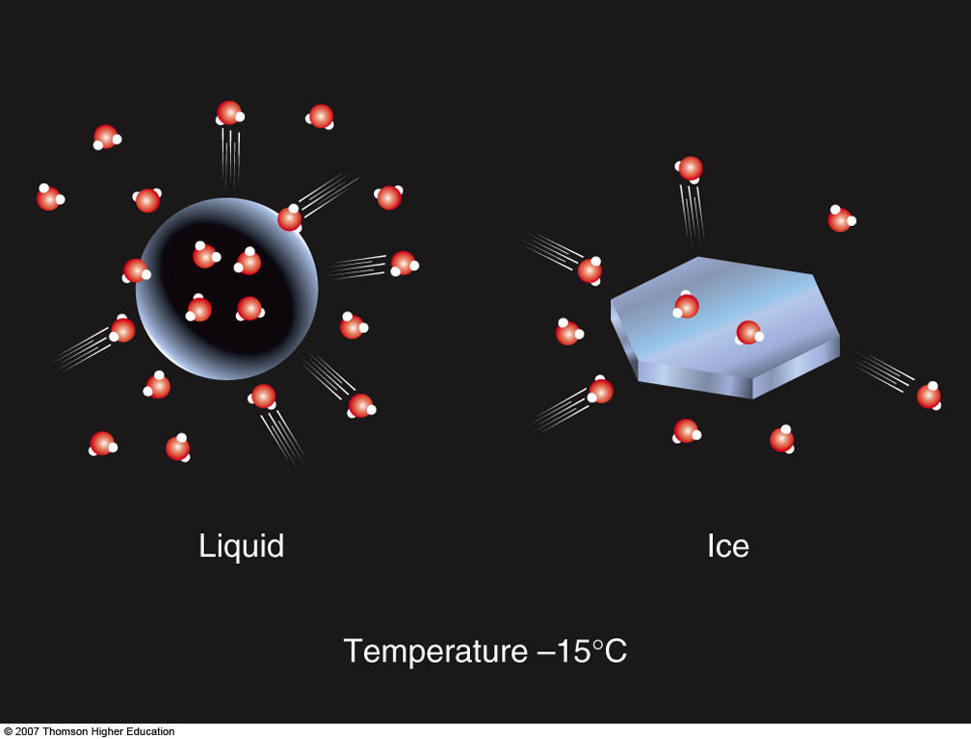
Bergeron (Ice Crystal) Process
When a cloud is comprised of both Supercooled Water and Ice Crystals, The Bergeron Process is the dominant process producing precipitation (diffusional growth).
The saturation vapor pressure over a water surface is greater than that over an ice surface at the same subfreezing temperature.
More vapor evaporating from liquid droplets than ice. Excess vapor deposits directly onto ice.

Slide 15
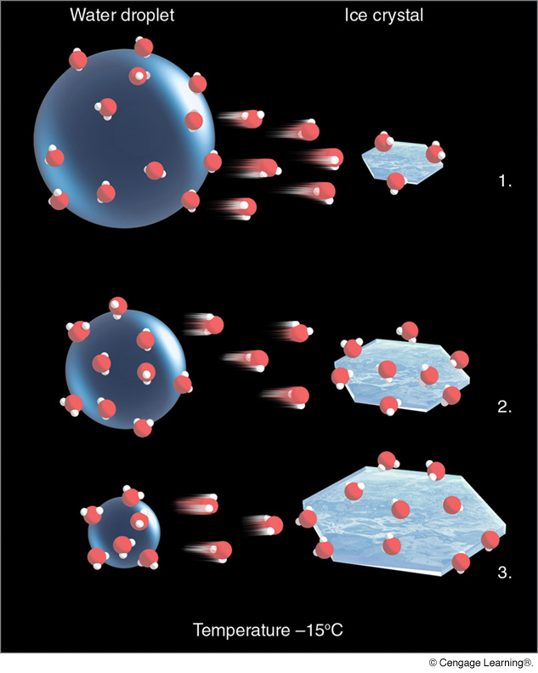
Bergeron (Ice Crystal) Process
(N: 135–146;
A: Chap. 7)
Notes:
Figure 7.9
The ice-crystal process. The greater number of water vapor molecules around the liquid droplets causes water molecules to diffuse from the liquid drops toward the ice crystals. The ice crystals absorb the water vapor and grow larger, while the water droplets grow smaller.

Slide 16
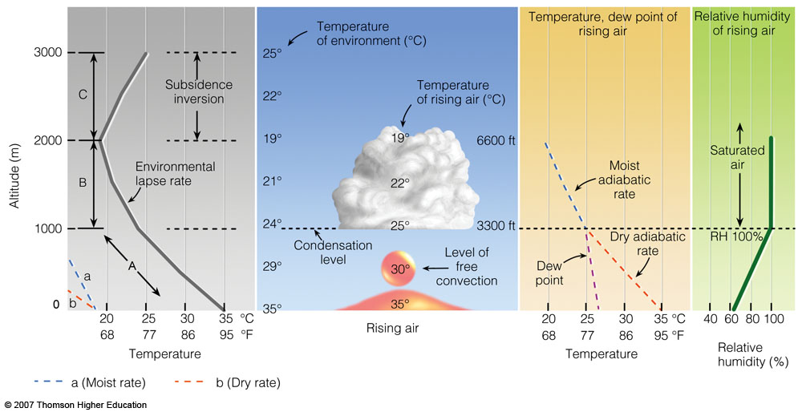
Convective Cloud Formation
Notes:
Figure 6.18
The development of a cumulus cloud.

Slide 17
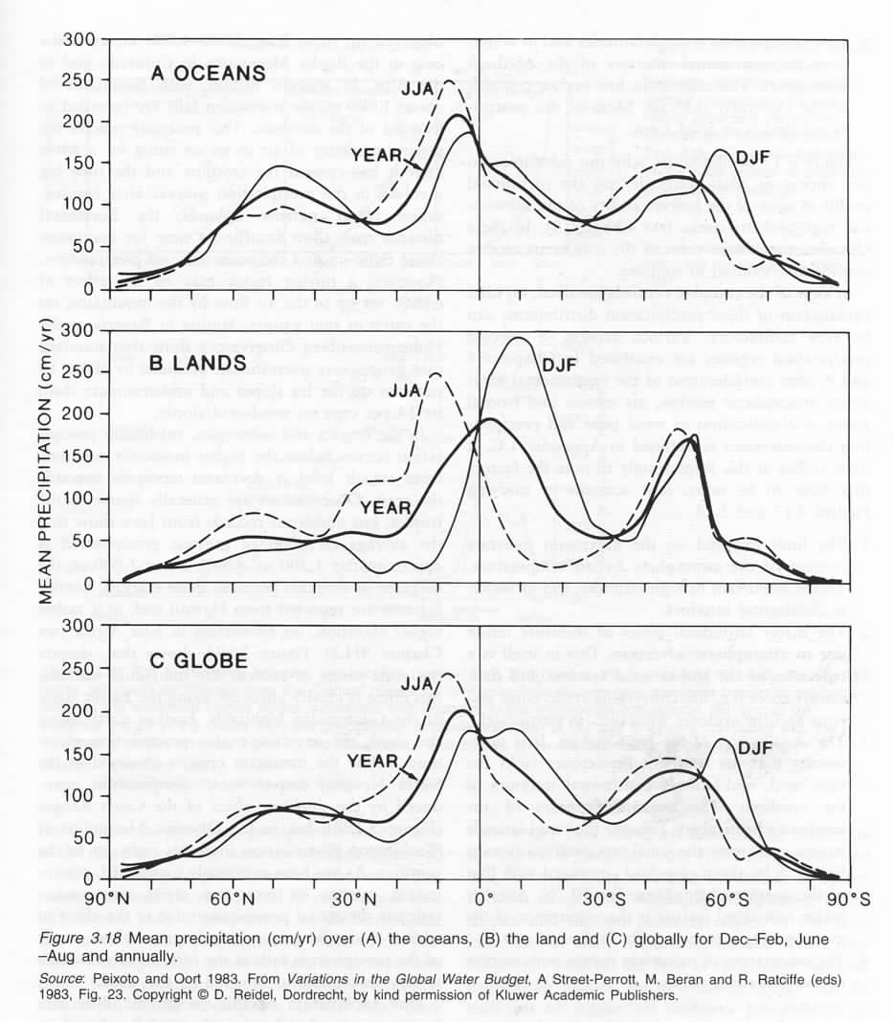
PRECIPITATION BY LATITUDE BAND
*
*S. Chile

Slide 18
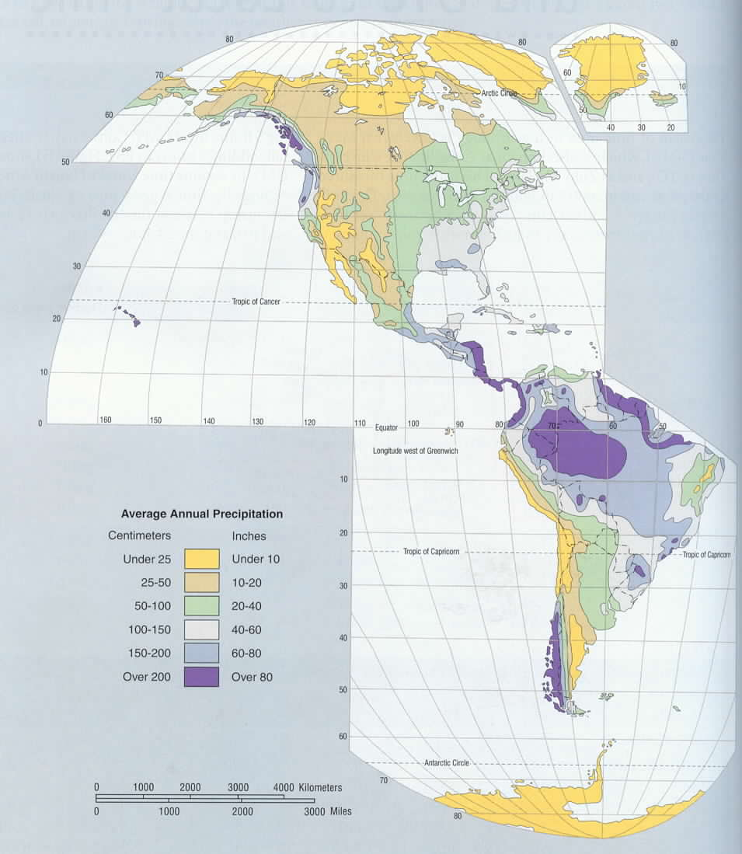
Mean Annual
Precipitation

Slide 19
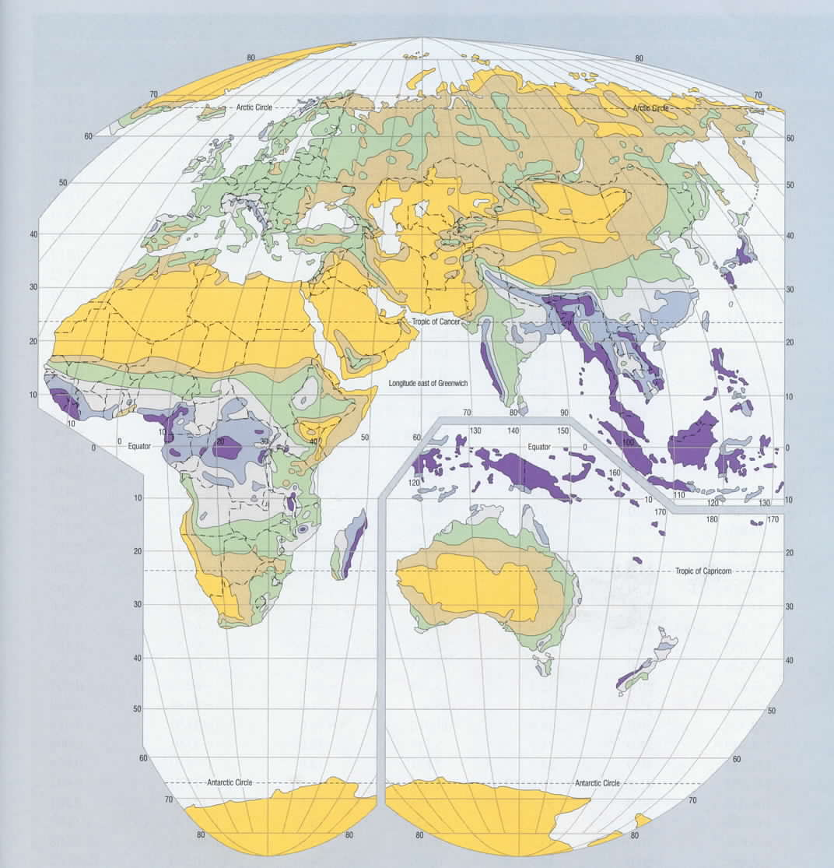
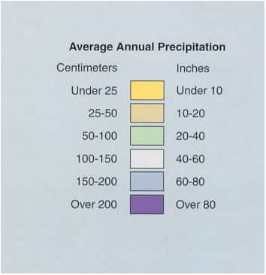
Mean Annual
Precipitation

Slide 20
Mean Annual Precipitation

Slide 21
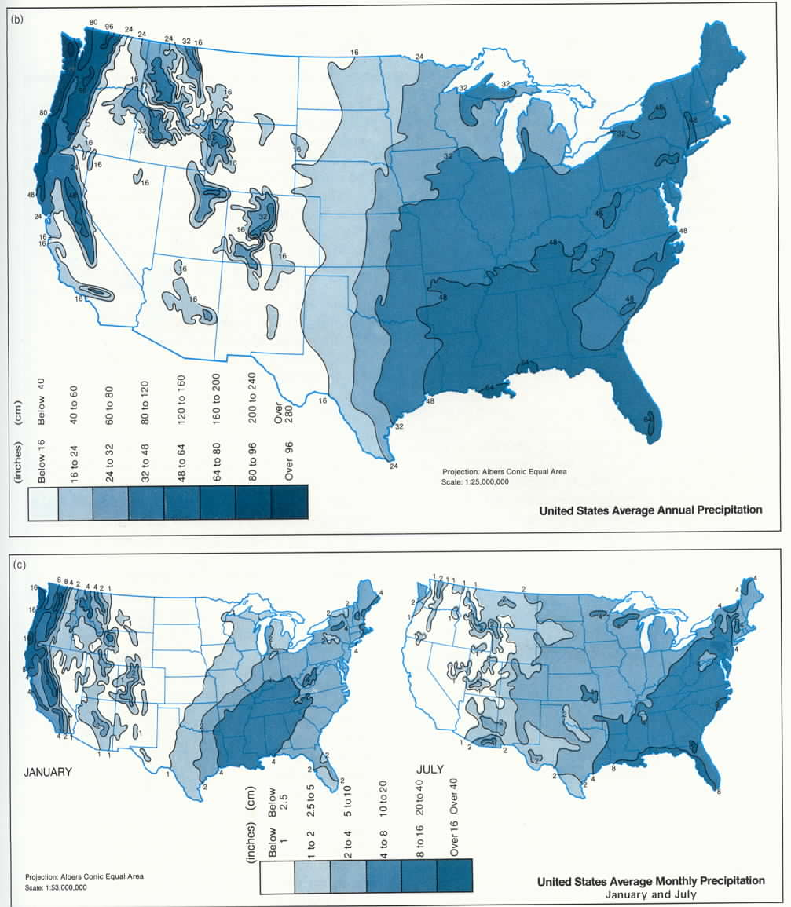

Slide 23
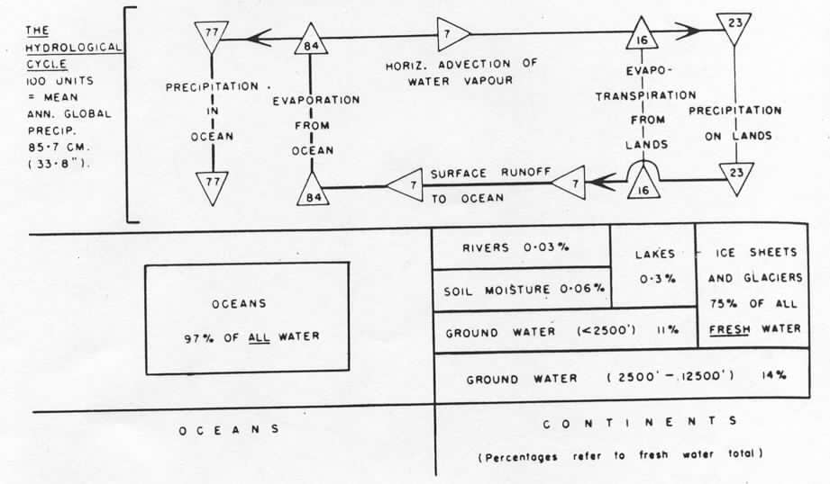
14 (87%)
2 (13%)
63 (75%)
21 (25%)

