Slide 1
EVSC 3300
ATMOSPHERIC COMPOSITION

Slide 2
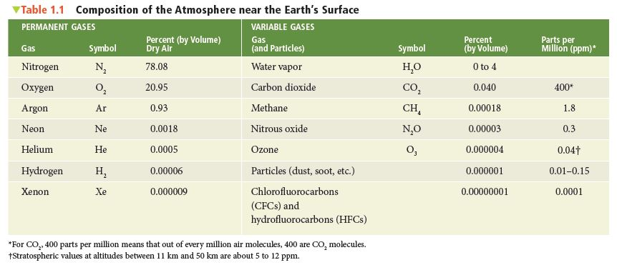
Average Atmospheric Composition
Permanent
Variable
Notes:
TABLE 1.1 Composition of the Atmosphere near the Earth’s Surface

Slide 3
SOURCE
(to atmosphere)
SINK
(removal from atmosphere)
N₂
Denitrification by anaerobic
bacteria in decaying
plants/animals
Fixed by soil bacteria
Fixed by ocean phytoplankton
Lightning
Aerobic bacterial processes
Combustion
Respiration (oxidation: food to energy)
O₂
Ocean phytoplankton
Photosynthesis
6 CO₂ + 6 H₂O
Vis. light
C₆H₁₂O₆ + 6 O₂
Photosynthesis
Fixation by ocean phytoplankton
Dissolved directly into ocean surface
CO₂
Respiration
Combustion
STORAGE: limestone sediments, marine shells, fossil fuels

Slide 4
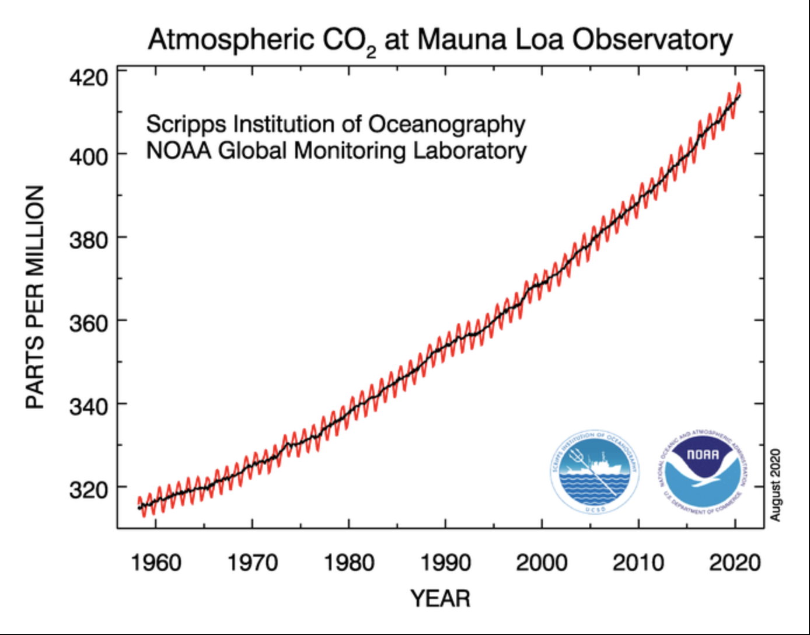
Mauna Loa Carbon Dioxide Record
Pre-industrial background
280 ppm
Current level
412 ppm
Notes:
FIGURE 1.5
Measurements of CO2
in parts per million
(ppm) at Mauna Loa
Observatory, Hawaii.
Higher readings
occur in winter when
plants die and release
CO2 to the atmosphere.
Lower readings
occur in summer
when more abundant
vegetation absorbs
CO2 from the atmosphere.
The solid line
is the average yearly
value. Notice that the
concentration of CO2
has increased by more
than 20 percent since
1958.

Slide 5
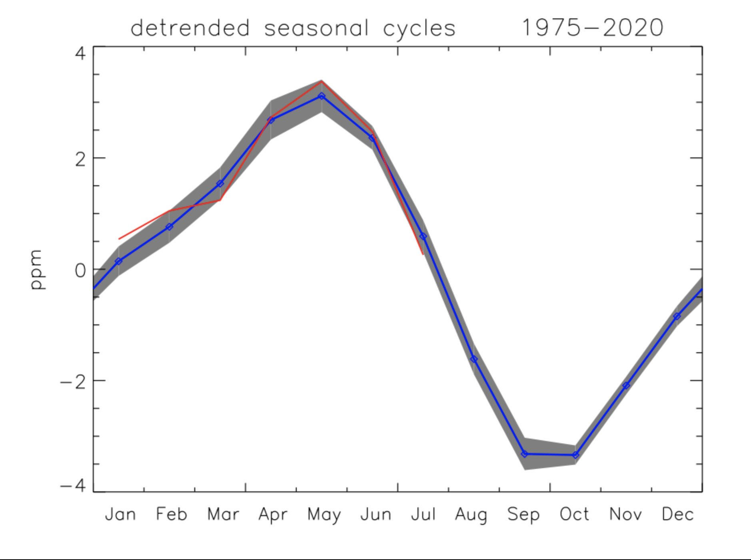
2020 so far
mean seasonal cycle
(gray=1 standard deviation)
https://www.esrl.noaa.gov/gmd/ccgg/covid2.html

Slide 6
SOURCE
(to atmosphere)
SINK
(removal from atmosphere)
Anaerobic processes
(wetlands, rice paddies)
Bovine flatulence
Termites
Biomass burning
Interaction with hydroxyl in atmosphere
Soils
CH₄
CH₄ + OH
CH₃ + H₂O
Bacteria in soils/oceans
(nitrification)
Combustion (cars, biomass)
Fertilizers
Stratospheric photochemistry
(converted to NOx)
N₂O
O₃
O₂ + O
O₃
O₃ + uv
O₂ + O
Also chlorine, bromine, NOx
Evaporation from open water
Sublimation (from ice)
Transpiration (through plants)
Condensation onto surfaces
Precipitation
Deposition
H₂O

Slide 7
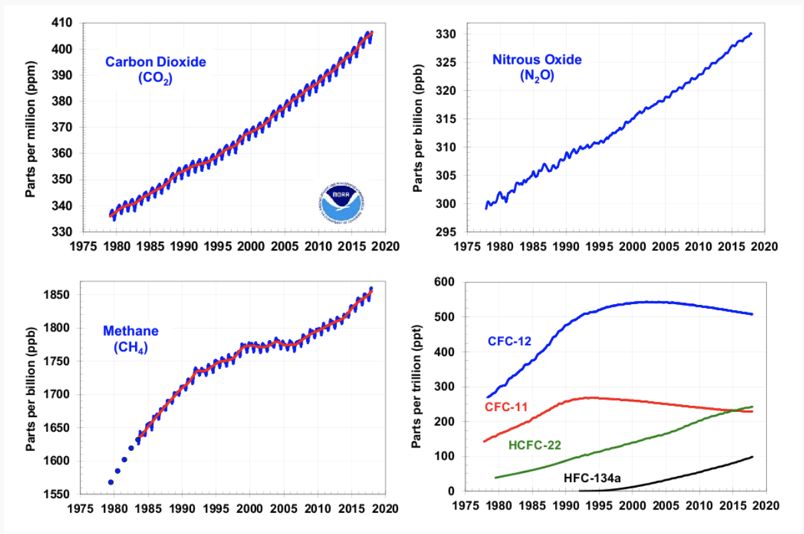
Greenhouse Gas Trends Since 1979
Montreal Protocol
(NOAA: Earth System Research Laboratory)

Slide 8
Average Atmospheric Composition
Permanent
Variable
CF₂Cl₂; CFCl₃
Notes:
TABLE 1.1 Composition of the Atmosphere near the Earth’s Surface

Slide 9
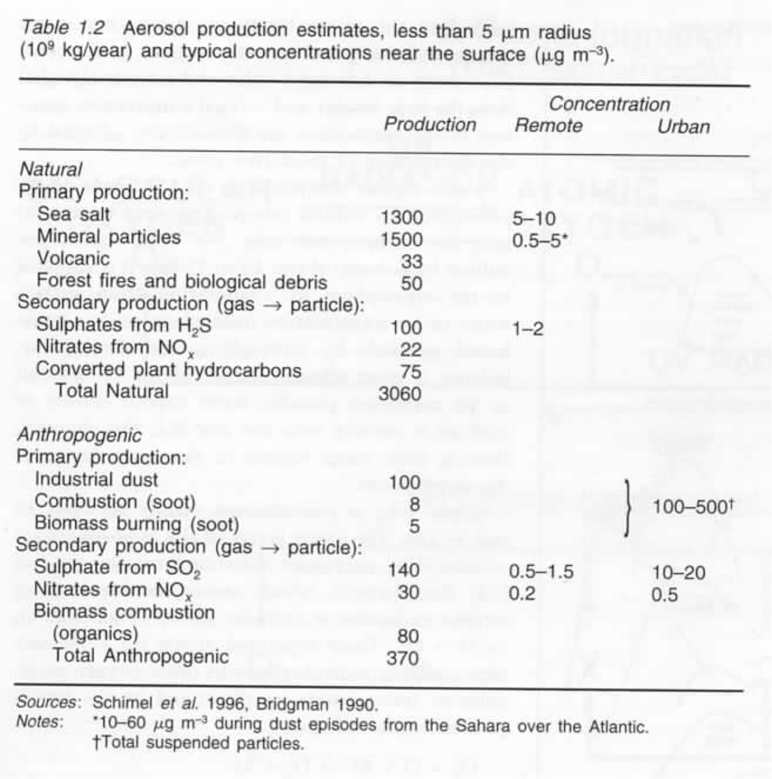
Aerosols

Slide 10
If you are reading along in the textbooks, I will
periodically provide updates in the slideshows
regarding the sections that have just been covered:
N = Neiburger
A = Ahrens
The previous material on atmospheric composition
is N (pp. 32–36), A (pp. 4–10)

Slide 11
Vertical Structure of the Atmosphere
Newton’s Second Law of Motion: $\vec{F}=m\vec{a}$
$$\vec{F}$$
= resultant force [Newtons, N = kg m/s²]
$$m$$
= mass [kg]
$\vec{a}$
= acceleration [m/s²]
Pressure (p) is weight of air (force) acting per unit area (A)
$$p= \frac{F}{A}$$
$$\left[\frac{kg m}{m^{2}s^{2}}\right]$$
$$=\left[\frac{N}{m^{2}}\right]$$
= Pa (Pascals)

Slide 12
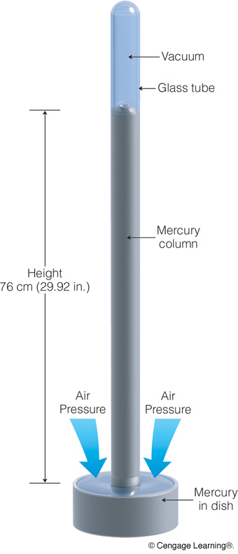
Mercury Barometer
Notes:
Page: 203
FIGURE 8.6 The mercury barometer. The height of the mercury column is a measure of atmospheric pressure.

Slide 13
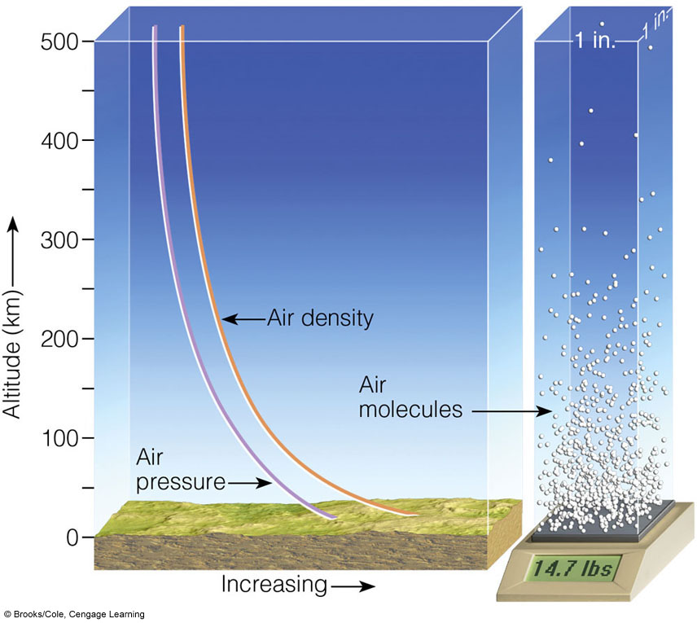
Variation of Pressure/Density with Height
Notes:
FIGURE 1.9 Both air pressure and air density decrease with
increasing altitude. The weight of all the air molecules above the earth’s
surface produces an average pressure near 14.7 lbs/in.2

Slide 14
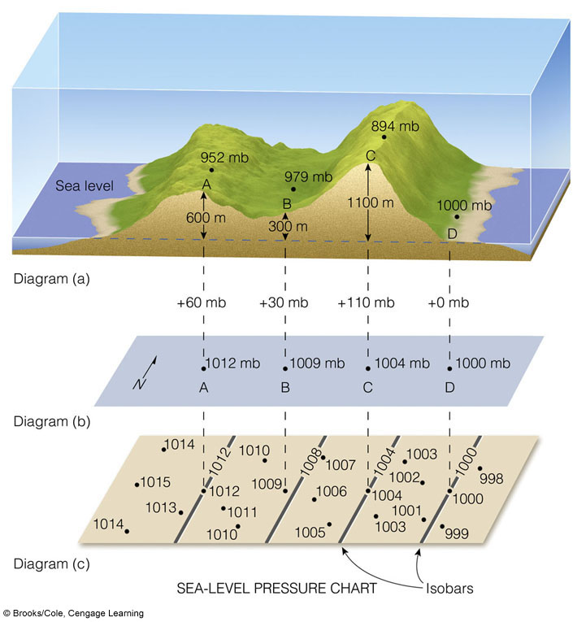
Station
vs.
Sea-level
Pressure
station pressure—barometer measurement
correction for
station elevation
resulting map of sea-level
pressure variations
(surface map)
Notes:
FIGURE 8.9 The top diagram (a) shows four
cities (A, B, C, and D) at varying elevations above
sea level, all with different station pressures. The
middle diagram (b) represents sea-level pressures of
the four cities plotted on a sea-level chart. The
bottom diagram (c) shows sea-level pressure
readings of the four cities plus other sea-level
pressure readings, with isobars drawn on the chart
(gray lines) at intervals of 4 millibars.

Slide 15
“Tawny” Kitten
(a.k.a. “Tawny Mocha Chip Marshmallow Paws”)

Slide 16
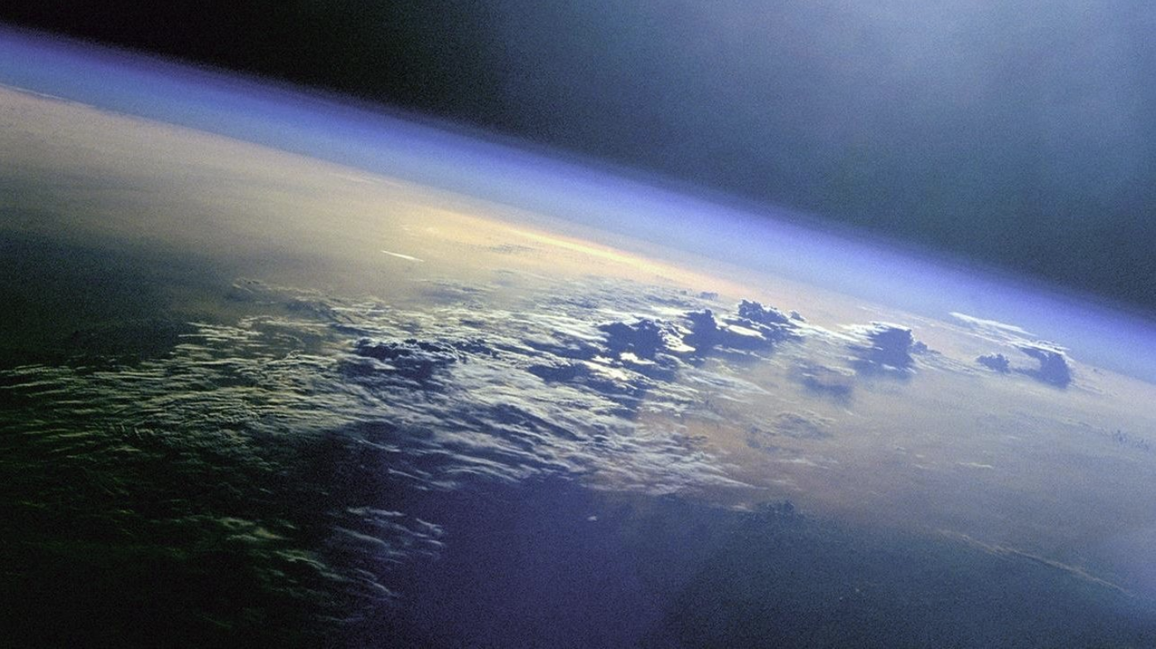
How thick is Earth’s atmosphere? (Or how high is the top?)
Light is not scattered (sky is
dark) at 80 km (50 miles)
99% of the total mass of the atmosphere can be found below 31 km
Atmospheric gasses are well-mixed below 100 km (60 miles) = homosphere
(above homosphere, separated by molecular weight = heterosphere)

Slide 17
VARIATION OF PRESSURE/DENSITY WITH HEIGHT
Notes:
FIGURE 1.9 Both air pressure and air density decrease with
increasing altitude. The weight of all the air molecules above the earth’s
surface produces an average pressure near 14.7 lbs/in.2

Slide 18
Mean Sea-level Pressure in Various Units
VALUE UNITS
101.325 kPa kiloPascals
1013.25 hPa** hectoPascals
101,325 Pa Pascals
101,325 Nm^{–2} Newtons per square meter
101,325 kgm^{–1}s^{–2} kg-mass per meter per second squared
1.033227 kgcm^{–2} kg-force per meter per second squared
1013.25 mb** millibars
1.01325 bar bars
1.033227 atm atmosphere
14.69595 psi pounds-force per square inch
2116.22 psf pounds-force per square foot
760 Torr Torr
Measured in a liquid in glass barometer:
29.92126 in Hg inches of mercury
760 mm Hg millimeter of mercury
33.89854 ft H₂O feet of water
10.33227 m H₂O meters of water
**know this one!
Note: 100 Pa = 1 mb

Slide 19
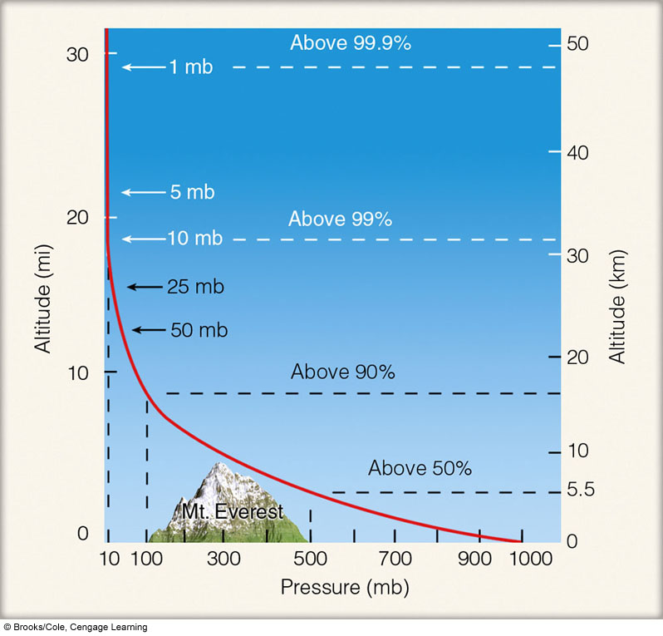
Variation of Pressure with Height
N (94–96,
99–101)
A (202–206)
Pressure can be used as a meaningful vertical scale.
Notes:
FIGURE 1.10 Atmospheric pressure decreases rapidly with
height. Climbing to an altitude of only 5.5 km, where the pressure is
500 mb, would put you above one-half of the atmosphere’s molecules.

Slide 20
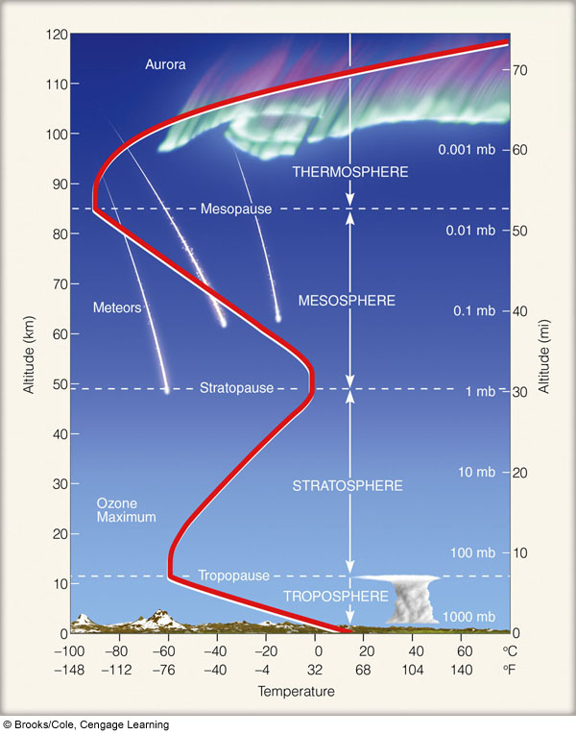
Average
Vertical
Temperature
Structure
of Atmosphere
B
A
A: Homosphere
B: Heterosphere
Notes:
FIGURE 1.11 Layers of the atmosphere as
related to the average profile of air temperature above
the earth’s surface. The heavy line illustrates how the
average temperature varies in each layer.

Slide 21
Lapse rate: rate of temperature decline with height
troposphere: γ =6.5°C/km (5.5°F/1000 feet)
Inverted lapse rate (“inversion”): temperature increases
with height
Ideal Gas Law: $p=$ρRT
ρ (density) = $\frac{Mass [kg]}{Volume [m3]}$
=
=
At a given pressure, cold air is denser than warm air
warm
cold
ht.
warm
cold
STABLE
UNSTABLE

Slide 22
Average
Vertical
Temperature
Structure
of Atmosphere
B
A
A: Homosphere
B: Heterosphere
Notes:
FIGURE 1.11 Layers of the atmosphere as
related to the average profile of air temperature above
the earth’s surface. The heavy line illustrates how the
average temperature varies in each layer.

Slide 23
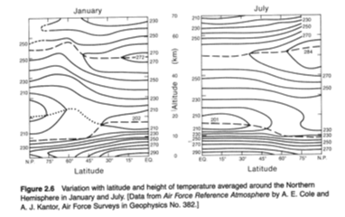
Northern Hemisphere Temperature, by Latitude and Altitude
230
210
230
230
250
250
250
270
250
272
270
stratopause
284
250
stratopause
270
250
250
270
230
210
250
230
230
210
210
202
201
tropopause
210
210
210
230
tropopause
230
230
230
250
250
250
230
270
270
270
290
290
N (36–47); A (10–17)

Slide 24
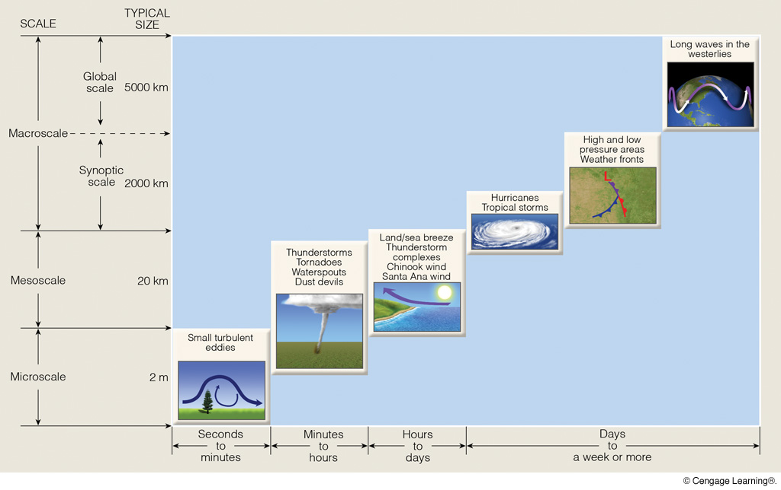
Scales of Motion
Notes:
FIGURE 9.2 The scales of atmospheric motion with the phenomenon’s average size and life span. (Because the actual size
of certain features may vary, some of the features fall into more than one category.)

